Slide 1
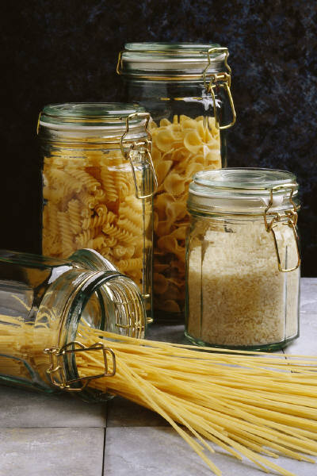
Rice & Pasta

Slide 2
Rice and Pasta
1. List the types of rice below:
Type of Rice | Description
Shorter than long grain rice. When cooked, it is moist and tender.
A. Conventional Rice
4-5 times longer than the width. After cooked, it will be light and fluffy.
B. Long Grain Rice
Short, plump and almost round. Cooked grains are soft and cling together.
C. Short Grain Rice
Chewy texture and “nut-like” flavor. Rich in vitamins, minerals and fiber.
D. Brown Rice *Has the most fiber!
Long, dark and streaky color. Distinct flavor.
E. Wild Rice
It has been completely cooked and then dehydrated. The process reduces time required for cooking.
F. Pre-Cooked/Instant Rice

Slide 3
2. To cook rice:
Use about 2 CUPS of water for every cup of rice.
Bring WATER to a boil.
Add rice and COVER the pan.
Bring water back up to a BOIL.
Reduce heat so rice will SIMMER.
Check for DONENESS. The rice should be TENDER but firm, and there should be no water left.
If some water remains, continue cooking, but remove the LID.
3. Rice Yield: 1 cup uncooked rice will make 3 cups cooked rice (1:3 ratio)

Slide 4
3. To cook pasta:
Use about 1 QUART of water for every 4 ounces of dry pasta.
Bring water to a BOIL.
Add pasta SLOWLY to boiling water so boiling does not stop.
Do not COVER the pan.
Stir pasta FREQUENTLY while it’s cooking.
Cook pasta to al dente stage (pasta remains firm to the bite).
Drain pasta in a COLANDER.
To keep pasta WARM, set the colander over a pan of hot water and cover with the colander.
3. Pasta Yield: 1 cup uncooked pasta will make 2 cups cooked pasta (1:2 ratio)

