Slide 1
Carbs and fiber

Slide 2
Why do we need carbs and grains?
B Vitamins (thiamin, riboflavin, niacin and folate)
Minerals (iron, magnesium)
Reduce blood cholesterol
Lower the risk of heart disease, obesity and type 2 diabetes
Feel full longer
Carbohydrates-gives us energy
Form red blood cells
Iron carries oxygen in the blood

Slide 3
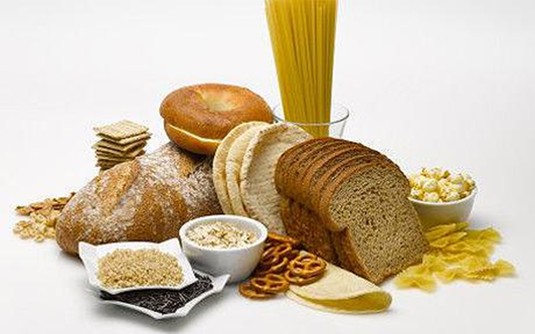
carbohydrates
Carbohydrates are the body’s main-energy source. They help the body use protein and fat efficiently.
Sugar
Starch
Fiber
4 calories per gram

Slide 4
Simple vs. complex
Simple Carbs
Contain one or two sugars
Fruit, milk, white & brown sugar
Digested and absorbed quickly
Short bursts of energy
Complex Carbs
Contain long chains of sugar
Grains, legumes and starchy veggies
Long-lasting energy
Take longer to digest

Slide 5
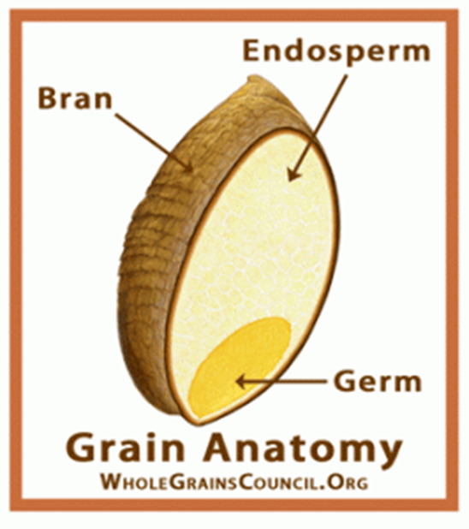
fiber
Fiber is found only in plant food, along with starch and sugar. It is the part of the plant that cannot be digested by people.
Bran, legumes, fruit, vegetables, whole grains

Slide 6
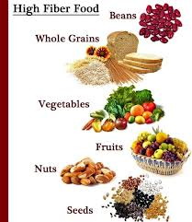
Fiber
Soluble
Dissolves in water.
Feel full longer
Slows down the release of sugar into blood, helps lower cholesterol
Insoluble
Does NOT dissolve in water
It’s rough
Cleans and scrubs the digestive tract

Slide 7
