Slide 1
Intro to the Sewing Machine

Slide 2
1. Bobbin Cover
Opens to allow you to put the bobbin and bobbin case in the machine.

Slide 3
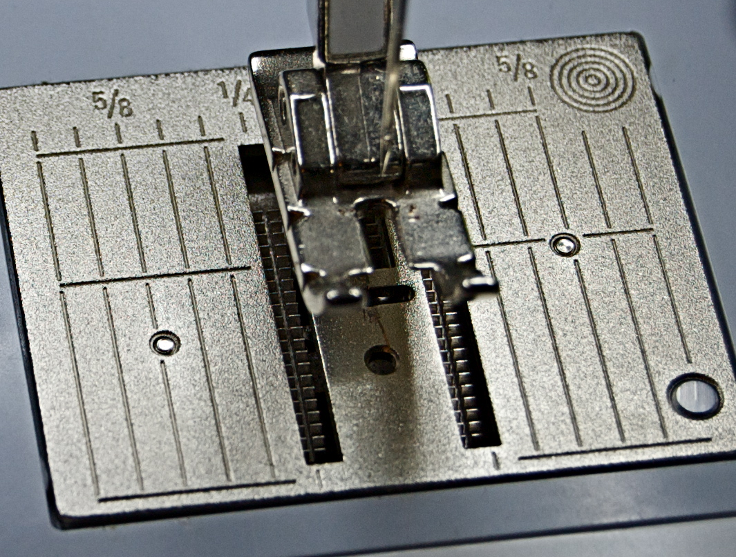
2. Stitch Plate
Where the seam allowance guidelines are found.
Each line is 1/8” apart, beginning with the inside edge of the presser foot, and ending with the far right edge of the stitch plate.

Slide 4
1/8
Inside Edge of the Presser Foot = __________”
(No Line On the Stitch Plate)

Slide 5
1/4
Outside Edge of the Presser Foot = __________”
(First Small Line)

Slide 6
3/8
First Long Line = __________”

Slide 7
1/2
Second Long Line = __________”

Slide 8
5/8
Third Long Line = __________”

Slide 9
3/4
Fourth Long Line = __________”

Slide 10
7/8
Fifth Medium Line = __________”

Slide 11
1
Right Edge of the Stitch Plate= _______”

Slide 12
3. Feed Dogs
Toothed metal piece below the stitch plate that moves up and down to push the fabric along beneath the needle.

Slide 13
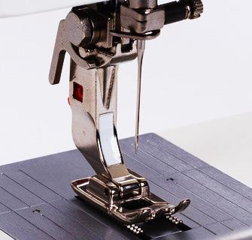
4. Presser Foot
Holds the fabric down against the feed dogs to move the fabric evenly through the machine.
There are several different types of presser feet, each designed to make a particular sewing task easier.

Slide 14
5. Machine Needle
The upper thread is threaded through the machine needle.
There are several different types of machine needles for different types of fabric and sewing techniques.

Slide 15
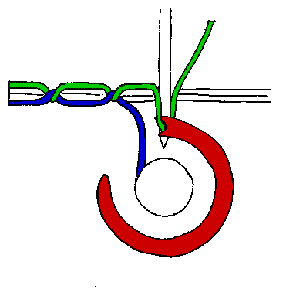
6. How a Stitch is Formed
The upper and lower threads INTERLOCK as the needle passes through the fabric.

Slide 16
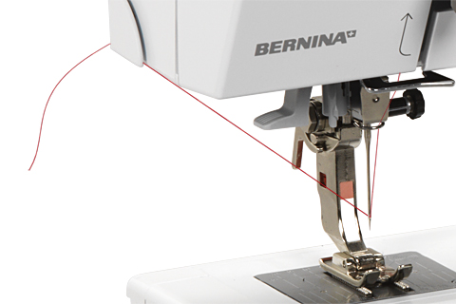
7. Thread Cutter
Cutting tool on the left side of the sewing machine that allows for easy thread trimming.

Slide 17
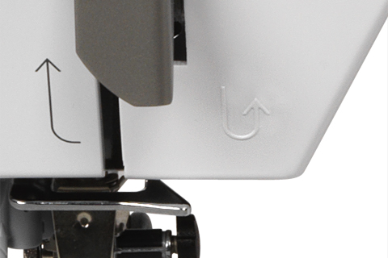
8. Backstitch Button
When pushed in, it allows you to sew backwards until it is released.

Slide 18
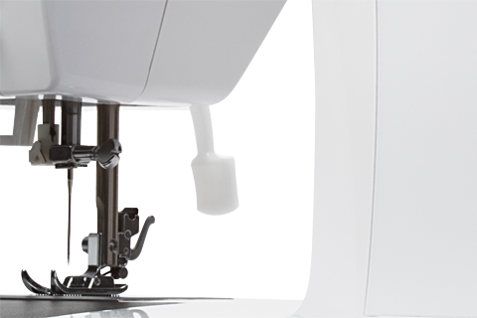
9. Presser Foot Lever
Raises and lowers the presser foot. It is found on the back of the machine.

Slide 19
10. Thread Take-Up Lever
Pulls the thread from the spool pin.
It must be at its highest point before you can sew.

Slide 20
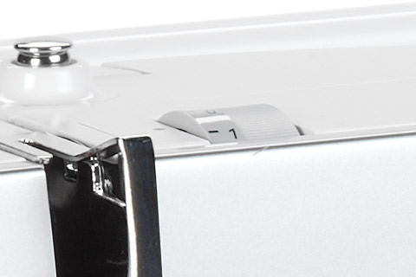
11. Bobbin Tension Knob
Helps provide the correct amount of tension when winding thread around the bobbin. The thread should be tight and smooth when finished.

Slide 21
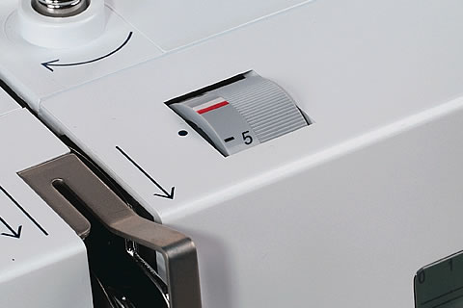
12. Thread Tension Dial
Controls the tightness or looseness of the thread.
The red line should be lined up with the dot.

Slide 22
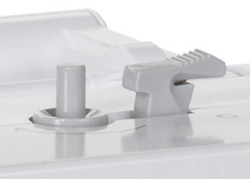
Bobbin Stop
Bobbin Winder
Thread Cutter
13. Bobbin Winder and Bobbin Stop
Winds the thread around the bobbin.
There is another thread cutter on the side
of the bobbin stop.

Slide 23
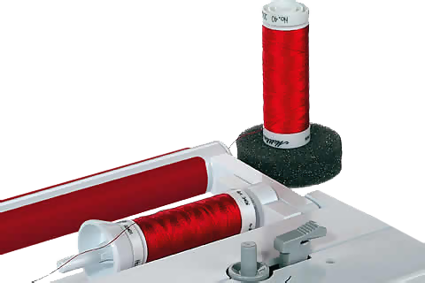
14. Spool Pin
Keeps the spool of thread in place as the thread feeds through the machine.
There is a horizontal one and a vertical one.

Slide 24
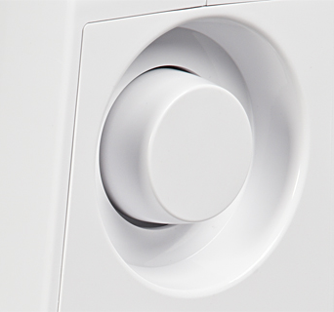
15. Handwheel
Will also raise and lower the needle.
Turn it TOWARD you when sewing.

Slide 25
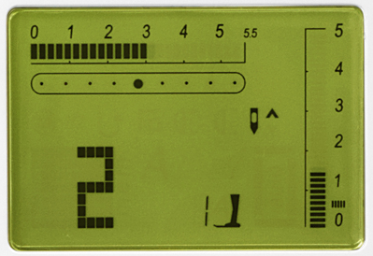
16. Display Screen
Shows the selected settings for stitch width, stitch length and needle position.

Slide 26
Normal stitch width should be at “0”
17. Stitch Width Selectors
Allows you to alter the width of the stitching.

Slide 27
Normal needle position should be in the center.
18. Needle Position Selectors
Allows you to change the position of the needle.

Slide 28
Normal stitch length should be at “2.5”
19. Stitch Length Selectors
Allows you to alter the length of the stitching.

Slide 29
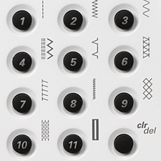
20. Stitch Selectors
Allows you to select several different stitches, including the buttonhole stitch.

Slide 30
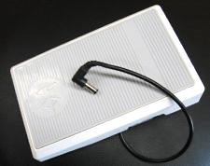
21. Foot Pedal
Applying pressure to the foot pedal will run the machine. The more pressure that is applied, the faster the needle will go up and down.

Slide 31
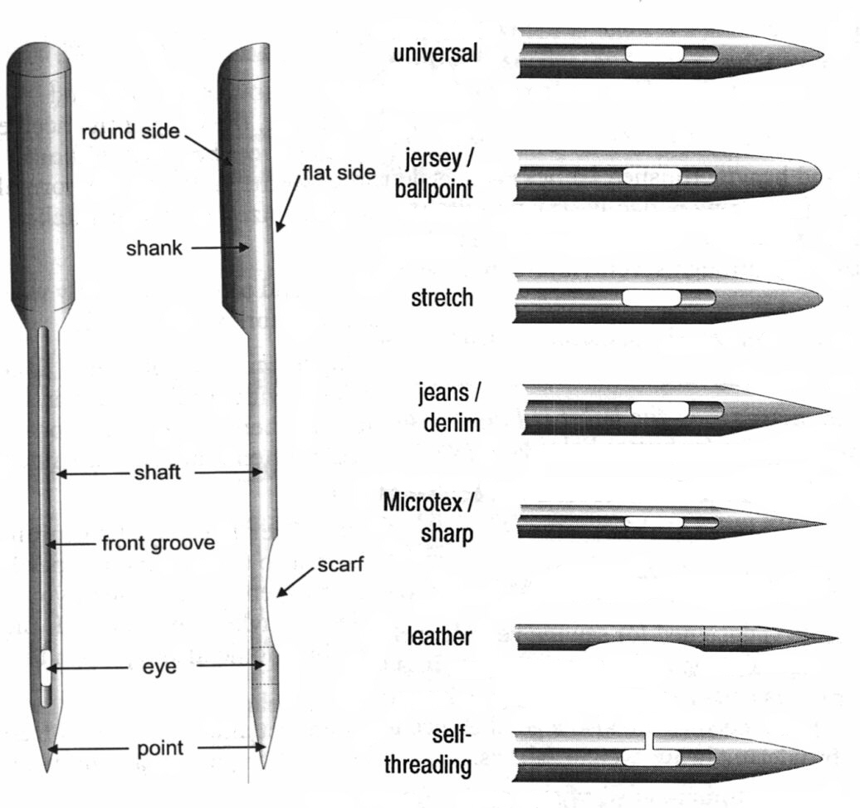
Parts of the Machine Needle
The most commonly used needles are: a. UNIVERSAL
b. SHARP
c. BALL POINT
Front View
Side View
Types of Needles
2. The FLAT SIDE of the shank faces the BACK of the machine when you are replacing the needle.
3. The SMALLER size/number needles are used for fine or lightweight fabrics.
4. The LARGER size/number needles are used for dense or heavy fabrics.

Slide 32
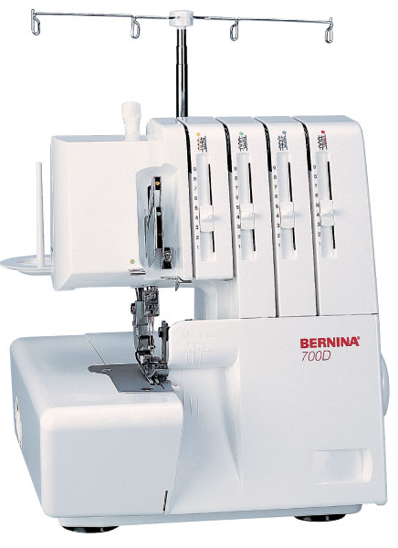
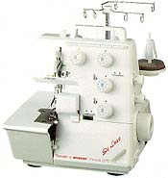
Parts of the Serger

Slide 33
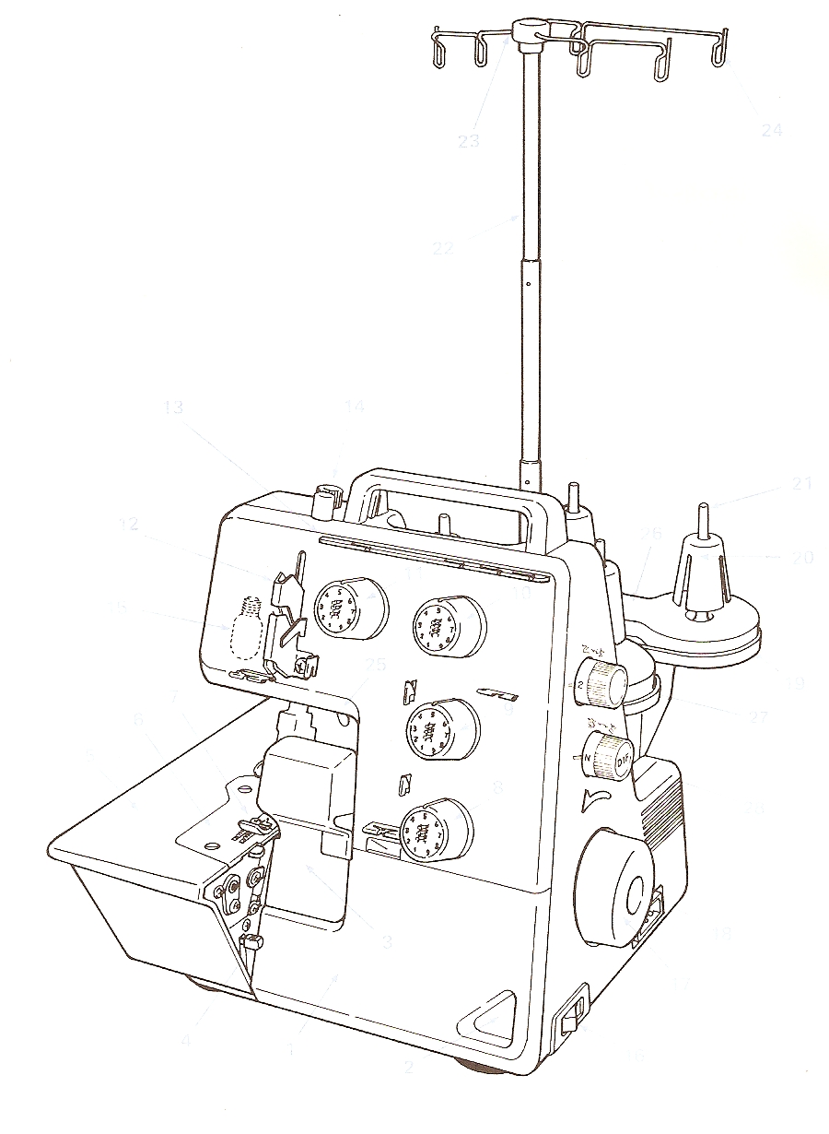
1. Looper Cover
2. Looper Cover Opening Indent
3. Knife Guard
4. Cloth Plate Opening Leaver
23.
24.
5. Cloth Plate
6. Stitch Plate
7. Presser Foot
22.
8. Lower Looper Thread Tension Dial
9. Upper Looper Thread Tension Dial
10. Right Needle Thread Tension Dial
14.
11. Left Needle Thread Tension Dial
21.
12. Thread Take-Up Cover
13.
13. Thread Guide Plate
26.
12.
14. Presser Food Adjusting Screw
11.
20.
15. Sewing Light
15.
10.
16. Power/Light Switch
25.
17. Handwheel
7.
9.
19.
18. Machine Socket
6.
27.
19. Thread Stand
5.
8.
28.
20. Anti-Vibration Cone
21. Spool Holder Pin
18.
22. Retractable Support Rod
3.
23. Thread Guide
17.
24. Open Thread Guide
4.
25. Presser Foot Lifter
1.
16.
26. Foam Pad
2.
27. Stitch Length Adjustment Knob
28. Differential Feed Adjustment Knob

Slide 34
Serging Tips
Some advantages of using a serger include:
Cuts off excess fabric as it sews.
Fastest way of finishing a seam.
2. The three rules of serging are:
Keep your fingers away from the knife.
Don’t lift up the presser foot.
Leave a “thread tail” behind when finished.
3. Do not lift up the presser foot unless you are serging around a round edge. Make sure the presser foot is down before beginning to serge.
4. Do not serge over pins, zippers or excessive bulk.

Slide 35
5. The FIRST thing to check when a serger is not operating properly is the threading.
6. On a serger, the metal prong around which stitches are formed is called the stitch finger.
7. The part of the serger that trims the seam allowances as the stitches are formed are the knives.
8. The loopers control the lower thread.

Slide 36
9. Lint in both the sewing machine and serger should be removed regularly to prevent build-up. The machines should also be oiled regularly to keep the machine running smoothly.
10. Serger thread is finer in size and must be good quality to prevent thread breakage and lint accumulation.
Serger Thread
All-Purpose Sewing Machine Thread

Slide 37
Resolving Sewing Machine & Serger Malfunctions
If the sewing machine does not sew properly, it is usually due to incorrect use.
BEFORE you ask for help, check the following:
Check whether:
The upper and lower thread are correctly threaded.
The needle has been inserted correctly with the flat side of the shank to the rear.
If the upper thread breaks:
The needle is blunt (not sharp).
The upper thread tension is too tight.

Slide 38
If the lower thread breaks:
The lower thread tension is too tight.
The bobbin is jammed.
The needle is blunt or bent.
If you have skipped stitches:
The needle is blunt, bent or incorrectly inserted.
A different needle is needed.
If your needle breaks:
The needle clamp screw is not tight enough.
The thread being used is of poor quality.
The fabric is being pulled while needle is still inserted.

Slide 39
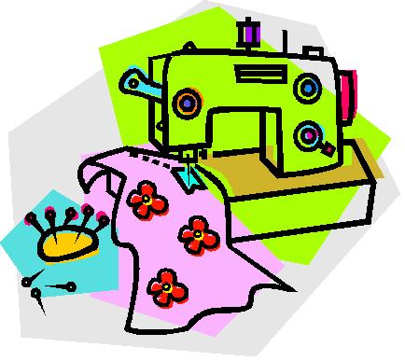
If your machine fails to run, perhaps:
The plug is not inserted correctly.
The power is not on.
The bobbin winder is engaged.
The handwheel is loose.

