Slide 1
Bell Work
What does a newborn look like?

Slide 2
Bell Quiz #1
1. Fontanelles:
A. Are signs of a birth defect affecting the baby’s bones
B. Cause the baby’s head to be misshapen throughout life
C. Allow the bones of the baby’s head to move during delivery
D. Signs of brain damage that occurred during delivery
2. Which reflex helps the baby find their food source?
A. Sucking / Rooting
B. Walking
C. Let Down
D. Grasping and Palmar
3. The test done one minute and again five minutes after birth to determine the newborn’s general well-being is:
A. Physical Determination
B. Reflex Aptitude
C. Apgar Scale
D. Ultrasound

Slide 3
Bell Quiz #1
4. Newborns learn primarily through:
A. Practice
B. Example
C. Their Parents
D. Their Senses
5. Merconium is
A. Newborn white heads or pimples
B. Yellow coloring due to the liver not working proper
C. Dry, flaky, crusty scalp
D. When the infant has its first bowel movement

Slide 4
First Year of Life Celebration
We will be making First Year of Life Books
You will visit each station around the room and use the resources to create your book.
You may also visit the website on this computer.
Keep the booklet with your study guide

Slide 5
Why does an infant cry?

Slide 6
The Period of Purple Crying
View the Video and take notes on the short note guide.
Attach the notes to your Neonate and Infant Study Guide.

Slide 7
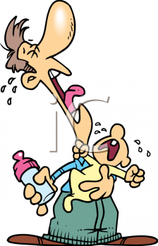
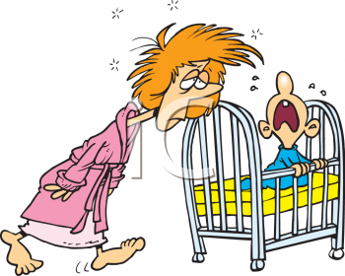
4 Basic cries
Hungry cry
Rhythmical rise and fall with short pause in between the cry.
The most DEMANDING CRY!
Bored, Tired, Fussy cry
Whimper in short bursts, low pitched but gradually gets loud and
demanding if ignored and the Infant will learn to use this cry to get what it needs.
Pain cry
The most obvious and fearful cry. Begins with a loud inward gasp and is followed by a rising shriek. Inward gasp may take a few seconds before the bay gets enough air to shriek.
Anger cry
Less piercing than pain, but still Loud and demanding
forceful bursts on and off.

Slide 8
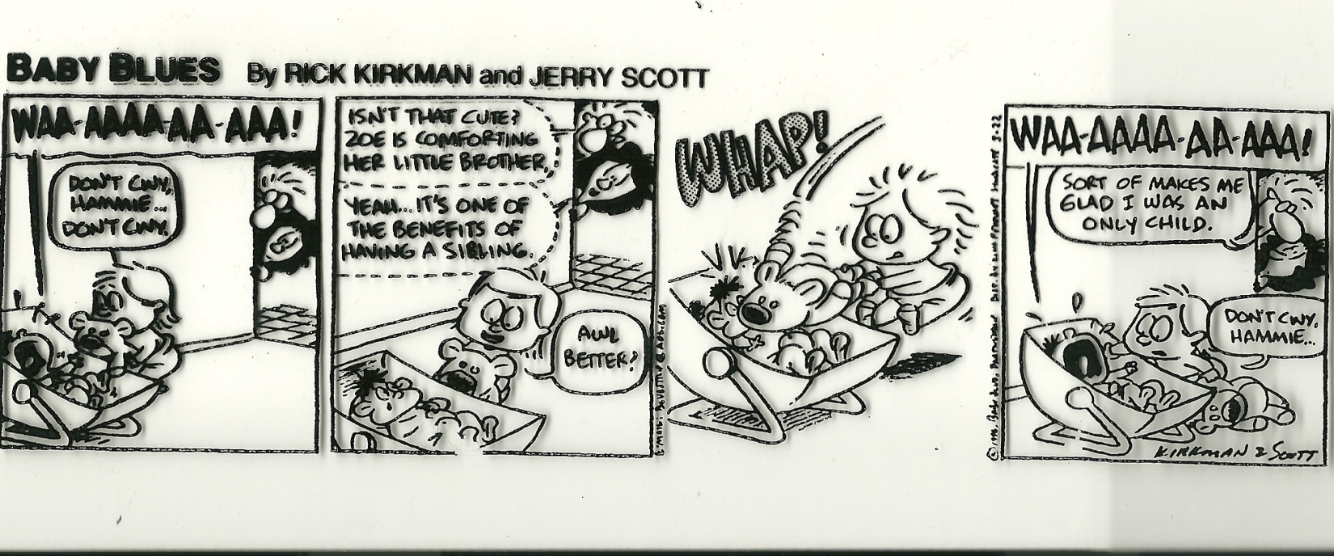

Slide 9
Any other forms of communication?
How does your reaction to a crying baby influence it?

Slide 10
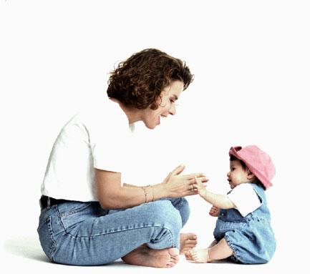
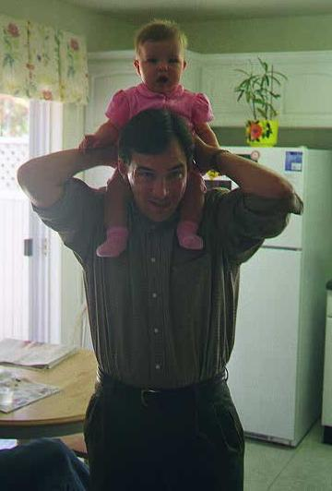
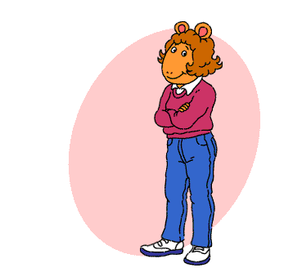
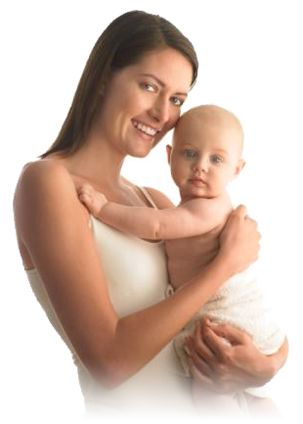

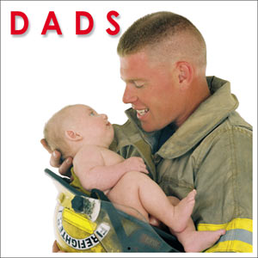
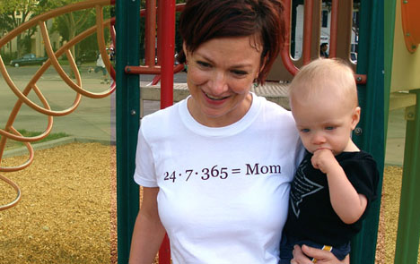
Who are the potential child abusers?
They all could be and so could you!

Slide 11
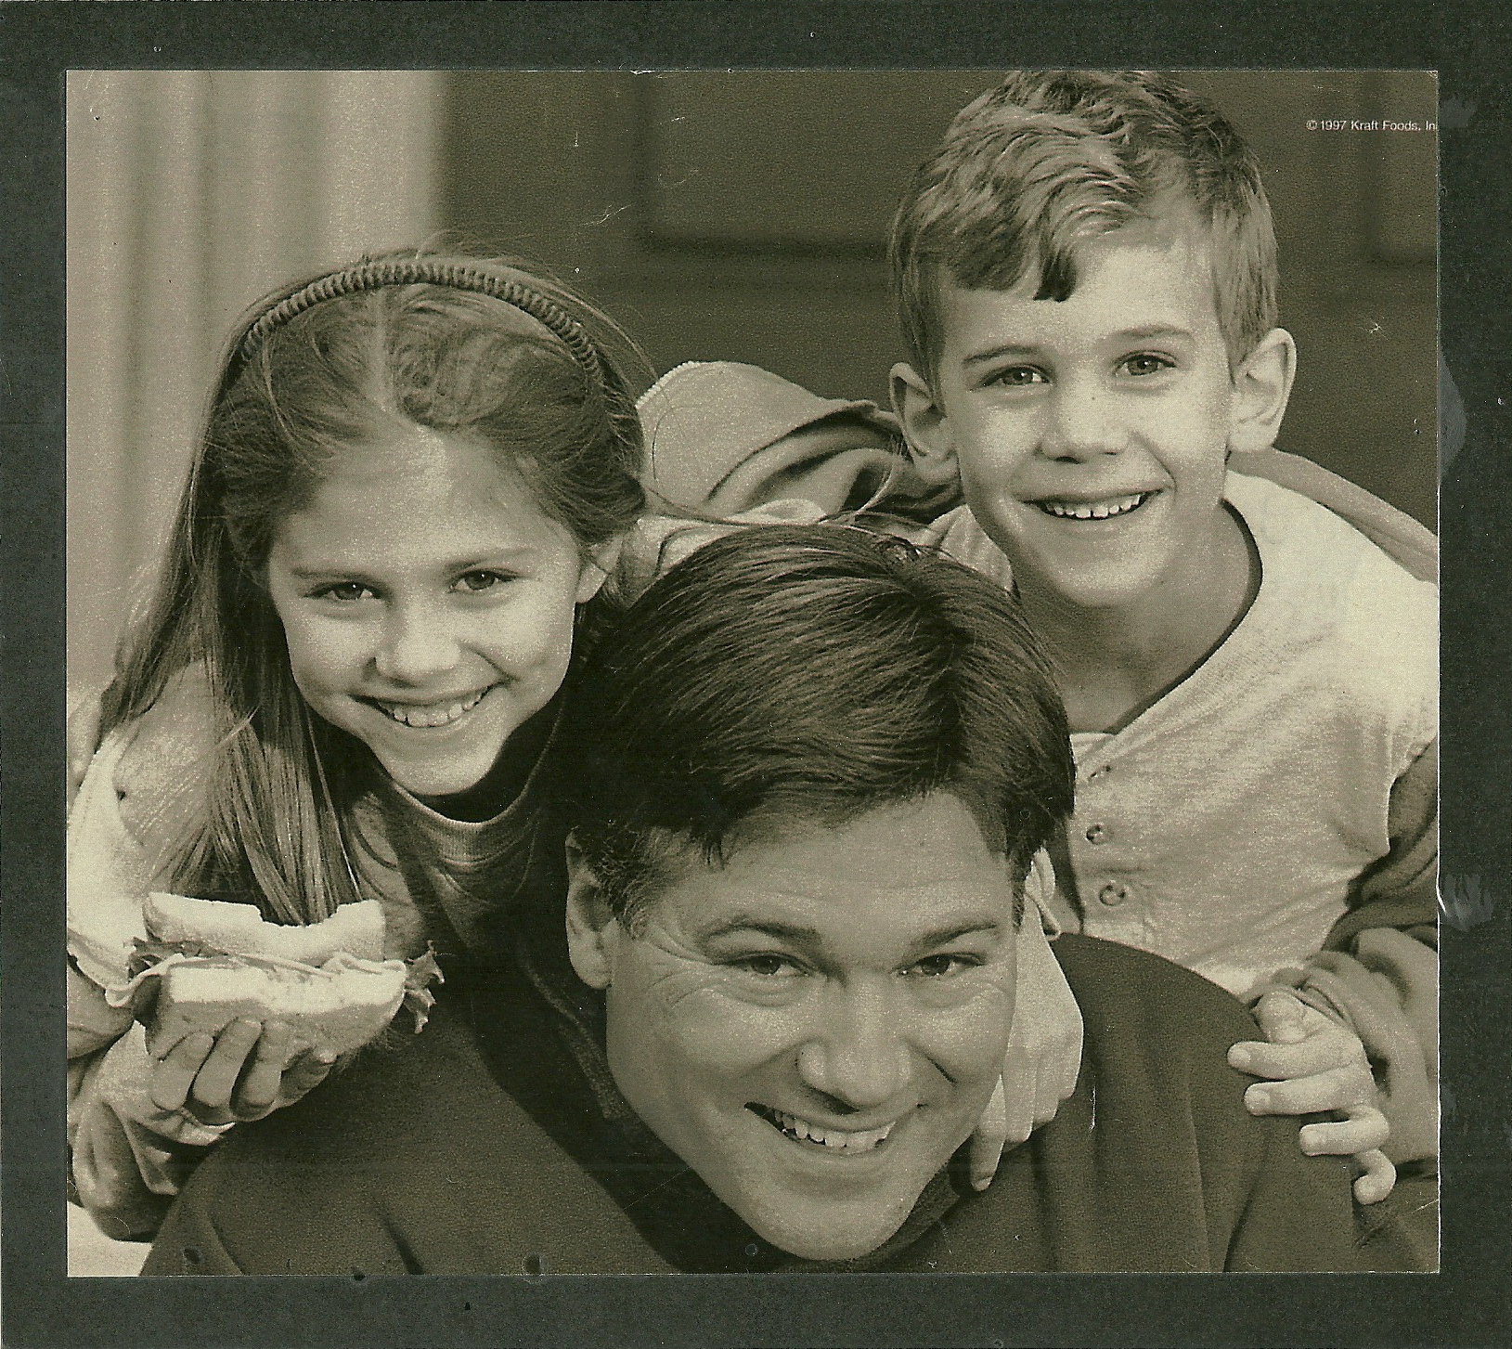

Slide 12
Formula for abuse
Let’s get stressed
Child
+
Caregiver
+
Stress
____________________________
CHILD ABUSE

Slide 13
What to check when an infant cries
Remember they are too young to understand your requests.
Just because it is night does not mean the baby turns off or switches to your schedule.
Make up your mind that you are there to help the baby, not necessarily to stop the baby from crying.
Things to check:
  Is the baby hungry?
  Does the baby need to burp?
  Is the diaper wet or dirty?
  Is the baby comfortable?
  Is the baby trying to release stress?
  Does the baby want to be held?
  Is the room too warm or too hot?
  Is the light appropriate?
Is the baby ill?
  Does the baby have a temperature?
  Are the baby's gums red or swollen?
  Are ears warm to the touch or is there drainage?
  Is the baby vomiting?
  Does the baby have diarrhea?
  Could the baby have allergies?
Could the baby have colic?
  Does the baby pull his/her legs up to the stomach and release them in a jerking motions?
  If the baby is breast fed, has the mother eaten something to upset the baby (onions, garlic, broccoli, cauliflower, lettuce, high intake of dairy products)?
  Is the baby eating the correct formula
  is it time to introduce sold food into the baby’s diet?

Slide 14
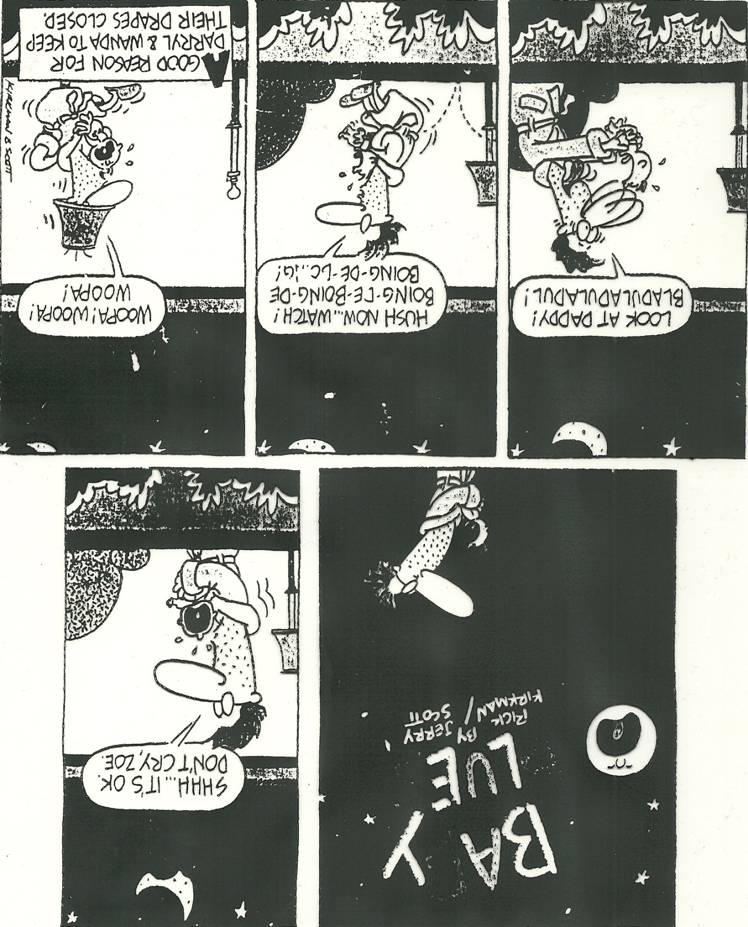
In desperation, you might find yourself doing things you hope no one will ever see you do!

Slide 15
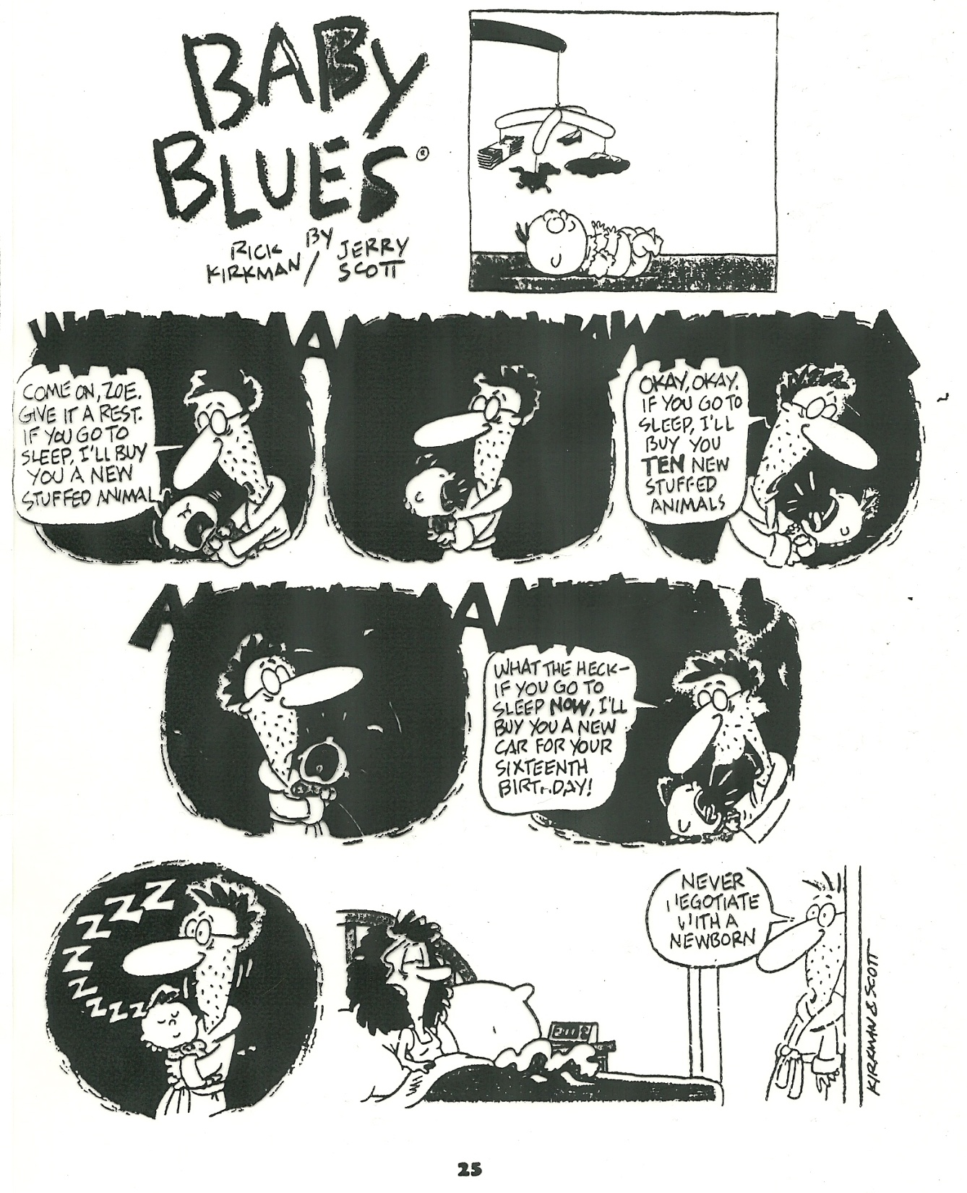
In desperation, you might find yourself bribing the child.

Slide 16
Elijah’s Story
This is a true story about the unfortunate life of Elijah

Slide 17
SBS- Shaking Baby Syndrome
Term used to describe the many signs and symptoms resulting from the violent shaking of an infant or young child.

Slide 18
What do you Know?
T F 1. Babies’ heads and bodies are the same proportion as adults.
T F 2. Babies cry an average of 30 minutes a day.
T F 3. More serious injuries are caused by shaking a baby than if the baby fell from a distance of 10 feet.
T F 4. Shaking a baby once can cause death.
T F 5. The medical cost for a baby that is shaken can be thousands of dollars.
T F 6. If you have tried everything and your baby is still crying, it is okay to leave the baby in the crib for a few minutes.

Slide 19
Quiz KEY
T F 1. Babies’ heads and bodies are the same proportion as adults.
FALSE- Babies larger
10% body weight vs. 2%
T F 2. Babies cry an average of 30 minutes a day.
FALSE- Average of 2-3 Hours

Slide 20
Quiz KEY
T F 3. More serious injuries are caused by shaking a baby than if the baby fell from a distance of 10 feet.
TRUE
T F 4. Shaking a baby once can cause death.
TRUE

Slide 21
Quiz KEY
T F 5. The medical cost for a baby that been shaken can be thousands of dollars.
FALSE - up to a Millions +
T F 6. If you have tried everything and your baby is still crying, it is okay to leave the baby in the crib for a few minutes.
TRUE

Slide 22
SIGNS & SYMPTOMS of SBS
Concussion
Vomiting
Irritability
Lethargy
Trouble feeding
Sleepy
coma

Slide 23
STATISTICS:
70% of the perpetrators are MALE
  (father, step-father, boyfriend, etc.)
56% of the victims are male babies
Average age of shaking is 3-8 months
26 SBS cases in Utah in year 2000
  (up from 13 in 1999)
25% of the SBS victims die immediately after being shaken
75% will live with complications because of the shaking.
SBS is the leading cause of death in infants due to child abuse/neglect.

Slide 24
A HAND SLAP on the face of an infant under 15 months can cause similar damage
THROWING a child up in the air and catching it
TWIRLING a child under age 2 by it’s arms or legs
BOUNCING ROUGHLY on knee/foot can also have damaging affect on baby

Slide 25
Statistics:
28% surviving victims return to THEIR HOMES.
11% adopted by GRANDPARENTS
11% placed in FOSTER CARE

Slide 26
Never
Never
Never
Never
Shake a Baby
Or TODDLER!

Slide 27
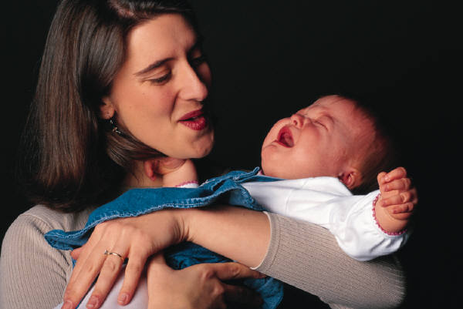

How to cope with crying
Walk with the baby
Rock the baby
Dance with the baby
Bounce the baby gently in your arms or on your knee
Take the baby for a stroller ride
Take the baby for a ride in the car
Let the baby sit in a baby swing
Provide white noise for the baby (vacuum, radio)
Divert the baby’s attention
Sing to the baby
Rub the baby’s back
Massage he baby with a warmed lotion
Wrap the baby snugly in a blanket.
  SWADDLE it a blanket
Feed the baby
Burp the baby
Give the baby a pacifier
Turn off the lights and gently rub the babies back
Let someone else tend to the baby
Turn on the TV
Take the baby outside
Turn on music
Change the baby’s diaper
Give the baby a warm bath
Lay down and place the baby on your stomach and rub the baby’s back
Make sure the room temperature is comfortable

Slide 28
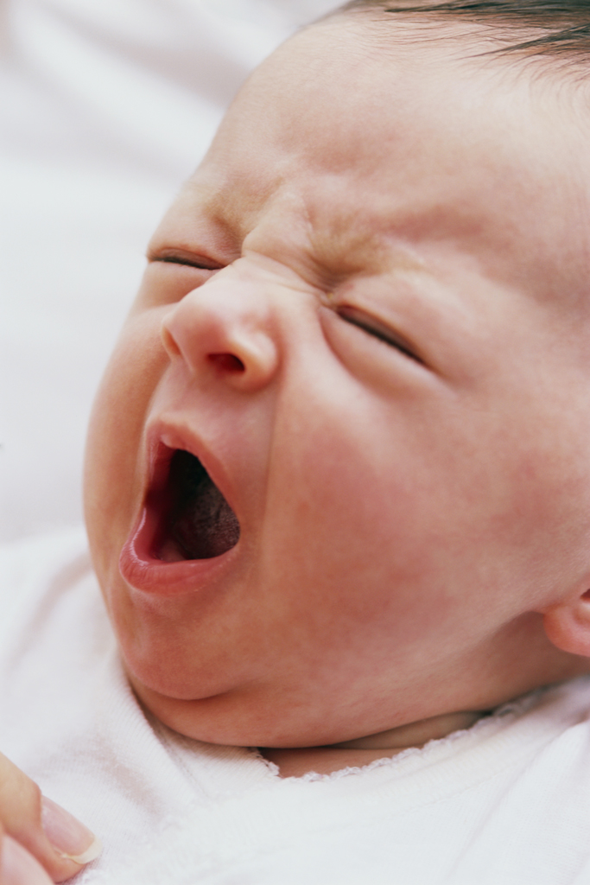
If all else fails:
(Because sometimes they just want to cry)
After checking to make sure the baby is not hungry, wet, or in danger, place him/her in the crib, close the door, and call a friend to talk to for a few minute be sure to check the baby at least every ten minutes.

Slide 29
SIDS- Sudden Infant Death Syndrome
  Sudden, unexplained death of an apparently healthy child. Generally occurs in the first year of life.

Slide 30
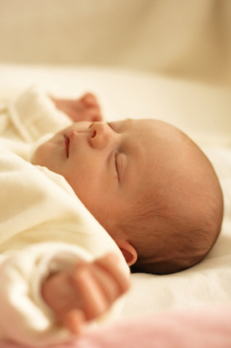
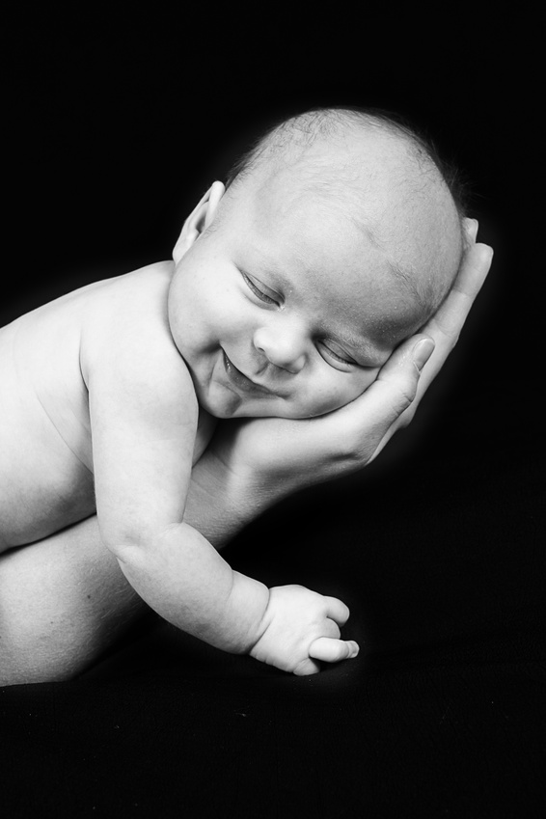
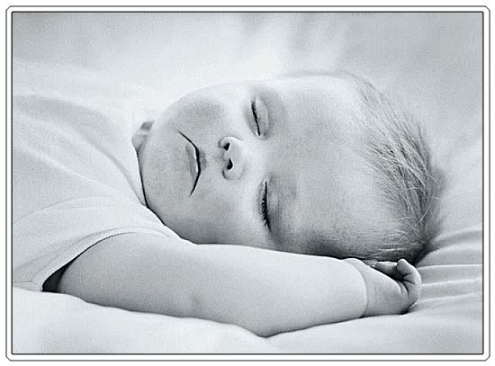
Can SIDS be prevented?
Have infant sleep on its back
Do NOT smoke or be around smokers
No stuffed animals or soft bedding

Slide 31
Safety Pamphlet
As a group, read over and discuss your assigned safety topic. Further information can also be found in the class textbook.
As a group design a brochure that is colorful, creative, eye-catching, and informative NOT JUST A BUNCH OF WORDS.
Keep information short and to the point. Use proper grammar and spelling.
Be prepared to present this information to the class. Plan your group presentation.
Make this something you would like to listen to and read. If you think that you would be bored listening to or reading the information, than it needs to be changed.
Before your presentation, give this grade sheet to the teacher. After your presentation, give your pamphlet to the teacher.

