Slide 1
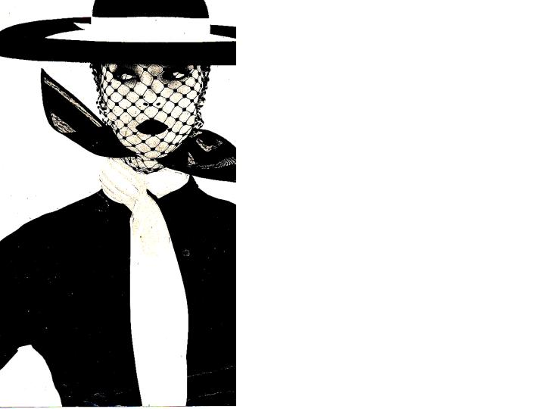
The Art of Fashion

Slide 2
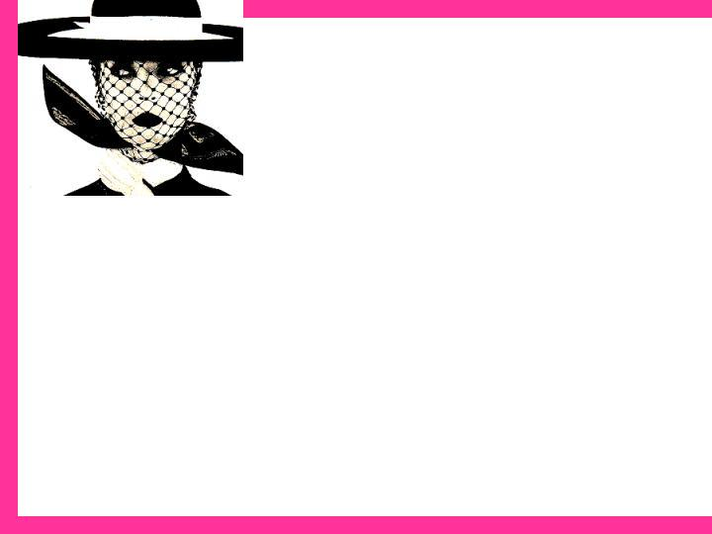
Elements of Design: the ingredients
Line
Shape/Silhouette
Color
Texture
Pattern

Slide 3
Line
Refers to an elongated mark that connects two or more points. Line encloses and divides space, creating shapes and forms. Seam lines divide and enclose space on a garment.

Slide 4
Effects of line
Can create optical illusions.
Can Give messages
Show Optical Illusion Slide Show
A
B
C
D

Slide 5
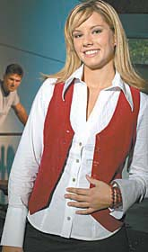
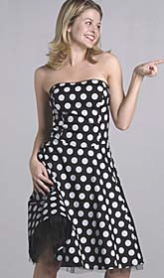
Structural
Vs.
Structural – lines required to maintain the structure of the garment; for example, seams
Decorative – lines created by the designer purely for decoration; for example, a printed-on design
Decorative

Slide 6
Curved Lines
Message
Gentle, Romantic, Fragile, Soft, Casual, Feminine, Graceful, Sensual
Illusion
Holds attention longer, increases, emphasizes, reinforces rounded soft-body curves, counter straight lines and angular body areas

Slide 7
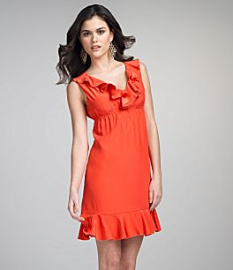

Slide 8
Vertical
Message
Formal, strong, dignified, stiff, business-like, stately, conservative, grandious, majestic, efficient
Illusion
Increases, emphasizes, reinforces length, height, narrowness, thinness– slimming, counters horizontal lines

Slide 9
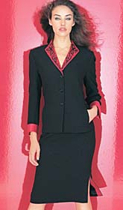
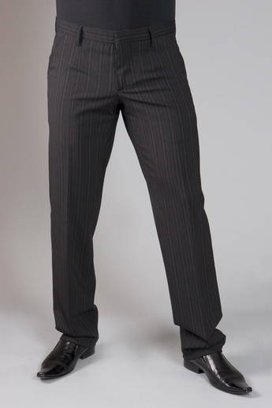

Slide 10
Horizontal
Message
Restful, stable, calm, relaxed, casual, quiet, serene, in repose, lethargic
Illusion
Increases, emphasizes, reinforces width, bulk, shortness, counters vertical lines, when placed high appears taller, when placed low appears shorter

Slide 11
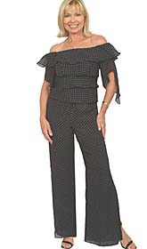
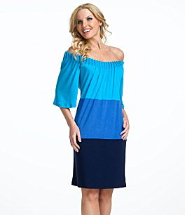
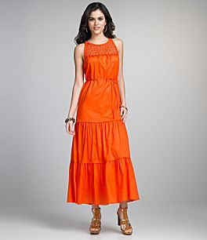

Slide 12
Diagonal
Message
Active, movement, instability, excitement, interesting, dramatic, restless, sophisticated, in motion, vitality
Illusion
Increases, emphasizes, reinforces the direction of the dominant angle, counters vertical and horizontal lines

Slide 13
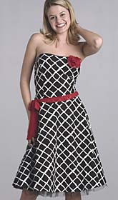
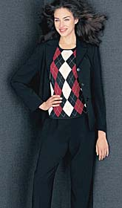
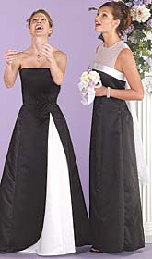

Slide 14
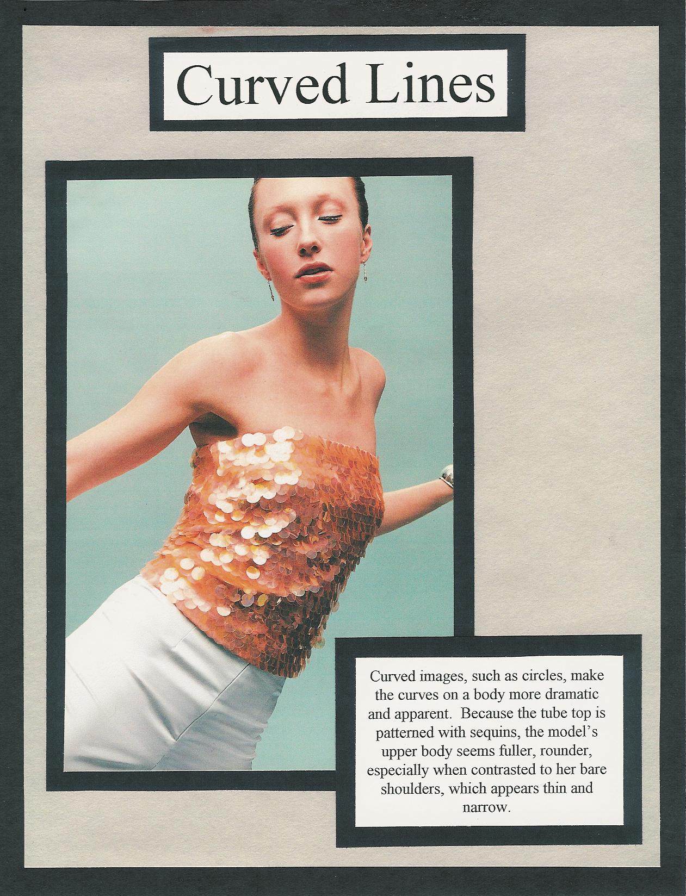
Curved line sample portfolio page

Slide 15
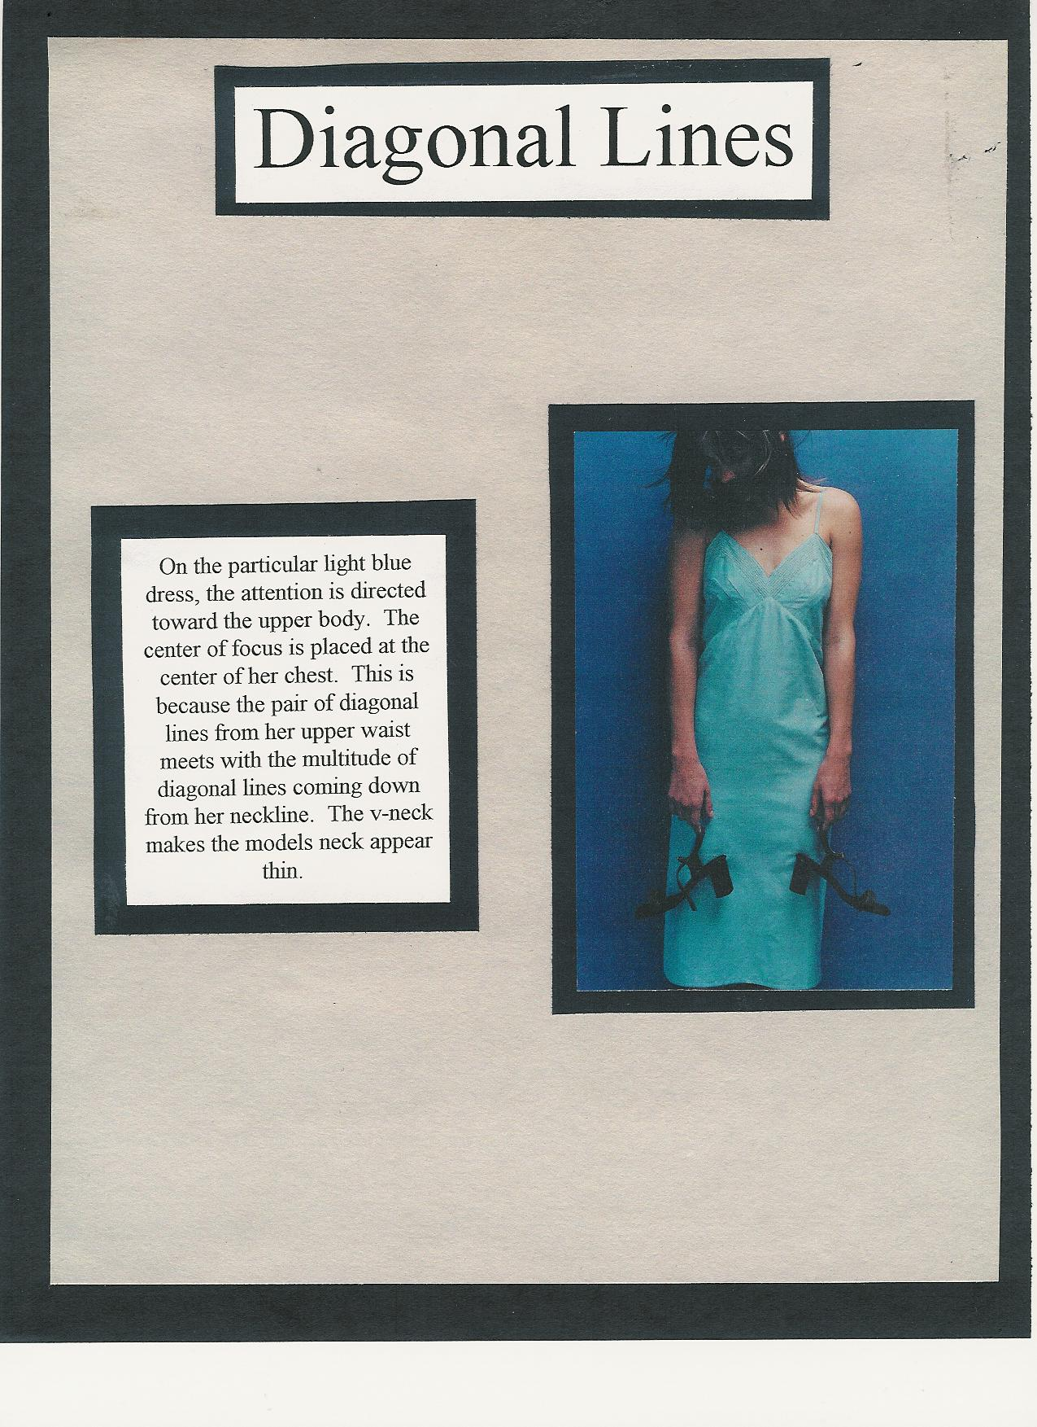
Diagonal Line sample portfolio page

Slide 16
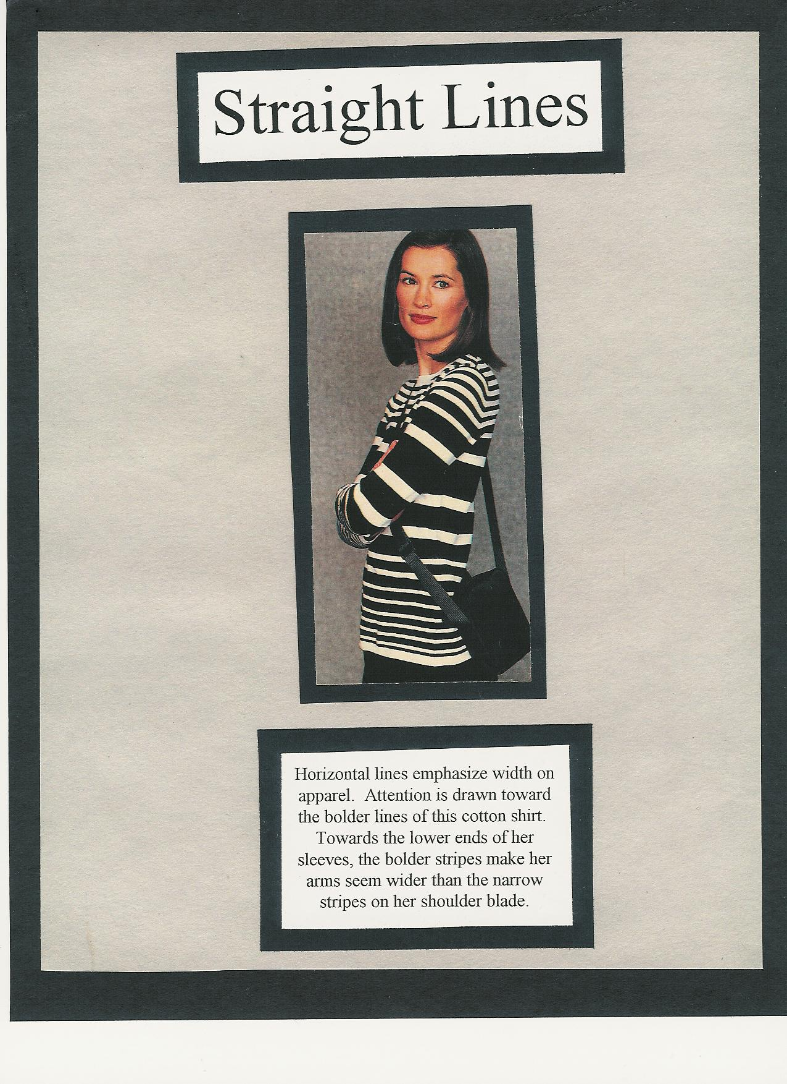
Straight line portfolio sample page

Slide 17
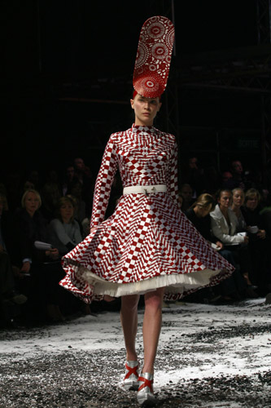
What lines appear in this dress?

