Slide 1
Interior Design
To create a functional and beautiful living environment.

Slide 2
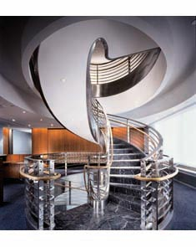
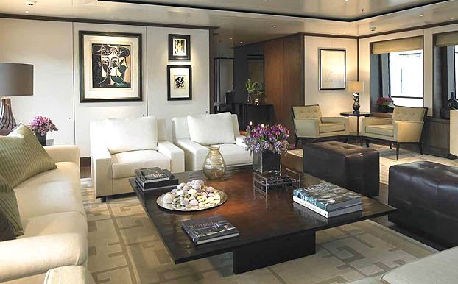
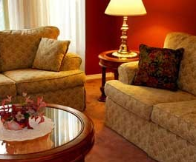
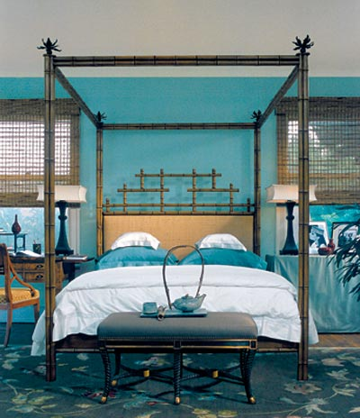
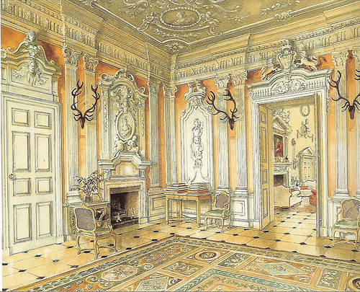
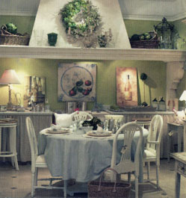
What is your style?
Industrial
Traditional
Contemporary
Asian
Rococo
Country French

Slide 3
Elements of Design
The tools (or ingredients) of design
Hands on—can be manipulated
  Space
  Shape and Form
  Line
  Texture
  Pattern
  Color

Slide 4
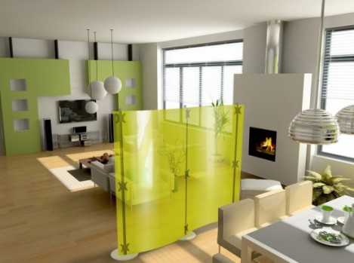
Space
The area in which the designer is given to work with
The area between objects in a room
What type of space do you like? A house with separate rooms or a house with all rooms in one space?

Slide 5
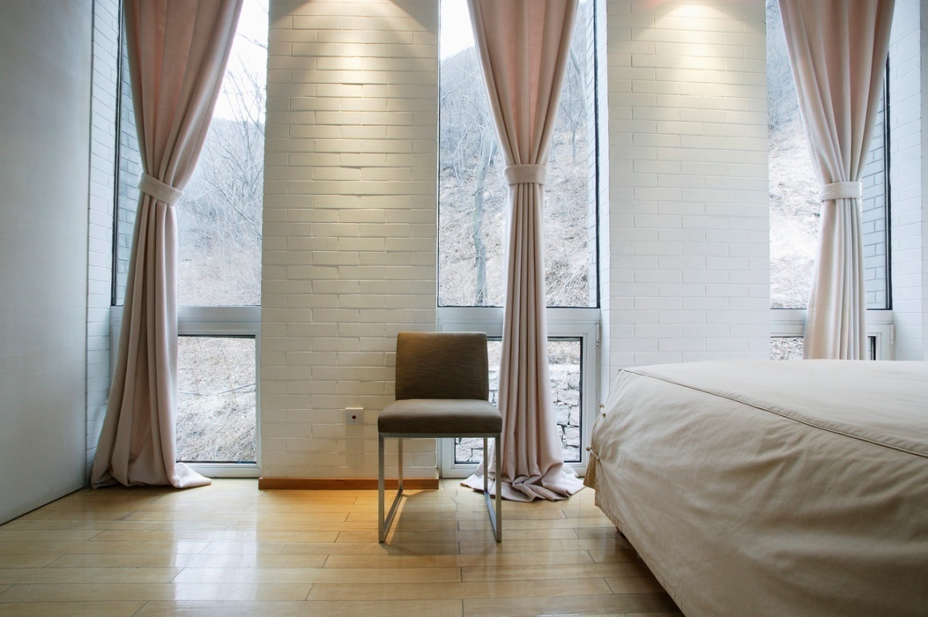
SPACE
Space is probably the most important element of design. It gives us the ability to change.
Space changes as we move, as light changes, or psychologically by where we are located.
The basic space problems people encounter include having too much or, more often, not having enough.

Slide 6
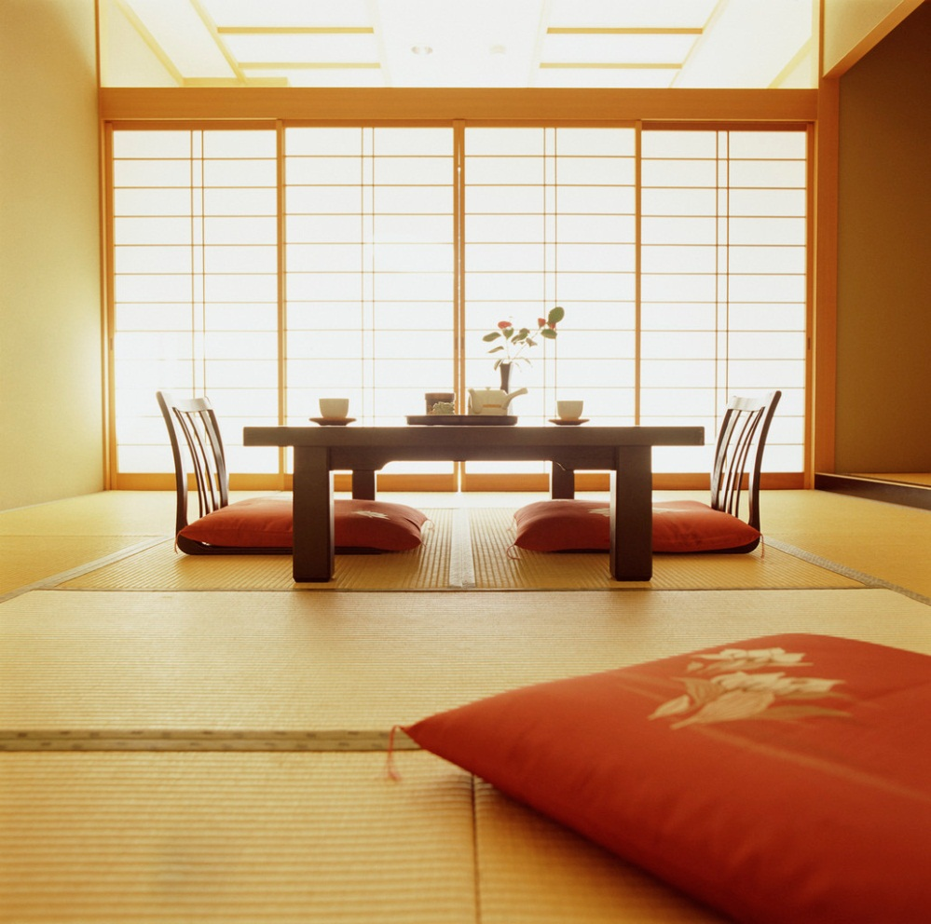
To make an area feel more spacious:
1. allow large openings between rooms
2. place furniture near walls
3. use small furniture, patterns and textures
4. use a minimum of furnishings and accessories
5. allow for empty spaces between furniture and on walls
  The key is to keep the eye moving in an uninterrupted way, causing our brain to think the room is larger.

Slide 7
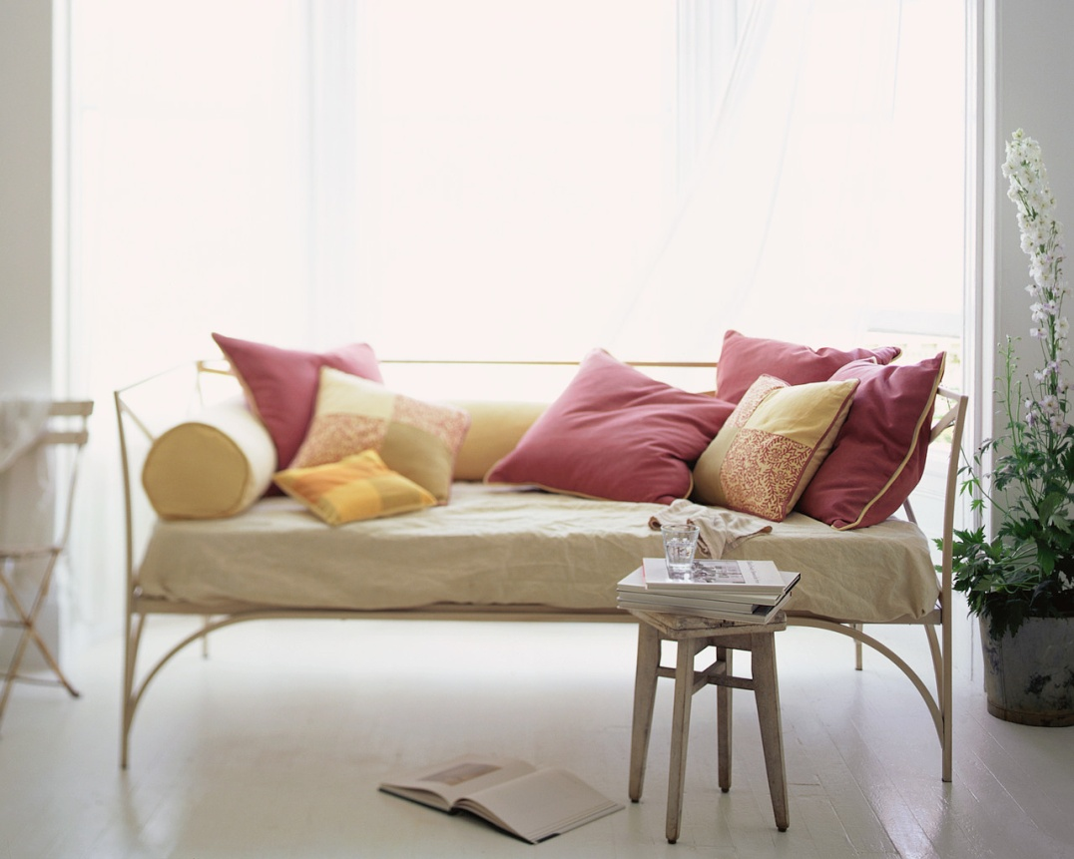
More spacious continued…
6. allow as much floor to show as possible
7. use mirrors to create the illusion of space
8. unify spaces by using the same floor/wall coverings
9. use light, cool colors
10. place lighting on the outside of the room or underneath furniture
Good space planning helps people feel more comfortable in their environments.

Slide 8
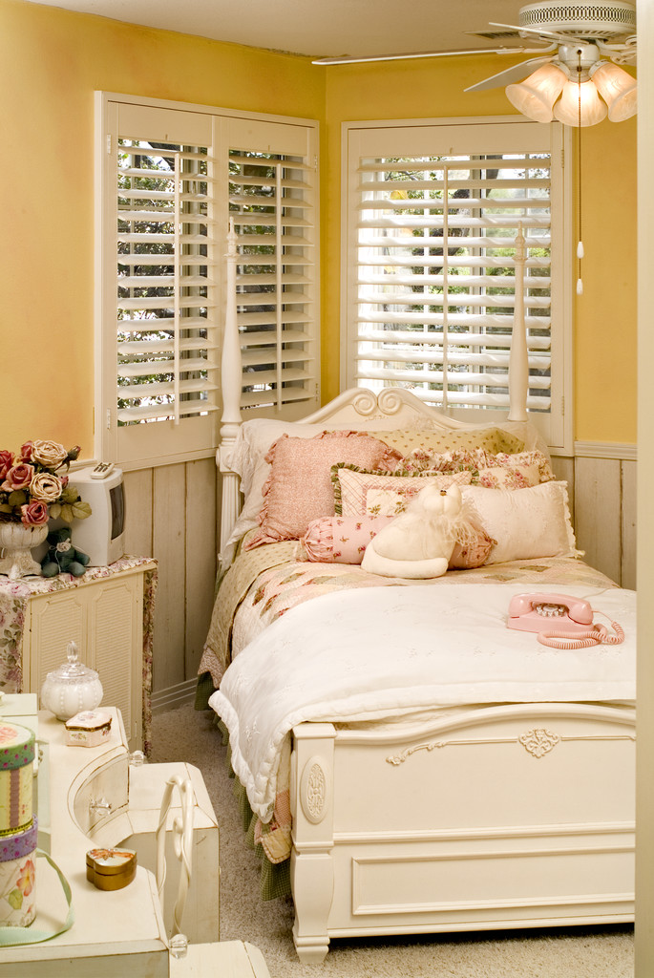
To make an area more intimate:
1. place furniture perpendicular to the walls
2. use furniture of differing heights
3. group furniture according to areas of activity
4. use large furniture that sits directly on the floor

Slide 9
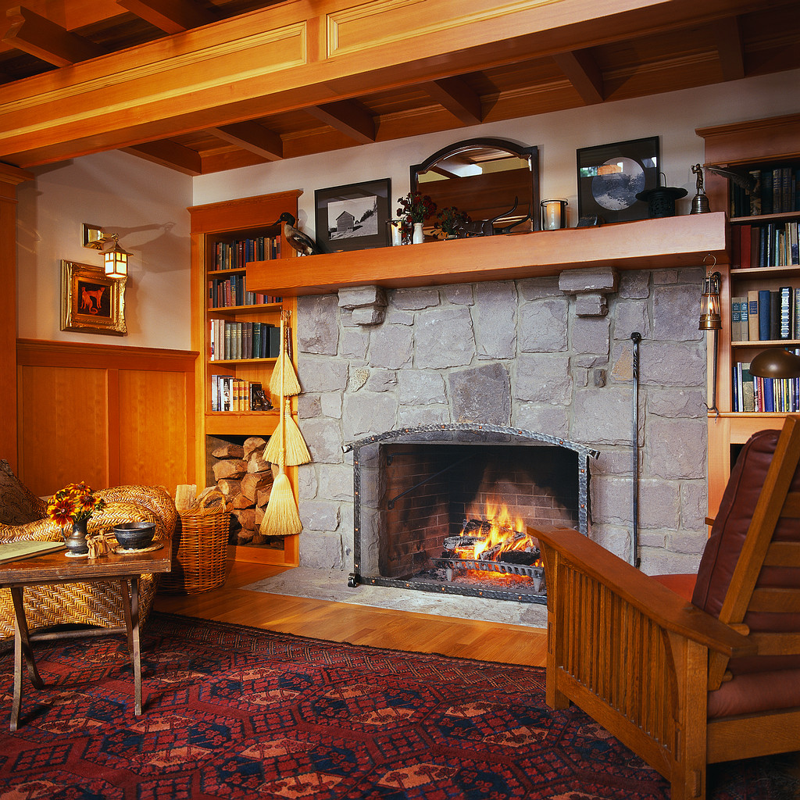
More intimate continued….
5. use large, contrasting patterns, colors and textures
6. use warm, dark colors
7. use natural lighting
8. use soft, rough textures to absorb sound

Slide 10
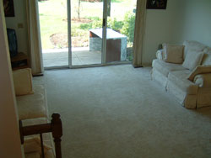
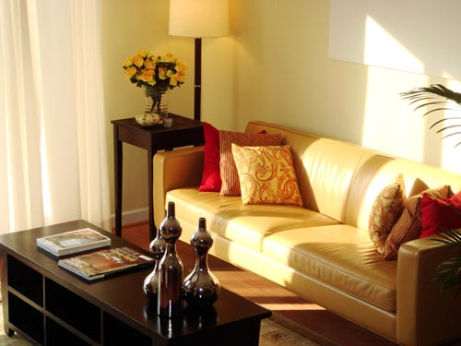
Before and After
Remember: If space is not correctly planned, the other elements of design will not be as effective.

Slide 11
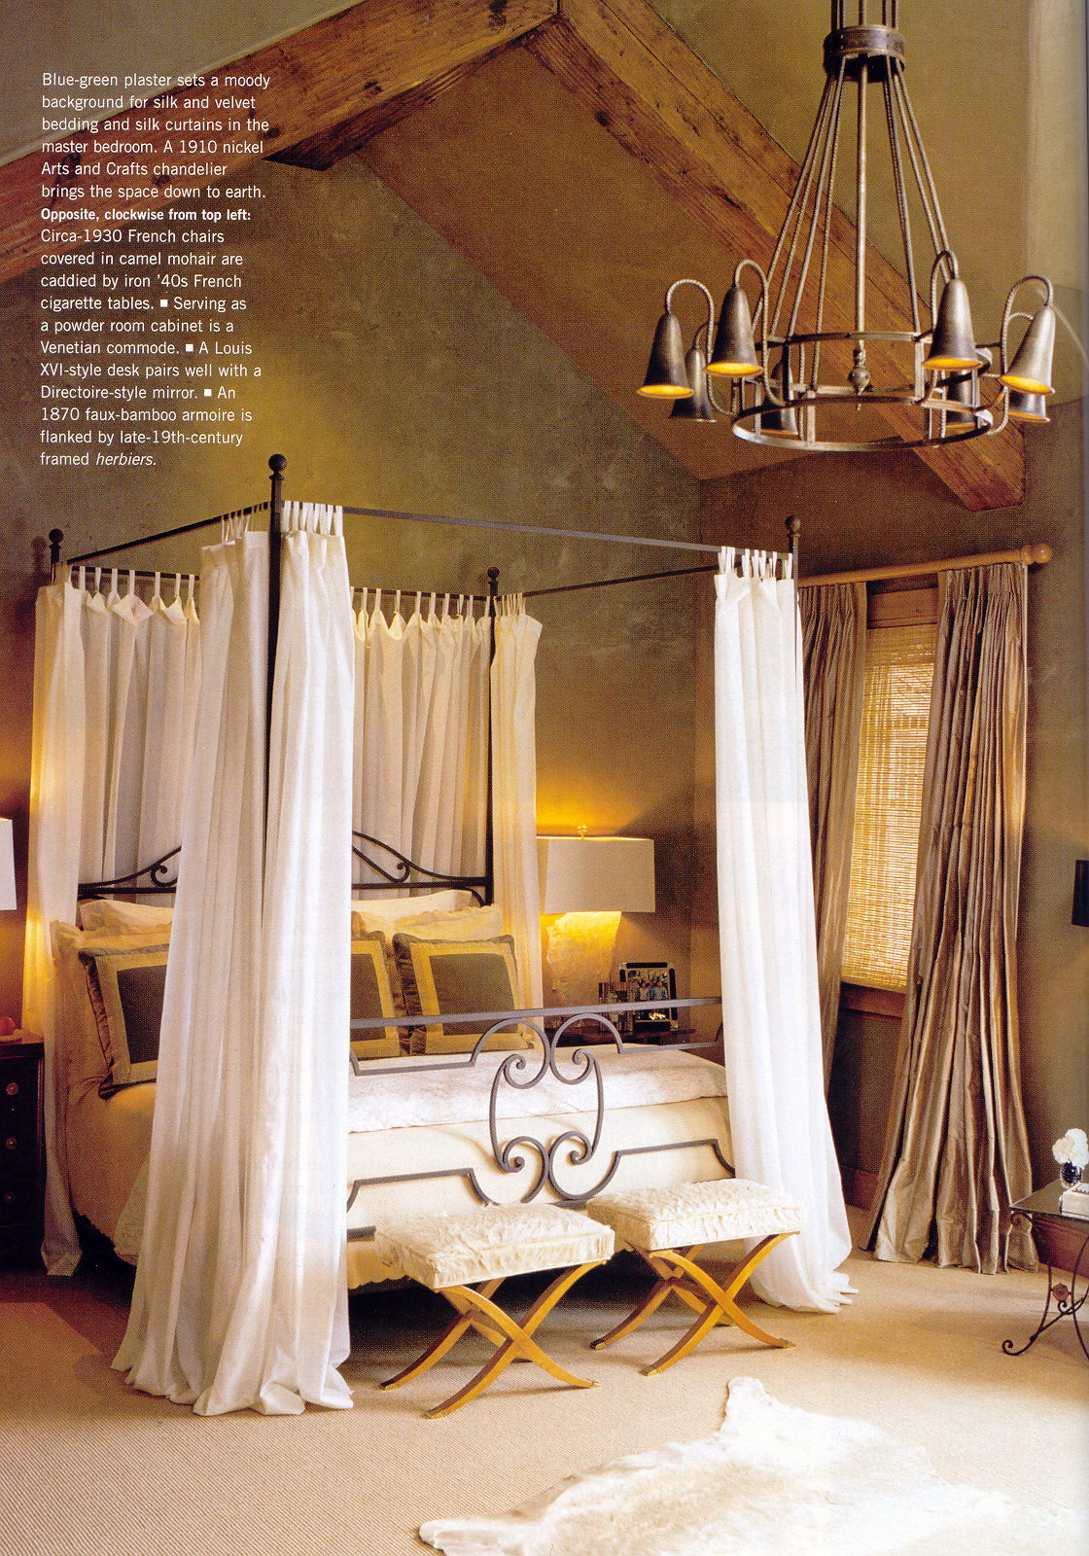
Positive vs. Negative Space
It is important in our designs to include both positive and negative space to achieve a look of overall balance.
Positive is filled space while negative is empty space.
Too much positive space can cause the space to feel cluttered.
Too much negative space can cause the space to feel empty.
Using the space guidelines from the previous pages will help to add overall balance to the design.

Slide 12
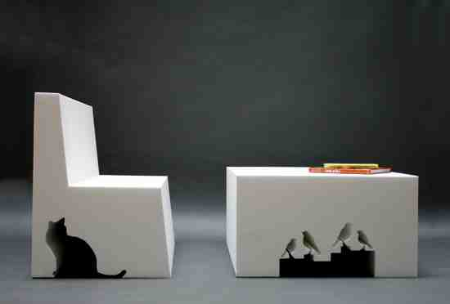
Two Kinds of Space
Positive Space
  Space in which the object resides
Negative Space
  The empty space around the object

Slide 13
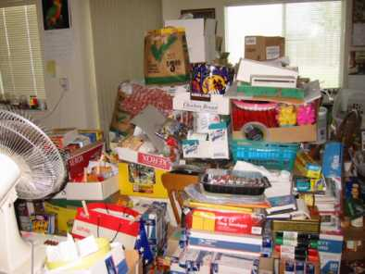
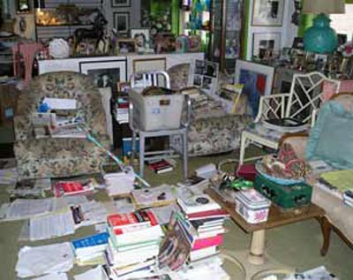
Each room needs both positive and negative space

Slide 14
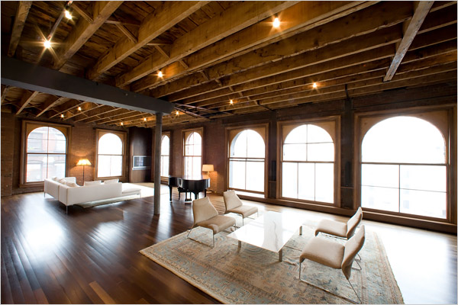
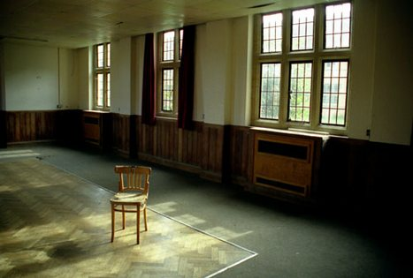
Each room needs both positive and negative space

Slide 15
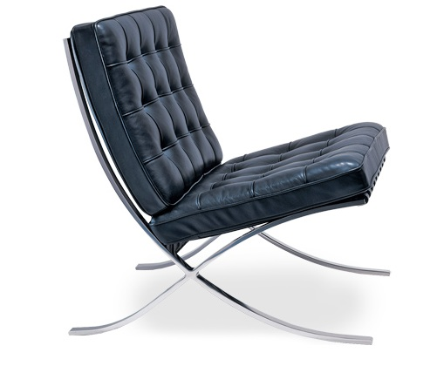
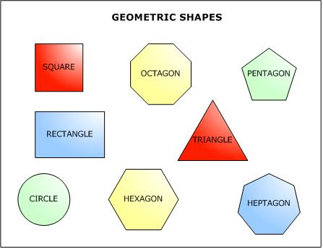
Shape
2-dimensional, made by connecting lines, only length and width
The solid form or structure of an object: 3-dimensional, length, width and height
Form

Slide 16
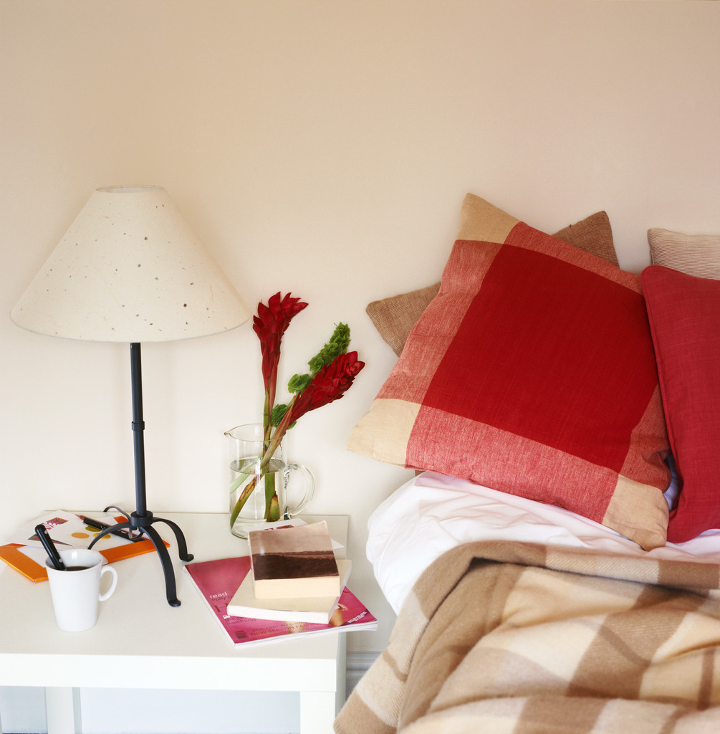
Shape vs. Form
Shapes are the simple outlines of objects and are flat.
Circles, squares, triangles etc.
Forms have an extra dimension and create realism in design.
Cones, cylinders, spheres, cubes, etc.

Slide 17
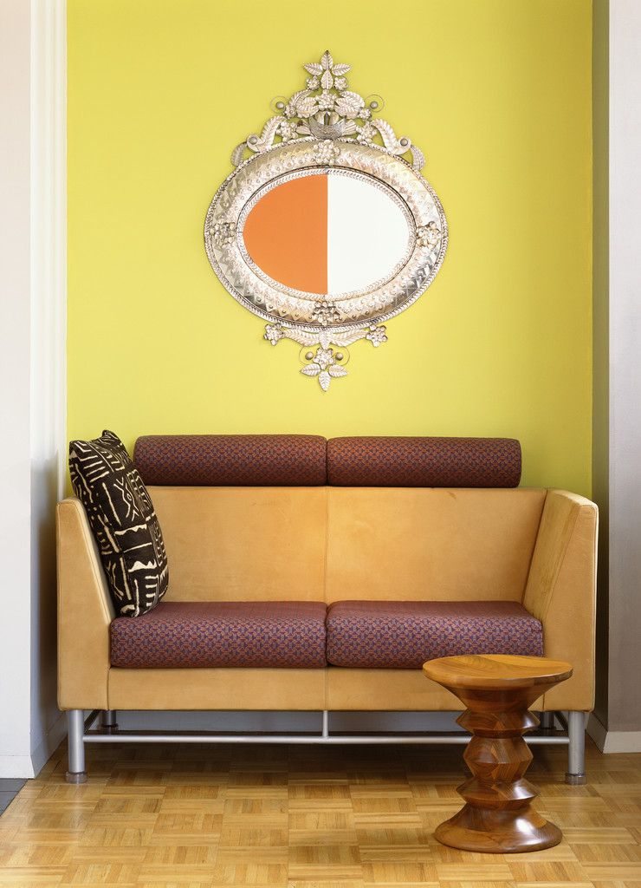
Types of Shapes
There are three basic types of shapes:
  Rectilinear: Most often used in homes. Fit well with each other.
  Curved: Remind us of motion and are stable.
  Angular: Make things look larger because they are not as common. They are the strongest shape.

Slide 18
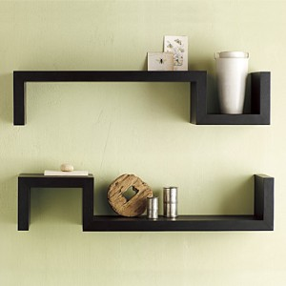
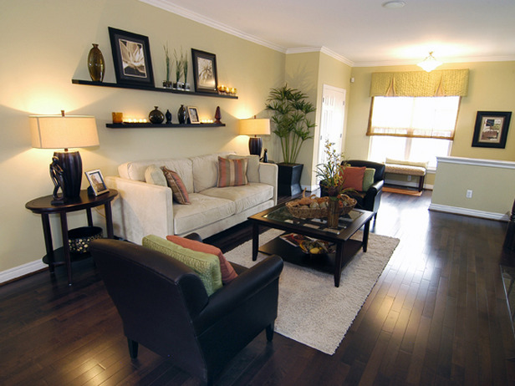
Every room needs form on at least one wall

Slide 19
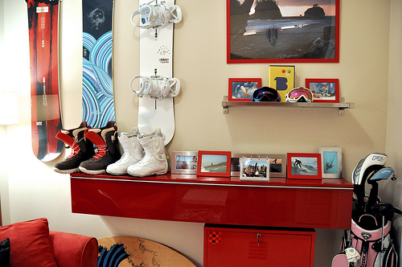
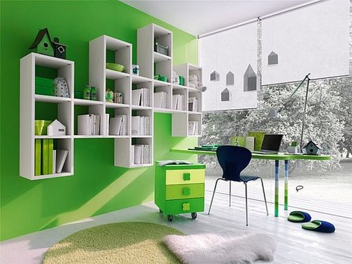
Every room needs form on at least one wall

Slide 20
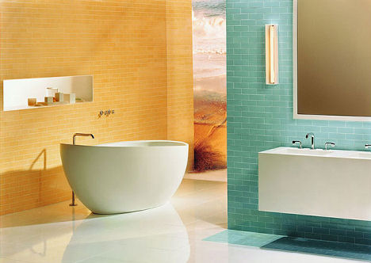
Line
The outline of an object
Connects two points
Leads the eye from one point to another
Line gives direction and divides space
Types
  Vertical
  Horizontal
  Diagonal
  Curved
Notes:
Line delineates space, outlines form, and conveys a sense of movement or direction

Slide 21
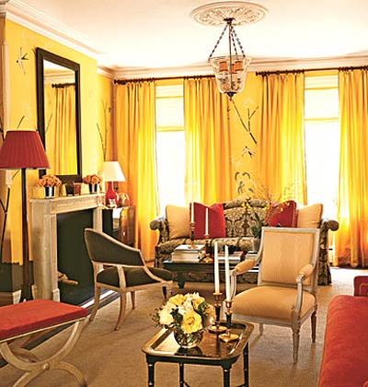
Vertical Lines
Vertical lines convey:
  Strength and stability
  Feelings of power, dignity, height, and formality

Slide 22
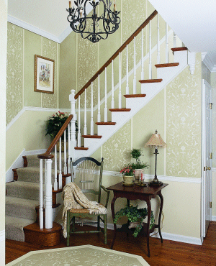
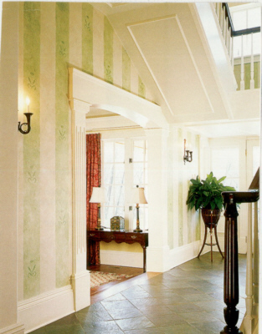
Vertical Lines

Slide 23
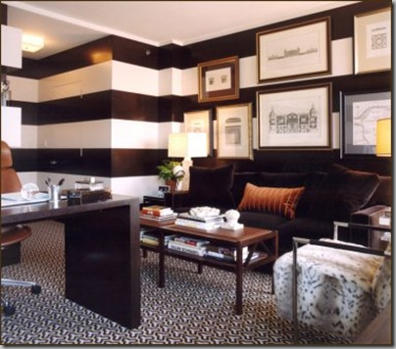
Horizontal Lines
Horizontal lines:
  Relaxing
  Restful
  Informal
  Sturdy
  Calm

Slide 24
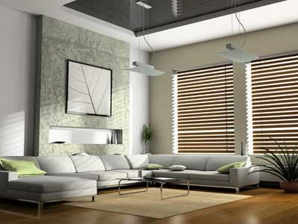
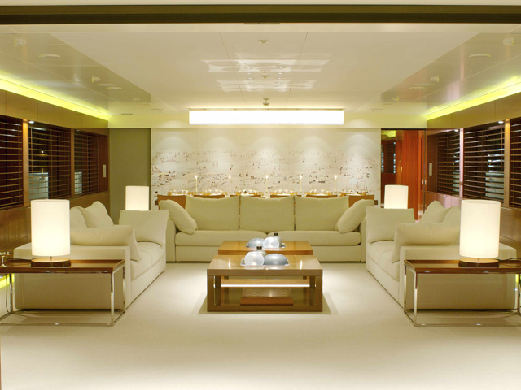
Horizontal Lines

Slide 25
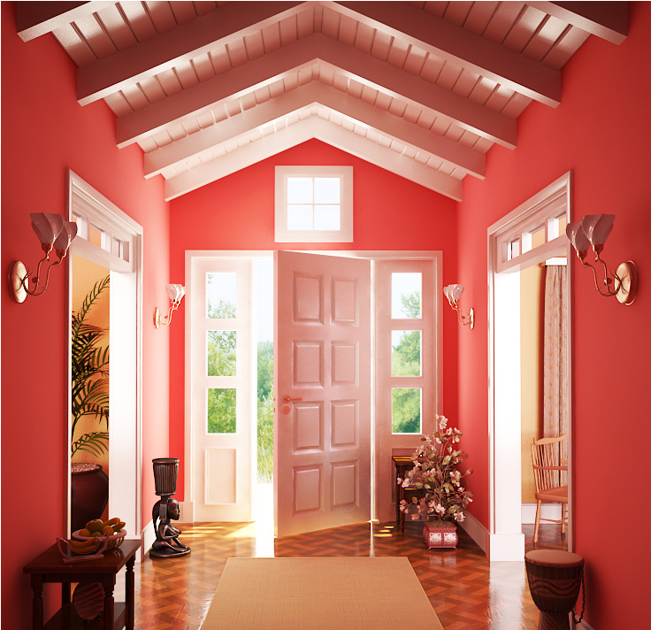
Diagonal Lines
Diagonal Lines
  Creates a feeling of action and suggests movement
  Evokes excitement

Slide 26
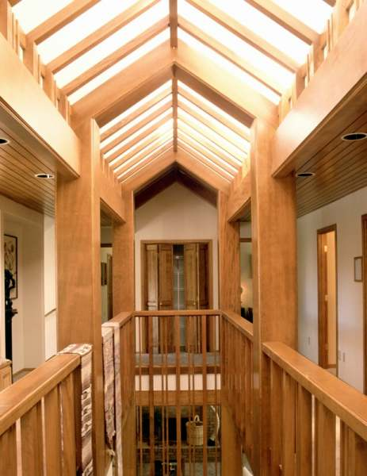
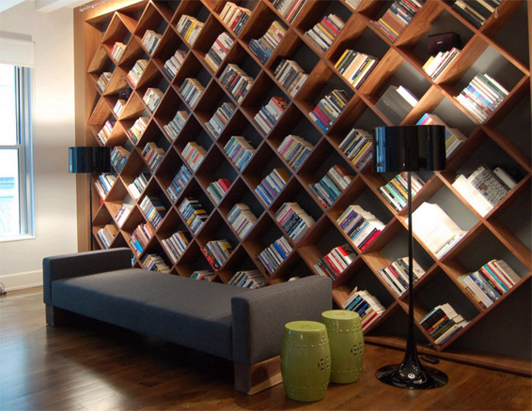
Diagonal Lines

Slide 27
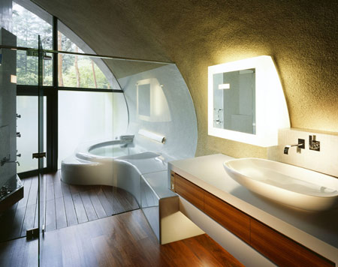
Curved Lines
Curved Lines
  Creates a feeling of gentleness and femininity
  Pleasing effect

Slide 28
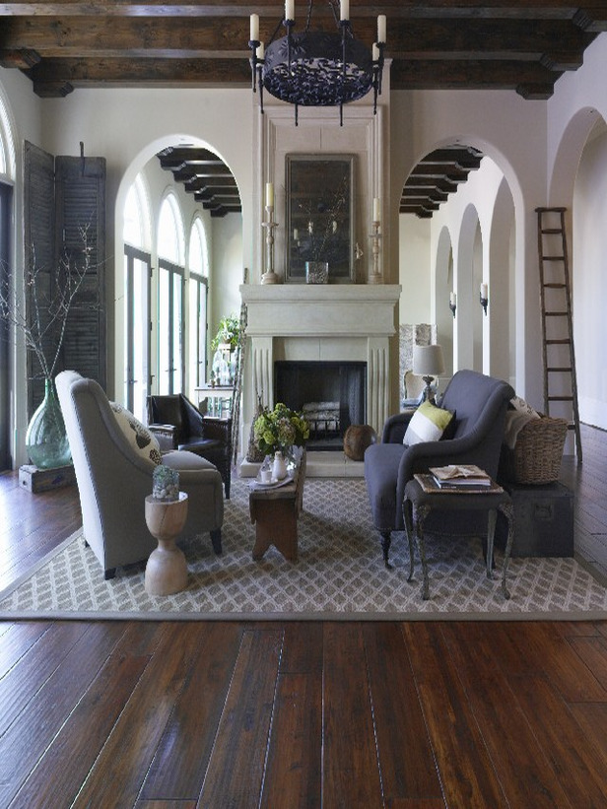
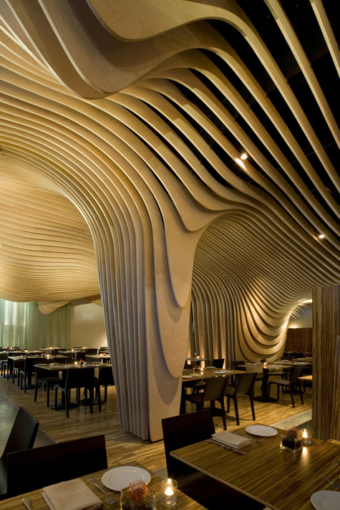
Curved Lines

Slide 29
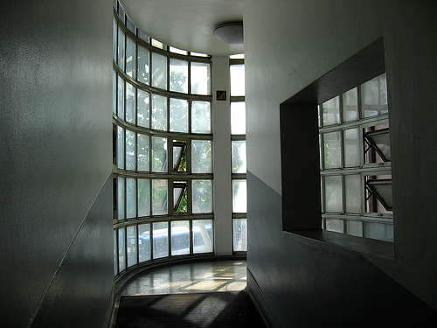
What lines do you see?

Slide 30
Which lines do you “feel” when you read this?
You are watching a parade. As the military group approaches you, their commanding officer orders, “Halt!” The drums stop and the group stands silently at attention.
It is a warm summer day with not a hint of a breeze. You have been driving for a long time on a very straight highway and you are drowsy. You see a shade tree with a cool looking spot of grass. You stop your car. You are very tired, so you lay down on the grass and fall asleep.
It is Halloween night and you are 10 years old. You have become separated from your friends and you meet a gorilla like man who jumps from behind a bush and scares you.

Slide 31
Which line do you “feel” when you read this?
It is a lovely spring night and you are with your boyfriend (girlfriend) in a sailing boat. The gentle breeze is blowing the boat calmly across the water.
You are at a fashion show. A very beautiful woman dressed in a pink chiffon gown, trimmed with soft lace, seems to almost float across the ramp. Her soft hair falls gently around her shoulders and her dainty slippers seem to hardly touch the floor.

Slide 32
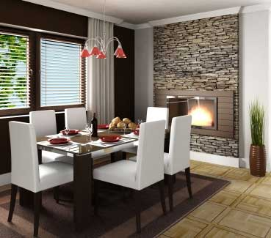
Texture
Texture is the only element you can see AND feel
The way an object looks and feels
Visual texture
  What do I see?
Tactile texture
  What do I feel?

Slide 33
Texture
ribbed
rough
crinkled
smooth
soft
bumpy
satiny
silky
fluffy
hard
silky
sandy
ribbed
flat
abrasive
nubby
shiny
plush
fuzzy
ridged
spiky
coarse
gritty
slick
grainy

Slide 34
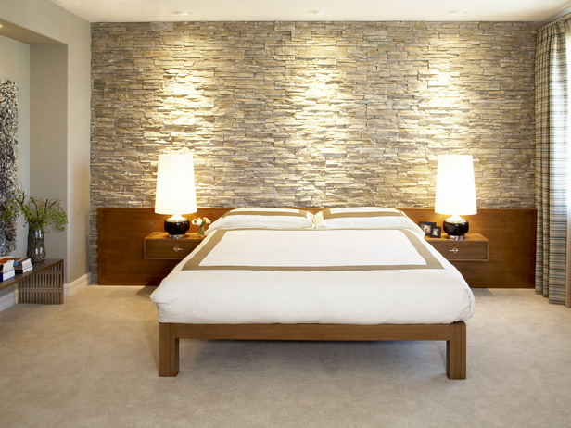
Rough Texture
Make color look darker and less intense
Generally less formal

Slide 35
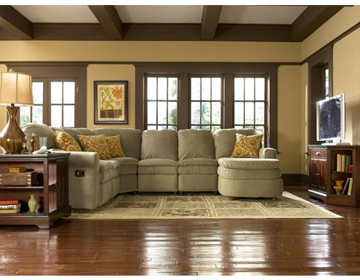
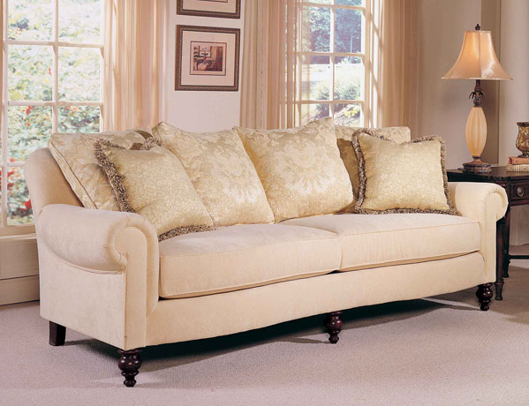
Smooth Texture
Make colors appear lighter and brighter
Generally considered more formal

Slide 36
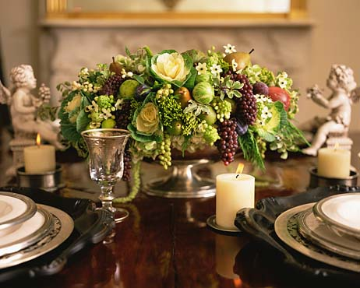
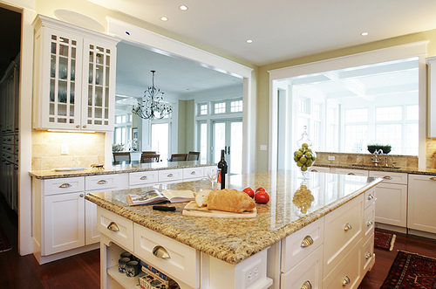
Shiny Texture
Reflective
Has more intense color

Slide 37
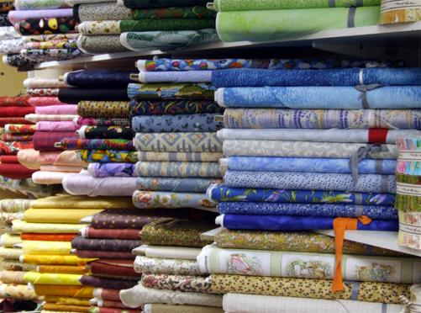
Tactile vs. Visual Texture
Tactile is texture we can feel… there is variation in the surface.
Using a variety of tactile textures in a room can add visual appeal.
Visual is texture we only see… there is NO variation in the surface.
Visual texture is sometimes applied on walls using a faux paint finish.

Slide 38
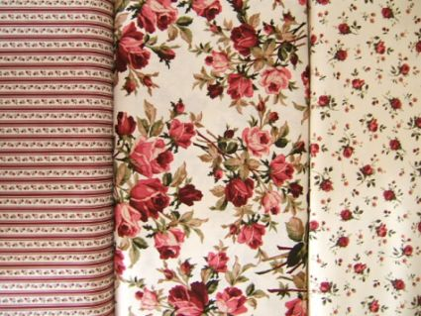



Pattern
Using pattern in rooms adds variety with the other elements of design.
The four basic patterns are:
  Natural/realistic
  Conventional/
  stylized
  Geometric
  Abstract
Natural/realistic
Geometric
Conventional/stylized
Abstract

Slide 39

What elements to you spy in this room?

