Slide 1
Fashion History
B.C. Review
1890
1900
1910
1920
1930
1940

Slide 2
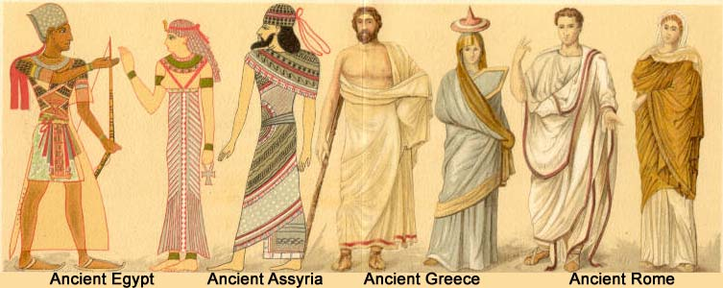
B.C.
Fashions of this period come from several groups in existence at this time: Egyptians, Cretes, Greeks, Romans, and Byzantine.

Slide 3
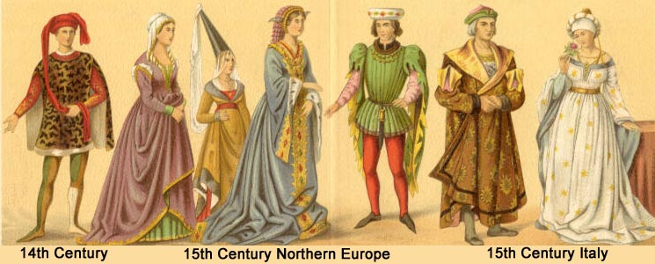
1200-1300’s
The Hennin was worn in the 14th and 15th century, was a cone-like hat resembling the spires of the cathedral spire.
The Tunic was often one of the stylistic features of the classic businessman.

Slide 4
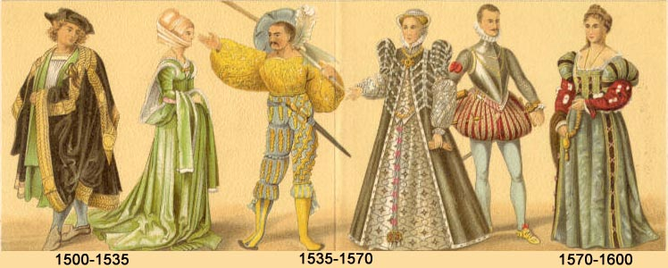
1400-1500’s
Women of this time used pregnancy pillows when the maternal look was fashionable.
Men of this time wore a codpiece, a decorative triangular piece of fabric attached at the groin.

Slide 5
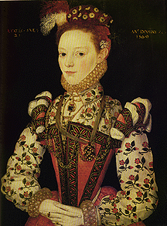
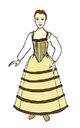
1400’s-1500’s
The Farthingale was a stiff metal cone-shaped article worn under skirts, while the Ruff was a large stiff collar worn at this time.
Farthingale
Ruff

Slide 6
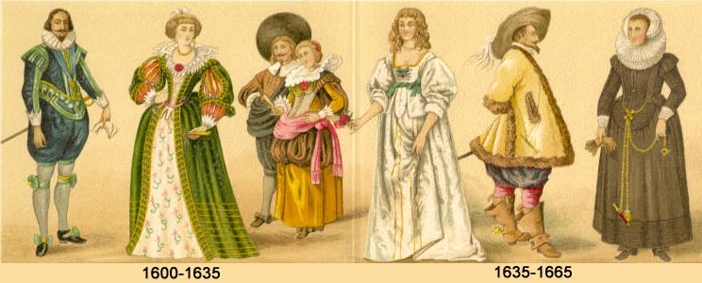
1600’s
The French Courtiers influence for this time was a fashion which said “I don’t have to work for a living.”
The Puritan costumes were very simple. When religious values are ascendant, dress becomes austere.

Slide 7
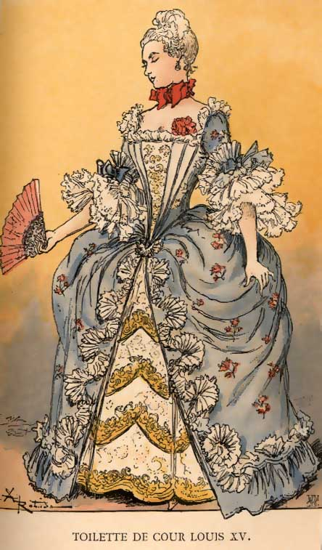
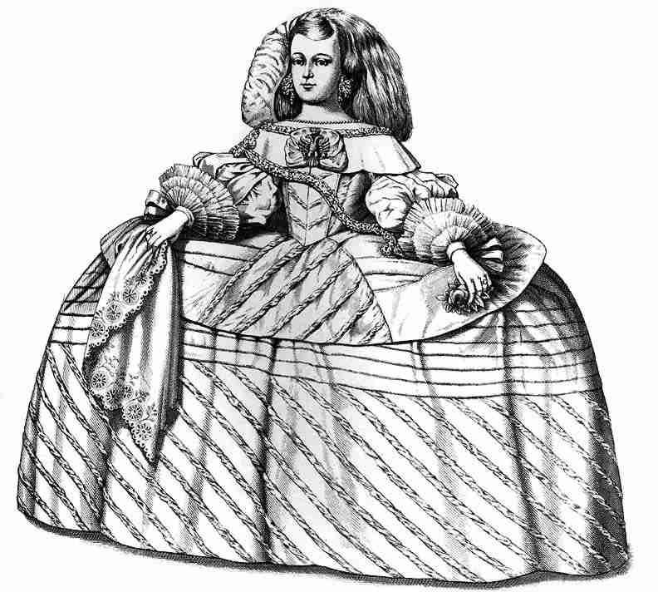
1700’s
The 1700’s started with the drastic extension of both the hips and the hair for women. Women were beginning to make contributions to society by becoming writers, business women, artists and doctors. The drastic visual display of their dress was a spectacle which far outweighed the proportions of a man.

Slide 8
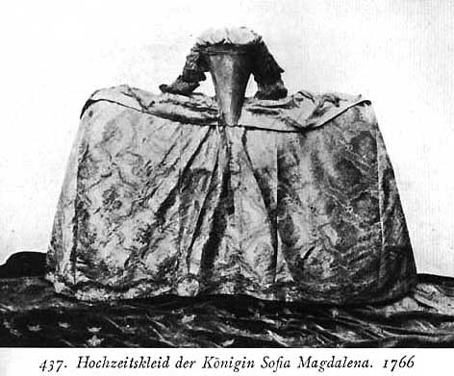
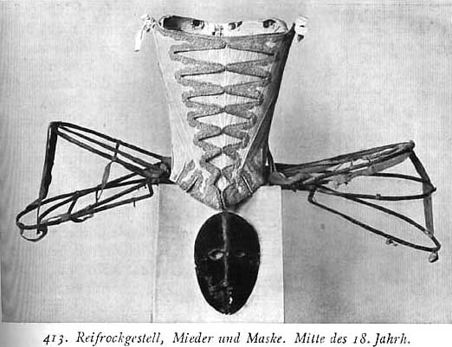
1700’s
This shows the hoop and mask used under a ladies dress to extend the hips drastically.

Slide 9
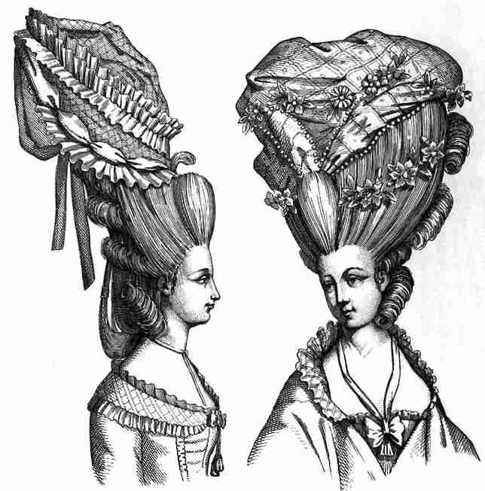
1770’s
Hair was piled high on the head in the pompadour style and atop the mountain of hair (which usually included pieces of someone else’s hair called a Rat) sat large hats topped with feathers, bows and ribbons.

Slide 10
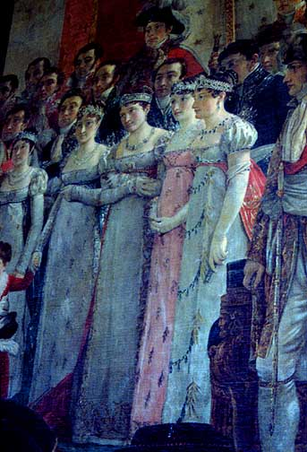
Late 1700’s
Near the end of the 1700’s women began to wear dresses that followed the simple lines of the Greek silhouette. The hair softened at this time as well. Women left behind the corset for a brief time.
1790, Napoleon’s sisters

Slide 11
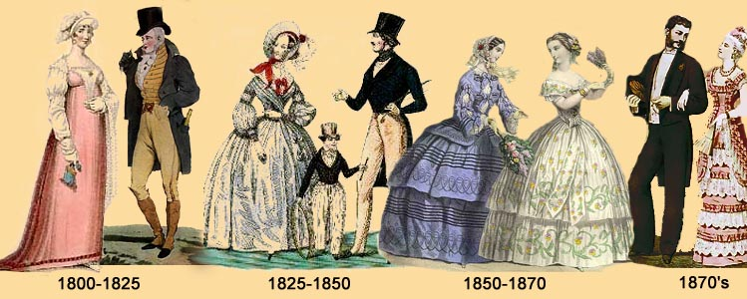
1800’s
Fashion at this time went through some very distinct changes. The 19th century starts with the Greek influence, then woman gradually add to the dress until the Greek is not noticeable. The corset returns!
The high society had rich fashions, while the common people dressed simply. It was an era of romance and manners

Slide 12
1890’s
Start taking notes in your packet now!

Slide 13
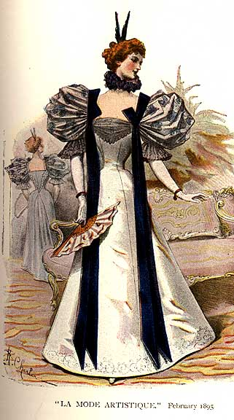
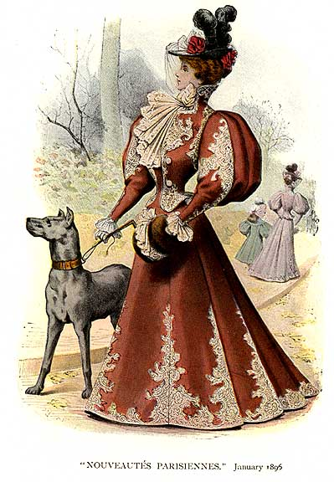
1890’s: Exaggerated Hourglass
1895, Paris
1895

Slide 14
Influence of History:
Victorian Era
Queen Victoria, peace and prosperity
Age of Optimism
Ragtime
Jazz & Rhythm
Civil War 1861 – 1865 (You don’t have to write this one- simply FYI)

Slide 15
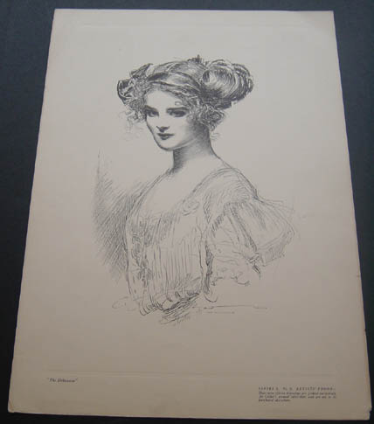
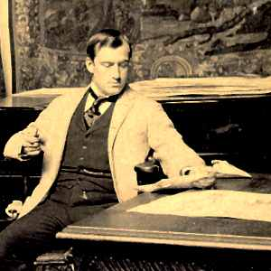
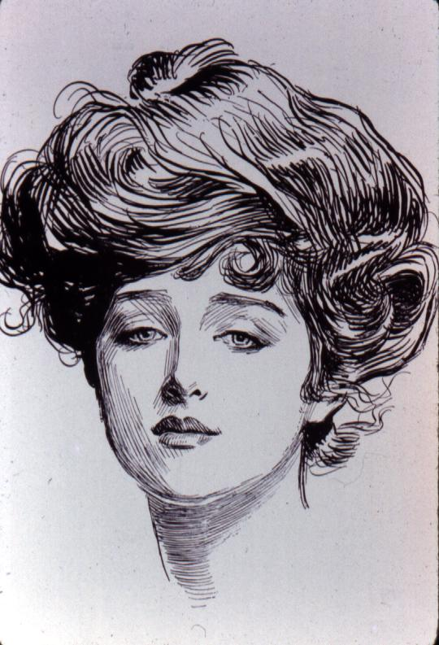
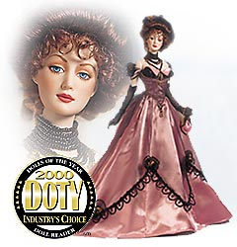
1890’s Gibson Girl
Artist’s sketches of young women by Charles Dana Gibson, known as the Gibson Girls, were published in newspapers and set the standard for the all-American girl.

Slide 16
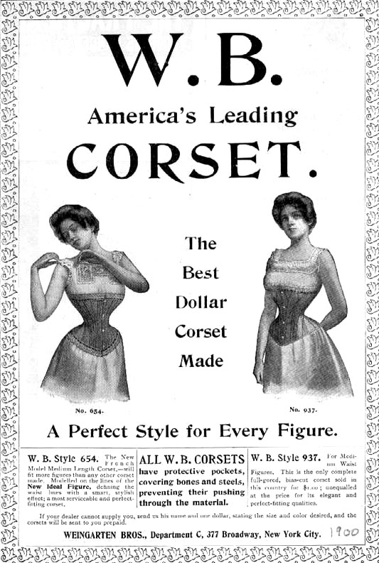
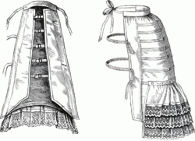
1890’s
The exaggerated hourglass was the silhouette style of this decade. Shoulders were wide, waists were cinched in unmercifully by corsets and the hip was incredibly increased by the bustle. Women also wore layers of petticoats to accentuate the hourglass silhouette. The bustle was a frame that was designed to add fullness to the back side of a female. It was worn under their skirt

Slide 17
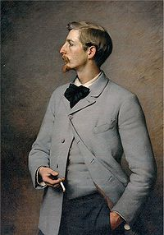
1890’S Men’s Fashions
Winged shirt collars: generally turned over or turned into “wings”
Sack Coat: straight, not fitted
Waistcoat: vest worn under coat
Ascot Tie: Loose, fluffy tie

Slide 18
Movies that represent 1890’s
Tarzan

Slide 19
1900’s: S-Curve Silhouette
The silhouette softened into the S-shaped curve with softer shoulders, less restrictive corsets, and the bustle, never returned.

Slide 20
1900’s Influence of History
This period became known as the Edwardian Era. During this time, Edward VII ruled England. Even though he dies in the early 1900’s , the decade beyond his death continues to hold his influence.
Industrial Revolution
Automobiles & Electricity

Slide 21
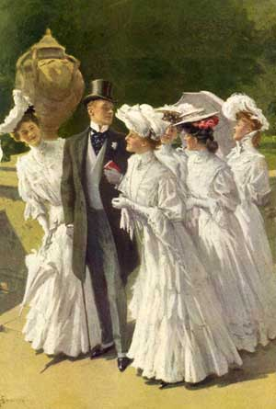
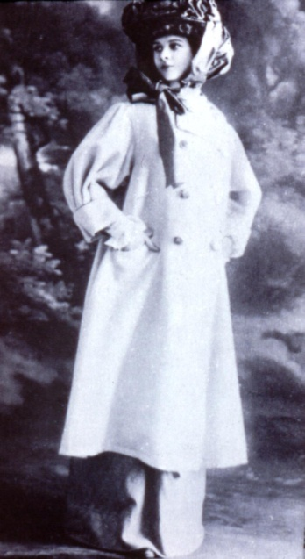
1900’s Women’s Fashion
Duster Coat: Men and women wore these to protect their clothing when driving or riding in cars.
Shirtwaist: A blouse with buttons down the front
Leg O’ Mutton Sleeves: Lots of material at top, tapered at wrist.
FYI: In 1906 the permanent wave was developed.

Slide 22
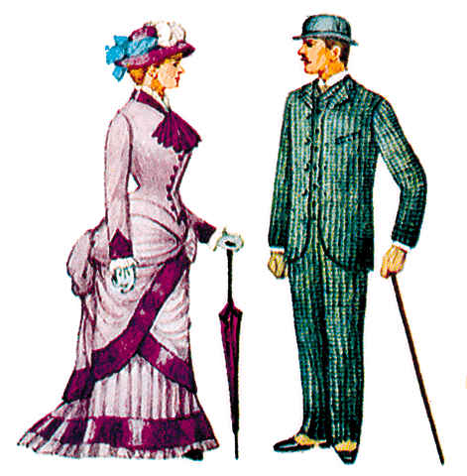
1900’s Men Fashion
The three-piece suit for gentlemen was introduced. The suit was relatively non-constricting with a sack coat, simple vest, and pleated trousers.
Creased and cuffed trousers were also popular.

Slide 23
Movies that represent 1900-1910
Meet me in St. Louis
Anne of Green Gables

Slide 24
1910’s: Inverted Triangle Silhouette
Decade starts out with inverted triangle silhouette, but towards the end of WWI barrel silhouette or tonneau look comes in.
It is a baggy dress/jacket combination that made women look large and droopy in the chest.

Slide 25
1910’s Influence of History
World War I 1914 – 1918
World War I saw fashion come to a standstill with patriotism at an all-time high.
Women’s Movement
The women’s movement demanded the right to vote, wear make-up, cut their hair short for the first time in a Bobbed style, and wear skirts above the ankle.

Slide 26
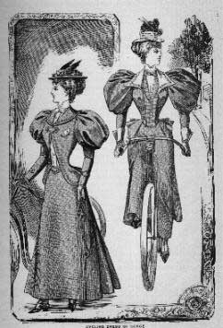
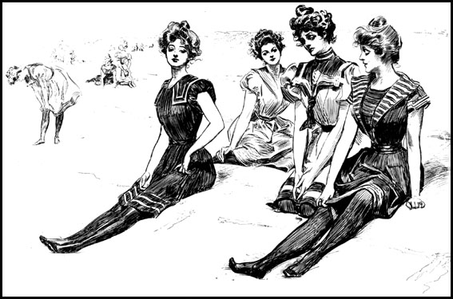
1910’s –The Bathing Suit & Bloomers
The new two-wheeled cycle, was the craze of the country. Amelia Bloomer designed a practical outfit for the avid cyclist consisting of a tunic dress worn over loose trousers gathered at the ankle. Later this was revised into a split skirt with gathers under the knee, called Bloomers.
The one piece bathing suit was introduced by Annette Kellerman which shocked the world.

Slide 27
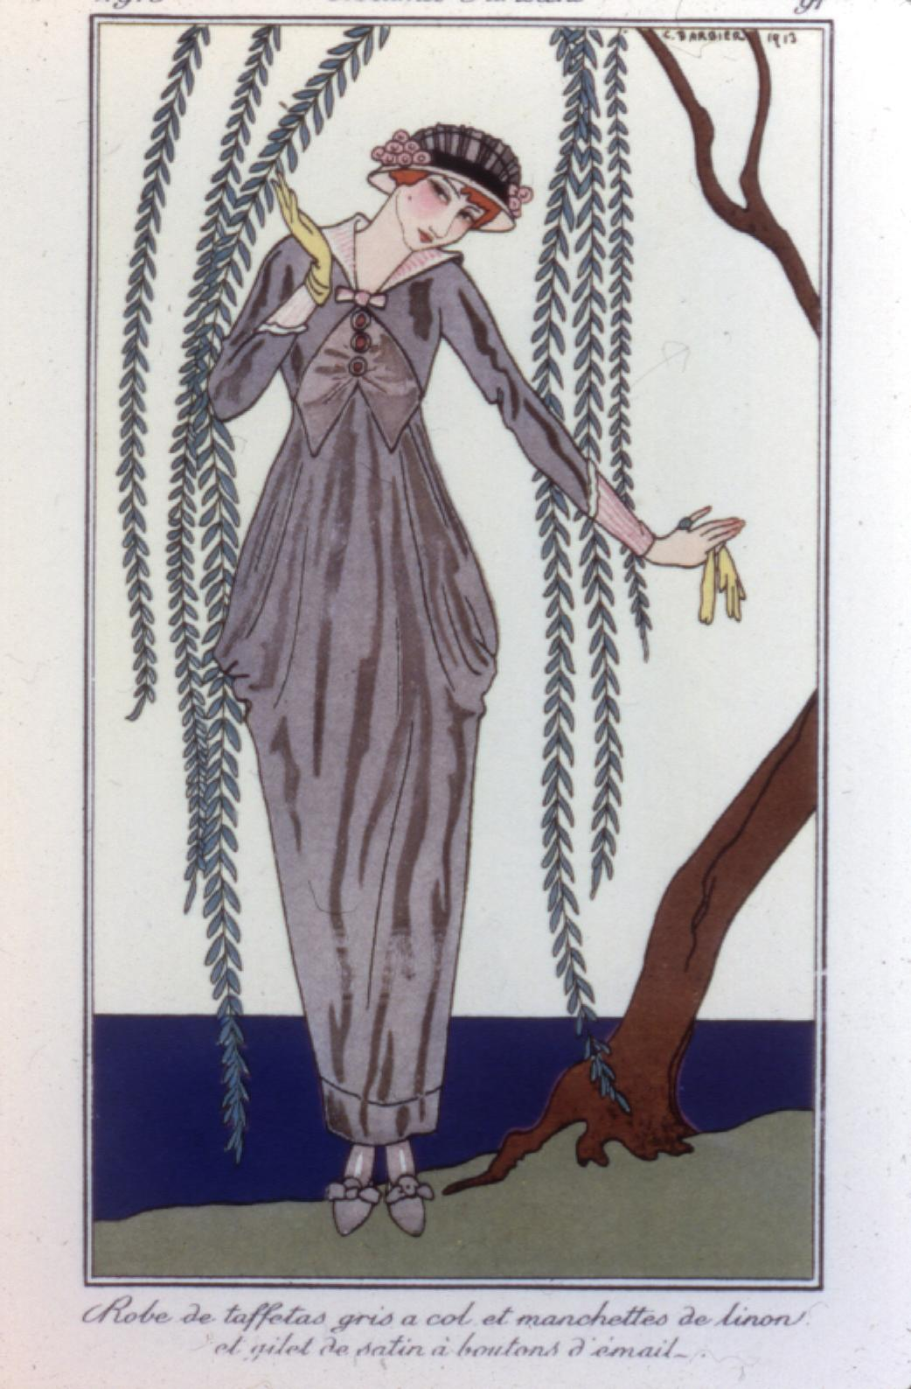
1910’s – The Hobble Skirt
French designer Paul Poiret broke the new rule of freedom by designing the Hobble Skirt. The hemline was so narrow that women could only take very tiny steps. The Pope spoke out in defense of the women, so Poiret split the skirt to the knee, bringing a response of outrage from the public.

Slide 28
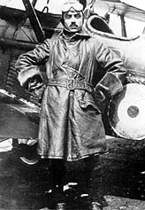
1910’s Men’s Fashion
Military Influence
Trench Coats

Slide 29
Movies that represent 1910’s
Anne of Avonlea*
Titanic*
Somewhere In Time
Mary Poppins

Slide 30
1920’s: Tubular (androgynous) Silhouette
Life began to move ahead and fast. The silhouette at this time was straight up and down or tubular.
FYI: the brassiere (BRA) was introduced, but it was used to flatten the figure, not uplift or enhance it.

Slide 31
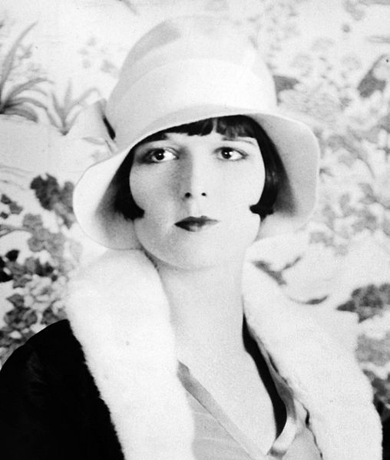
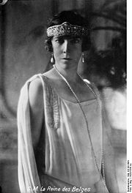
1920’s Influence of History
“Roaring 20’s”
Age of Jazz
Prohibition

Slide 32
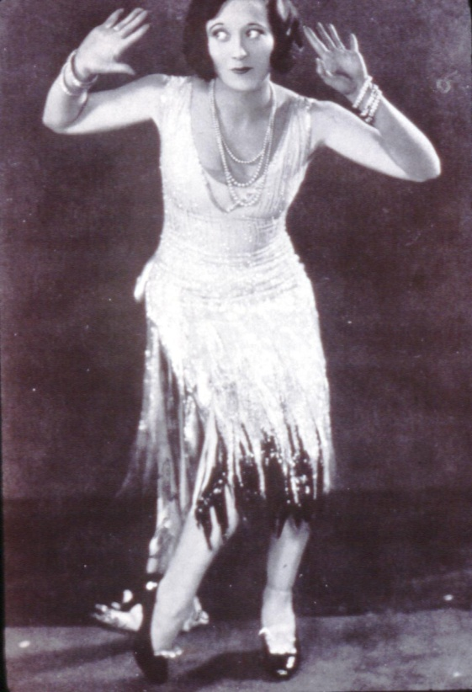
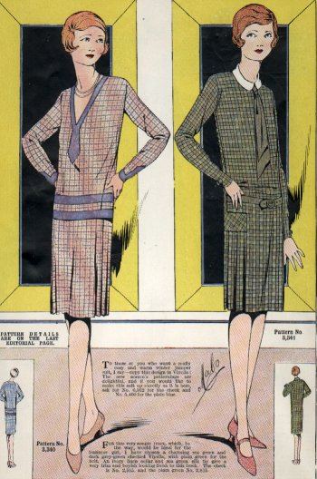
1920: Flapper vs. Thinking Woman
The Flapper wore a headband around her forehead, usually with a feather in front. Her face was powdered, her skirt was the shortest in history, and her knees were rouged. Silk stockings were the rage; they were rolled down just above the knee.
The “Thinking Woman” was college educated and considered herself to be the opposite of the flapper. Her dress was emancipated but not extreme.
Safe make-up, costume jewelry, and suntans were in great demand.

Slide 33
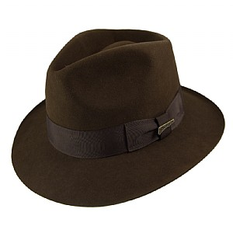
Cloche hats
The cloche hat was not confined to the 1920s as is often first thought.
It was fashionable from 1908 to 1933 was one of the most extreme forms of millinery ever, with an appearance that resembled a helmet. It was the iconic hat of the twenties decade and will ever be associated with the flappers of the era. To wear one correctly the hat had to be all but pulled over the eyes, making the wearer have to lift up the head, whilst peering snootily down the nose.
Fedora hats

Slide 34
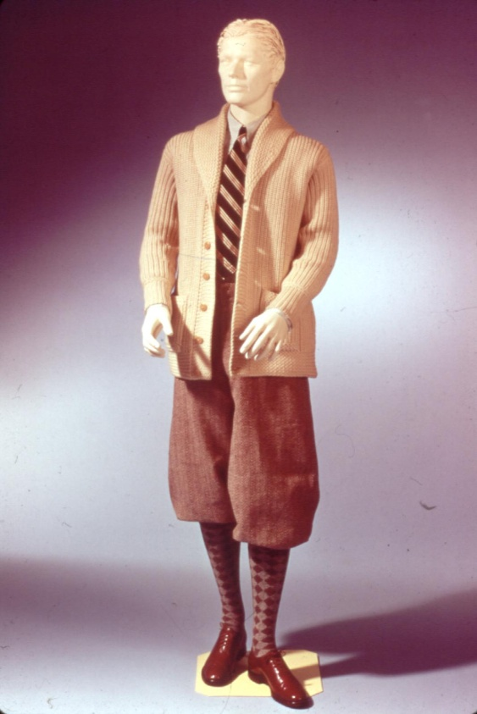
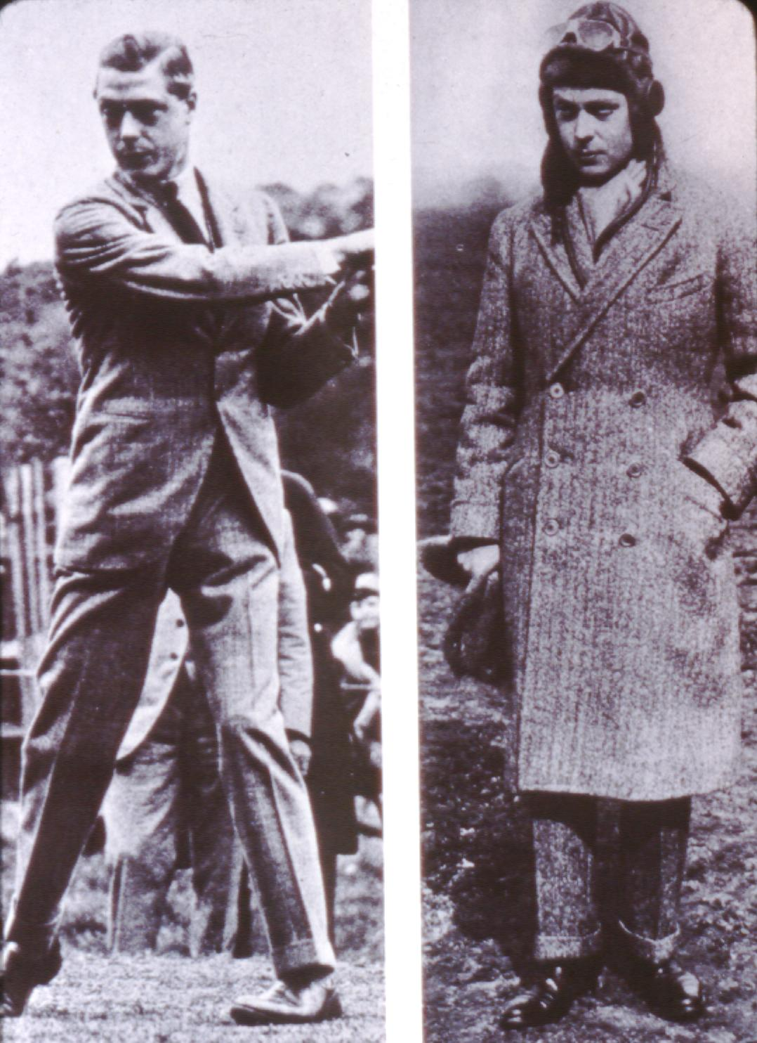
1920’s Men’s Fashion: Influence of England
The Prince was the ultimate trend setter of the 1920’s
He often wore Oxford bags, extremely wide trousers, often reaching 25 inches at the knee and cuffed at the bottom- knickers
Cardigan sweater, plus-fours/oxford bags, argyle socks, wingtip shoes, club stripe tie.
Edward 8th Prince of Wales -Shown here in a suit and overcoat, ascot at the neck.

Slide 35
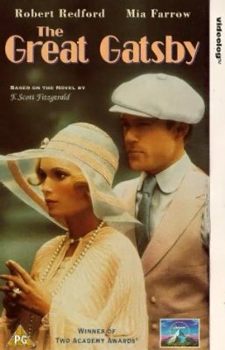
Movies that represent 1920’s
The Great Gatsby
Singing in the Rain
Thoroughly Modern Millie

Slide 36
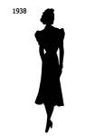
1930’s: Elongated Hourglass Silhouette
Long and slim with flared hem (Think mermaid)

Slide 37
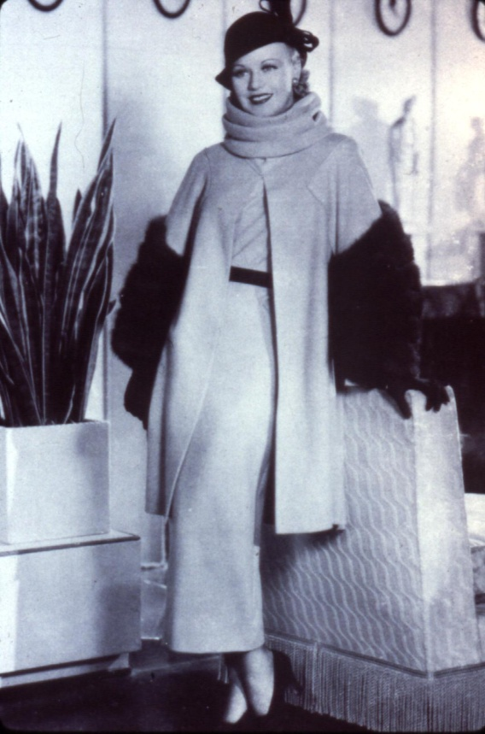
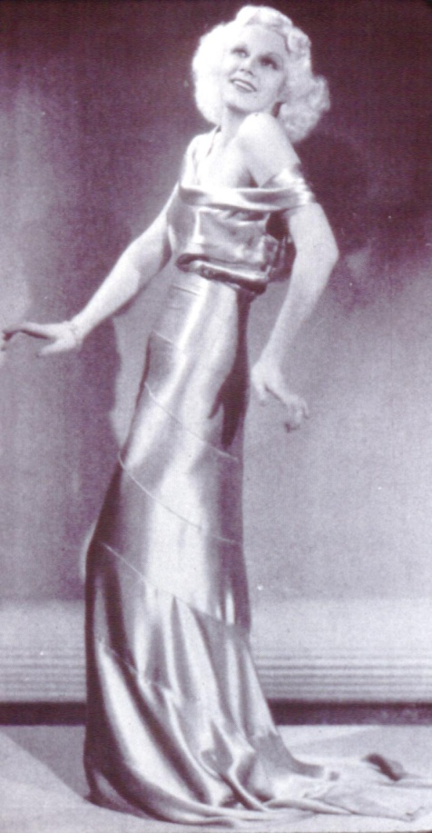
1930’s Influence of History
Depression Era
Good times ended with the crash of the stock market, which led to the Great Depression.
Crash in 1929.
Designer Quotes (Next Slide)
Movie Star Influence
Ginger Rodgers
Jean Harlow

Slide 38
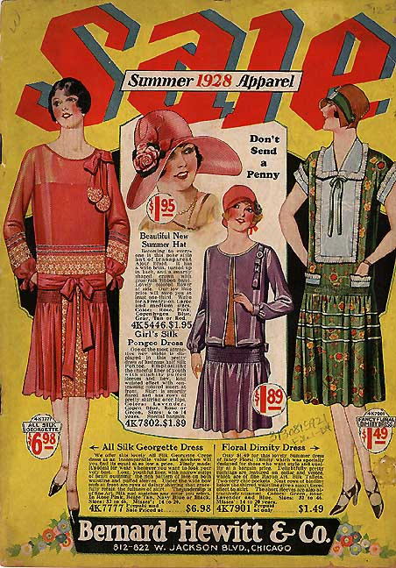
1930’s - Designers
Paul Poiret vowed, “I will strive for omission, not addition.” This he did with dresses which hung from the shoulders to the waist, with soft, silky, flowing, sheer fabrics.
Coco Chanel made a hit in fashion using black and navy in simple frill-free designs. She said, “Each frill discarded makes one look younger.”

Slide 39
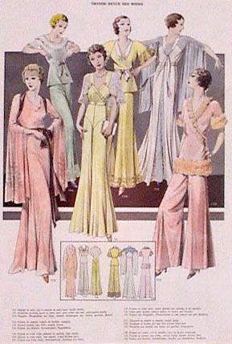
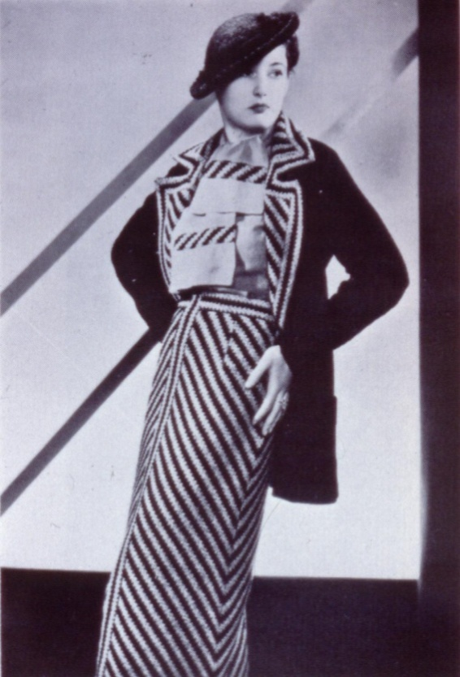
1930’s
Bias cut gowns were popular for evening wear.
Hemlines in the 1930’s went down and down again. By the end of the 1930’s fashion seemed to stand still in the shadow of impending war.

Slide 40
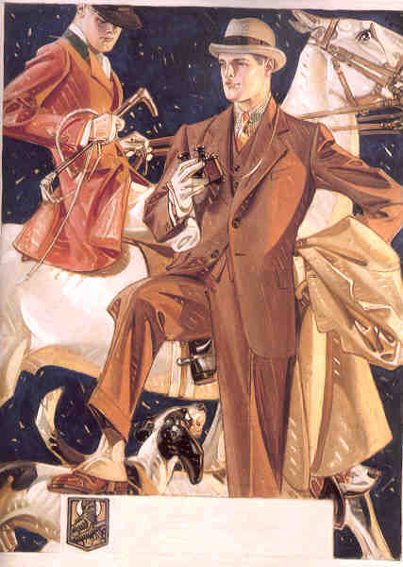
1930’s – Men’s Fashion
The Depression brought about the classic styles in suits and dresses, clothing that would last a long time and stay in style.
Straight, Wide leg trousers
Sweater Vests

Slide 41
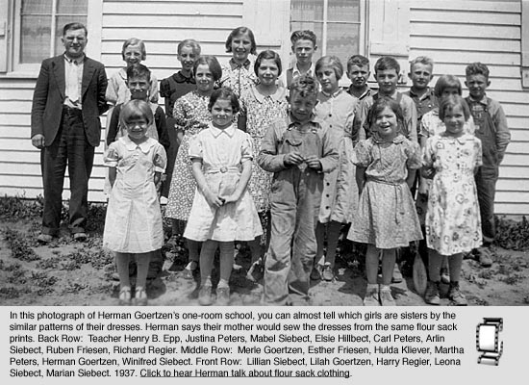
1930’s Children
Hand-me-downs became fashionable not only for thrifty families, but for everyone.
Depression babies had layettes sewn from sugar sacks while school children often wore underwear embellished with the trademarks of Pillsbury flour. combination, were the fashion in millinery wear.

Slide 42
Movies that represent the 30’s
Annie
Wild Hearts Can’t Be Broken

Slide 43
1940’s: Inverted Triangle Silhouette
Women began to wear pants as he practical dress for work in industry. It was not too long before pants were popular outside the workplace as a comfortable casual fashion.
The fashion at this time was very manly and the fabric was sensible tweed. The shoulder was square, wide and padded. Suit dresses were very popular and saddle stitching was a favorite trim.

Slide 44
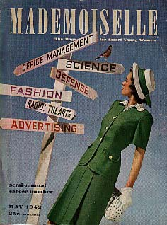
Influence on Women
The women were thrown into the workplace and then told to leave once the men returned. However, women now had their eyes open to the opportunities available to them.

Slide 45
1940’s Influence of History
WWII 1939 – 1945
With the fashion industry closed down by the war in Europe, the U.S. was left to its own designers for fashion direction. The designers turned to the military for inspiration.
Rationing
Couture leaves Paris, NY gains importance
This woman was married in a suit quickly for her husband to be shipped out.

Slide 46
War Restrictions
Not only fashion was restricted but food was rationed.
Stockings, which were not required under pants, were expensive and usually not available. Women in this picture are shown painting their legs to appear to have nylons on.

Slide 47
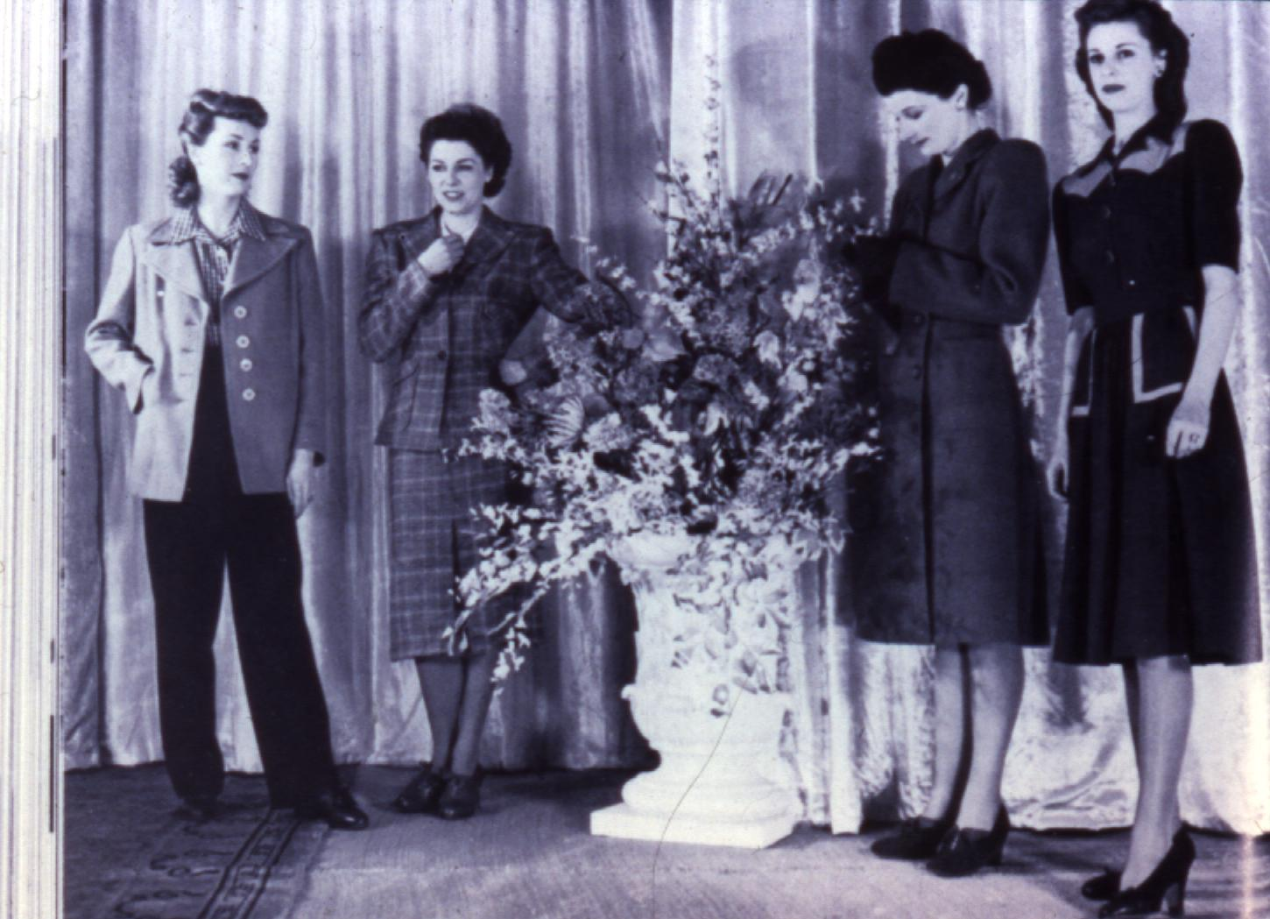
1940’s
L85 was a law which restricted the manufacture of clothing. Ruffles were forbidden. Only one pocket per blouse or shirt was allowed. Hems could be no deeper than 2 inches and the widest part of the hem of a dress could not exceed 72 inches. Hemlines rose and leveled off just below the knee.
For men several things were removed: cuffs, vests, 2 pant suits, patch pockets, cloth belts, and pleats.

Slide 48
1940’s Men’s Fashion
The Eisenhower jacket made fashion history as it was adopted for civilian use. The shoulders were roomy and comfortable. The Bomber jacket also gained in popularity.

Slide 49
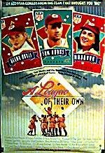
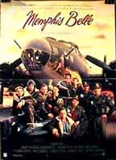
Movies that represent the 40’s
A League of Their Own*
Memphis Belle*
White Christmas
I.Q.*

