Slide 1
Bell Work
What are two reasons to teach children about sexuality? (Use your notes)

Slide 2
Reasons for Teaching Sexuality
Sex Still Has a Price Tag
http://www.youtube.com/watch?v=U0ezYNWIDB0&feature=player_embedded&safety_mode=true&persist_safety_mode=1

Slide 3
Female Reproductive Organs
Reproduction

Slide 4
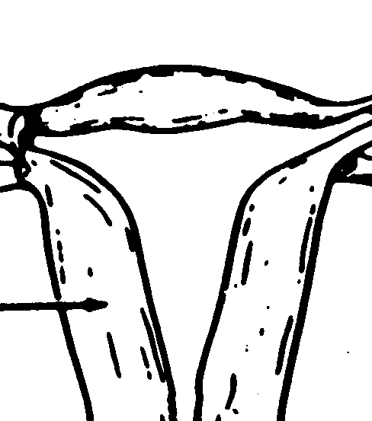
Female Reproductive Organs
1. & 8. Uterus:
Also known as the womb: organ that provides protection, nutrients, and houses the fetus.

Slide 5
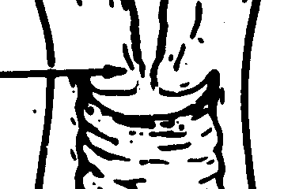
Female Reproductive Organs
2. & 9. Cervix:
The opening to the uterus which leads to the vagina. It helps hold the baby in the womb. In order for birth to occur the cervix must dilate.

Slide 6
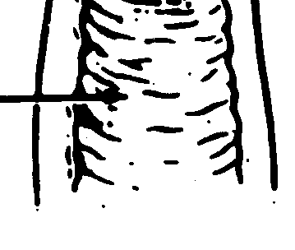
Female Reproductive Organs
3. & 13. Vagina:
The passageway leading from the female’s external genital organs to the uterus. During birth, it is referred to as the birthing canal.

Slide 7
Female Reproductive Organs
4. & 6. Fallopian tube:
The “oviduct.” This is a passageway to transport the egg from the ovary to the uterus.

Slide 8
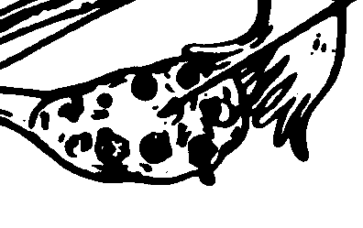
Female Reproductive Organs
5. & 7. Ovary:
Two almond shaped organs which produce the female egg.

Slide 9
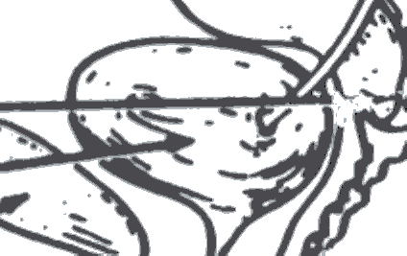
Female Reproductive Organs
10. Urinary Bladder:
Location urine is stored until it exits the body.

Slide 10
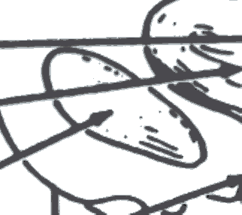
Female Reproductive Organs
11. Pubic Bone

Slide 11
Female Reproductive Organs
12. Urethra:
One of the three outside openings to the women’s body.

Slide 12
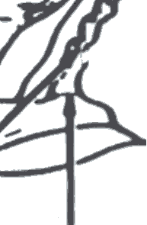
Female Reproductive Organs
14. Vaginal Opening:
One of the three outside openings to the women’s body.

Slide 13
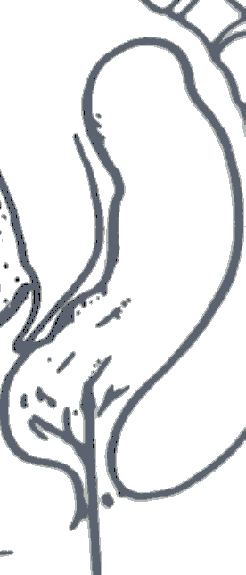
Female Reproductive Organs
15. Rectum:
One of the three outside openings to the women’s body.

Slide 14
Female Reproductive Organs
Menstruation

Slide 15
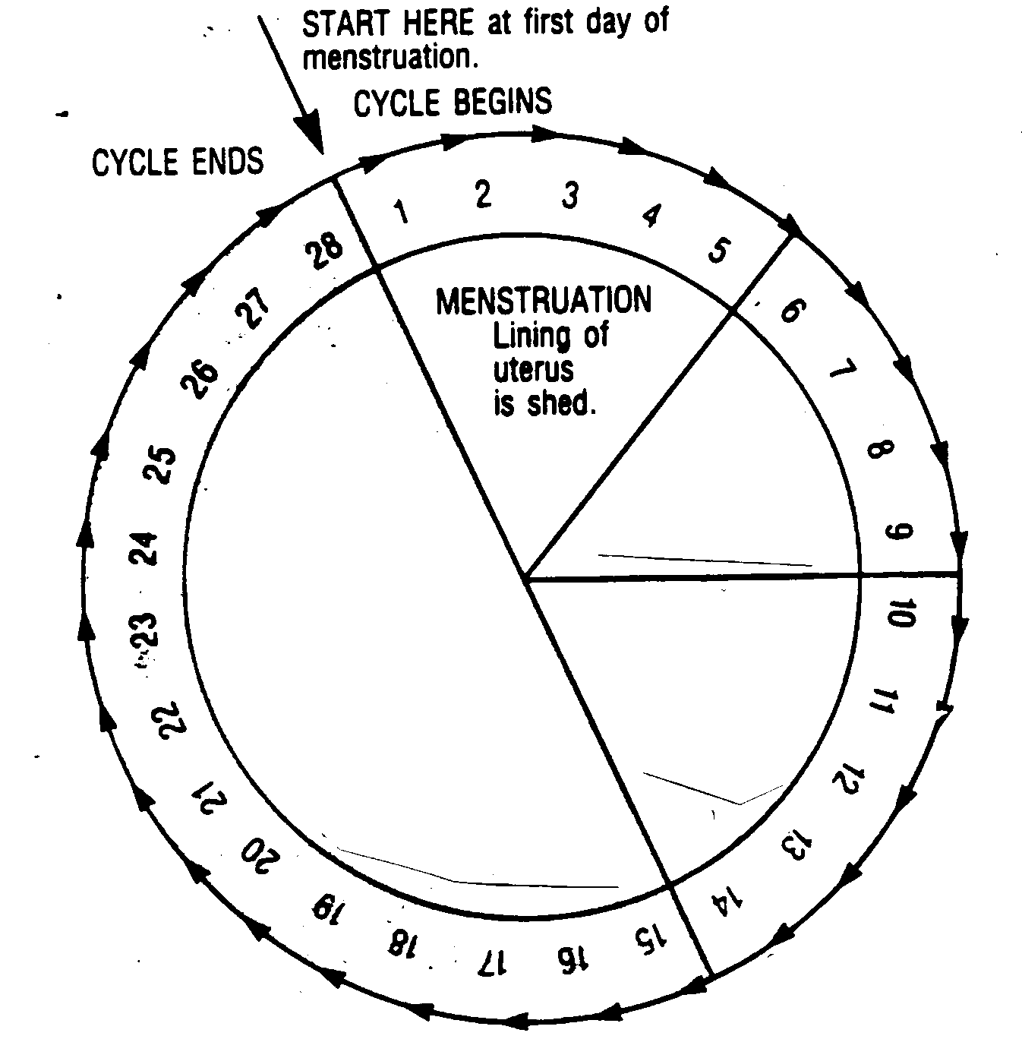
Phase One

Slide 16
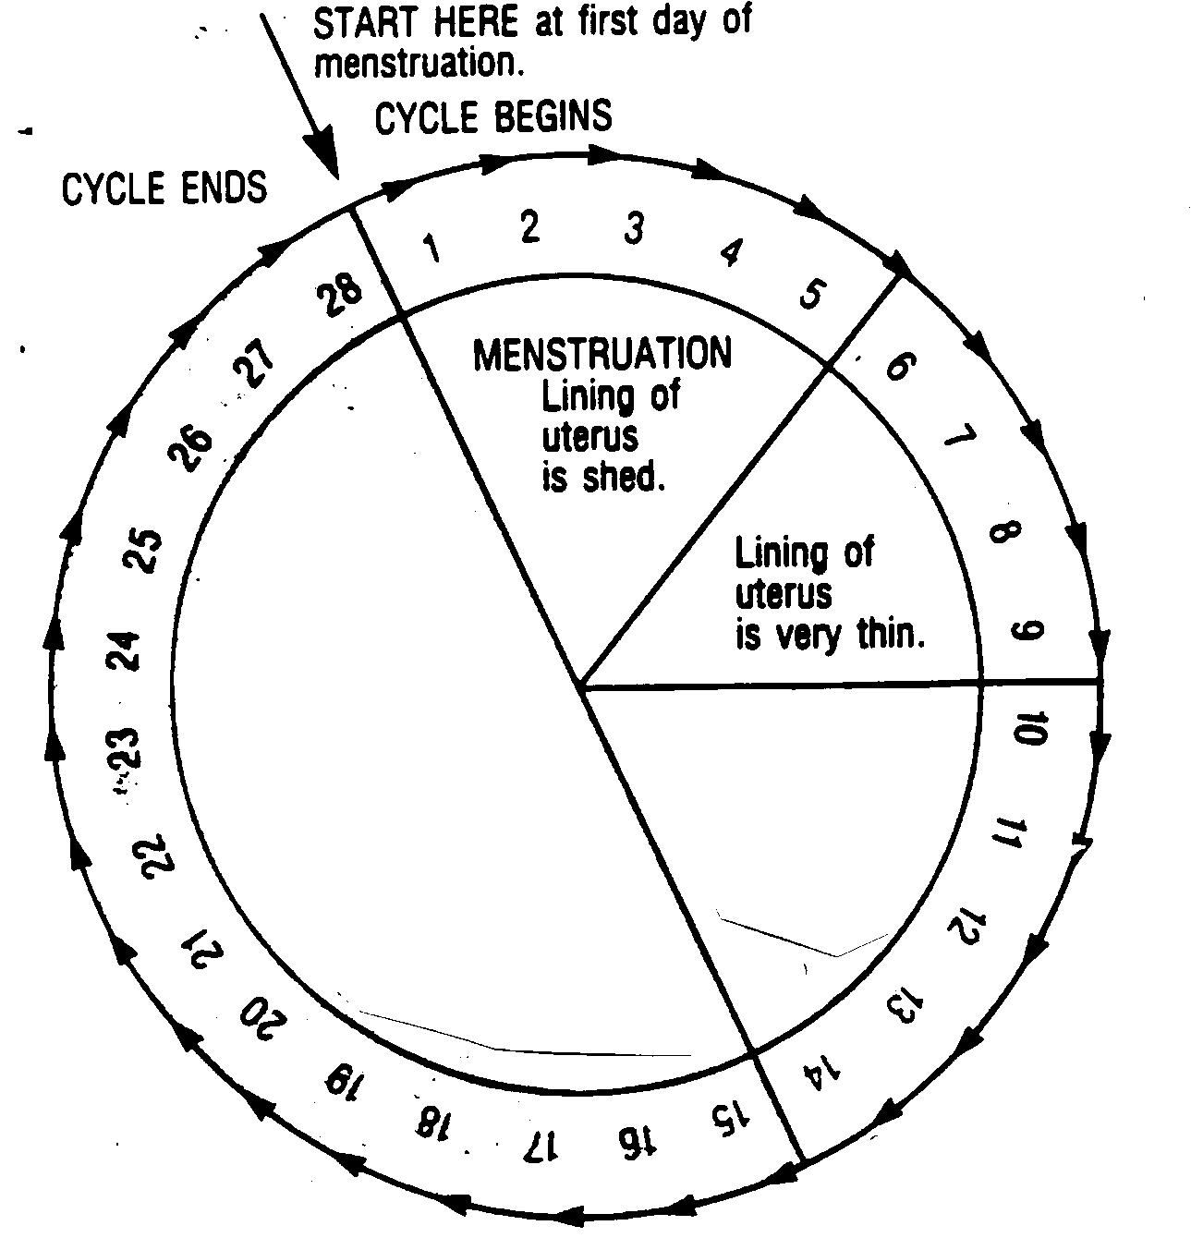
Phase Two

Slide 17
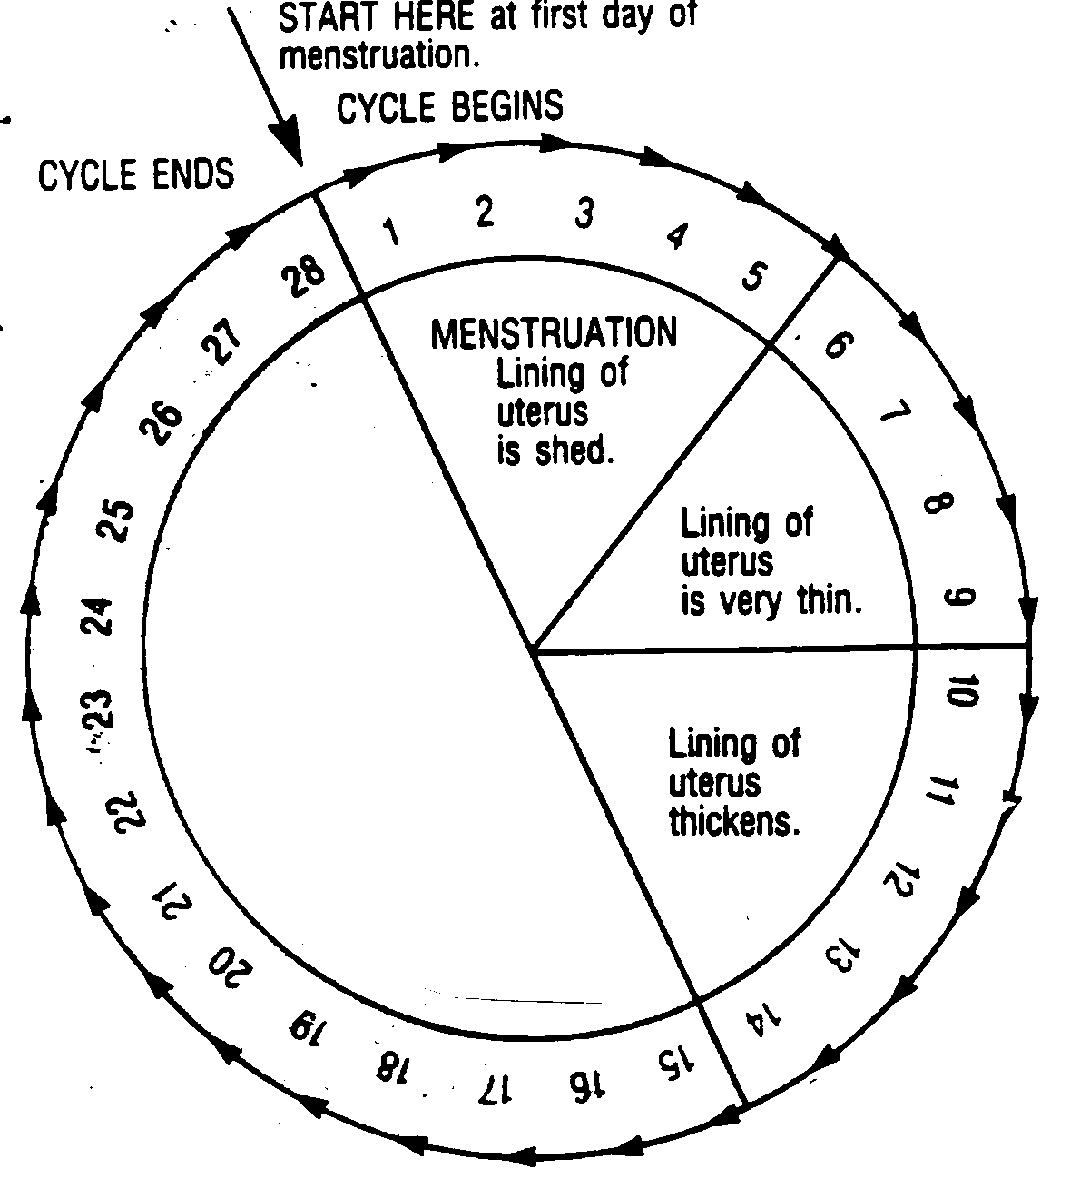
Phase Three

Slide 18
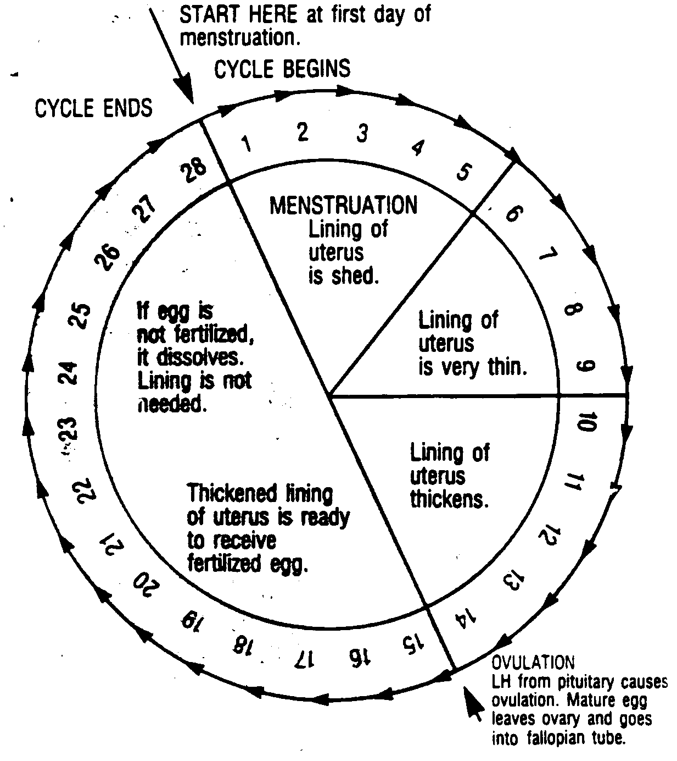
Phase Four

Slide 19
Video time!!
Life’s Greatest Miracle
Take notes as you view the video.
Yes you will get to see a birth at the end

Slide 20
Vocabulary
Vas Deferens-passageway carrying sperm from the epidiymus to the seminal vesicles.
Fallopian Tubes- a passage way to transport egg form the ovary to the uterus.
Scrotom-sac around the testicles. A muscular tissue that holds the testes to suspend them away from the body.
Uterus- organ that provides protection and nutrients and houses the unborn child.

Slide 21
Vocabulary
Vagina- passageway leading from the female’s external genital organs to the uterus.
Semen- mixture of sperm cells and gland secretions.
Cervix- opening in the uterus that leads to the vagina. Holds baby in the womb. Must dilate for birth to occur.
Cowper’s Gland- two small glands that secrete a clear sticky fluid to help neutralize the acidity of the urethra.

Slide 22
Vocabulary
Ovary- two almond shaped organs that produce the female egg cell.
Urinary Bladder membranous sac for temporary retention of urine
Epididymus coiled tube in which sperm complete maturation; stores sperm

Slide 23
Vocabulary
Pubic Bone-The forward portion of either of the hipbones, at the juncture forming the front arch of the pelvis
Genitals-sex organs, (male or female)
Penis- organ of transfer (sperm or semen) containing the urethra. Male external reproductive organ.
Menstruation Cycle- a recurring cycle (beginning at menarche and ending at menopause) in which the endometrial lining of the uterus prepares for pregnancy; if pregnancy does not occur the lining is shed at menstruation; "the average menstrual cycle is 28 days"
Prostate Gland- gland located beneath the bladder. Produces fluid to mix with the semen. It is a sticky fluid that helps neutralize the acidity of the urethra.
Sperm- male reproductive cell
Testosterone sex hormone produced by the testicles from the start of puberty; responsible for normal growth and development of the male sex and reproductive organs
Seminal Vesicles- where a sticky, sugary fluid to nourish the sperm is produced. This fluid provides 60% of the semen.
Testes- organ that produces sperm.

Slide 24
Menstruation Cycle- a recurring cycle (beginning at menarche and ending at menopause) in which the endometrial lining of the uterus prepares for pregnancy; if pregnancy does not occur the lining is shed at menstruation; "the average menstrual cycle is 28 days"
Prostate Gland- gland located beneath the bladder. Produces fluid to mix with the semen. It is a sticky fluid that helps neutralize the acidity of the urethra.
Sperm- male reproductive cell

Slide 25
Testosterone sex hormone produced by the testicles from the start of puberty; responsible for normal growth and development of the male sex and reproductive organs
Seminal Vesicles- where a sticky, sugary fluid to nourish the sperm is produced. This fluid provides 60% of the semen.
Testes- organ that produces sperm

Slide 26
Unit 4, Reflection #2
Will, when and how will you teach your future children about sexuality?

