Slide 1
Bell Work
What is the APGAR Score?
When is it taken?

Slide 2
Child Development
Book Reviews
Reality Baby
Susana P.
Lu G.
NEXT TIME- Friday
Sierra M.
Kaitlyn C.
Ahlai
Zack
Lu
Jordan
Shante

Slide 3
Reality Baby ~ Tuesday-Thursday
Charice
Shavelle
McKenzie
Dakota
Trystin
I will not be here on Tuesday, so you will be responsible to take Baby. I will have them all set up for you.

Slide 4
APGAR Score
http://www.babycenter.com/2_newborn-apgar-test_10300050.bc

Slide 5
Neonatal Development
Mrs. Christensen

Slide 6
Vocabulary
Neonatal: Newborns are often referred to as neonates because
Neo= New
Natal = Birth
The neonate is no longer dependent on its mother for survival.

Slide 7
The Moment of Birth
Pressure during the birth process forces the amniotic fluid out of the baby’s lungs. Once they are out the pressure is released and the lungs expand allowing baby to take her first breath.
A special valve in the heart closes and soon will become permanently sealed.
Well developed sense of taste
Blotchy skin – usually born with red or pink skin (No matter their race)

Slide 8
The Moment of Birth
Lanugo may still be present
Milia are tiny white bumps that look like tiny whiteheads on the neonate.
Caused from vernix clogging the pores in the skin.
The neonates appearance will change dramatically over the first few hours of life

Slide 9
Bill Cosby Video
http://www.youtube.com/watch?v=BYR9xX6DvpM&feature=related (Part 1)
http://www.youtube.com/watch?v=mOP52g_rO24&feature=related (Part 2)

Slide 10
Neonates~ The first moments of life
Do neonates really look like the pictures shown?
What do they really look like?

Slide 11
Neonates

Slide 12
Neonates

Slide 13
Neonates

Slide 14
Neonates

Slide 15
Neonates

Slide 16
Neonates

Slide 17
Neonates

Slide 18
Neonates

Slide 19
Neonates

Slide 20
Neonates

Slide 21
Neonates

Slide 22
So, What SHOULD the baby look like??

Slide 23
Size
7.5 lbs and 19 “ long
Thin, wrinkly and splotchy

Slide 24
Head to Body Proportion *Large Head – ¼ body size! *Rounded Chest and protruding stomach *Short legs compared to arms *Pelvis and hips are narrow *Legs pulled up and bowed out *Short Neck
Body Proportions

Slide 25
Facial Features
Eyes- grayish blue or dark, swollen, red splotches on white of eye, may be cross eyed.
Mouth- tiny jaw and chin, puffy cheeks, short tongue, dry lips
Nose- Short, flat
Skin- blotchy, pink, dry and peeling, vernix, lanugo, loose and wrinkly, loose scalp.

Slide 26
Infant Reflexes
http://newborns.sta nford.edu/PhotoGallery/RootingReflex1.html
http://newborns.stanford.edu/PhotoGallery/SuckingReflex1.html
http://newborns.stanford.edu/PhotoGallery/ProtectiveReflex1.html
http://newborns.stanford.edu/PhotoGallery/MoroReflex2.html
http://newborns.stanford.edu/PhotoGallery/FootGraspReflex1.html
http://newborns.stanford.edu/PhotoGallery/StepReflex1.html
http://newborns.stanford.edu/PhotoGallery/Jittery1.html
Fill out notes for each reflex on page 7-8 while we view each reflex.

Slide 27
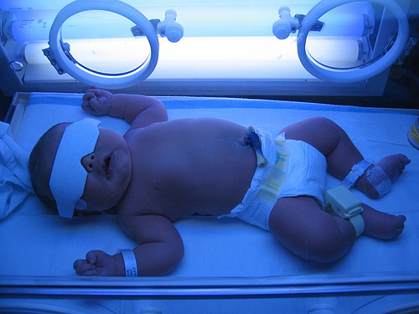
Jaundice
Yellow coloring due to liver not yet working properly.
Baby will be put under “bilirubin” lights until symptoms clear up, typically blood test is done to show improvement

Slide 28
Milia
Tiny, white, hard spots that look like pimples on a newborn's nose

Slide 29
Sucking Blister
Blister in center of top lip from baby sucking it’s thumb while inutero

Slide 30
Cradle Cap
Dry, flaky, crusty scalp

Slide 31
Umbilical Cord
Cord that connects the baby to the mother ~ no longer needed after birth!

Slide 32
Physical Development
Swollen Genitals
Fontanels
Soft Spot – open space in baby’s skull
Due to large amounts of mother’s hormones

Slide 33
Marks
Birth Marks, Angels Kiss, Stork Bite, Mongolian Spot
Pink spots where blood vessels broke- usually go away with time
http://newborns.stanford.edu/PhotoGallery/Lanugo1.html

Slide 34
Bones and Teeth
Teeth usually not seen yet.
Bones are still rubber like and can bend easily.

Slide 35
Reflection #10
Describe how to safely handle a baby.
REMEMBER!!!
Pregnancy Brochure is due FRIDAY!

Slide 36
Shaking Baby Syndrome
View « The Period of Purple Crying »
Fill out your noteguide as you watch the video.

