Slide 1
Neonate Voc.

Slide 2
Vernix

Slide 3
Languo

Slide 5
Milia

Slide 7
Angel Kiss

Slide 8
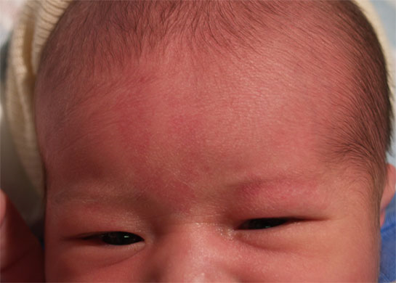
Angel Kiss Cont

Slide 9
Angel Kiss cont.

Slide 10
Stork Bite

Slide 12
Sucking Blister

Slide 13
Cradle Cap

Slide 14
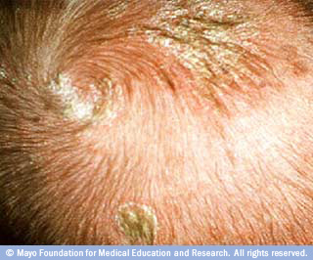

Slide 15
Fontanels
Fontanels are soft spots found on your newborn's skull; they are the patches where skull bones have not yet met. Fontanels are squishy to touch and seem very vulnerable. In fact, they are made up of a fibrous membrane that protects your baby's brain. There are six fontanels on your newborn's skull, but only two are evident. The larger, diamond shaped fontanel is on the top front of the head while the smaller fontanel is placed at the base of the skull.
What's the Purpose of a Fontanel? While they seem to make your newborn more vulnerable, fontanels actually make your child's head more sturdy. Without fontanels, your baby's head wouldn't be able to deal with the pressure of passing down the vaginal canal. Otherwise, women's hips would have to be larger or babies would have to be born with smaller brains. In other words, fontanels allow for larger brain capacity.
The Changing Fontanels Don't be alarmed if you notice that the fontanels on your baby's head change in size. Smaller fontanels tend to get larger, while larger ones often shrink. The fontanels usually close by the time your baby hits 18 months, but as early as 9 to 12 months is perfectly normal. You'll notice that the fontanels close right before your baby starts learning to walk.

Slide 17
You'll notice two soft areas at the top of your baby's head where the skull bones haven't yet grown together. These spots, called fontanels, are designed to allow a baby's relatively large head to move down the narrow birth canal. They also accommodate a baby's rapidly growing brain. You may notice slight bulging from these spots when your baby cries or strains.
Soft spots are covered by a thick fibrous layer. They're safe to touch and typically close within 12 to 18 months, when the skull bones fuse together.

Slide 18
Jaundice

Slide 20
Clostrum spit up

Slide 21
Reflexes
newborns.stanford.edu/PhotoGallery/RootingReflex1.html

Slide 22
Bathing
Bathe your baby in a warm room
Have baby supplies ready
Always test the water before you place the baby in the tub.
Wash baby’s face first Use different parts of the washcloth for each eye
To avoid heat loss wash the baby’s hair last
To help keep your baby warm after a bath cover her head with a dry towel.

Slide 23
Diapering
Be Ready
Be Safe
Clean Well
Girls-wipe genitals from front to back
Boys-Clean under the scrotum
POWDER????

