Slide 1
All About Me Collage
Time to finish (20 Minutes)
Guess who’s is whose?

Slide 2

Nurturing and Bonding

Slide 3
Nurturing and Bonding
Nature (Heredity)
  Individual heredity and genetics. These explain who the person is and why they do what they do.
  Children are born with certain personalities and abilities that contribute to their social, mental and physical development.

Slide 4
Time for a Brain Quiz
As scientists learn more about how the human brain develops, many of our old ideas about the brain are being challenged. Let’s take
this Brain Quiz to find out more.
Answer TRUE or FALSE

Slide 5
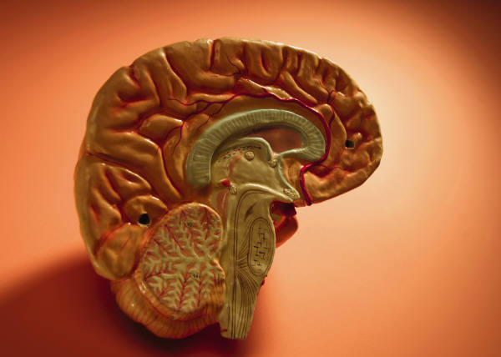
Brain Quiz
1. At birth the brain is fully developed, just like one’s heart or stomach.
2. The brain’s development depends entirely on the genes you are born with.
3. A toddler’s brain is less active than the brain of a college student.

Slide 6
Brain Quiz
4. Talking to a baby is not important because
he can’t understand what you are saying.
5. Children need special help and specific,
educational toys to develop their brainpower

Slide 7
Brain Quiz Results…
The answer to all of these statements is
FALSE. These are all myths!!!
While there are a number of factors that influence
early brain development, today we will focus on
love and nurturing.
As recently as 15 years ago, some scientists
thought the brain was genetically determined at
birth and brain growth only followed a biologically,
predetermined path. Now we know that early
experiences impact the development of the brain
and influence the specific way in which the circuits
of the brain become “wired.”

Slide 8
Baby Brain Development
A baby’s brain is a work in progress. Its development is shaped by the outside world that is absorbed through the senses—vision, hearing,
smell, touch, and taste.

Slide 9
For example:
1. The smell of the mother’s skin (smell)
2. The father’s voice (hearing)
3. Seeing a face or a brightly colored toy
(vision)
4. The feel of a hand gently caressing (touch)
5. Drinking milk (taste)
Experiences taken in by the five senses help build the connections that guide brain development. Early experiences have a decisive impact on the architecture of the brain.

Slide 10
Like a blank piece paper…
Take out the blank piece of paper you received at the door.
Fold it into fourths
In the top left corner, list 10 phrases or ideas you remember people saying about you when you were young.

Slide 11
Like a blank piece paper…
In the right corner, write how these phrases have influenced your life.

Slide 12
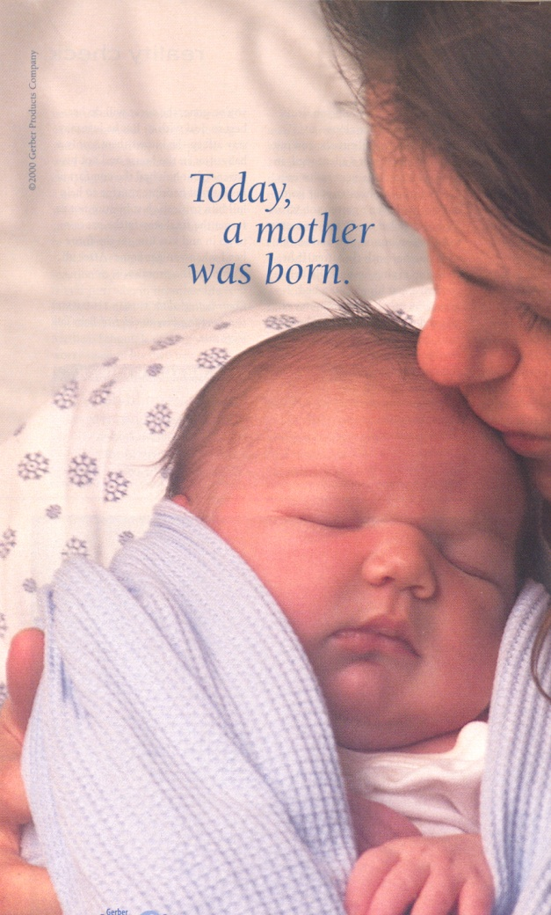
Nurture:
Promoting a child’s development by providing nourishment, support, encouragement and unconditional love throughout the life span.

Slide 13
Nurture
How a child is treated affects how they think, act, feel, and react.
Affects their ability to talk with and get along with others.
Can Process and develop information.

Slide 14
Nurture
Stable with who they are.
Trust/Feel Safe
Age appropriate physical skills. (Physically healthy)
Bodily functions work.

Slide 15
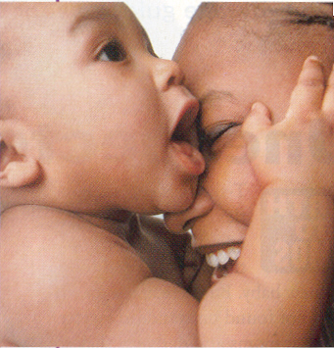
Bonding:
The formation of close emotional ties. (Extremely important to the social and emotional well-being of the child)

Slide 16
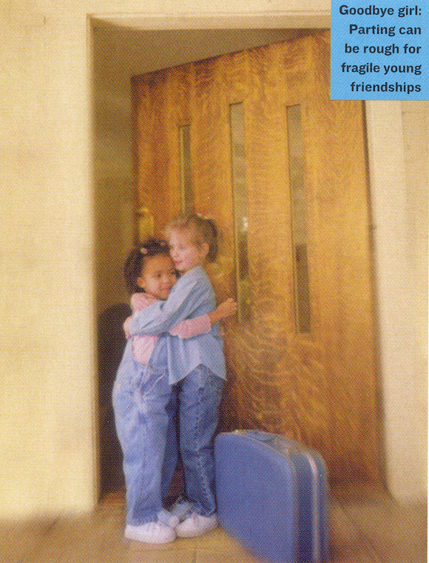
Attachments
Trust

Slide 17
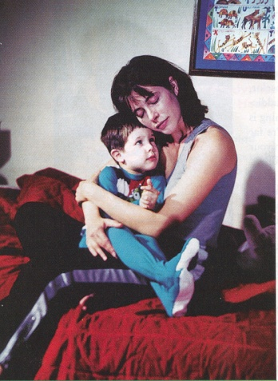
Nurturing/Bonding/Attaching
When do these take place in a child’s development?
Why are they considered to be so important?

Slide 18
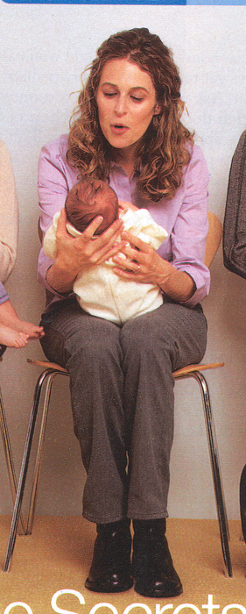
Bonding with an Infant
1. With long, loving looks. (Look into baby’s eyes during feedings, while holding or any other time!

Slide 19
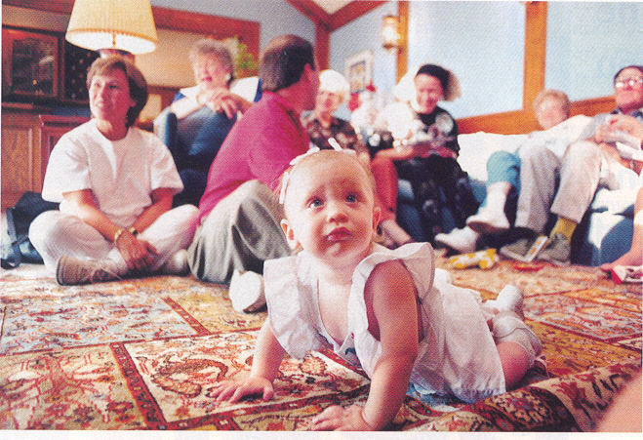
Nurturing/Bonding/Attaching
Four main benefits (and there are many, many more!)
1. Increases brain connections
2. Raises IQ
3. Produces more security in child
4. Strengthens health and immunity

Slide 20
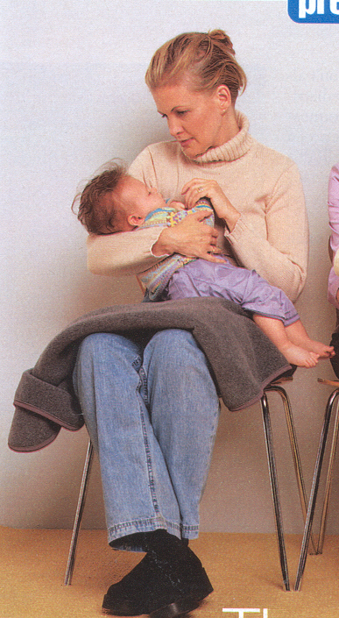
How to Bond with an Infant
2. Loving touches. Handle and touch in calm, gentle ways. (Infants can easily sense anger, nervousness and bad moods). Touch is extremely healing.

Slide 21
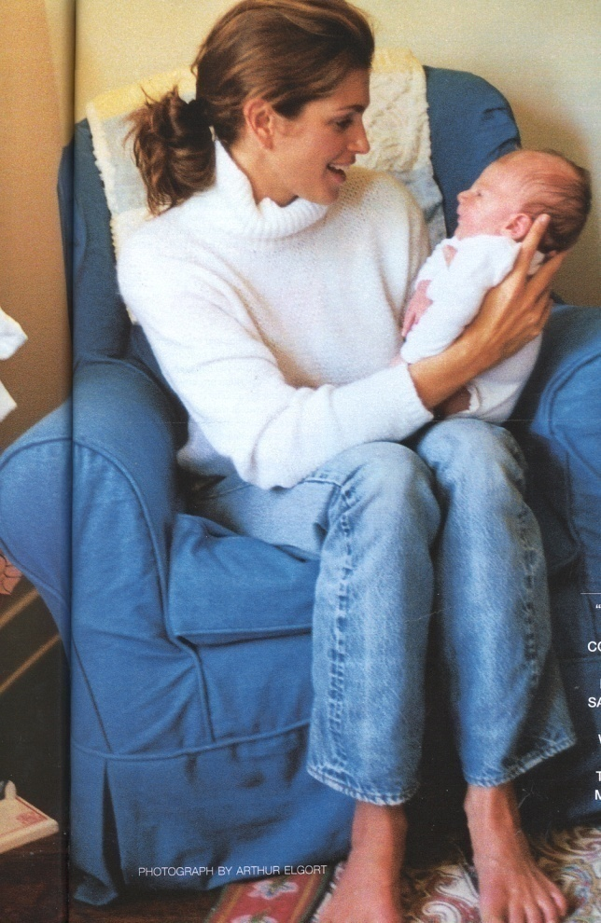
How to Bond with an Infant
Animated face and voice. Respond to their sounds, laugh with them, communicate with eyes and voice.

Slide 22
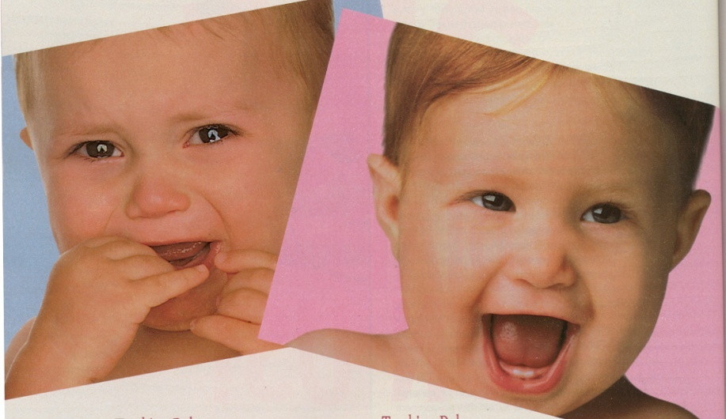
Basic Rules to Remember at Any Age to Continue Nurturing and Bonding
1. Consistency: A child needs to know what to expect. Inconsistency causes confusion to the child. How? Make sure you consistently respond to needs such as hunger.

Slide 23
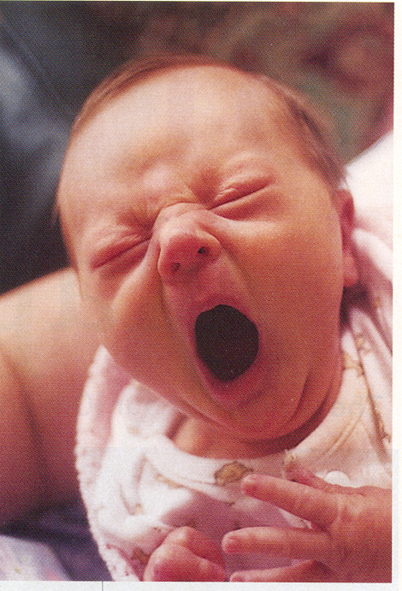
Bonding/Nurturing Rules
2. Responsiveness: Pay attention to them!!! Repeat back to them the sounds they make! If fussy or bored, play with them!

Slide 24
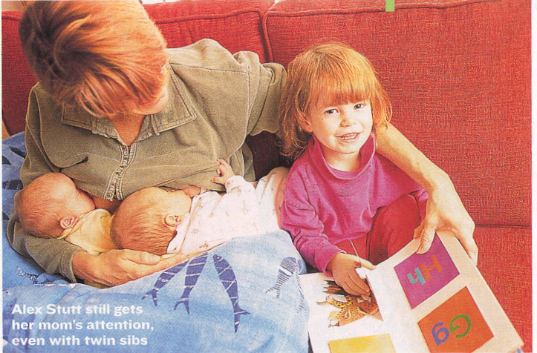
Bonding/Nurturing Rules
3. Sensitivity: Look at things from their point of view. Don’t force but gently lead with love. Try to understand their frustrations.

Slide 25
The Power of Touch
Research shows that people need at least 10 positive touches a day!
Group work:
  3-5 per group
  I will assign your group an age group.
  Come up with a list of 10 positive touches for your assigned group. (Non-sexual)
  Present your list to class

Slide 26
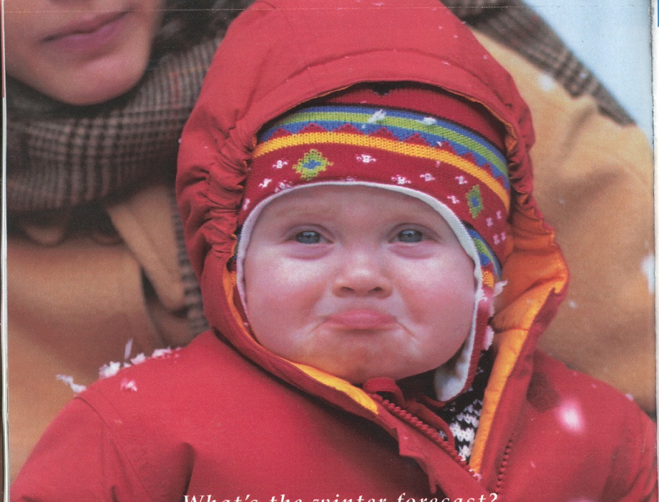
The Power of Touch
(Touch was the earliest form of healing)
Touch can lift depression. (It decreases stress hormones and improves sleep)

Slide 27

The Power of Touch
Increases immune function.

Slide 28
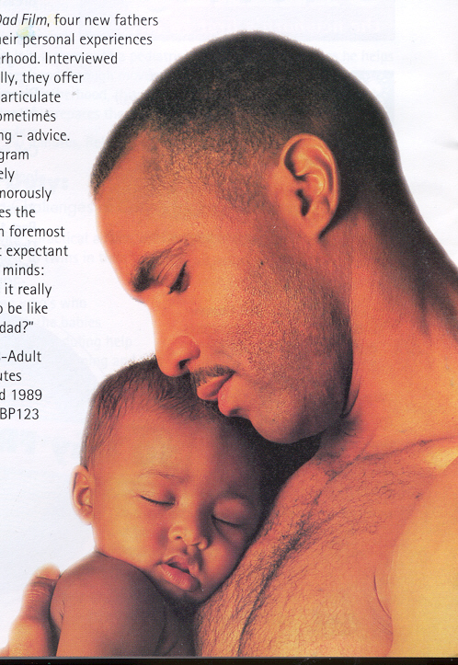
The Power of Touch
Reduces stress.

Slide 29
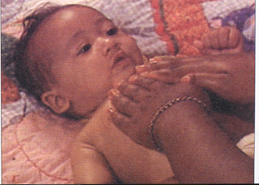
The Power of Touch
Premature infants show remarkable improvement when touched through openings in incubator over those who were not touched for fear of germs or disease.

Slide 30
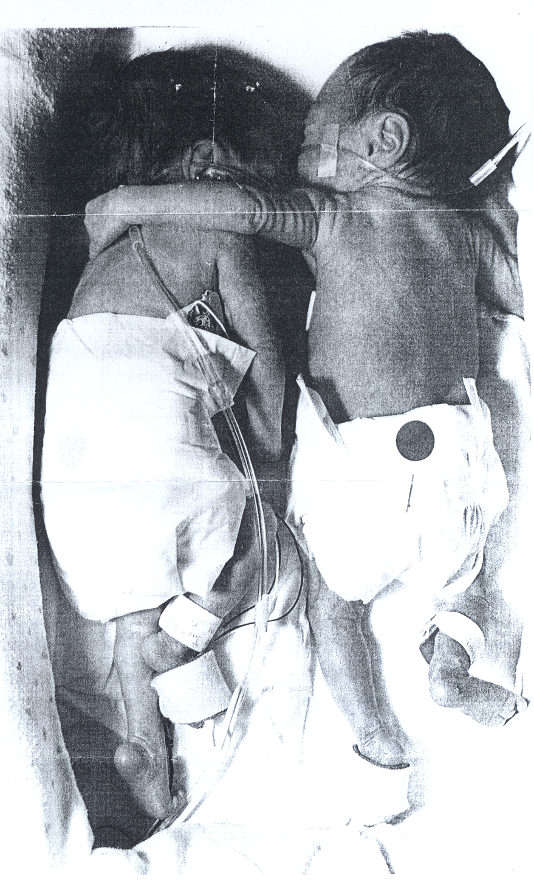

Slide 31
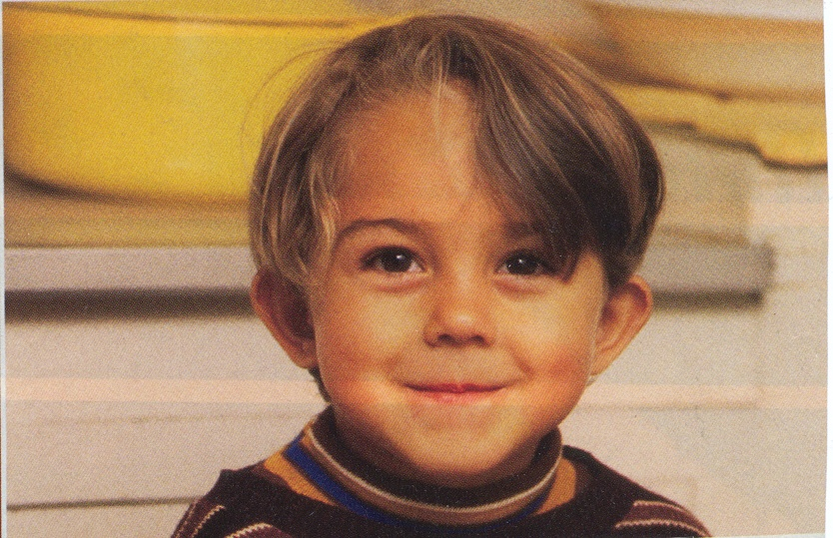
The Power of Touch
Autistic children (who often show an aversion to touch) showed remarkable improvement in social relationships.

Slide 32
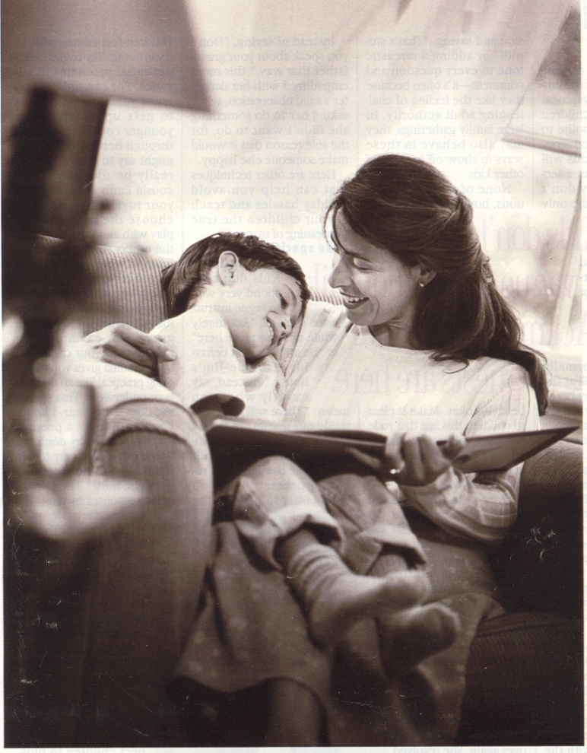
The Power of Touch
“Touch is a cheap and effective prescription for wellness.”

Slide 33
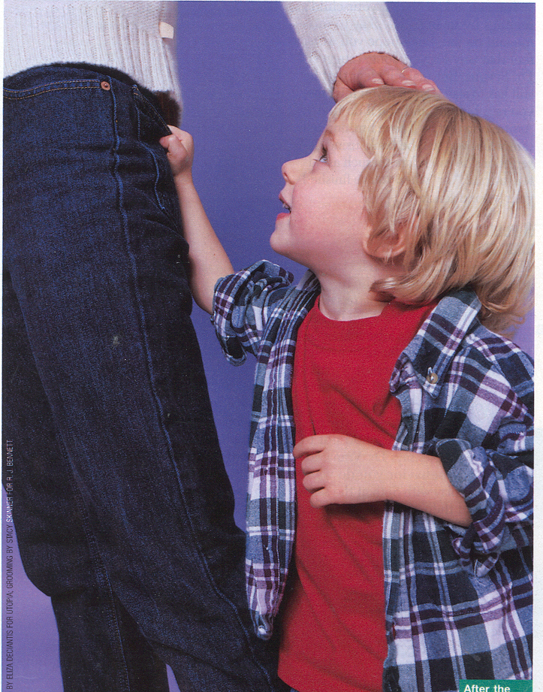
The Power of Touch
In spite of the healing benefits of touch, Americans touch their children 1/3 less than most foreign countries. Why?

Slide 34
Back to your blank paper
In the lower left corner, list 10 positive phrases you can use to nurture a child and make him/her feel loved.

Slide 35
Blank Paper
In the lower right corner, identify 10 actions you will take to nurture the children whom you will care for.

