Slide 1
Unit 4: Infant Physical Development
Children develop most rapidly during their first 3 years of life.

Slide 2
Laws of Growth and Development
Head (caudal) to Foot (cephalo)
    1st, Babies lift their head to see an object.
    2nd , they Use their arms and hands to pick up objects.
    3rd, they will move their body towards the object.
    4th they use their legs and feet to walk to the object
Near (proximal) to Far (distal)
  First the child moves their whole body towards the object, then the baby moves outward to their arms, their hands, and then their fingers.
  Waving “Hi” = First they learn to wave with arms, then wave with their hand and wrist, and then wave with fingers.
  Learning to eat follows the same Laws of Growth and Development.
Growth proceeds form simple to complex
  Basic actions of Sleeping, eating, pooping, peeing.
  Later they will learn more complicated tasks
    Babbling leads to talking
    Eating with fingers leads to using utensils
    First a child waves “Hi” and then they say it

Slide 3
1. Weight
A healthy baby gains 1-2 pounds per month during the first year.
They triple their birth weight in the first year.
The average weight of a 1 year old is 20-22 pounds

Slide 4
2. Height
The average height by one year of age is about 30 inches.
They increase their birth length by half.

Slide 5

Proportions
Compared to the rest of the baby’s body, their head and abdomen are larger than an adults.
And their legs and arms are short and small.

Slide 6
3. Teeth
At 6-7 months the primary or “baby” teeth begin to come in.
Common teething symptoms include:
  Cranky, restless, drooling, refusal to eat, desire for liquid
  Ear-ache, fever, runny nose, coughing
Although it is a normal process, teething can be uncomfortable for 2-10 days per tooth.
How can you help sooth the discomforts of teething?
  Teething biscuits or teething ring to bite on
  Something cold (ice cube, frozen teething ring) to numb it
  Teething medication can be rubbed on the gums

Slide 7
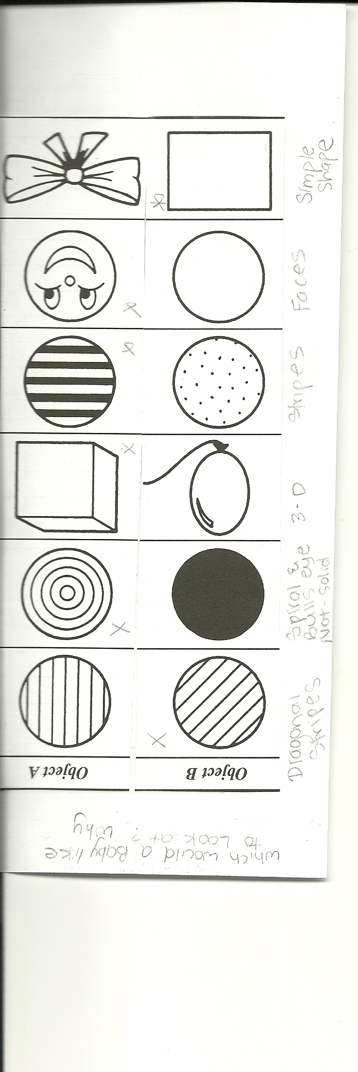
5. Sight
A slow moving mobile above the babies head will help develop the infant’s eye muscles.
They prefer looking at patterns that show contrast
and the color red. (alternating stripes, bulls eye, faces)
By the 3rd month they will prefer looking at real objects rather than flat pictures

Slide 8
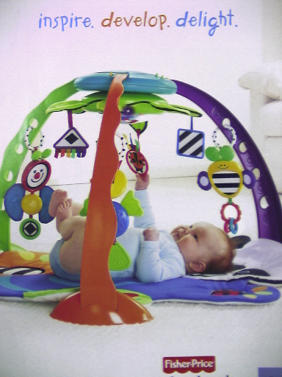
The ability to move their hands and fingers precisely to what is seen is called hand-eye coordination.
By 3-4 months babies begin to reach for objects that they see.

Slide 9
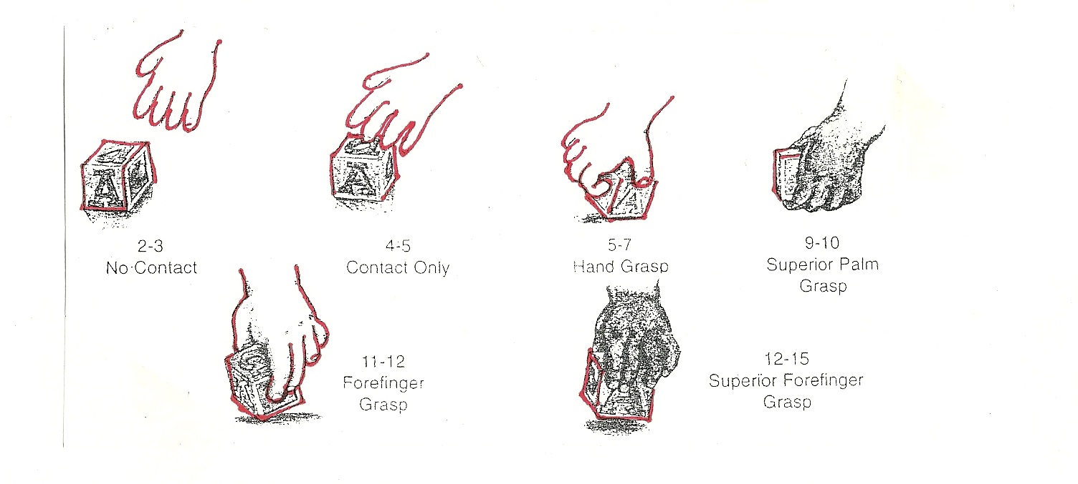
Simple to Complex

Slide 10
6. Hearing
Babies still respond to the tone / sound of your voice rather than the words that are said.
  An angry tone vs. a friendly or happy tone

Slide 11

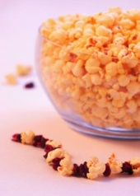



8. Motor Skills abilities = the use and control of muscles.
Large (Gross) motor skills are related to the large muscles of the body. (back, legs, shoulders, arms)
Give an example of some of these skills:
Small (Fine) motor skills are related to the small muscles. (wrists, hands, fingers, ankles)
Give an example of some of these skills:

Slide 12

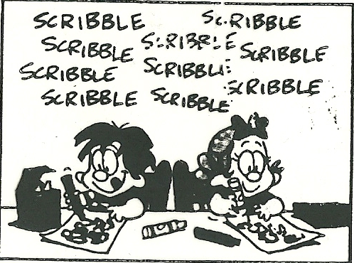
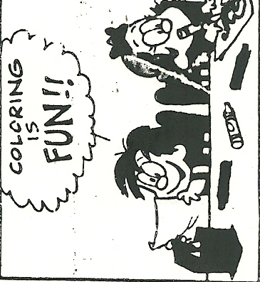
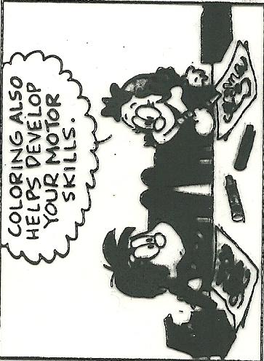
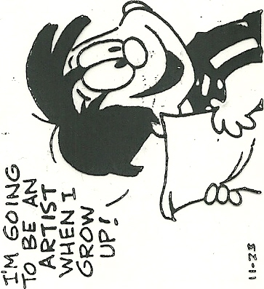

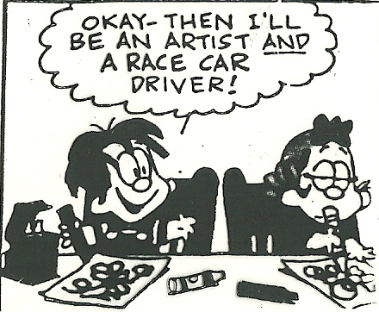

Slide 13

9. Physical Development Milestones
Arnold Gesell – Physical Development Theorist
lift heads while on their stomach,
roll front to back,
sit up,
crawl,
stand on own
walk
10. When handling, lifting, or moving a newborn, remember to support their head and neck.

Slide 14
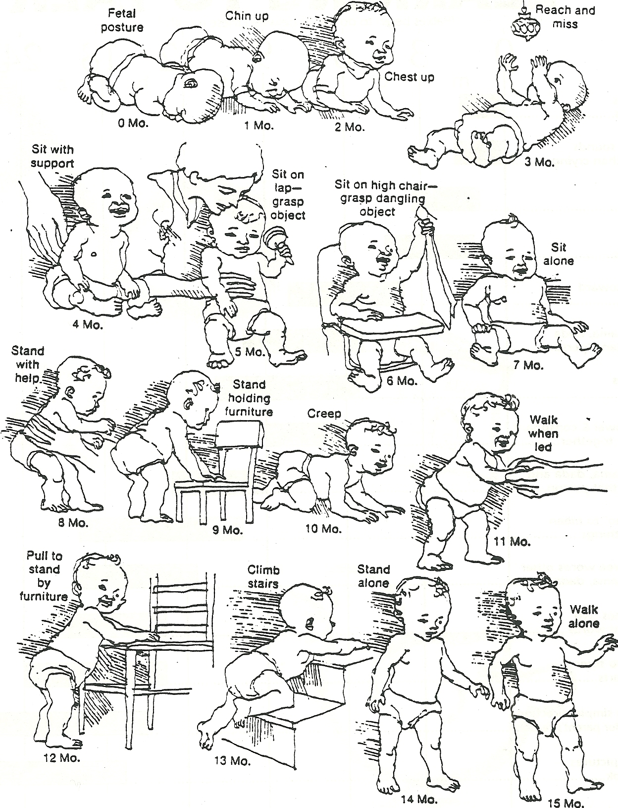

Slide 15
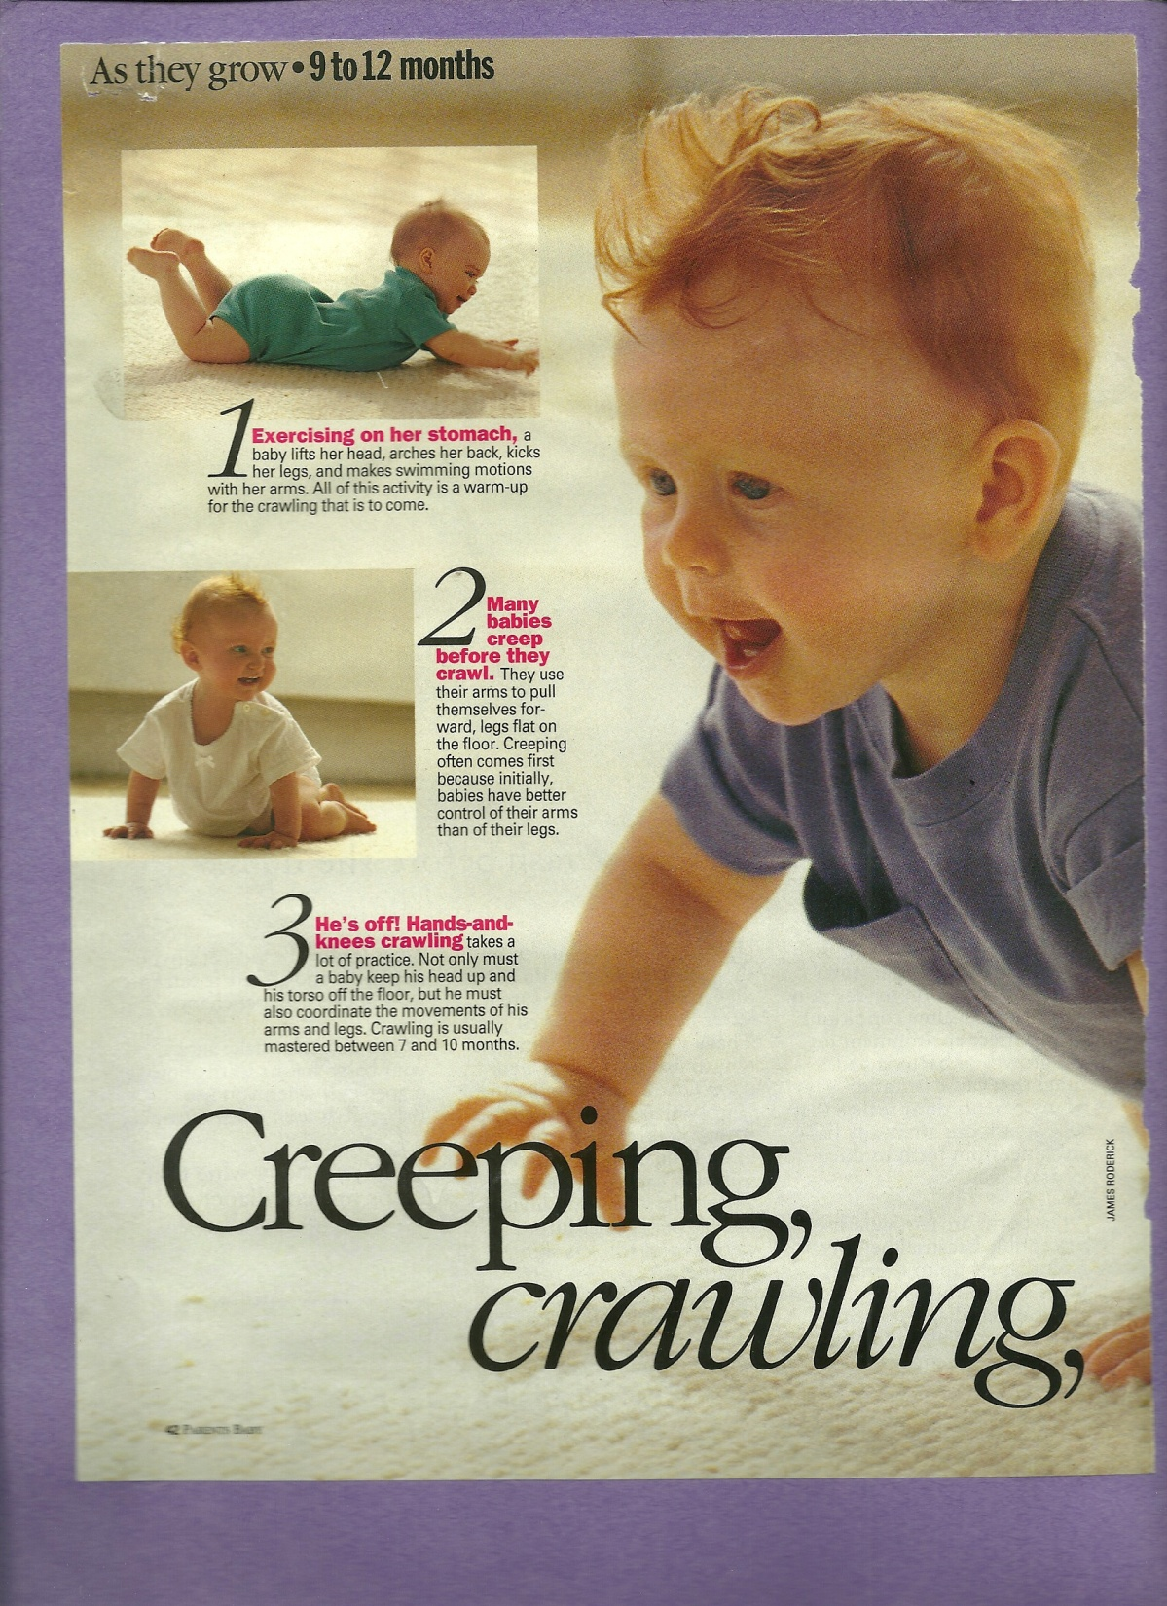
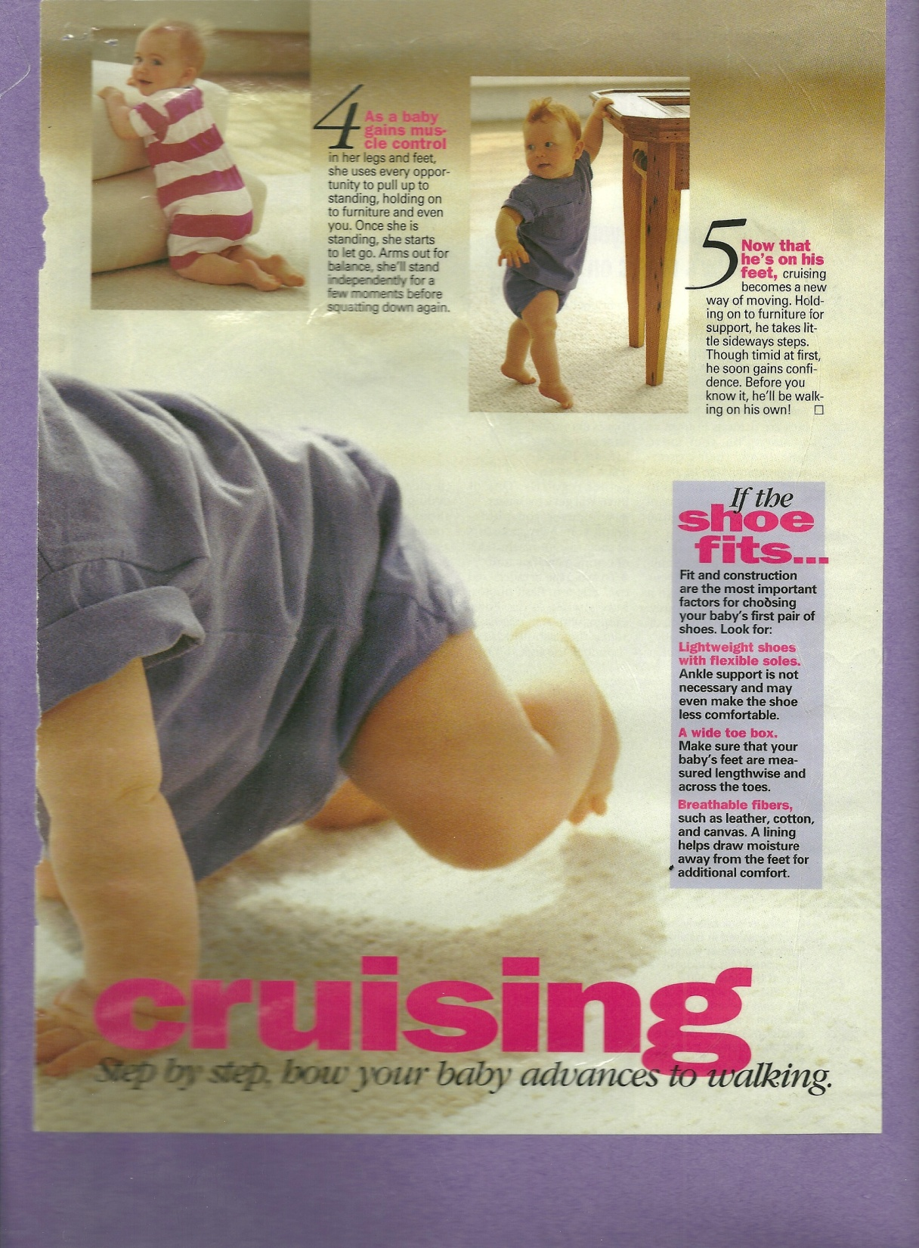

Slide 16
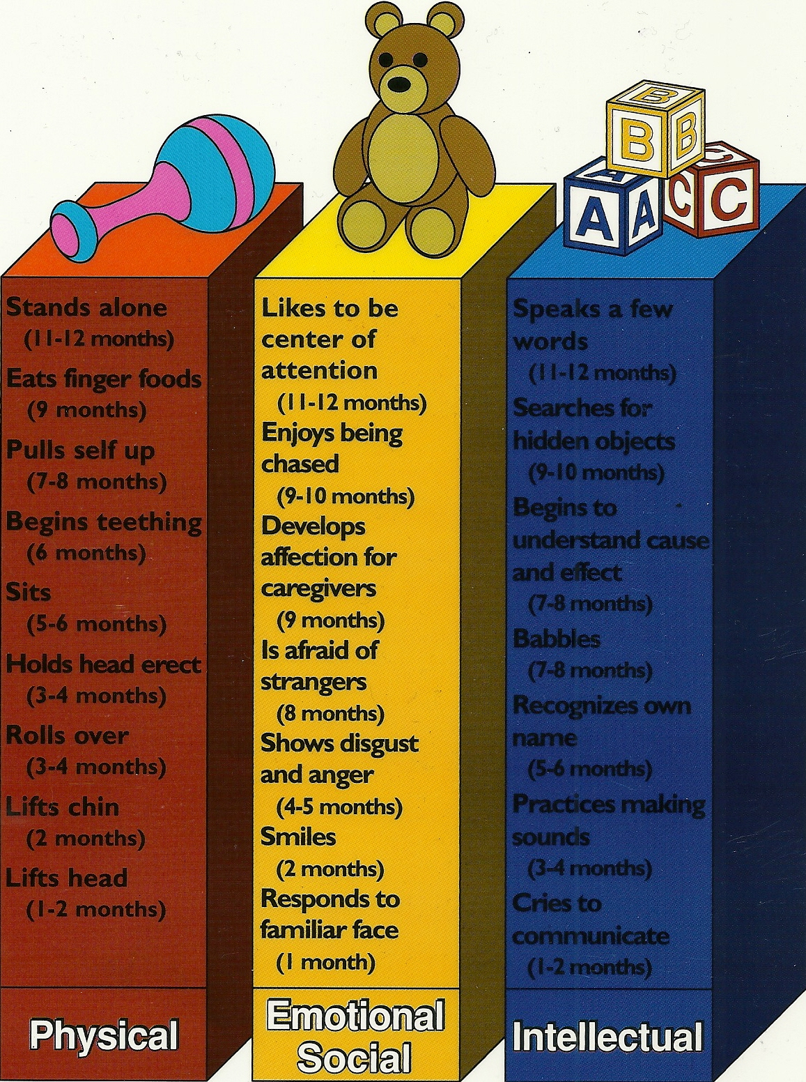

Slide 17
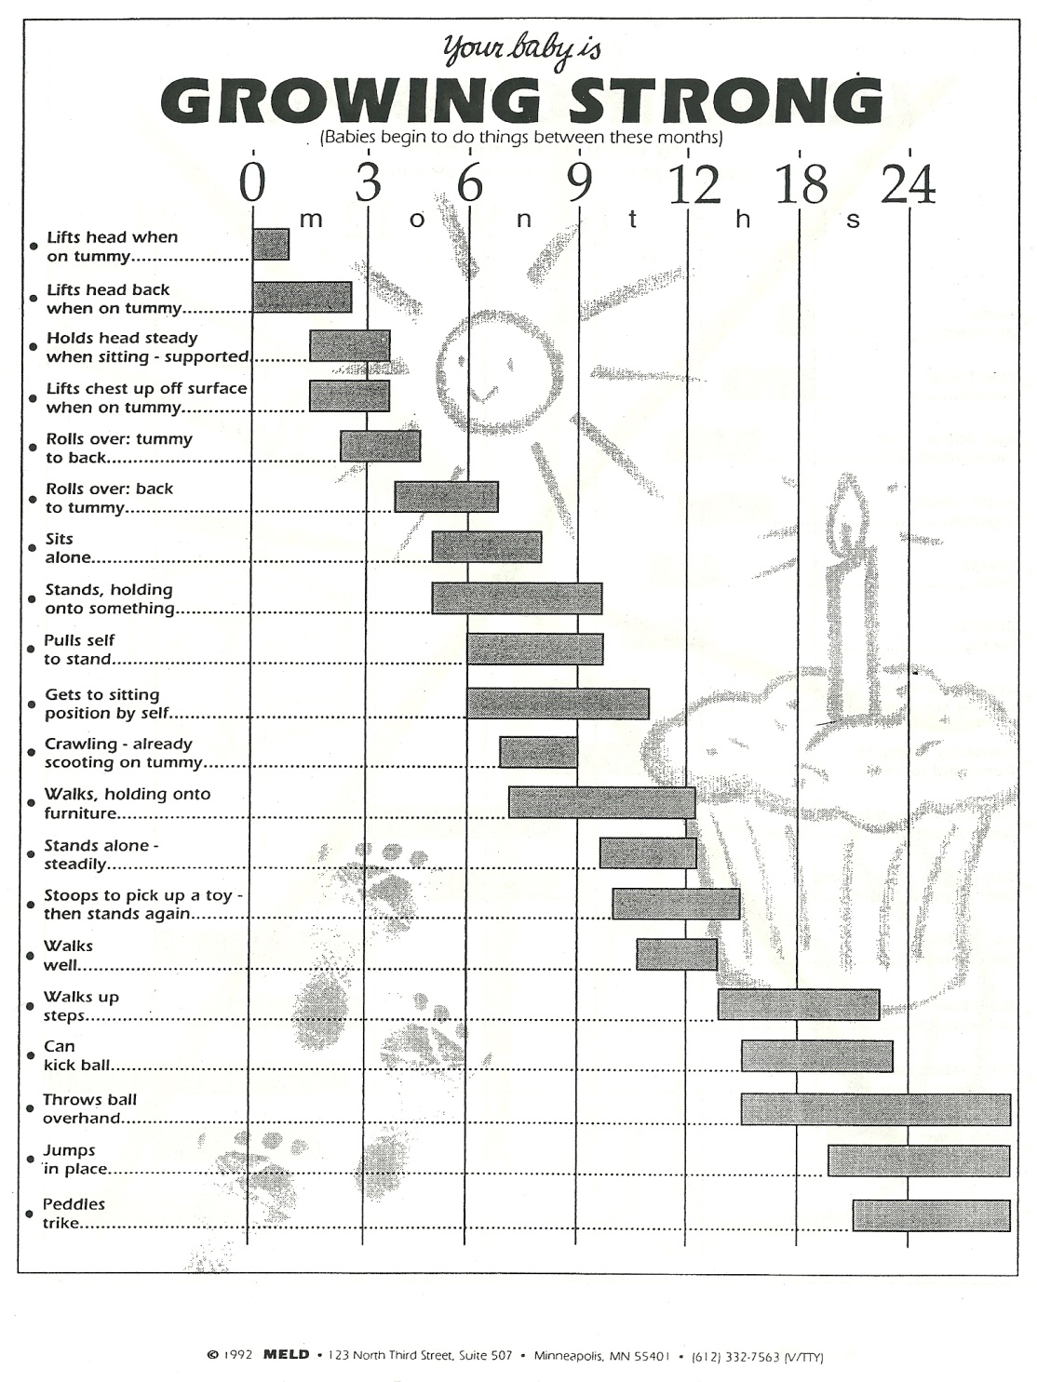
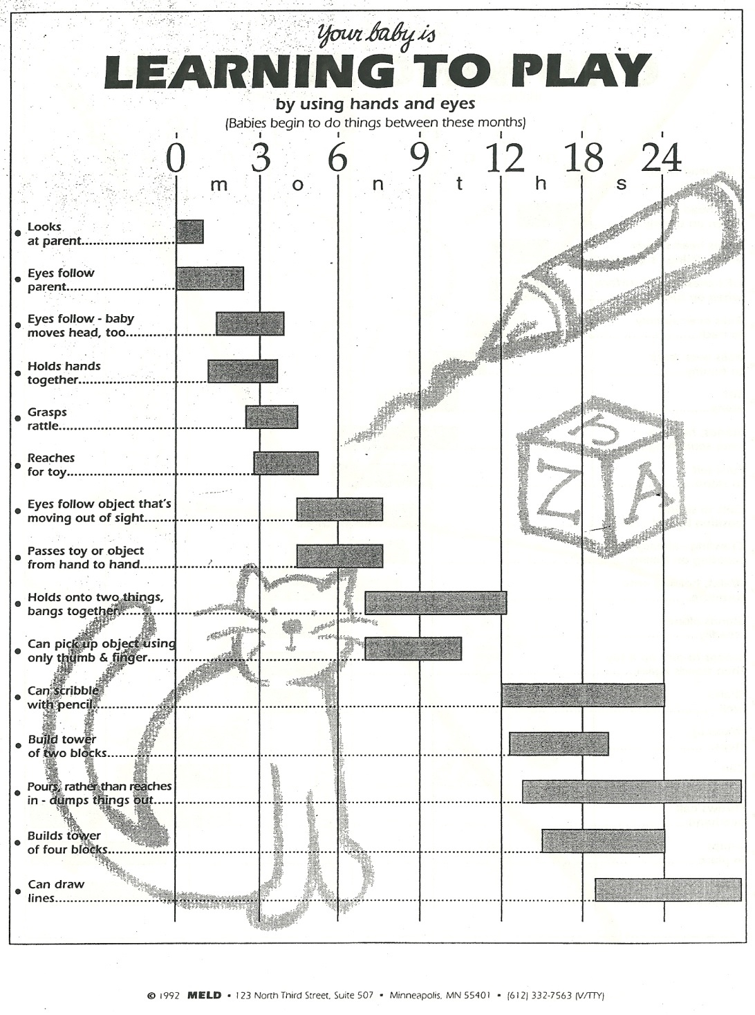

Slide 18
FEEDING IN THE FIRST YEAR
1. By the 2nd or 3rd month, a baby is eating every 3-4 hours.
  By about 12 pounds the baby can usually sleep through the night.
  If the baby cries, don’t immediately offer food.
    Tears don’t mean hunger and you don’t want them associating food with comfort.
      1 in 3 kids are likely to develop obesity related diabetes.
Pillowcase game

Slide 19
2. Bottle-feeding
To warm a bottle of formula or breast milk:
  Run the bottle under hot water until the milk is lukewarm.
  Set the bottle in a pot of water on the stove and heat to lukewarm
  Check the temperature by shaking a few drops onto your wrist.
Microwave heating creates dangerous hot spots in the liquid that will burn the baby. Never microwave the bottle.
Propping a bottle up in the baby’s mouth causes milk to gush into their mouth.
  They could develop ear infections, digestive problems, and tooth decay
  They miss out on the important physical contact and attention

Slide 20
3. Self- FEEDING IN THE FIRST YEAR
At 4-6 months of age the infant is able to digest solid foods and ready to begin eating these foods.
First foods you should introduce to a baby :
  cereal and breads
  vegetables (yellow than green)
  fruits
  protein (7 mths)- poultry before beef,
  dairy- (7 mths)yogurt, cottage cheese, egg yolks
    NOT cows milk
Introduce one new food at a time to be able to identify allergic reactions to food.

Slide 21
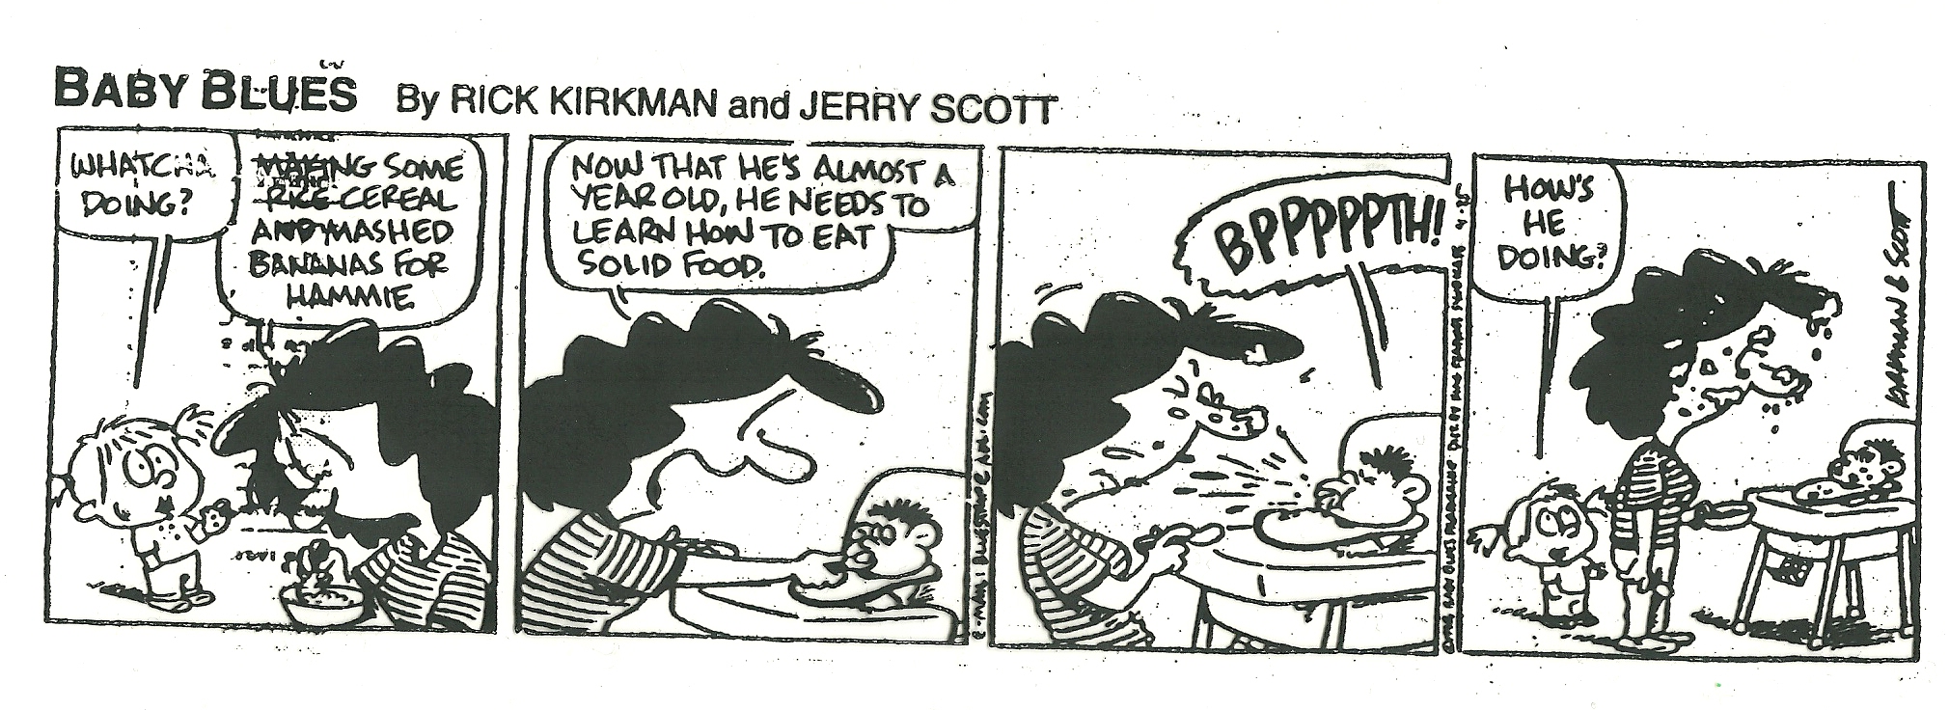

Slide 22

FEEDING IN THE FIRST YEAR
List 4 foods to avoid giving an infant:
  egg whites, citrus fruits, peanut butter, fish, honey, sugary juice and pop, sugary snacks, salty snacks
Wait until child is one years old to give cows milk, it is a high allergen and hard to digest.

Slide 23
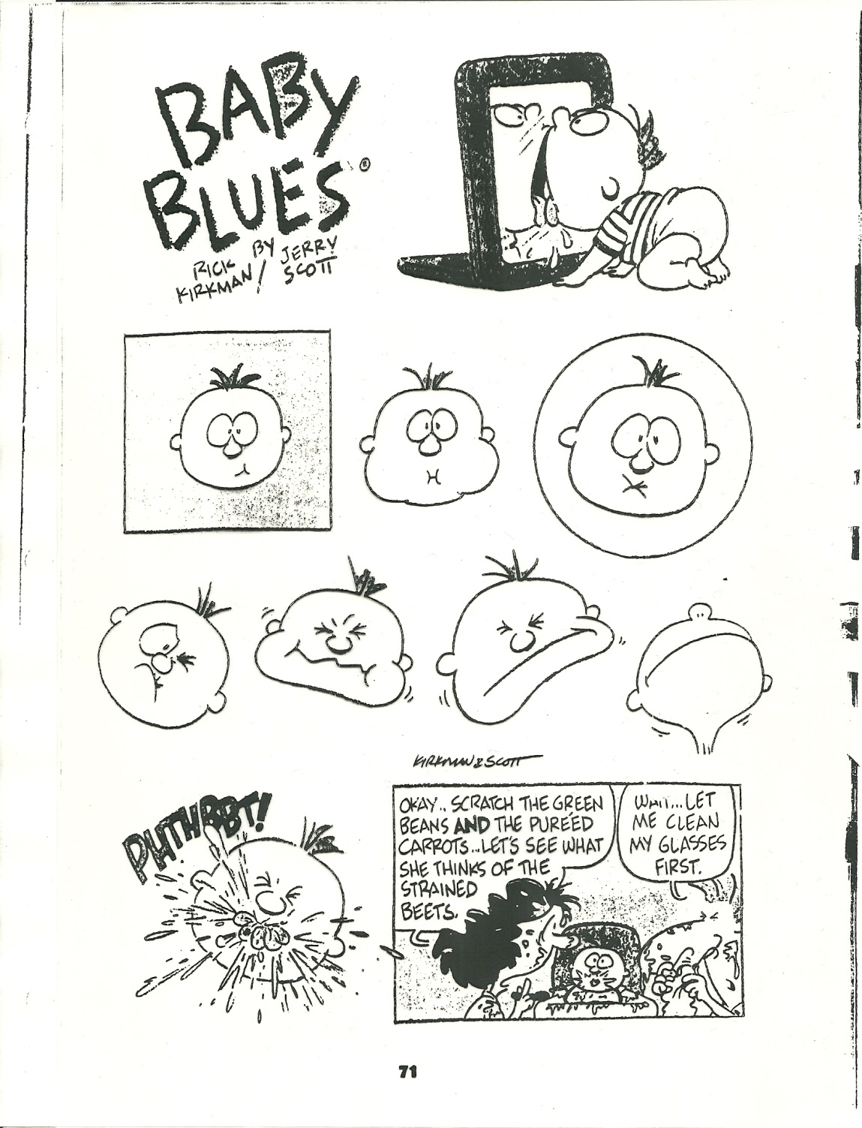
Children begin self-feeding at about 8-10 months.
Some guidelines for self-feeding safely:
  small pieces,
  easy to break apart,
  nothing that must be chewed,
  give a small amount at a time,
  watch them continuously

Slide 24
FEEDING IN THE FIRST YEAR
4. Bacteria from the baby’s saliva mixes in and lives in the baby food.
  It begins to break down the food and causes it to spoil.
  Disease-causing bacteria can grow quickly and lead to illness.
5. Bottle fed babies are at risk for overfeeding because the caregiver may urge the baby to finish the milk left in the bottle, even if the child is full.

Slide 25
6. Healthy eating habits and adequate nutrition:
Follow the food guide pyramid
Give smaller serving sizes/portions
  Use their hand as a guide for their portion
Help children to enjoy fresh fruits and vegetables
Limit salty, sweet, and fatty foods.
Provide enough calories for rapid growth
Provide foods rich in necessary nutrients
  Protein, iron, calcium, B vitamins, C vitamins, and D vitamins
Foods that are easy to digest
Adequate amount of liquid – Mostly WATER
  Use 100% juices

Slide 26
FEEDING IN THE FIRST YEAR
Rotate through the 4 stations to learn about feeding during the first year of life.
Be sure to answer the questions on your worksheet at each station.

Slide 27

1. CHOOSING AN INFANT’S CLOTHING
Safety
  Fire retardant, not tight and binding, no loose buttons or fasteners, no loose strings or trims
Comfort
  Soft-knit fabrics, not bulky, no fuzzy trims that tickle, neck openings large enough to go over the baby’s head, not tight and binding, roomy for active body movements, anti-static, absorbent, right weight for warmth
Easy to Care For
  Machine washable, lighter fabrics stain easier, little or no ironing, shrinkage control (sanforized on the label), no dry cleaning, easy to mend
Advance for Growth
  1 piece without obvious waistlines, fabrics that stretch, elastic waistbands, 2 piece outfits, adjustable straps

Slide 28
