Slide 1
Children’s Books
Lindsey
Monday:
  Brooke
  Tasmin

Slide 2
Guidance Techniques
Redirection
NATURAL AND LOGICAL CONSEQUENCES
CHOICES WITHIN LIMITS
Time out
Reverse attention
Consistent
Example
Postive Statement
Encouragment

Slide 3
Bell Work
What are three behavioral needs that children need to have met. (use your note packet)

Slide 4
Unit 3: Challenging Situations
Positive Guidance

Slide 5
Dad's and Baby's
http://www.youtube.com/watch?v=yeJPmSrHUQo&safety_mode=true&persist_safety_mode=1

Slide 6
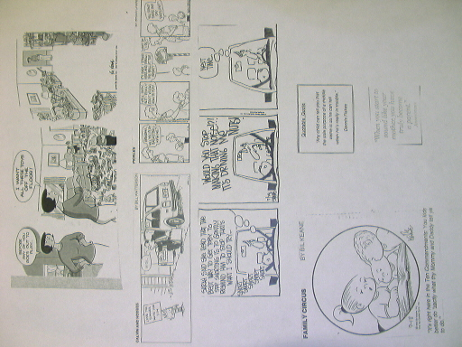

Slide 7
Annie and the Terrible, no good, very bad Week
Beginning: Annie is a three year old. She is very independent. Write an introduction about her describing what she looks like and why s he gets into so much trouble. Draw a picture of her.
Monday: Annie goes to preschool and while she is playing with Mark, she grabs the truck that he is playing with. It is a terrible, no good, very bad week. Write a short paragraph about the situation and how the teacher responds, using proper guidance techniques.

Slide 8
Tuesday: When Annie gets home on Tuesday, her mom gives her coloring books and crayons to play with. As she starts coloring, she discovers that crayons break, and proceeds to break each crayon in the box in half. It is a terrible, no good, very bad week. Write a short paragraph about the situation and how the mom responds, using proper guidance techniques.
Wednesday: Annie is really mad on Wednesday because her week is so rotten. She goes to a new babysitter’s house and just sits in the corner and refuses to play with anyone else. It is a terrible, no good, very bad week. Write a short paragraph about the situation and how the babysitter responds, using proper guidance techniques.

Slide 9
Thursday: After snack time on Thursday, Annie decides that she doesn’t want to help with clean up. It is a terrible, no good, very bad day. Tell about how the teacher responds, using proper guidance techniques.
Friday: On Friday night, Annie’s mom decides to read her a story. Although it was interesting at the beginning, she refuses to sit still at the end. It is a terrible, no good, very bad week. Write a short paragraph about the situation and how the mom responds, using proper guidance techniques.

Slide 10
Saturday: On Saturday Annie plays marbles with her dad. He asks her several times to only take one at a time, but Annie insists on playing with all of them. It is a terrible, no good, very bad week. Write a short paragraph about the situation and how the dad responds, using proper guidance techniques.
Sunday: On Sunday Annie has her cousins over. When they don’t do what she wants, she becomes easily angered. She stomps her feet, yells loudly, and hits. It is a terrible, no good, very bad week. Write a short paragraph about the situation and how the mom responds, using proper guidance techniques.

Slide 11
Conclusion: Annie’s mom sings her to sleep and explains that some weeks are just like that. Do some sort of cute conclusion. Write a short paragraph about the situation and how the Annie responds.

Slide 12



1. REDIRECTION
a. Substitute unacceptable behavior for acceptable behavior by helping the child to focus on or pay attention to something else that is more appropriate
  (Let’s run and yell outside instead of in the house)
b. Children up to 2 years old can be easily distracted to change their behavior.
For all ages, adjust the environment. Put items away and out of sight to avoid creating problems.

Slide 13
2. NATURAL AND LOGICAL CONSEQUENCES
a. Natural Consequences occur without interference, allowing the consequence to happen, not an inflicted punishment by the caregiver.
  Best method of discipline, but the hardest one to do.
  The child can see the result of his behavior or choices. This type of consequence can’t be used if it will cause harm to self, others, or property.
(If a child does not eat = they go hungry If the child leaves their bike out = it gets stolen)

Slide 14
b. Logical Consequences should be relevant to the misbehavior.
This type of discipline should provide opportunities for children to learn from their behavior
It should be short in duration and not imposed in the caregivers anger.
(If the child draws on the wall = they scrub it off Child doesn’t keep their bathroom clean = can’t use it)

Slide 15
c. 4 Rules to Remember When following through with a consequence
1. The consequence must logically (be relatable) follow the act
2. The consequence cannot be imposed when the caregiver is angry. Calm down so you can think rationally about a logical punishment
3. The consequence must make the child feel as though it is an unpleasant result of their behavior.
  Give the consequence and let the child feel its effects without any further comments from you or this might cause resentment.
4. The consequence should be short in duration and specific enough to have an impact on the child

Slide 16

3. CHOICES WITHIN LIMITS
a. Give children opportunities to make choices (Do you want water or Juice? NOT What would you like to drink?)
b. When children are allowed to make choices, they get practice in making decisions
c. Setting limits allows children to control themselves rather than feel like they are being controlled
d. Limits put on the child should have a purpose and should benefit the child.
e. Limit the options when giving choices. (“either - or” choices will help to narrow it down)
f. Make sure you are willing to give the choices that you offer.

Slide 17

4. TIME OUT
a. Use a consistent place that distances the child from the problem where there are no distractions and they can regain their composure. NOT a place to sit and think about what they have done wrong.
b. One time out minute for each year of the child’s age. ie: 2 year old should receive 2 minutes.
c. Use time out only for serious misbehavior like tantrum, fighting, intentional destructiveness
d. Do not talk to the child while in time-out
e. Use time out immediately after the behavior occurs
f. Once the time is up, calmly explain to the child why they were punished and what behavior will be expected in the future. If the behavior happens again, immediately repeat the process – do not give
reminders.
g Make an extra effort to notice their good choices after time out.

Slide 18
5. REVERSE ATTENTION
a. Ignoring the negative behavior (whenever possible) and reinforcing the positive behavior.
b. Catch them doing good things rather than scolding them for all of the bad things

Slide 19
6. CONSISTENT
a. Children feel more secure when parents are consistent.
b. Positive Guidance is dependent on maintaining consistency. It is more important than how strict or lenient you are.
c. Children will always know what to expect and what is expected of them.
d. It eliminates arguing and forgetfulness on the child’s part.
e. Make threats to a child that can and will be followed through with.

Slide 20
7. EXAMPLE
a. This is a very effective way to teach children a desired behavior
Children will always follow what you do before they follow what you say

Slide 21
8. ENCOURAGEMENT
a. Encouragement is the best form of positive reinforcement. It is the best way to teach children a positive / good behavior
b. What is the difference between Praise and Encouragement? What are the effects of these?
Praise
1. A Type of reward based on competition. It is given for winning and being the best
2. It teaches a child that if they do something considered good, they will be recognized with an external / tangible reward like a treat.
3. Places value judgements on a child.
(“I’m so proud of you!” “What a good boy!” “Here’s a sticker”)

Slide 22
Encouragement
1. Given for effort or improvement. Its focus is on the child’s strengths and positive traits.
2. A person who encourages is not interested in how the child compares with others, but they are concerned with the child accepting himself and developing the courage to face difficult tasks.
3. Encouragement helps a child to feel worthy. It attempts to motivate children by giving internal rewards, evaluations and contributions. This type of reward lasts longer and means more.
4. It can be given when a child is not doing well or when they are facing failure.
  1. Demonstrates acceptance: (“I like the way you handled that!” “I’m glad you enjoy learning.”)
  2. Shows confidence: (“You’ll make it!” “Knowing you, I’m sure you’ll do fine”)
  3. Express appreciation: (“Thanks, that helped a lot.” “That was thoughtful of you.”)
  4. Recognize effort and improvement (“It looks like you really worked hard on that project” “Look at the progress you have made!”)

Slide 23

9. POSITIVE STATEMENTS
a. Tell a child what to do NOT what not to do. (Don’t run in the house!!! vs. Please walk in the house)
b. When giving directions, clearly state in a positive manner, what the child is expected to do and talk to the child on their eye level.
c. To encourage children to do a task, tell them what needs to be done and then help them get started.

Slide 24
Negative Statements in Study Guide
1. Don’t run with scissors in your hand.
2. Don’t forget lunch.
3. Don’t run in the house.
4. Don’t hit her again.
5. Don’t touch anything!
6. Stop acting like a baby.
7. Don’t eat like a sloppy pig.
8. Don’t stay up so late.
9. Don’t dawdle on the way home from school.
10. Don’t slam the door.

Slide 25
Toxic Waste Game

Slide 26
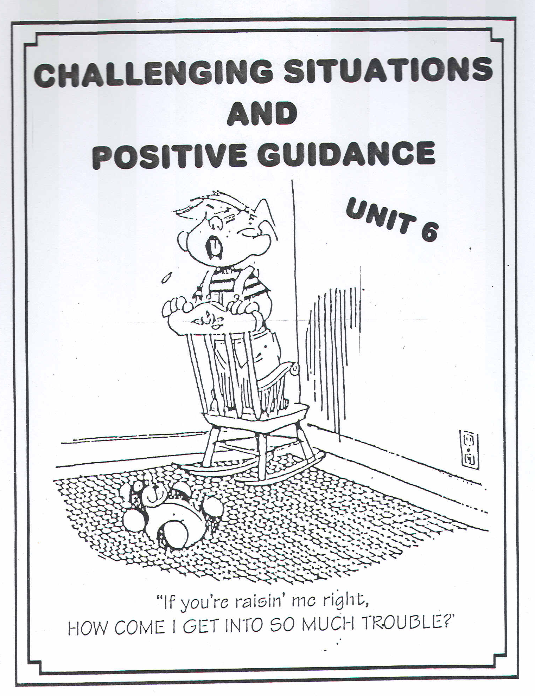

Slide 27
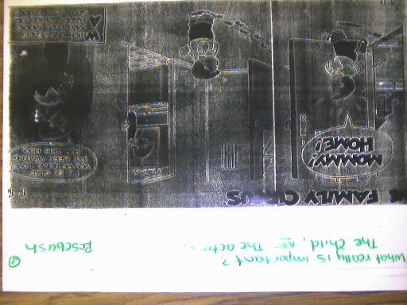

In the end, what is really important?

Slide 28
Unit 3, Reflection #1
How will you positively guide your future children?

Slide 29
DAPLA Activity
Bead Forms

