Slide 1
Reading a Recipe and Measuring

Slide 2
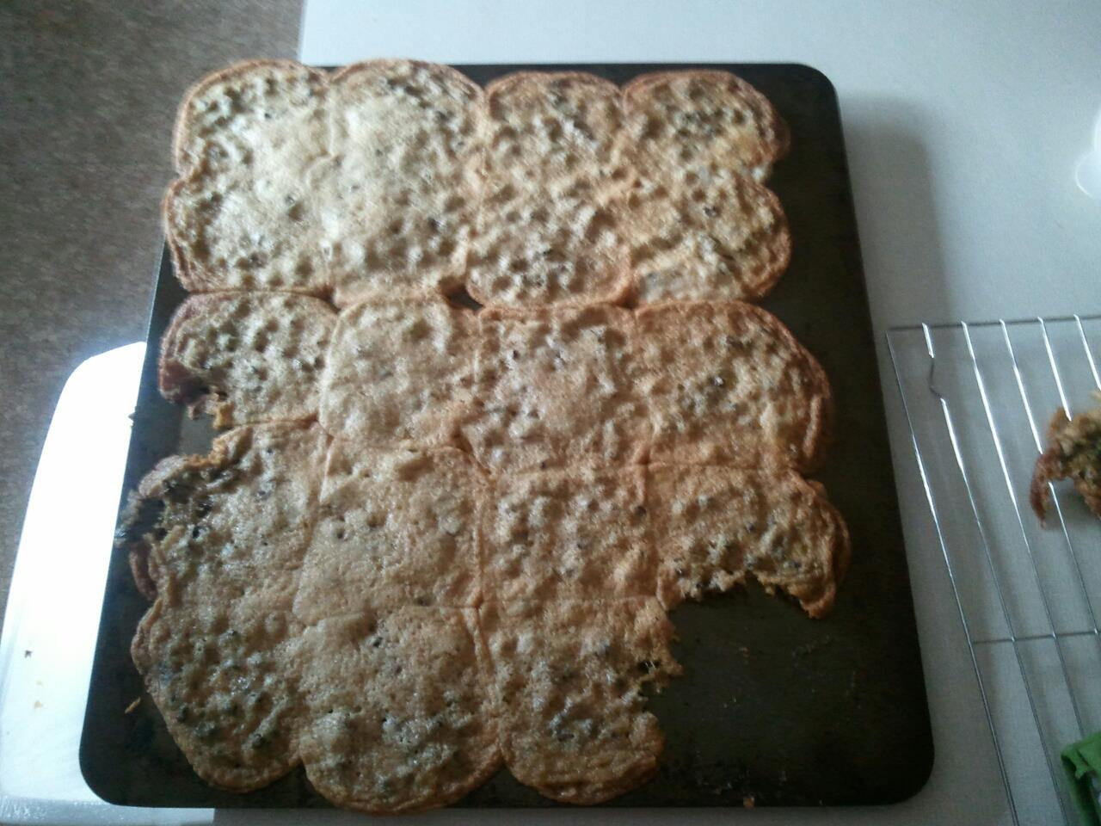

Slide 3
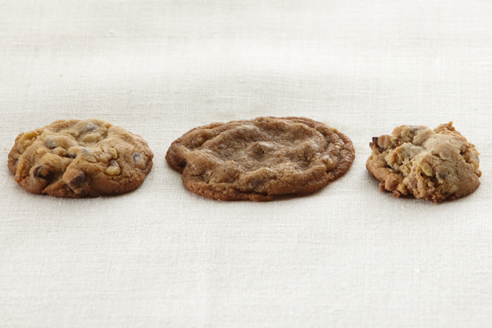

Slide 4
List the FOUR parts of a recipe:
List and amounts of ingredients
Step-by-step instructions
Essential info about temperature and equipment
Number of servings

Slide 5
2. What are the EIGHT steps to following a recipe correctly?
Read the recipe carefully before beginning
Check to see if you have all the ingredients
Pre-heat the oven if needed
“Gather” all equipment needed
Complete preparation of specific ingredients (EX: Chopped Nuts, Melted Chocolate, etc.)
Measure exactly!
Mix carefully, following each direction
Bake or cook at temperature and time directed

Slide 6
What is the most important step and why?
#1! (Reading the recipe)-so you know what you need to do and what ingredients you need
Before cooking, you should wash your hands for at least how long?
20 seconds

Slide 7
5. What should you NEVER do when measuring flour?
Pack or tap the cup (it releases the air needed in the measurement)
How should you measure flour instead?
Spoon in the flour then level it off

Slide 8
6. What is the most efficient way to measure the following measurements of dry ingredients?
4 Tbsp. = ___________________
3/4 c. = ___________________
3 tsp. = ___________________
1/8 c. = ___________________
1/4 c.
1/2 c. + 1/4 c.
1 Tbsp.
2 Tbsp.

Slide 9
When cutting a recipe in half, or when doubling a recipe:
The cooking TEMPERATURE remains the same, but the SIZE of the cooking pan and the length of TIME will be affected.
8. When baking with a glass dish, you need to reduce (lower) the oven temperature by:
25⁰

Slide 10
Equivalents & Abbreviations
T., Tbsp., or tbsp = tablespoon
t., or tsp. = teaspoon
Min. = minute
Oz. = ounce
Qt. = quart
Pt. = pint
Gal. = Gallon
Hr. = hour
Doz. = dozen
C. = cup
lb. or # = pound
Pkg. = package

