Slide 1
Elements of Design
Shape/Silhouette

Slide 2
Silhouette
Silhouette ~ the shape formed by the outer line of clothing

Slide 3
Shape
Shape is the outside form or silhouette of an object. There are four basic shapes:
Natural
Tubular
Bell
Full

Slide 4
Tubular
Tubular shape is rectangular with vertical emphasis. The waistline is not defined. Examples ~ T-shirt dress, straight leg pants.

Slide 5
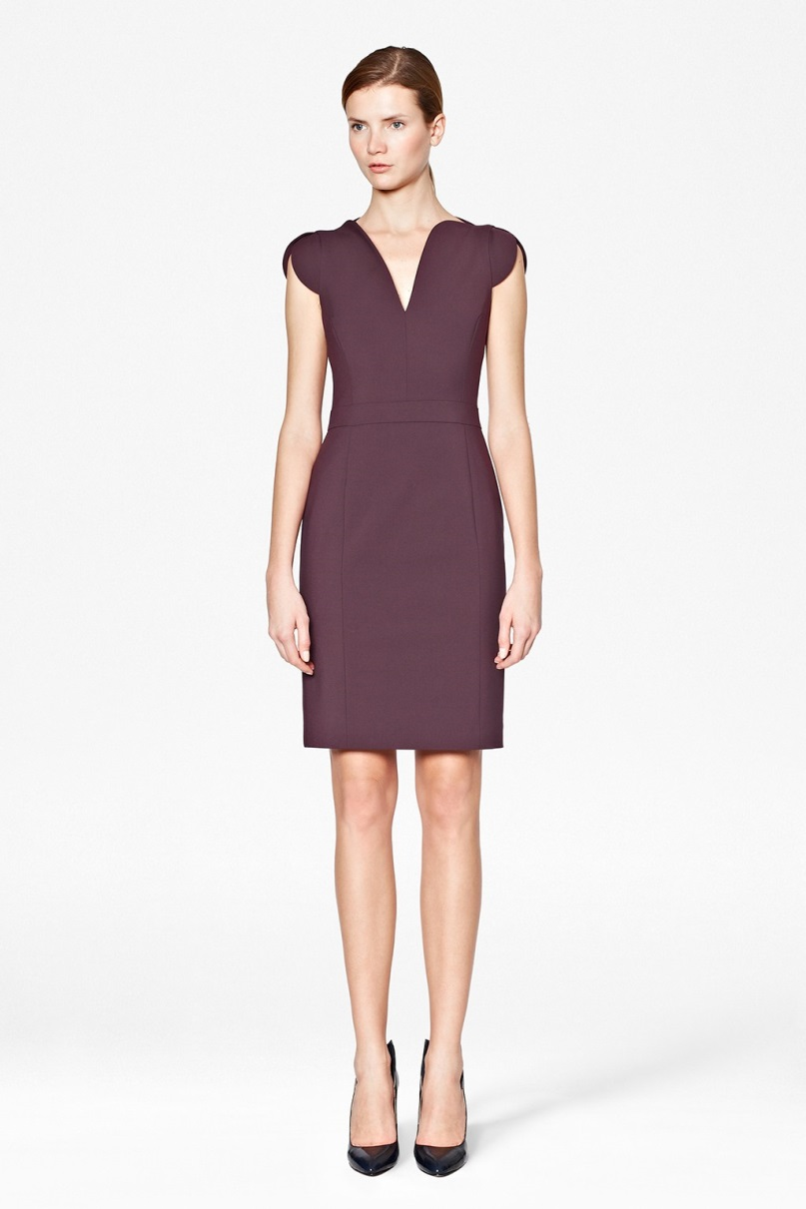
Natural
Natural close to the body and follows the body’s proportion and natural waistline. Clothing with natural shape is the most classic. Examples ~ straight dress or skirt.

Slide 6
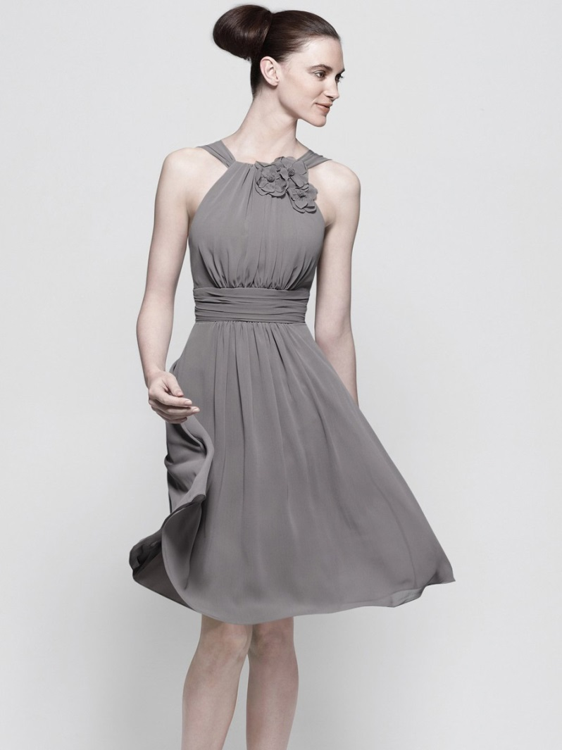
Bell
Bell shape combines both vertical and horizontal lines. Examples ~ A-line dress or skirt, flared pants or capes.

Slide 7
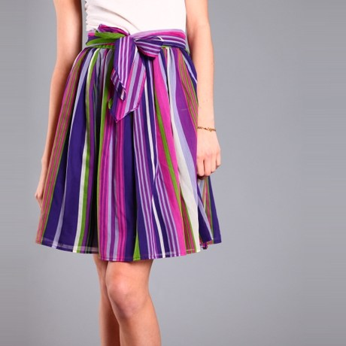
Full
Full shape has more horizontal and curved lines than do other shapes. Examples ~ gathered skirts and dresses, full sleeves and pants.

