Slide 1
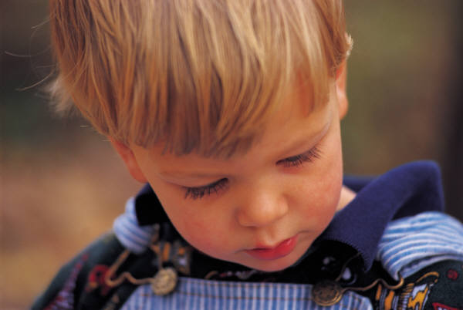
From Freud to Brazelton: 100 Years of Child & Parenting Development Theories
by Dr. Marty Rossmann

Slide 2
CHILD DEVELOPMENT IS……
The study of how a child grows and develops, from conception to age 18
5 STAGES OF CHILD DEVELOPMENT
1. Infancy – birth to 12 months
2. Toddler – 12 months to 3 years
3. Preschool – 3 years to 6 years
4. Schoolage – 6 years to 12 years
5. Adolescents – 13 years to 18 years

Slide 3
GROWTH and DEVELOPMENT
Growth = a child’s physical increase in size or amount that is
easily observed
Development = The ability of a child to do things that are
complex and difficult
LAWS of GROWTH and DEVELOPMENT
1. Growth proceeds from head (cephalo) to foot (caudal)
First infant lifts head to see object, later gains
muscle strength AND control to pick up an object, and
later learns to move toward the object.
2. Growth proceeds from near (proximal) to far (distal)
First moves whole body, then it moves outward to arms, hands, and then fingers.
Waving “Hi” = First they learn to wave with arms, then wave with their hand and wrist, and then wave with fingers.
3. Growth proceeds form simple to complex
Sleep and eat, later babbles and eats with fingers.
First wave “Hi” and then say it

Slide 4
AREAS of DEVELOPMENT
PHYSICAL DEVELOPMENT
▪Developing and controlling gross and fine motor skills
▪The child’s physical growth in size and in proportion.
Gross motor = large muscles (lift head, roll, sit up, crawl, walk)
Fine motor = small muscles (hands and fingers)
▪Development is most rapid during the first three years.

Slide 5
COGNITIVE / INTELLECTUAL DEVELOPMENT
▪The ability of the brain to take in and process information.
▪The people in the child’s environment are most important in
building / creating a strong learning environment.
▪ A child recognizing their name, recognizing their parent, language, recognizing that when he shakes a rattle it makes noise

Slide 6
SOCIAL DEVELOPMENT
▪A child learning and discovering the expectations and rules for
learning to get along with and understand others.
▪Moving from being egocentric (self-centered) to being able to
relate with others.
▪A child smiling at parent, child learning to share, imaginary friend

Slide 7
EMOTIONAL DEVELOPMENT
▪The ability to recognize and understand feelings and how to
respond to them appropriately.
▪Jealousy, being afraid, smile, laugh, sad, showing empathy

Slide 8
MORAL DEVELOPMENT
▪Identifying personal values and learning right from wrong
▪Respecting human rights, behaving accordingly, developing
principles to guide behavior, listening to their conscience
▪Being a good example is the best way to build a child’s conscience.

Slide 9
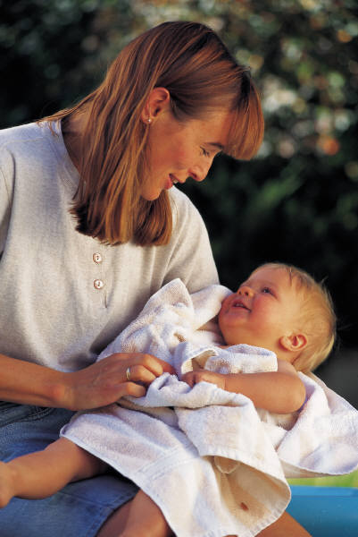
Why Study the Selected Theories?
The selected theories:
Have been popular and influential.
Represent different approaches to parent-child interaction.
Offer help in the “real world” of daily child-rearing.
Make good common sense.

Slide 10
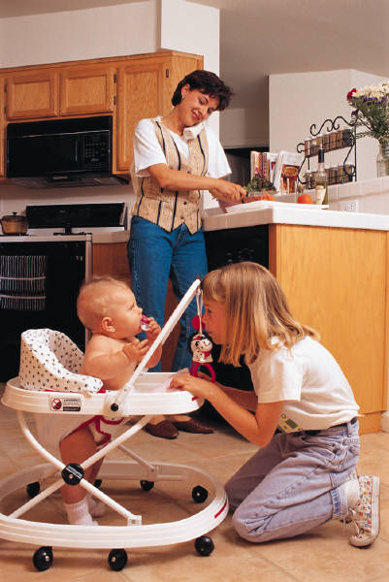
Why Study Child & Parenting Development Theories?
Theories help people:
Organize their ideas about raising children.
Understand influences on parenting.
Discover more than one way to interact with children.
Analyze the benefits and consequences of using more than one theory.
Sigmund Freud • Erik Erikson • Maria Montessori Jean Piaget • Urie Bronfenbrenner • Lev Semenovich Vygotsky Abraham Maslow • Arnold Gesell • John Bowlby • Rudolph Dreikurs Lawrence Kohlberg • B.F. Skinner • Benjamin Spock Diana Baumrind • T. Berry Brazelton • Howard Gardner

Slide 11
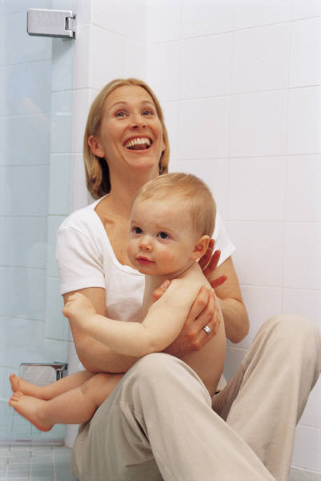
- (The 8 Stages of man) - Studied the stages of personality development throughout the life cycle. - This is always redeveloping itself. - Each level defines a new social awareness and interaction possible for the ndividual.  MEMORY JOGGER: ERICKSON = 8 letters for 8 stages of man (hold up 8 fingers) Letter E = Erickson, Eight, Emotional ☺ 😐 ☹     = Emotions
Erik Erikson (1902-1994)

Slide 12
ERIK ERICKSON
Trust vs. Mistrust (0-12 to 18 mos.)
Infant forms a loving, trusting relationship with parent or is frustrated and lacks self-confidence.
The degree to which a child learns to trust or mistrust others.
Determined by the type and amount of care the child receives.
Autonomy vs. Shame and Doubt (18 mos. to 3 years)
Child needs to develop self-control with firm, gradual and kindly support of parents so the child does not lose self-esteem.
The degree to which a child is allowed and encouraged freedom and self-direction
Initiative vs. Guilt (4-6 years)
Child gains skill in language and exploring and needs guidance from parents to proceed in life in a self-confident, guilt-free way.
The degree to which a child is allowed control of his/her body, choices, fantasy, motor activities, and language activities.
Begins to develop social skills (cooperating, leading, following)

Slide 13
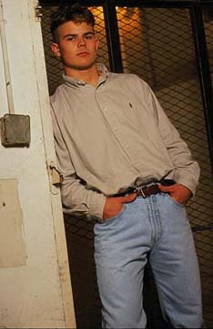
Psychosocial Theory
Erik Erikson (1902-1994)
There are stages of psychological development.
Psychosocial Stages:
Industry vs. Inferiority (7-12+ years)
Child pursues and completes activities that produce something and gain recognition from parents, teachers and friends. Failure makes the child feel inadequate and inferior.
Identity vs. Role Confusion (12-18 years)
The sense of “who I am” and what part I play in society (occupation, politics, sex roles, religion, etc.) is determined. Parents have new expectations for the adolescent. Those who don’t develop effective steps toward a tangible future may be insecure, confused and lack self-esteem.
(There are more stages for adults, not shown here.)

Slide 14
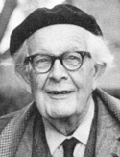
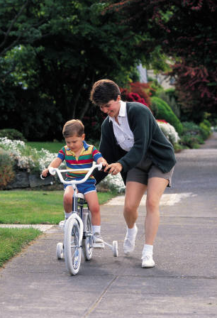
Understanding & supporting a child’s learning. He Researched and defined the cognitive / Intellectual skills of children and how they learn  MEMORY JOGGER: Notice his last name ends with “Get” and he taught how children GET SMART – point to head and say “Get smart”
Jean Piaget (1896-1980)
Two processes are essential for development:
Assimilation
Learning to understand events or objects, based on existing structure.
Accommodation
Expanding understanding, based on new information.

Slide 15
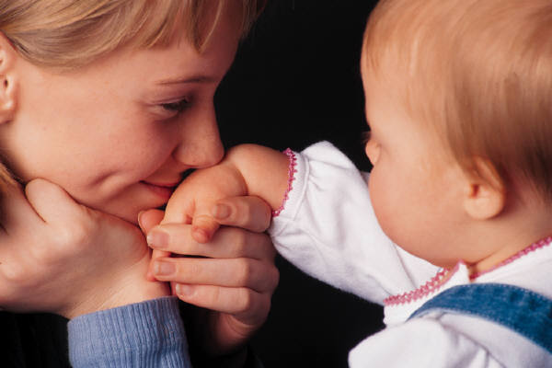
Cognitive Development Theory
Jean Piaget (1896-1980)
Understanding & supporting a child’s learning.
Sensorimotor (Birth – 2 years)
 MEMORY JOGGER: Stick out your tongue to help you
Learning about world through 5 senses (see, feel, hear, smell & taste).
Learning to control and manipulate muscles (small & large motor skills).
Learning about self (egocentric).
Learning from trial and error (12-18 months).
Thinking about how to do something without actually doing it.
Preoperational (2-7 years)
MEMORY JOGGER: The word operate is part of Preoperational and you Need smarts to OPERATE.
Learning by using language and mental images.
Learning to internalize thought process.
Continuing to be egocentric.
Learning by watching and performing.
 (police) (nike)  (no smoking) ⓪①(bathroom)  (stop) M (McDonalds)

Slide 16
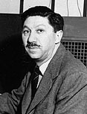
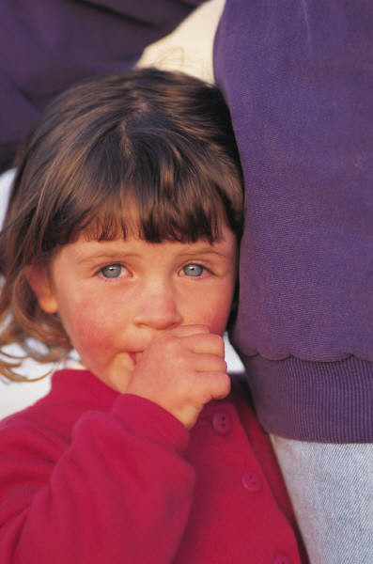
Human Needs Theory
Abraham Maslow (1908-1970)
Human needs influence each person’s development.
Influence of a hierarchy of human needs on personality.
Lower need must be filled before upper-level needs receive attention.
Child’s genetic potential will not flourish unless they are nurtured by adults as the child grows.

Slide 17
Maslow’s Hierarchy of Needs
Need to maximize one’s potential.
Need for self-respect and self-esteem and for the esteem of others.
Need for community, family, friends, lover, affection & intimacy.
Need for security, stability, freedom from fear, structure & order.
Need for shelter, food, clothes, air, sleep, and activity.

Slide 18
PHYSICAL DEVELOPMENT of CHILDREN Came up with physical development age norms. (sit, stand, walk, …) These standards are used today in medical profession to monitor.
ARNOLD GESELL

Slide 19
LAWRENCE KOHLBERG Moral Development of CHILDREN  MEMORY JOGGER: KO MO Dude Knock Out is not a moral thing to do 1. Preconventional Children begin life with no sense of right or wrong. Learn quickly the certain behaviors are punished and others rewarded Learn to avoid punishment and strive for behavior or acts rewarded 2. Conventional (about age 9) Learn to behave according to a sense of what others need or want. They follow established rules and respect authority Begin to act in accordance with what is right and wrong. 3. Post Conventional (about age 16) Mature morally. Respect human rights and develop individual principles to guide their behavior and choices. Their motivation to act a certain way comes from within, not just to follow the rules.

