Slide 1
Types of furniture

Slide 2
Canopy bed
A bed that has a piece of cloth above it like a roof

Slide 3
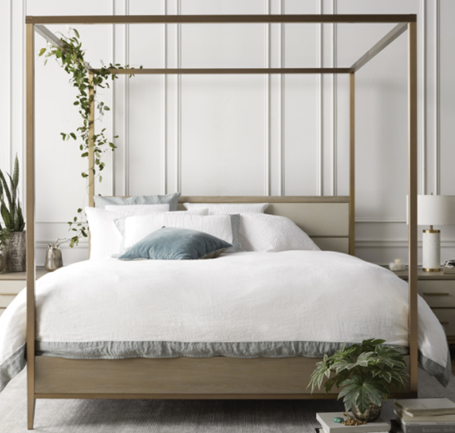
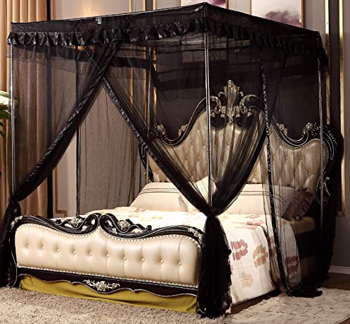

Slide 4
Four-poster bed
A bed with a post at each corner, sometimes supporting a canopy

Slide 5
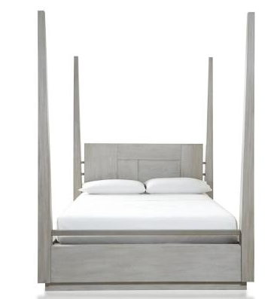
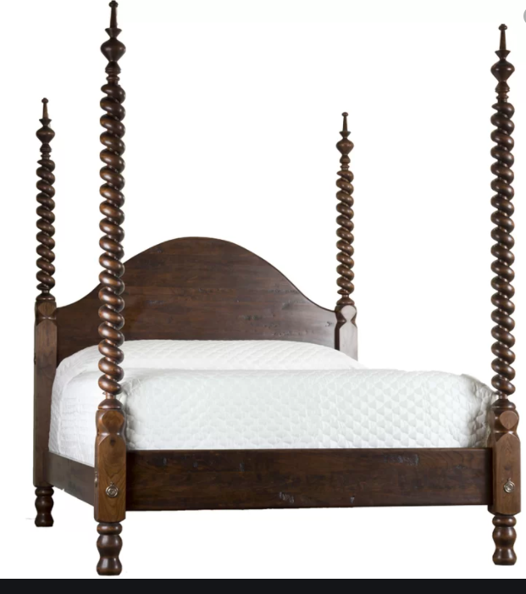

Slide 6
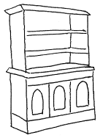
hutch
A set of shelves or cabinets placed on top of a lower unit with a counter & either drawers or cabinets

Slide 7
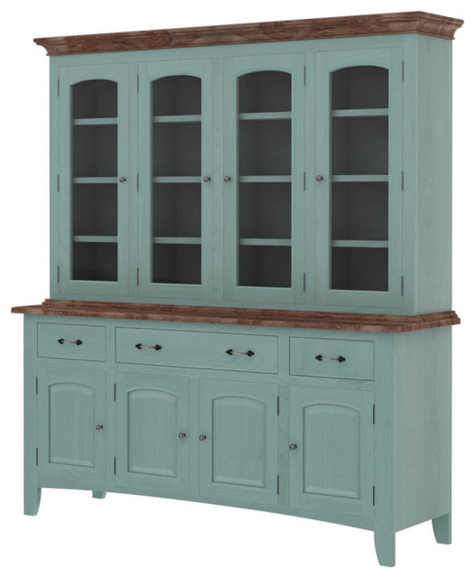
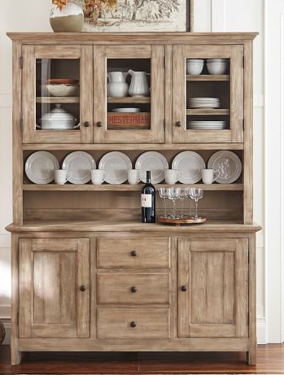

Slide 8
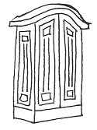
armoire
Large two-door cupboard, usually movable & containing shelves, hanging space, & sometimes drawers

Slide 9
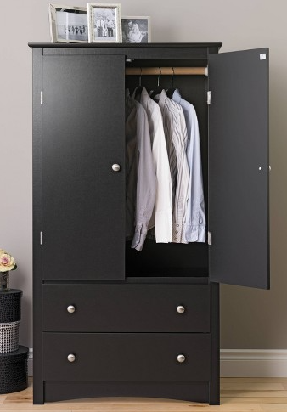
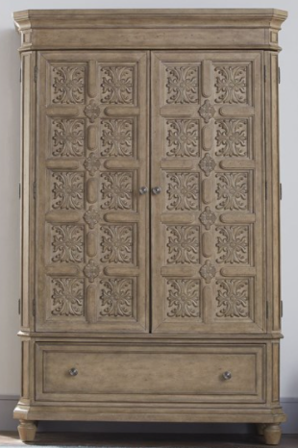

Slide 10
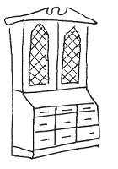
secretary
Made of a base of wide drawers topped by a desk with a hinged desktop surface, which is in turn topped by a bookcase usually closed with a pair of doors, often made of glass

Slide 11
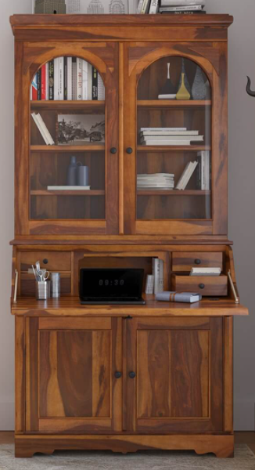
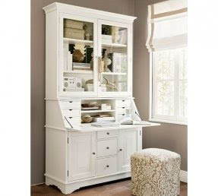

Slide 12
Knee-hole desk
A desk that has sets of drawers on either side of the recessed or “knee hole” area that provides room for the legs when a chair is pulled up to the desk

Slide 13
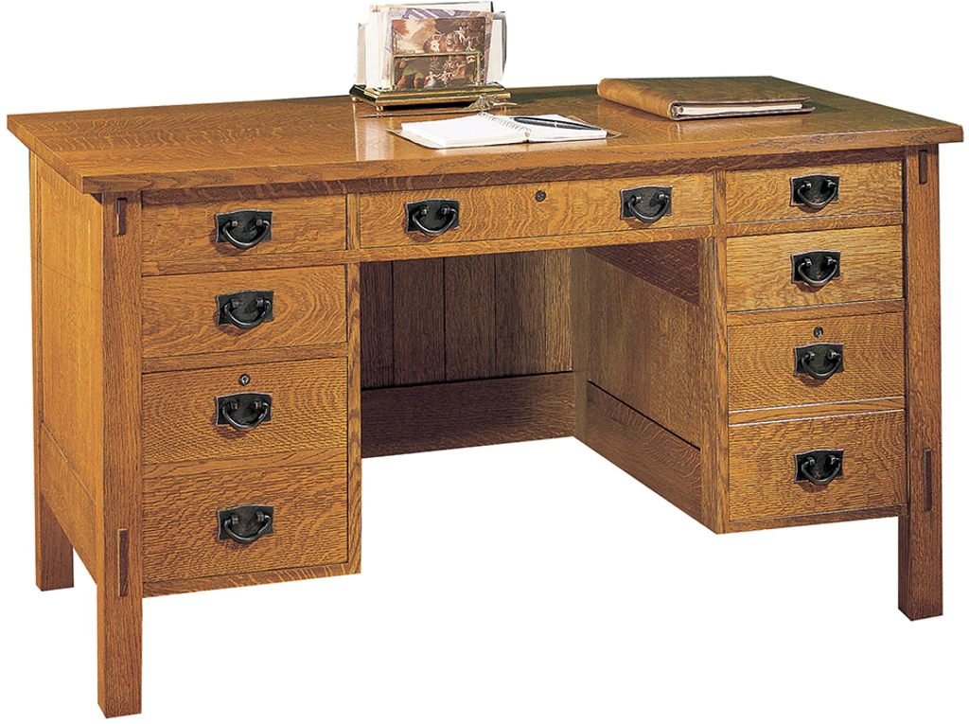
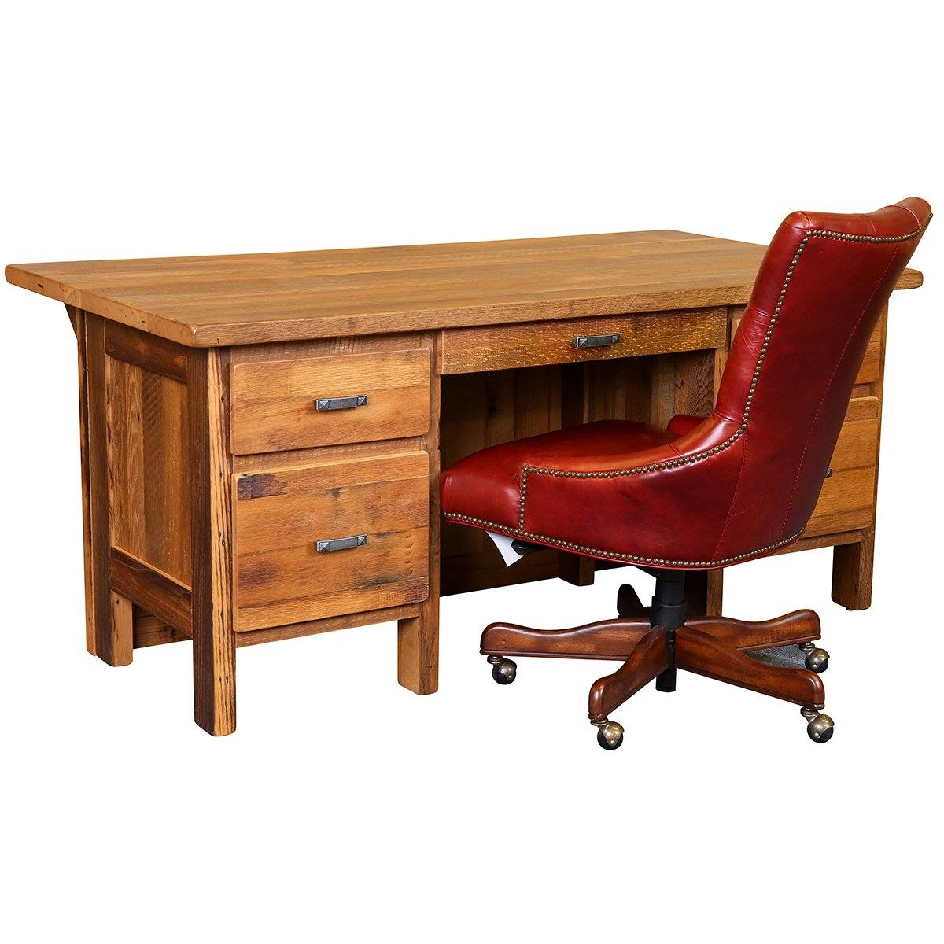

Slide 14
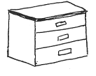
chest
A form of furniture typically of a rectangular structure with four walls & a removable lid, for storage

Slide 15
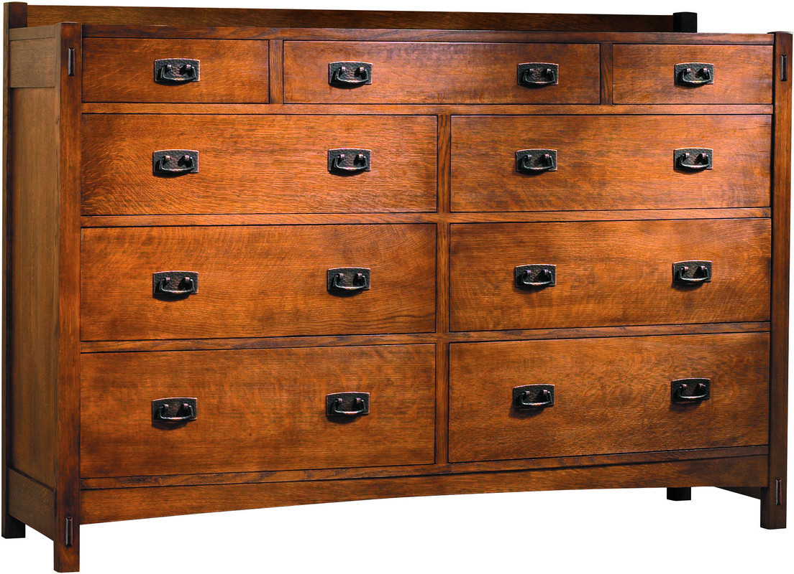
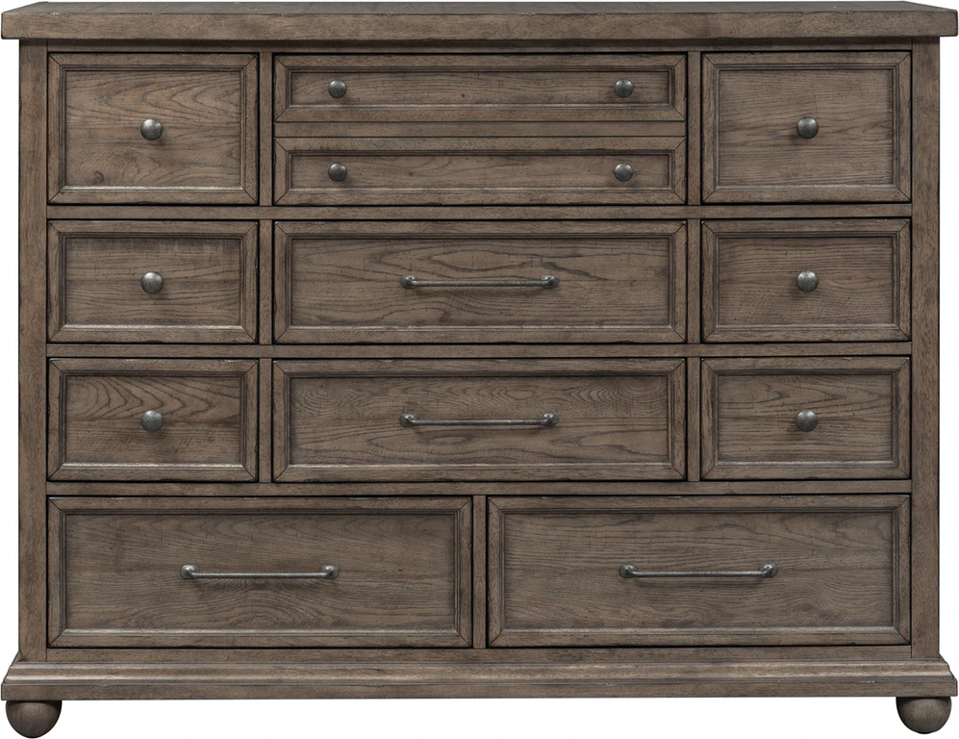

Slide 16
Buffet (aka sideboard)
Traditionally used in the dining room for serving food, for displaying serving dishes, & for storage. In later years, sideboards have been placed in living rooms or other areas where household items might be displayed

Slide 17
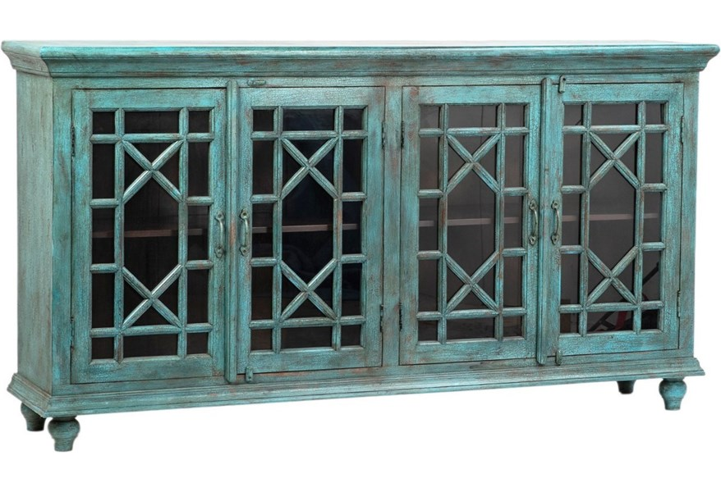
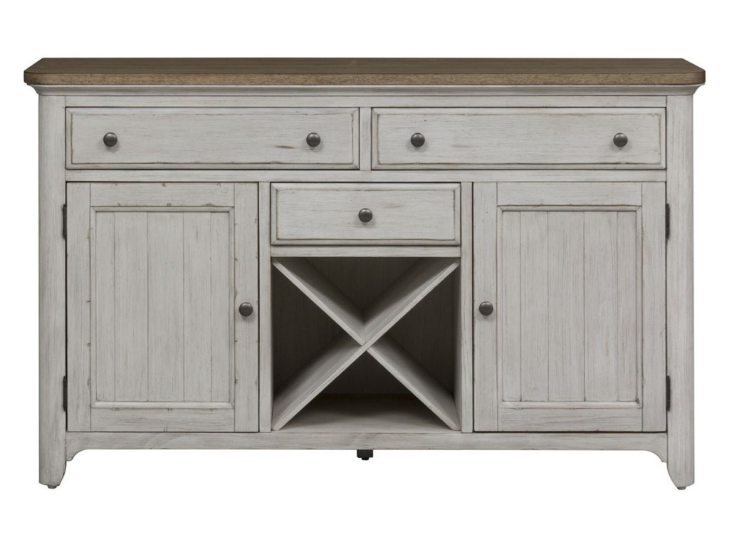

Slide 18
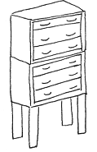
highboy
Consists of double chest of drawers (a chest-on-chest), with the lower section usually wider than the upper

Slide 19
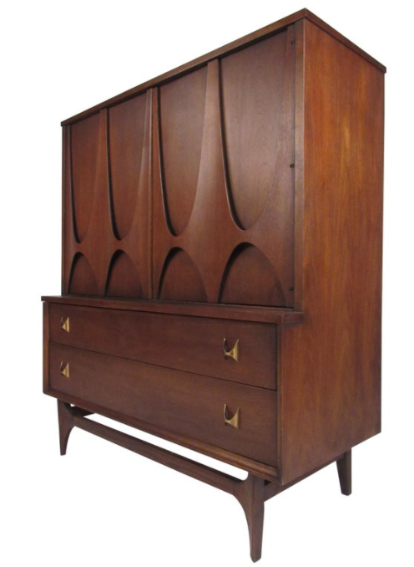
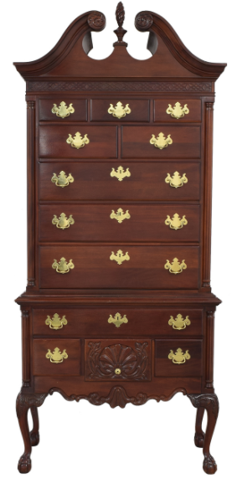

Slide 20
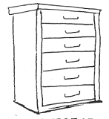
Chest of drawers
A piece of furniture designed to contain a set of drawers (as for holding clothing)

Slide 21
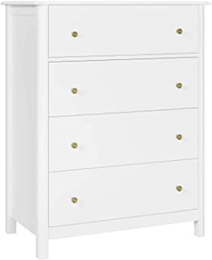
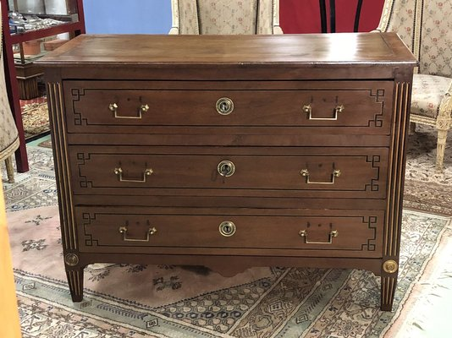

Slide 22
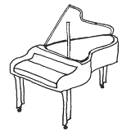
piano
A well-known instrument, but given its size, form & the quality of its manufacture, it is generally considered also a “valuable” piece of furniture

Slide 23
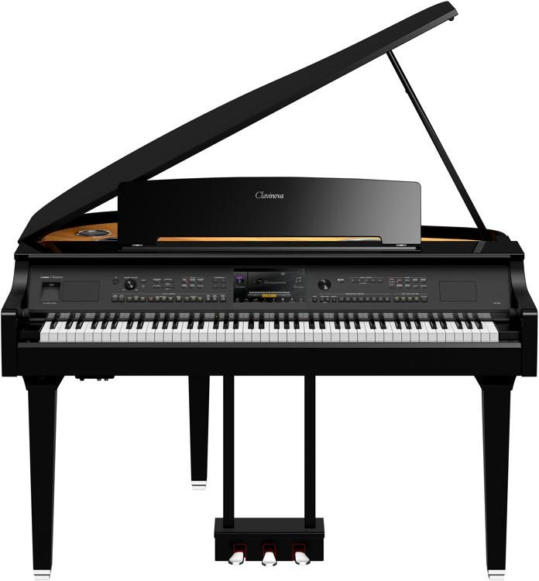
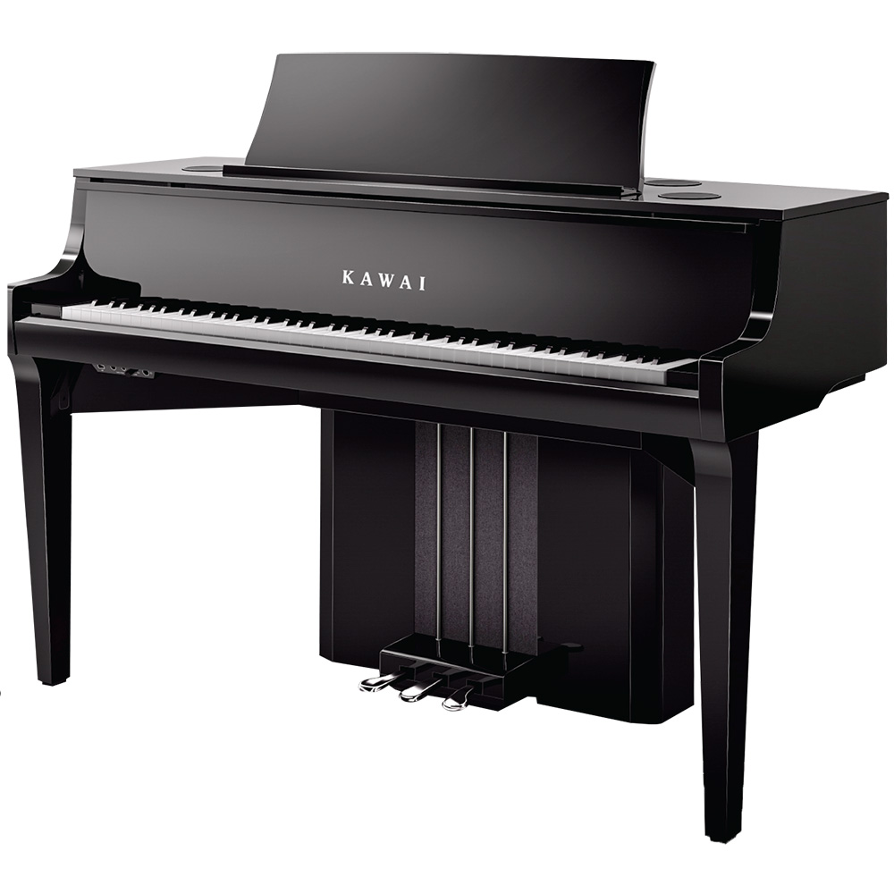

Slide 24
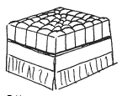
ottoman
Generally ottomans have neither backs nor arms. They may be an upholstered low couch or a smaller cushioned seat used as a table, stool or footstool.

Slide 25
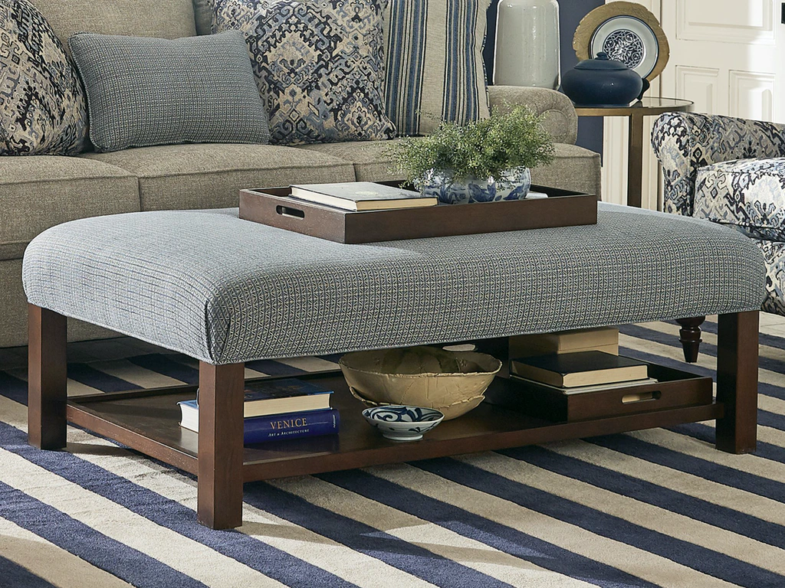
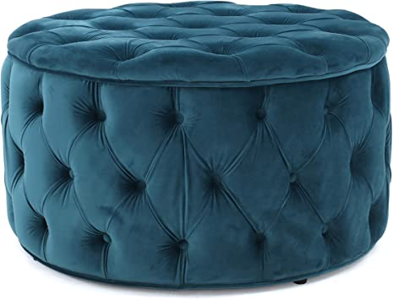

Slide 26
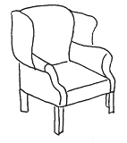
Wing chair
An upholstered armchair with high solid back & angled sides. (aka wingback chair)

Slide 27
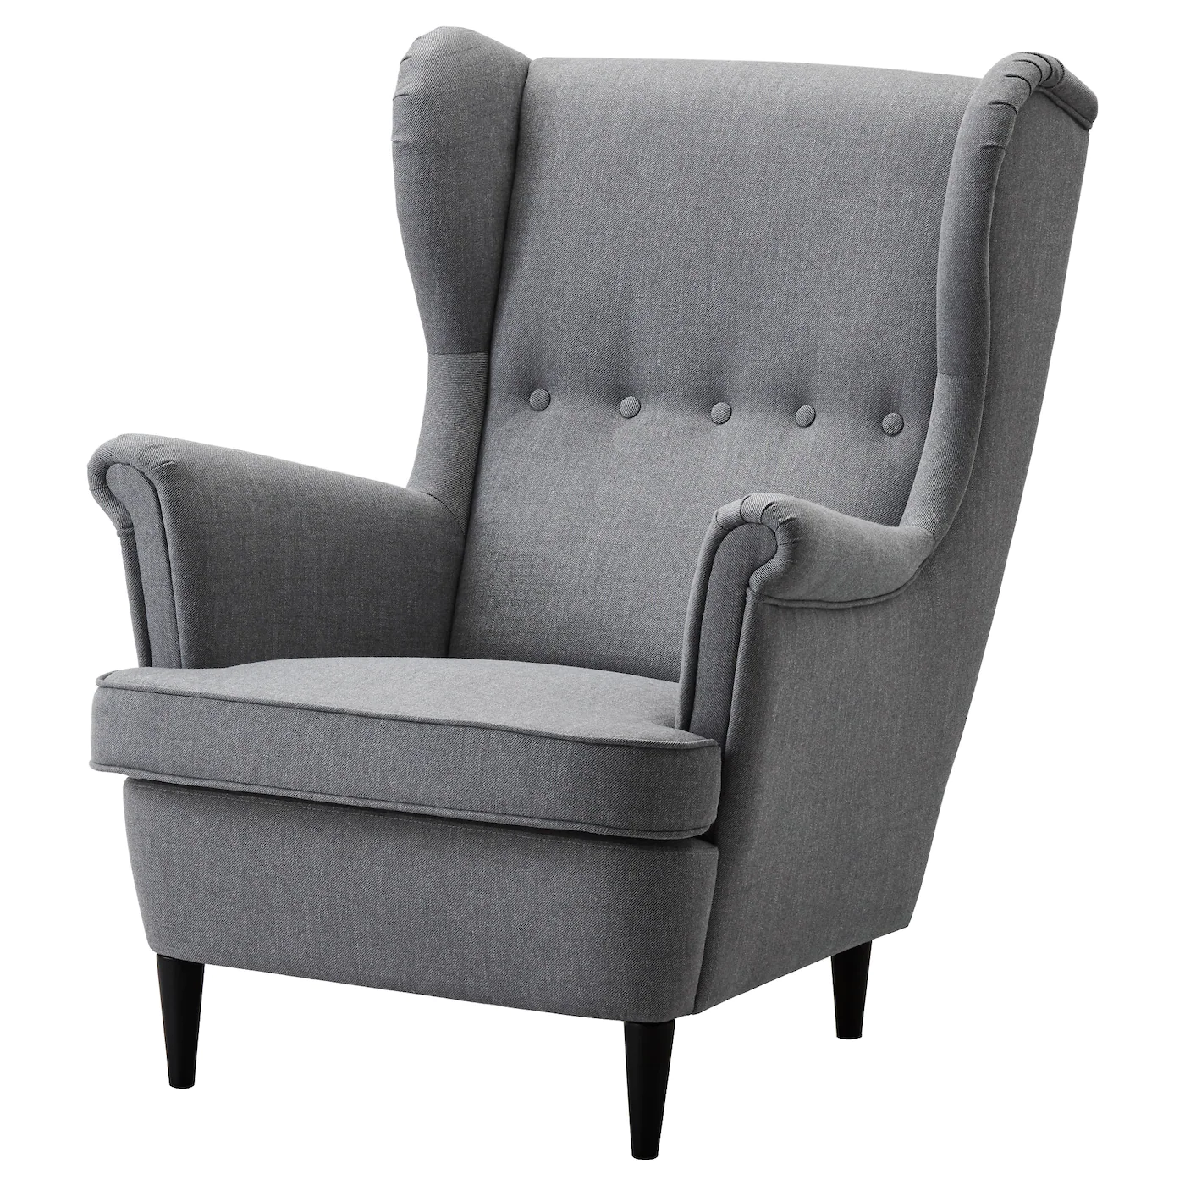
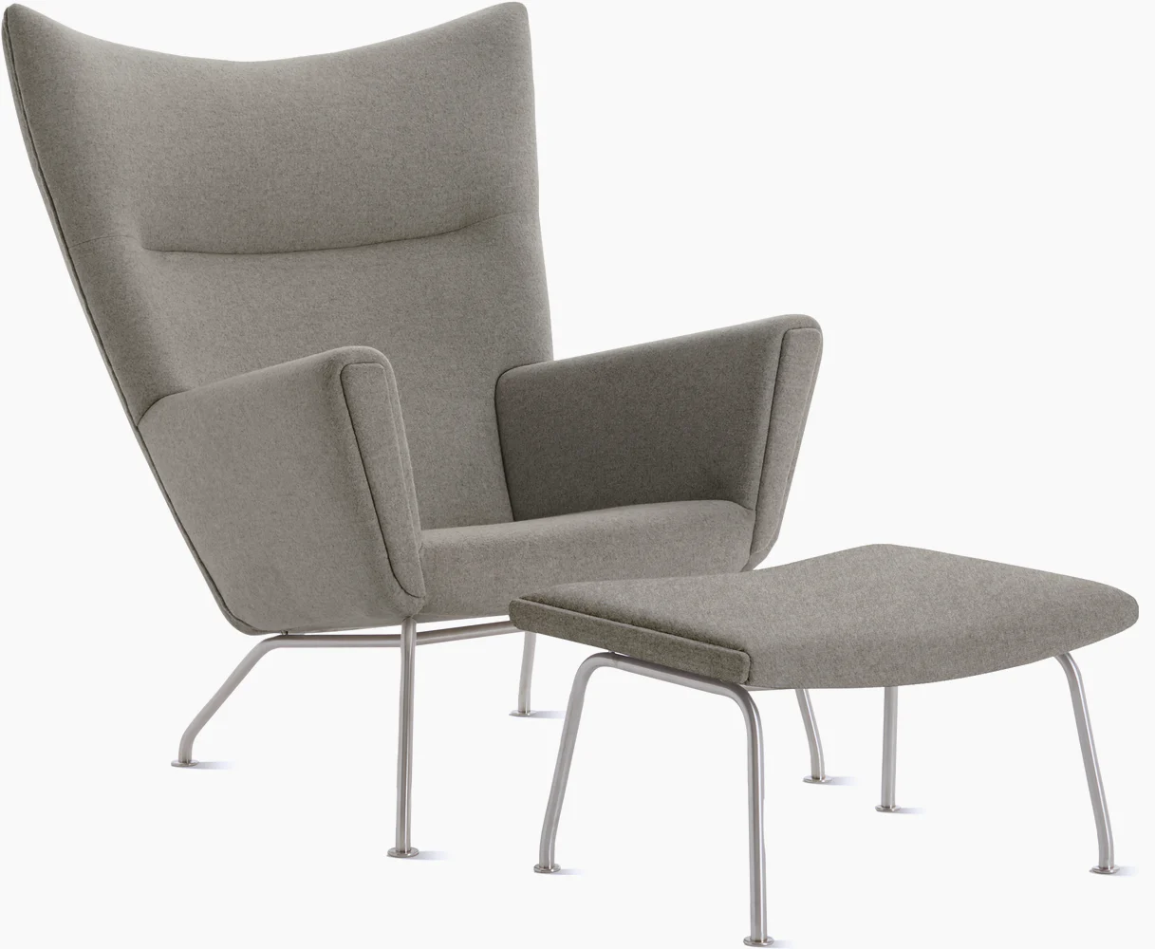

Slide 28
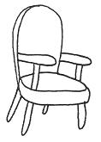
Open arm chair
An upholstered chair that has side supports for the arms or elbows

Slide 29
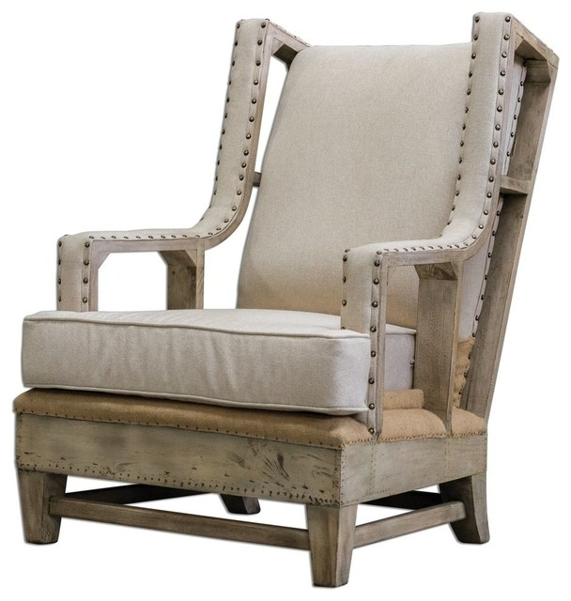
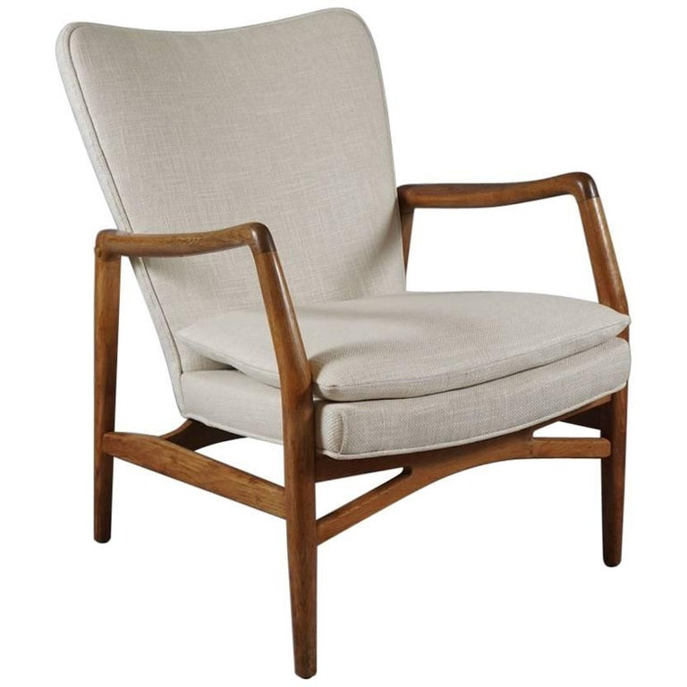

Slide 30
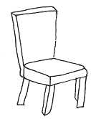
Side chair
A straight-backed chair without arms, usually part of a dining room set

Slide 31
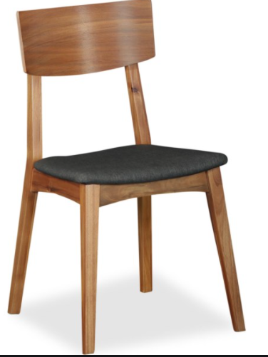
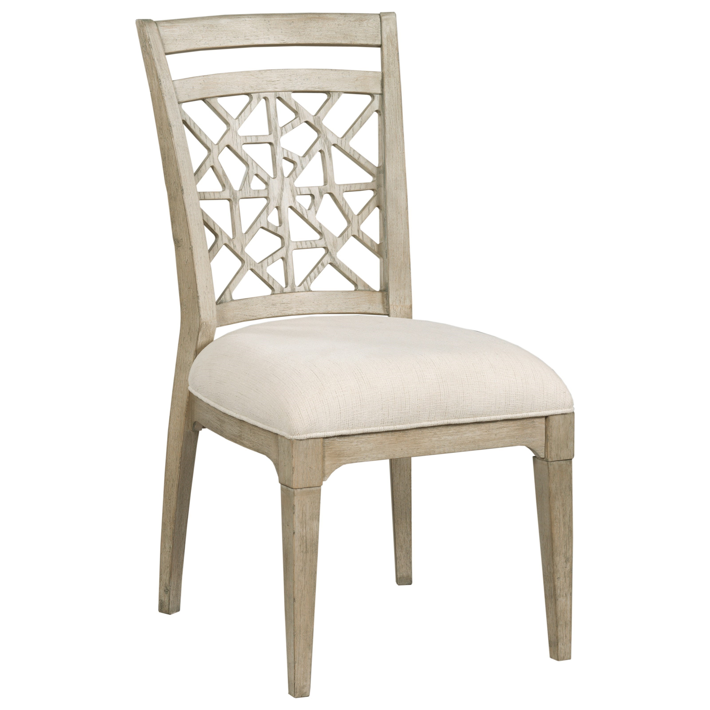

Slide 32
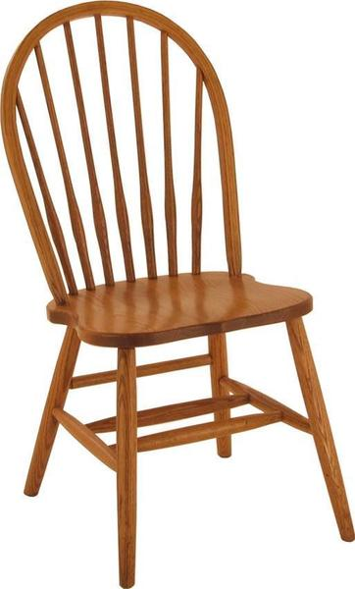
Windsor chair
A chair built with a solid wooden seat into which the chair-back & legs are round, or pushed into drilled holes, in contrast to standard chairs.

Slide 33
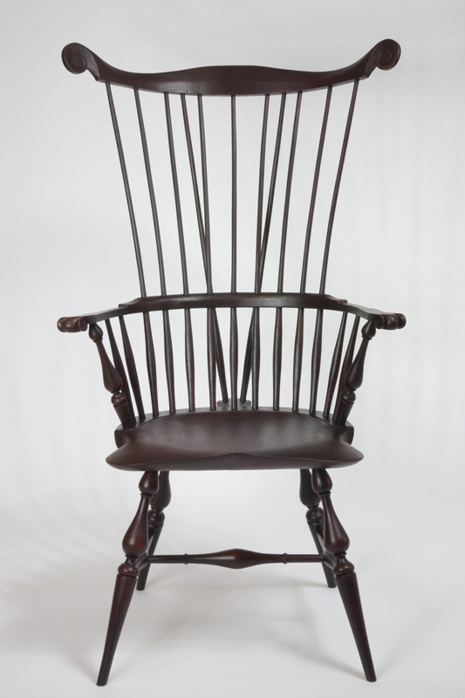
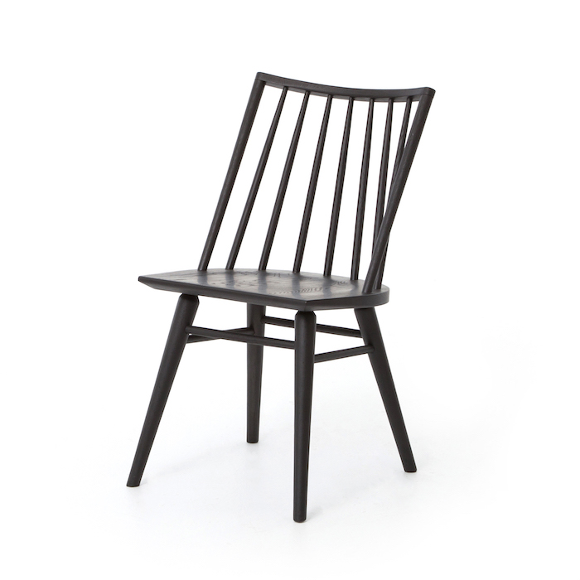

Slide 34
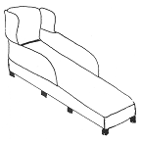
Chaise lounge
Is an upholstered sofa in the shape of a chair that is long enough to support the legs

Slide 35
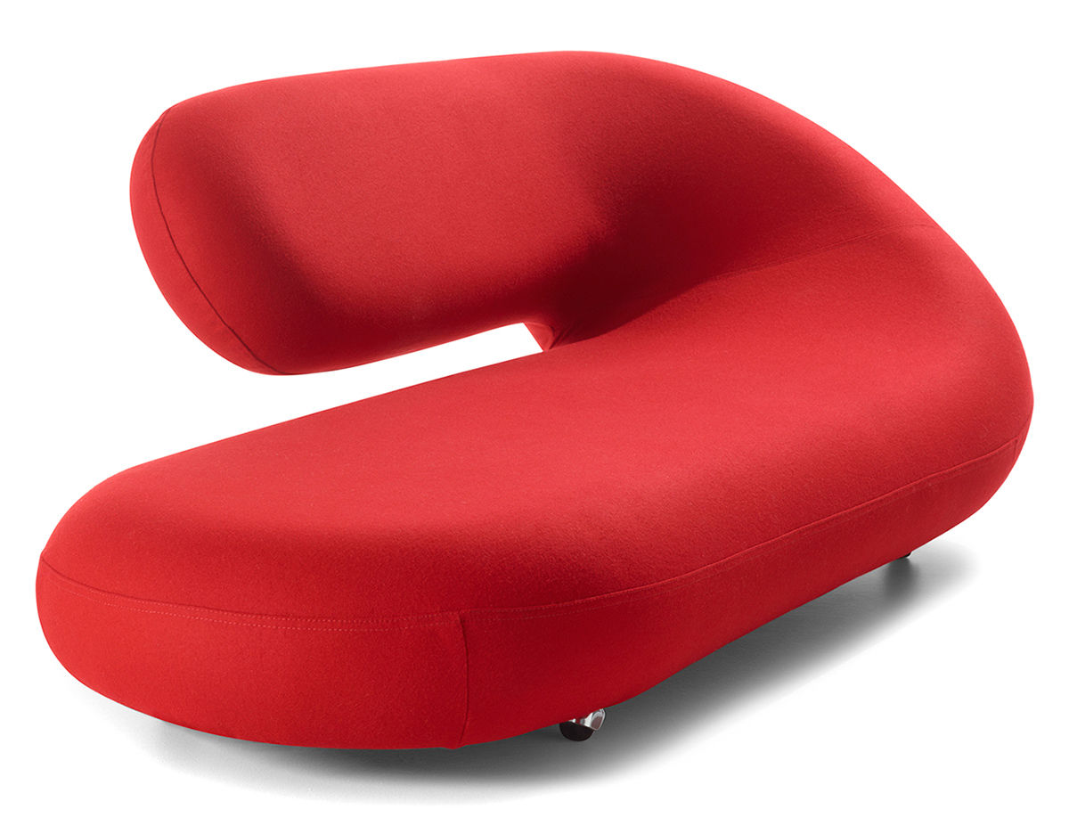
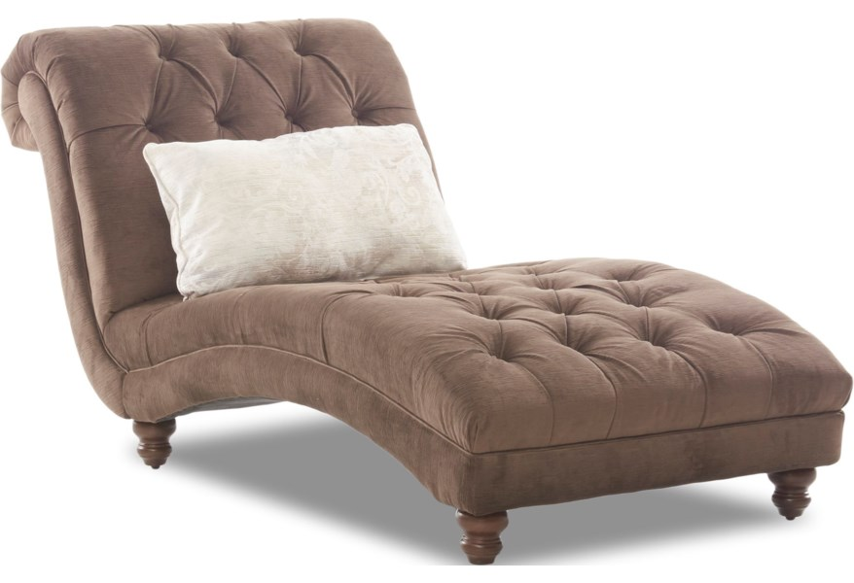

Slide 36
Camelback sofa
Named for its curved back that resembles a camel’s hump

Slide 37
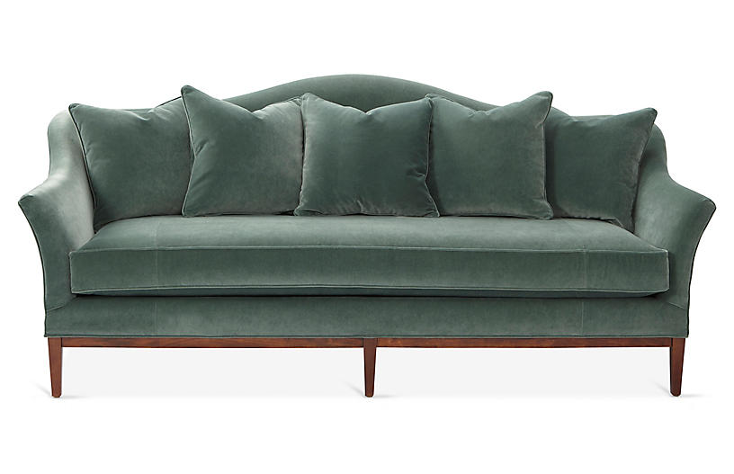
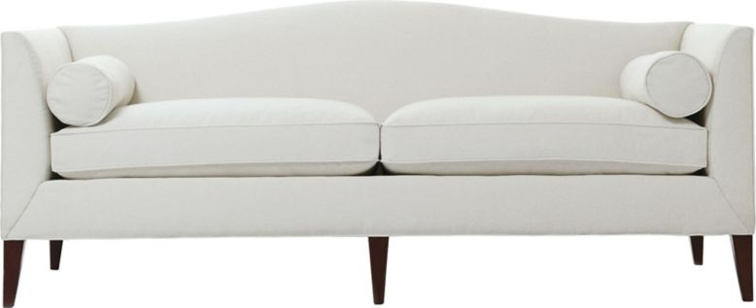

Slide 38
Lawson sofa
A comfortable classic, characterized by a simple silhouette, loose back pillows and three cushion seat design

Slide 39
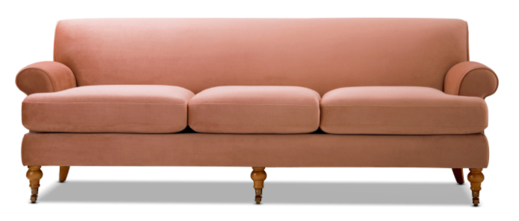

Slide 40
Tuxedo sofa
An upholstered sofa with slightly curved arms that are the same height as the back

Slide 42
Coffee table
A low table, typically placed in front of a sofa

Slide 44
End table
A small table usually about the height of the arm of a chair that is used beside a larger piece of furniture (such as a sofa)

Slide 46
Sofa table
A tall, narrow table used behind a sofa to hold lamps or decorative objects

Slide 48
Nesting table
One of a set of usually three or four small tables that are graduated in size so that they may be stacked on top of one another (aka stack table)

Slide 50
Pedestal table
A table supported by a single central column

Slide 52
Gate-leg table
The table top has a fixed section & one or two hinged leaves, which, when not in sue, fold down below the fixed section to hang vertically.

