Slide 1
Bell Work
How can meal time be made more appealing for a toddler? (i.e. what are some guidelines to follow)

Slide 2
Quiz #1 Unit 2
1. Which statement about toilet training is true?
A. Children are ready to be toilet trained when they turn two
B. Parents should train the child when the child is physically
and emotionally ready.
C. If the child has an accident, get angry and make them clean
it up
D. Once you start training the child, do not stop until the child
is trained
2. Which statement about toddlers’ physical development is true?
A. An average two year old walks and runs with his feet
further apart than an adult
B. Going down stairs alternating feet is easy for a two year
old to do
C. A toddler does not have the eye hand coordination to feed
themselves.
D. An average 3 year old toddler can hop on one foot

Slide 3
3. During the toddler stage, there is rapid growth in the:
A. Size of the head
B. Upper body
C. Arms and legs
D. height and weight
4. Which of the following items would encourage the development of a preschooler’s gross motor skills?
A. Modeling clay C. Puzzles
B. Tricycle D. Scissors
5. These are some of the following self help skills that a toddler is learning except:
A. Feeding themselves simple finger foods
B. Dressing themselves
C. Making their bed
D. Washing and drying themselves

Slide 4
Reality Baby and Books
Books
Reality Baby
Today:
Torri A.
Shania J.
Wednesday
Carie B.
Chase R.
Gunner
Pablo
Carie
Dalton
Myrranda
Sierra
Kenzee
Tiffany G.
Jenessa
Abbie

Slide 5
Pass back assignments
Grades
Catch-up

Slide 6
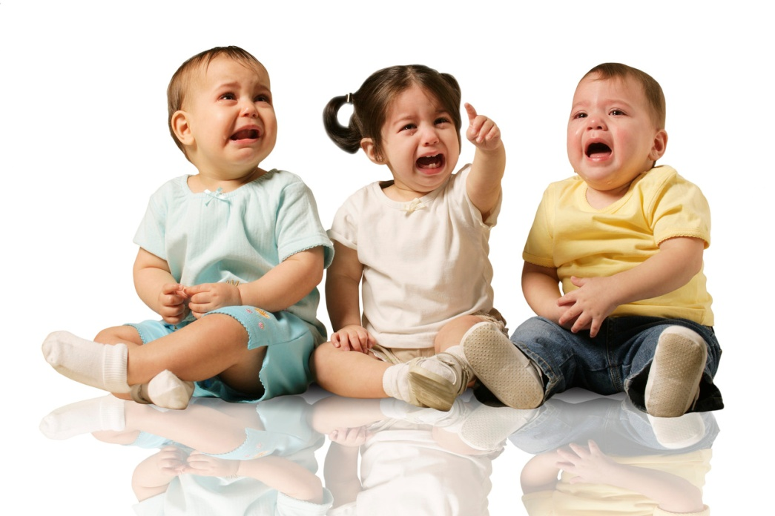
Emotional and Social Toddler

Slide 7

1. EMOTIONS are another word for feelings.
  These have a wide range, are spontaneous, and go in cycles within minutes.
  Can be frustrating for both the toddler and the caregiver.

Slide 8
Emotions Video Clip
http://www.youtube.com/watch?v=tlIWe0moTys&safety_mode=true&persist_safety_mode=1

Slide 9
Toddler emotional roller coaster traits:
One Year Old
  Learning emotions
  Possessive
Two Year Old
  Very self-centered (egocentric)
  Desire for independence
  Beginning a sense of personal identity and belongings
  Possessive
  Often negative
  Often frustrated
  Enjoys physical affection
  Resistive to change

Slide 10
The Toddler’s Creed
If I want it…. It’s mine!
If I give it to you, and change my mind… It’s mine!
If I can take it away from you…. It’s mine!
If I had it a little while ago… It’s mine!
If it’s mine, it will never belong to anyone else…..
No matter what!
If we are building something together, all of the pieces…
are mine!
If it looks like mine, or even if it doesn’t…IT’S MINE!

Slide 11


2. SELF-CENTERED (EGOCENTRIC)
When a toddler thinks about their own needs and wants and not those of others.
  They perceive that the world revolves around them.
As an infant, their needs and wants were met immediately, but now as a toddler, they are learning that some desires won’t be met as promptly.

Slide 12
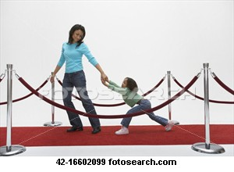
3. NEGATIVISM is doing the opposite of what others want, which is a normal part of toddler development.
Causes are:
  desire for independence,
  frustration,
  realizing power and freedom of being a separate person .
Techniques a caregiver can use to guide a child through this emotion are:
  give choices,
  redirect child’s attention,
  encourage talking of feelings

Slide 13
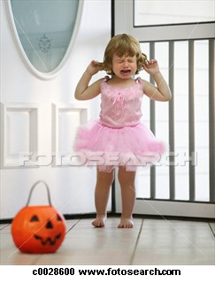
4. TEMPER TANTRUMS are a release of anger or frustration by violent screaming, crying, kicking...Generally 18 months – 4 years
Outbursts of anger happen because the child is:
    frustrated,
    mad,
    tired,
    ignored,
    testing the limits,
    over stimulated,
    hungry
  ... And they do not know how to appropriately deal with or express their feelings.

Slide 14

A caregiver can handle the outburst by:
holding the child
ignoring the child,
removing the child from the area,
remaining calm,
keeping the child safe,
resist raising your voice,
resist giving in to the tantrum
acknowledge the child’s feelings but emphasize why the demands cannot be met
don’t bother with long explanations – give a short, firm and direct statement
After the tantrum say, “I am so glad that you are feeling better. Now that you have calmed down……”
  Do not give a reward after the tantrum is over – business as usual
  If the child makes an obvious choice to not throw a tantrum, praise them

Slide 15
Children’s Book
Thursday
Monday
Nina
Kaeli
Bree
Brooke
Lilly
Cassidie
Cheyenne
Makayla

Slide 16
Reality Baby!!
Monday
Wednesday
Kelsey
Cassidie
Madi
Taylor
Charee
Darian
Lilly
Keresha
Kaeli
Jordyn

Slide 17
5. ANGER The primary human emotional reaction to a frustration, disappointment, embarrassment…
      An angry 18 month old usually does not direct the anger toward a person or object.
      A 2 year old is more likely to aim their anger at the responsible object or person.
  A caregiver can:
    Apply reasonable and limited demands on the child.
    Respond in a controlled manner : manage anger, words, frustrations,..
      Reacting angrily will only make the situation worse.
    Teach the child to use self-control.

Slide 18
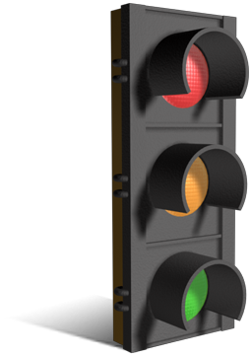
6. STUBBORN is a very common way for a toddler to show their desire for independence.
Helping a toddler with self-control…..
  Stop and go games
  Allow them to make their own choices
  Prepare a child before it happens (leaving)
  Only offer help and allow them to decide when to use it
  Toddlers do not reason, they just react!

Slide 19
7. FEAR is an emotion that can help a child avoid dangerous situations
It is very common for a toddler to have fears.
  Afraid of strangers, noises, dark, animals, storms, noises, getting hurt, bad people (those that look like ones in books/TV).
    Adults encourage belief in “nice” characters, like Santa, but not much is said about frightening make-believe like monsters, witches, ghosts…..
Imitation Fear = Caregiver will non-verbally teach or show their own fears to the children and then the children will imitate these same fears .

Slide 20

A caregiver can handle a toddler’s fear:
  by giving understanding and support,
  talking about it,
  not forcing a child to confront the fear,
  reading books on the fear,
  making the unfamiliar more familiar,
  not making fun of them
  not saying “There’s nothing to be afraid of”
  don’t push their fears aside, they are real to them
  teaching the child how to control fear (monster juice)

Slide 21

Separation anxiety, the fear of being away from family, caregivers, or familiar environments is still seen in a toddler.
  Begins about 8 months and Peaks from 14 – 18 months.
  It can even affect a toddler’s sleep patterns.
To ease Separation Anxiety:
  Prepare the child in advance about the separation time
  Explain to the child the activities they will be doing
  Have a meet and greet with the caregiver or at the location
  Tell the child when they will be picked up, where, and by whom
  Tell the child where you will be while you are gone
  Do not prolong the goodbyes. Create a short ritual and follow it every time
  Do not sneak out
  Play peek-a-boo and other similar games
  Practice predictability, routines, and consistency.

Slide 22
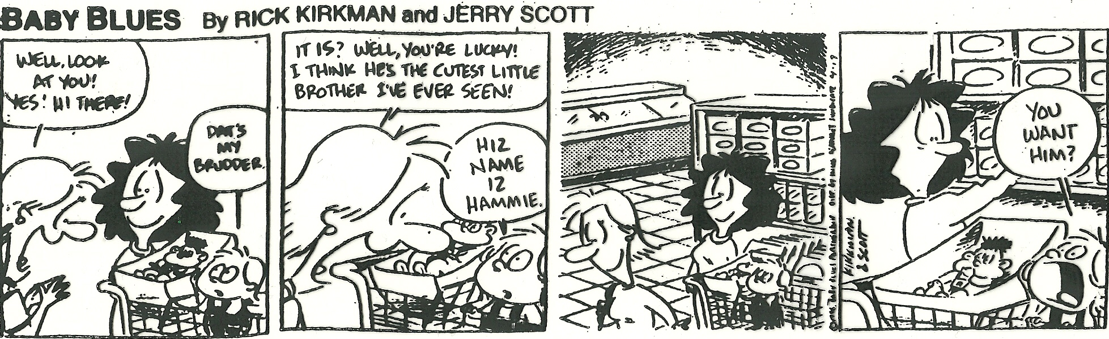
8. JEALOUSY is a common emotion that is evident after the first year and may result from a toddler not understanding that parent’s have enough love for everyone.

Slide 23
Toddler Scenarios
4 Groups~ count off
  Read the scenario and come up with 3 ways a caregiver can help the toddler deal with the problem.
    Rotate who will act out how to deal with the situation~ EVERYONE participates
I will give each group a whiteboard, while viewing the scenario put down the ways the caregiver diffused the situation

Slide 24
Toddler Scenarios:
1. You have just picked James up from his caregiver’s home. It’s been a long day for both of you. James is tired and hungry. So are you. As you approach the grocery store you decide to stop and grab some bread and milk. James sees a candy bar and wants it. You say ,”no” and he begins hitting you.

Slide 25
2. Sarah just had a birthday party. She received several nice, new toys from her grandparents. Now her cousin, Matt her has come over for cake and ice cream. He sees the toys and immediately want to play with them. Sarah throws a temper tantrum and grabs all the toys in her arm and yells, “No! Mine!”

Slide 26
3. You have an important meeting at 3:00 p.m. It is now 2:00 and you are getting ready to go. You look downstairs and see that you toddler has strewn toys all over the basement. You yell at him to hurry up and get the toys put away. He just sits down on the floor and begins to scream, “No go!”

Slide 27
4. When you came home from the grocery store yesterday, you went to put the new cereal in the cupboard. There you found several partially full boxes of cereal. You placed them on the cupboard for breakfast the next morning. However, Greg, your toddler, does not want any of them. He is having a tantrum and yelling, “No, no! Cookie!”

Slide 28
9. LOVE is an emotion first expressed toward those who satisfy a baby’s physical needs.
Giving hugs and telling a child that they are loved is a great way to teach this emotion. They will learn how to show it and be more accepting of it in the future.
A child’s self-confidence is built by having love and trust.
Micah

Slide 29
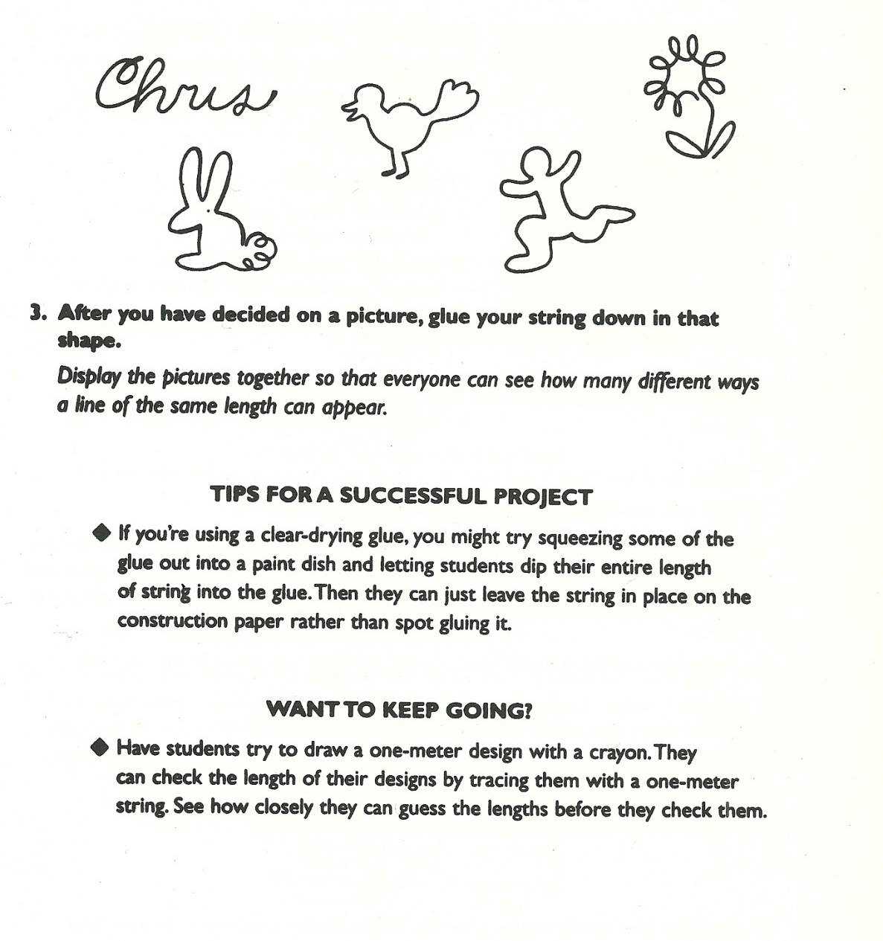
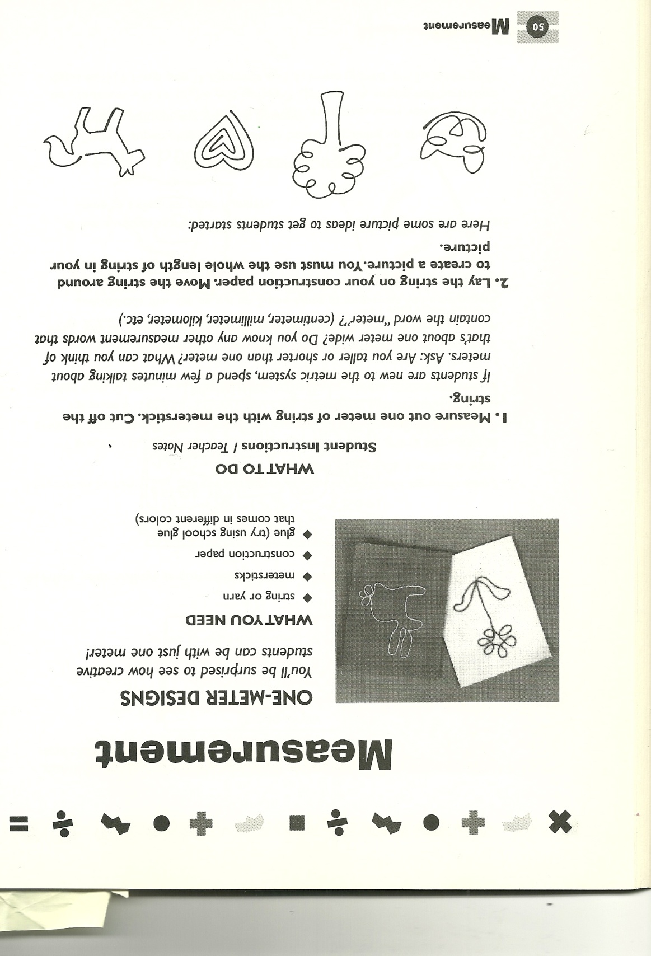

Slide 30
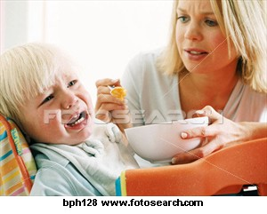
10. Autonomy vs. Shame and Doubt
Eric Erickson’s toddler stage of emotional development.
    Autonomy is developing a mind of their own / independence.
    An environment that fosters Autonomy (independence) and Trust enhances the emotional development of children and helps them to handle difficult situations now and later on in life.
A caregiver can encourage Autonomy by:
  allowing them to try things on their own,
  provide opportunities for success,
  recognize efforts made.
  let them make choices.
Autonomy leads to self-control, pride, and achievement and doing the opposite causes Shame and Doubt…

Slide 31
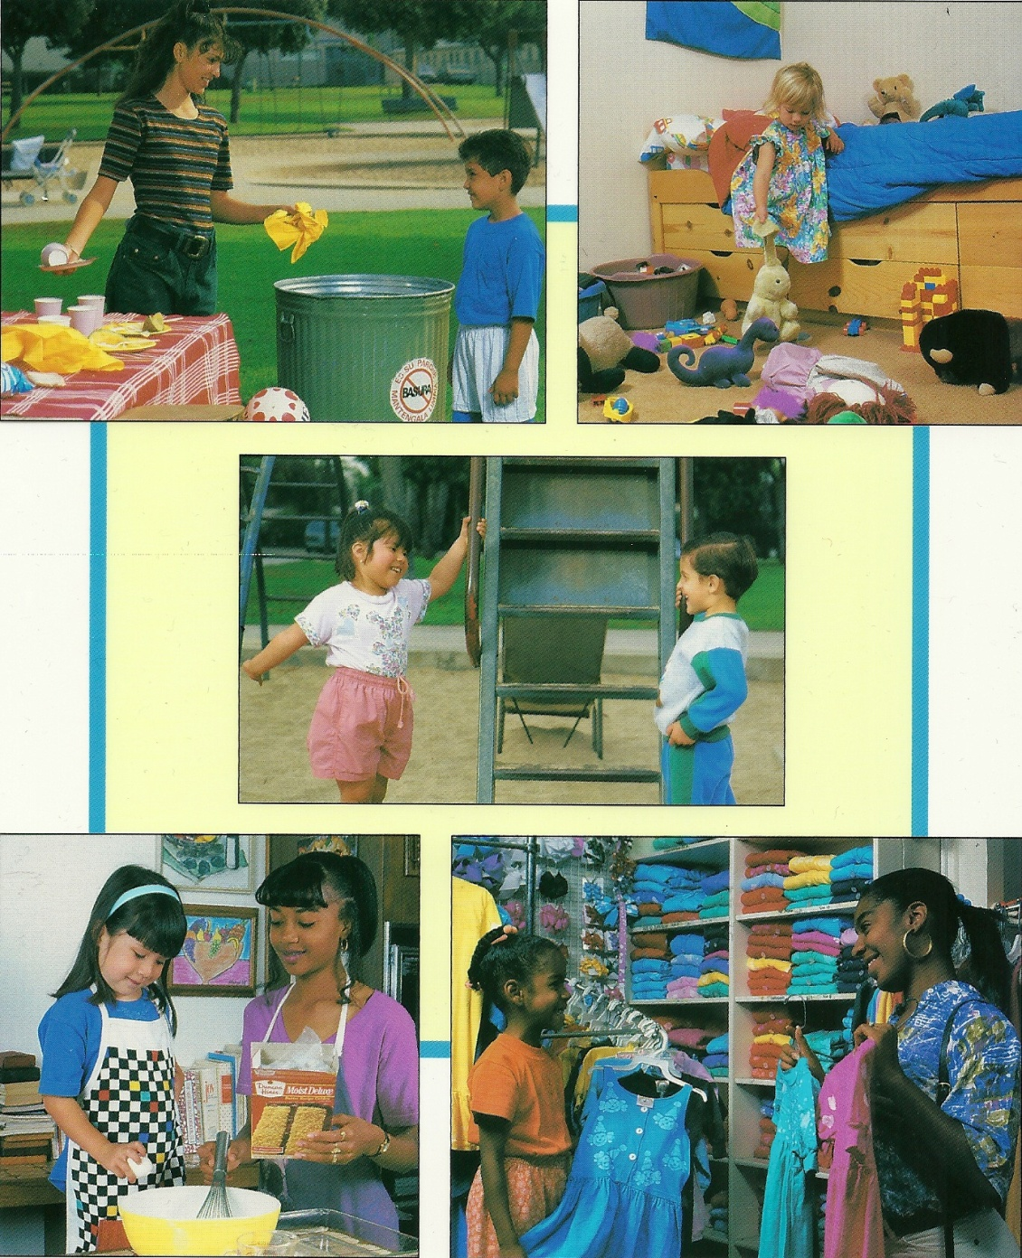

What would a positive parent say?
“Very Good”

Slide 32
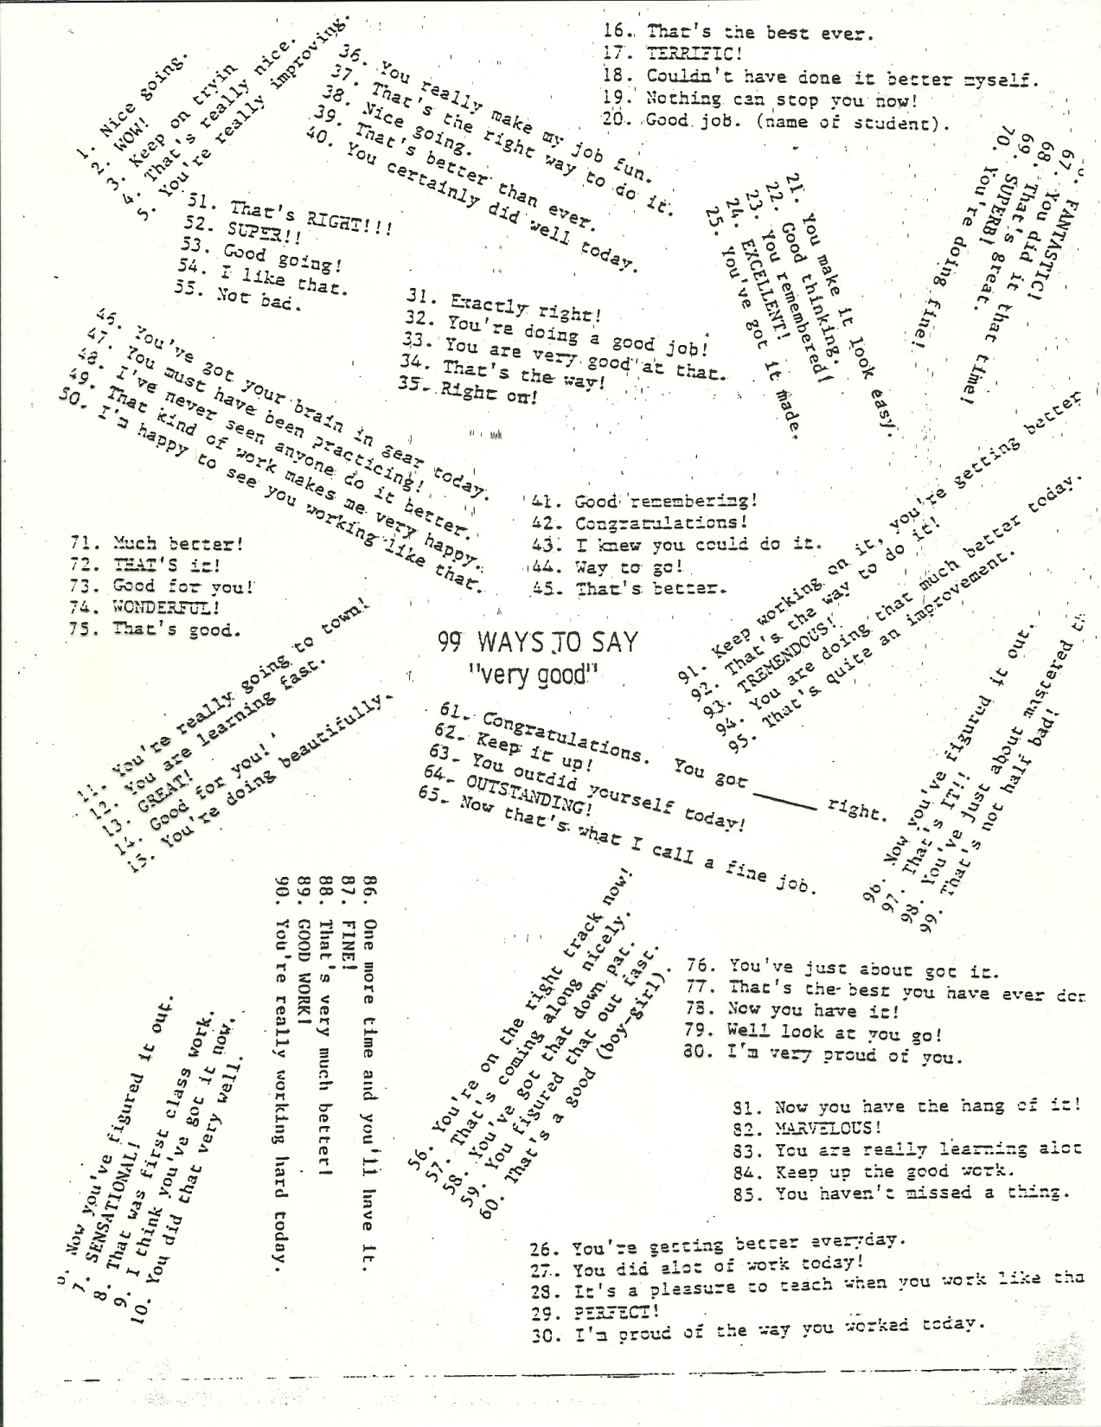

Slide 33
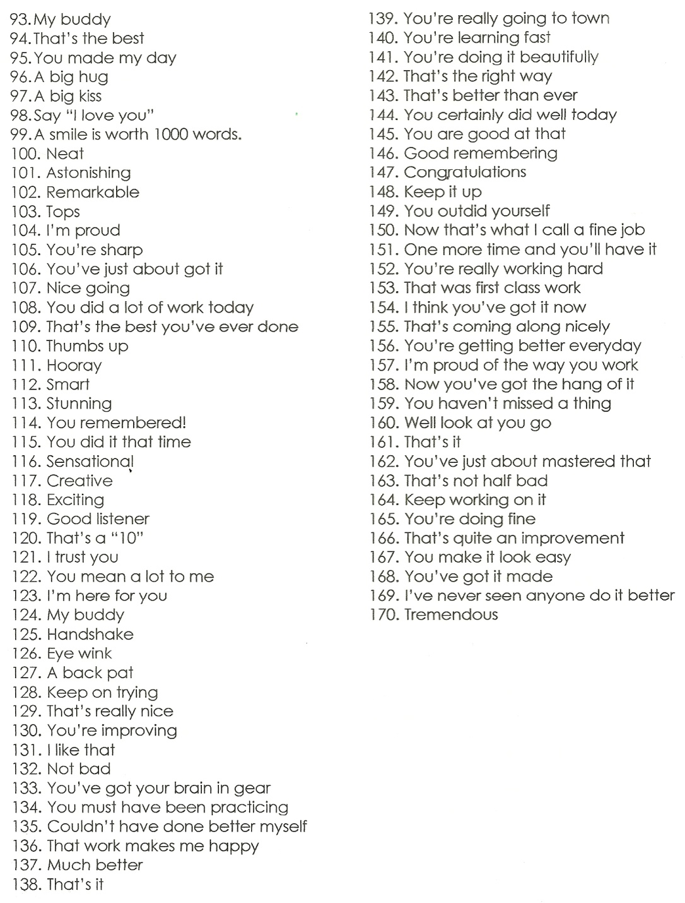
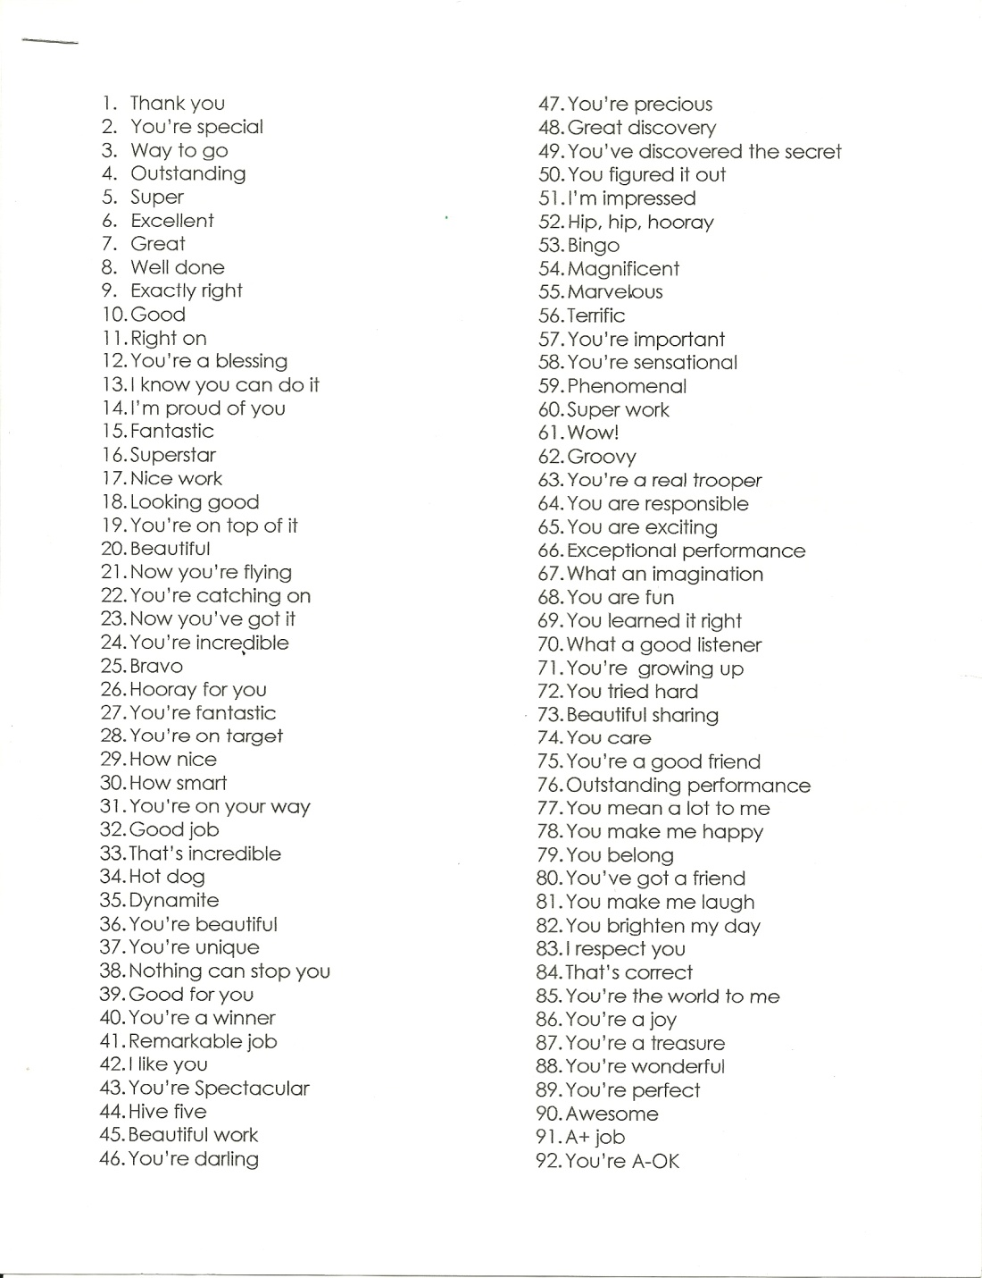

Slide 34
Bell Work
How would you handle a toddler having a temper tantrum in the park, when there are many parents and kids playing?

Slide 35
Unit 2 Quiz #1
A good way to show toddlers that they are loved is by:
  A. Giving hugs and telling them are loved
  B. Buying them toys
  C. Having surprises for them on birthdays and other special occasions

Slide 36
2. What type of play do toddlers MOST often participate?
A. Onlooker play
B. Parallel play
C. Cooperative play
D. Dramatic play

Slide 37
3. Which term is used to describe the toddler’s idea that the whole world revolves around them?
A. Negativism
B. Autonomy
C. Egocentrism
D. Stubborn

Slide 38
4. Which of these is a characteristic of a typical two year old?
A. Plays cooperatively with others
B. Accepting and agreeable
C. Patient
D. Short attention span

Slide 39
5. Toddlers want to be
A. Independent
B. Treated like a baby
C. Just like their friends
D. Helped when they do thing.

Slide 40
6. Which statement about toilet training is true?
a. Children are ready to be toilet trained when they turn two
b. Parents should train the child when the child is physically and emotionally ready.
c. If the child has an accident, get angry and make them clean it up
d. Once you start training the child, do not stop until the child is trained

Slide 41
7. Which statement about toddlers’ physical development is true?
A. An average two year old walks and runs with his feet further apart than an adult
B. Going down stairs alternating feet is easy for a two year old to do
C. A toddler does not have the eye hand coordination to feed themselves.
D. An average 3 year old toddler can hop on one foot

Slide 42
8. During the toddler stage, there is rapid growth in the:
A. Size of the head
B. Upper body
C. Arms and legs
D. height and weight

Slide 43
9. Which of the following items would encourage the development of a preschooler’s gross motor skills?
A. Modeling clay
B. Puzzles
C. Tricycle
D. Scissors

Slide 44
10. These are some of the following self help skills that a toddler is learning except:
A. Feeding themselves simple finger foods
B. Dressing themselves
C. Making their bed
D. Washing and drying themselves

Slide 45
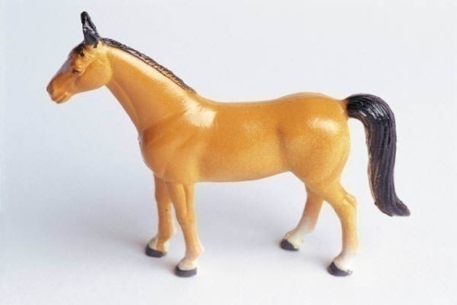

11. SELF – CONCEPT is how a toddler sees themselves.
They are becoming aware of their individual differences and those traits that make them special and unique. This can be positive or negative.
Build a positive self-concept in a toddler by:
  giving unconditional acceptance,
  encouraging self-help skills,
  provide opportunities for success,
  refrain from fixing things they do
      telling them positive specifics about themselves and their actions.
Twin Boys
GOOD!

Slide 46
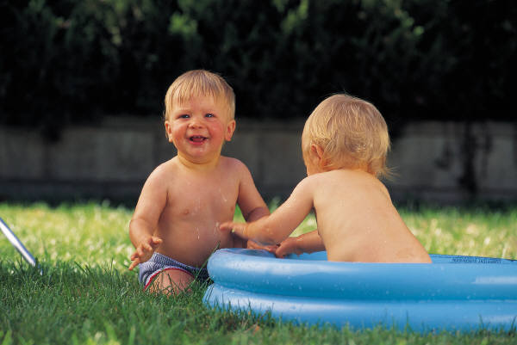
12. Toddlers are naturally SOCIAL
They like to be around and associate with other people.
  We are all friends.

Slide 47
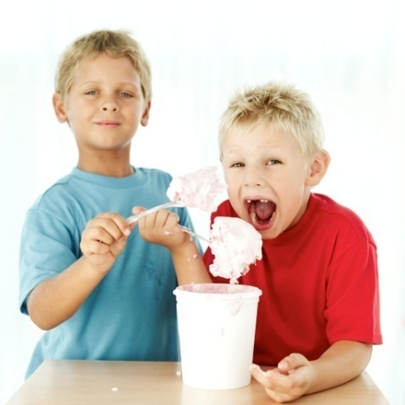

13. SHARING is one of the first social skills that children learn, but it is not easy for them to understand
A caregiver can teach this concept by:
  redirecting the child
  limiting materials
  Demonstrating and talking about it with the child
  A caregiver should avoid interfering in children‘s disagreements unless danger is occurring so the children can learn to problem solve on their own.
    Never force a child to share. Let it be their choice.

Slide 48
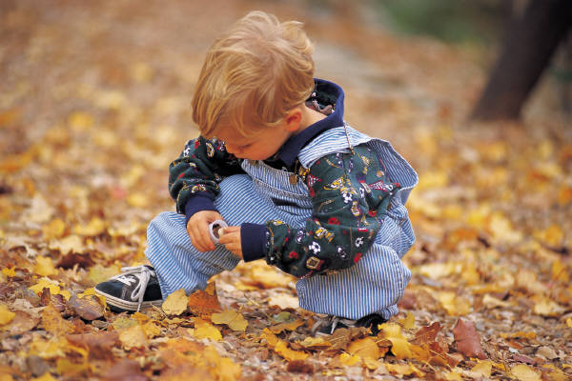
14. Play is a child’s form of work. Here, they learn and grow in all areas of development.
Solitary Play is playing alone.
On-Looker Play is watching everyone play, but having no interaction
Parallel Play is playing next to, but not with other children. This is the most common form of play for a toddler.
Toddlers have short attention spans and tend to bounce around activities.

Slide 49
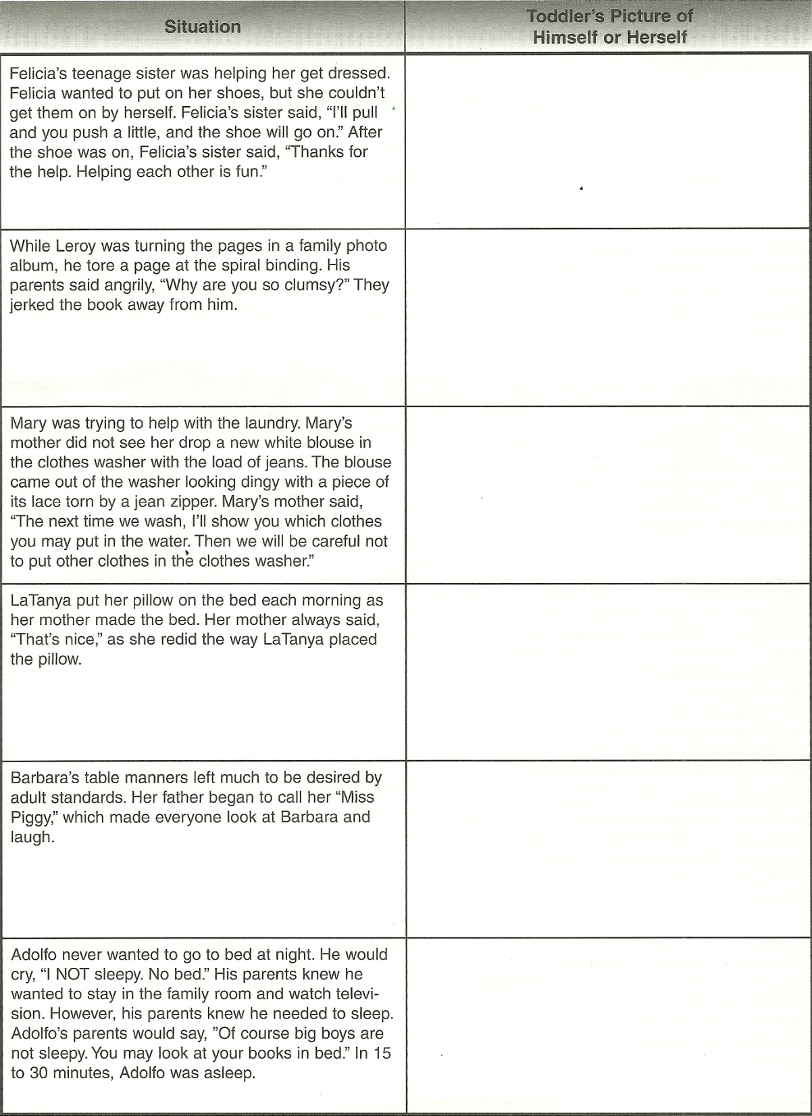
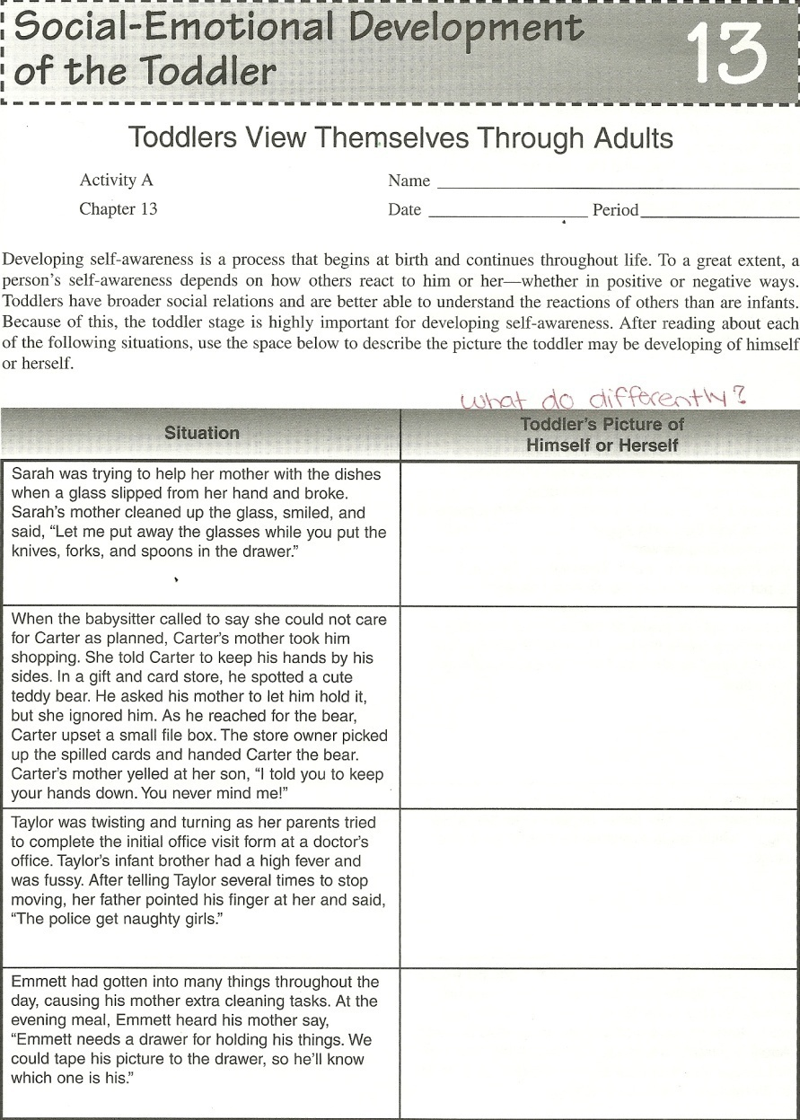
Scenarios

Slide 50
Reflection #3
If you could change your childhood would you? Why?

