Slide 1
10 Tips To
Build a Healthy Plate

Slide 2

#1 Balance Calories
Cook more often at home where you are in control of what’s in your food.
Eat the right amount of calories for you.
EXERCISE

Slide 3

#2 Enjoy Your Food But Eat Less
Eating too FAST or when your attention is elsewhere may lead to eating too many calories.
Pay attention to hunger cues before, during, and after meals.

Slide 4


#3 Avoid Oversized Portions
Use a smaller plate, bowl, and glass
When eating out choose a smaller size option, share a dish, or take home part of your meal.

Slide 5

#4 Eat more:
Vegetables
Fruits
Whole Grains
Fat free or 1% milk
These foods have more nutrients like fiber, calcium, Vitamin D, and Potassium.
Make them the basis for meals and snacks

Slide 6


#5 Make Half your plate Fruits and Vegetables
Choose red, orange, and dark green vegetables like tomatoes, sweet potatoes, and broccoli.
Add Fruits to meals as part of main or side dishes or as a dessert.

Slide 7

#6 Switch to Fat-Free or Low-fat (1%) milk.
They have the same amount of calcium and other essential nutrients as whole milk, but fewer calories and less saturated fat.

Slide 8

#7 Make Half Your Grains Whole Grains
To eat more whole grains, substitute a whole grain product for a refined product.
Eating whole wheat bread instead of white bread or brown rice instead of white rice.

Slide 9
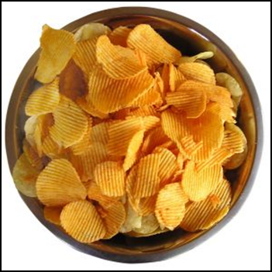


#8 Foods to eat Less Often
Cut back on foods HIGH in SOLID FATS, ADDED SUGARS, AND SALT.
Use these foods as occasional treats not everyday.

Slide 10
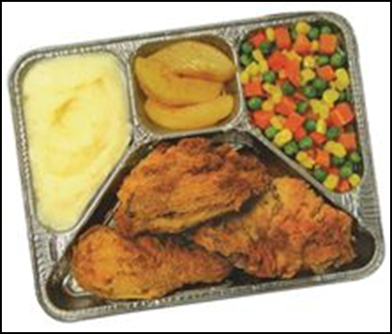
#9 Compare Sodium in Foods
Use nutrition Facts label to
Choose lower sodium versions like soup, bread, and frozen meals.
Select canned foods label with Low sodium, reduced, or no salt added.

Slide 11

#10 Drink water instead of sugary drinks
Cut calories by drinking water or unsweetened beverages. Soda, energy drinks, and sports drinks are a major source of added sugar, and calories.

Slide 12
Vary Your Protein Food Choices
Keep meat and poultry portions small and lean.
Try grilling, broiling, poaching, or roasting.
Eat a variety of meats including 8 oz. of seafood a week.

