Slide 1
What are three ways birth defects can be prevented by the mother and father
Bell Work

Slide 2
Unit 5, Quiz #1
1. A recessive gene will produce a trait only when it is transmitted by:
A. The Father
B. The Mother
C. Either Parent
D. Both Parents
2. Heredity influences all of the following except:
A. Eye color
B. Skin color
C. Weight
D. Hair color

Slide 3
3. Which of the following carries the inherited traits:
A. A gene
B. The placenta
C. Meiosis
D. Umbilical cord
4. If 2 ovum are fertilized what will the outcome be?
A. Fraternal twins
B. Siamese twins
C. Identical twins
D. Paternal twins

Slide 4
5. The chromosome combination that determines that a baby will be a boy is:
XX B. XY C. YY D. YZ
6. Birth defect classification in which the trait for the defect is carried by the female but shows up in the male is known as:
A. Blood Disorder
B. Congenital Malformation
C. Perinatal Damage
D. Sex (X) Linked

Slide 5
7. The test done by inserting a needle through the abdominal wall into the uterus to withdraw some amniotic fluid is:
A. Fetoscopy
B. Amniocentesis
C. Ultrasound
D. Chorion Villi Biopsy
8. Which statement describes Down’s Syndrome:
A. Previously known as Cystic Fibrosis
B. Chromosome 21 has an extra chromosome, a triplet rather than a pair
C. It affects a child’s intellectual development, but not their physical dev.

Slide 6
9. The birth defect caused by a baby’s inability to digest protein is:
A. Fetal Alcohol Syndrome
B. Cerebral Palsy
C. Neural Tube Defect
D. PKU
10. Which trimester is the fetus at greatest vulnerability to a Birth Defect, especially one’s caused by medication/drugs/alcohol?
A. First Trimester
B. Second Trimester
C. Third Trimester
D. Second and Third Trimester

Slide 7
Birth Defects Caused by Lifestyle and Environment
Unit 5 Section C
Change 3

Slide 8
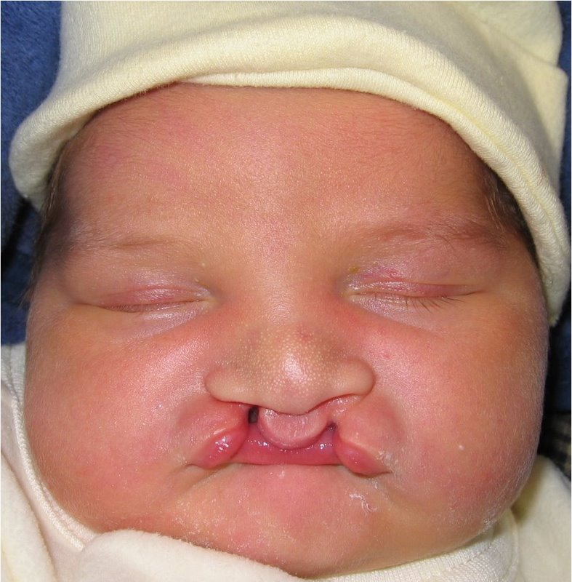
Cleft Lip

Slide 9
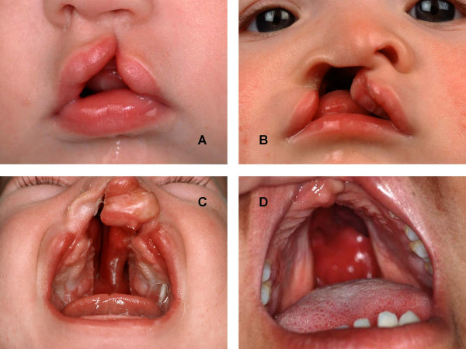
Cleft Palate

Slide 10
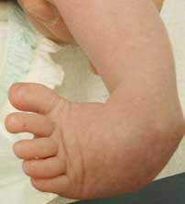
Club Foot

Slide 11
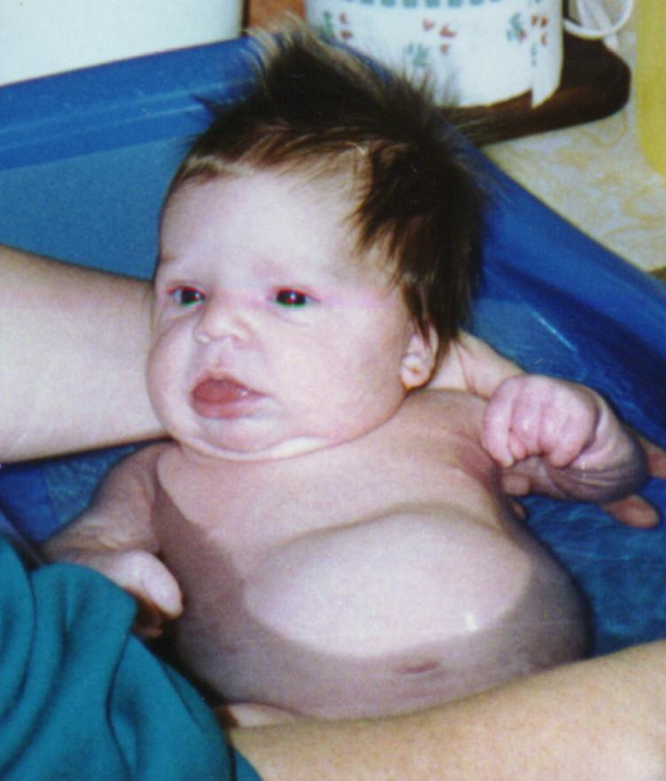
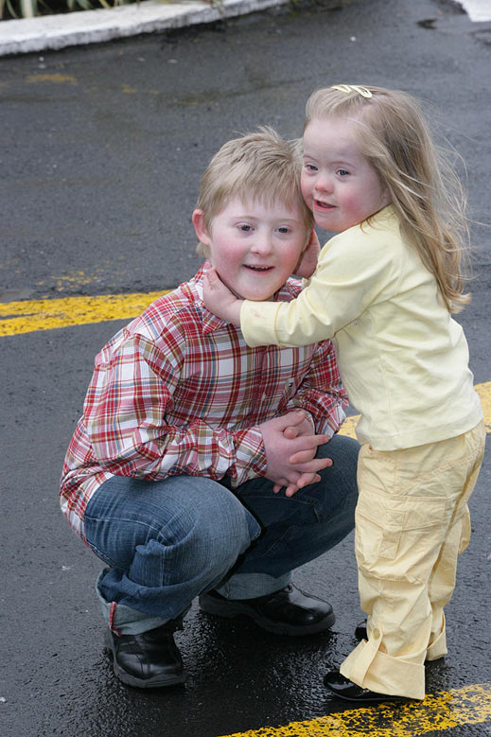
Down’s Syndrome

Slide 12
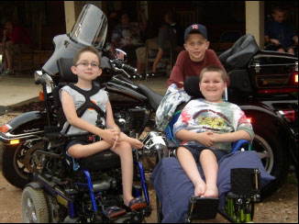

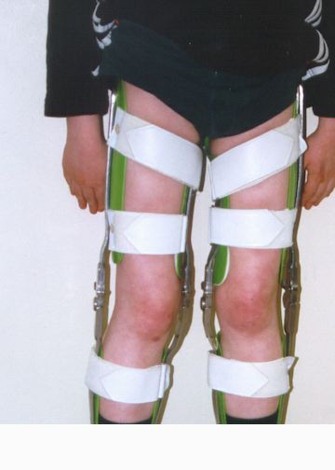
Muscular Dystrophy

Slide 13
Health and Nutrition
1. 20 – 35 Optimum age to have a baby is during these years.
2. weeks The first 6 are the most crucial for development. Mom doesn’t even know she is pregnant.
3. weight gain is the recommended amount for a
pregnant woman who is 24-30 pounds.

Slide 14
Health and Nutrition
4. calorie intake The recommended amount is 2500 calories for a pregnant woman vs. 2200 calories for the average pregnant woman.
5.­­­­food guide pyramid Follow this to ensure a pregnant person 6ets a proper diet and amounts of nutrients.
6. feeding a fetus When it comes to distributing nutrients, the mom’s body meets her need’s first and then the fetus scavenges for what nutrients are leftover.

Slide 15
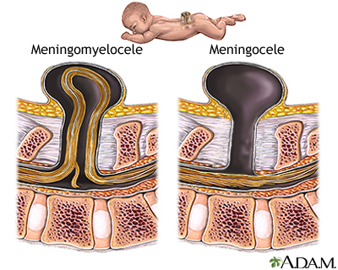
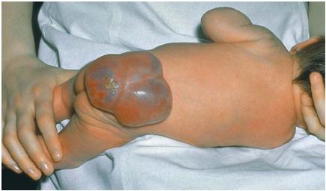
Neural Tube Defects
Spina Bifida

Slide 16
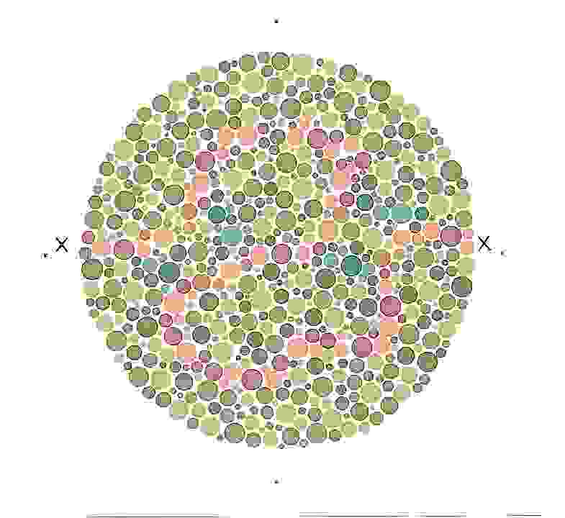
Are you color blind?

Slide 17
Health and Nutrition
7. malnutrition This is the number one cause of birth defects.
8. folic acid Lack of this nutrient contributes to a neural tube defect which will occur before the mom even knows she’s pregnant.
9. active Maintain this lifestyle throughout the pregnancy.

Slide 18
Health and Nutrition
10. Rest and Relaxation Get a lot of both of these. Practice techniques that will help you to stay calm and keep your heart rate low.
11. immunization shots Make sure these are up-to-date before you get pregnant to avoid any unwanted illness.
12. rubella Also known as German Measles, does not affect the mom but will affect a developing fetus by causing them to be blind, deaf, retarded, or dead.

Slide 19
Health and Nutrition
13. medication Only use this, in any form, under doctor’s care-even for a little headache or cold.
14. general anesthetic Avoid this during pregnancy. The dentist and that cavity can wait.
15. prenatal doctor visits Get this early on in the pregnancy and throughout it. Receive 13 check-ups before you deliver.
16. blood type Know this and your RH type to prevent a blood incompatibility between you and your partner.

Slide 20
CHILD ACTIVITY
BUTTERFLY
- Color on the filter – any design(s) and any color(s).
- Hold the filter between your fingers and spray it lightly with water – watch the colors blend together.
- Set it aside to dry
- Once it is almost dry, pinch the middle of the filter together like a bow tied and fan out the wings.
- Wrap a ½ piece of pipe cleaner around the middle – leave some sticking out the top to bend for the antennas.
- Hang it up!

Slide 21
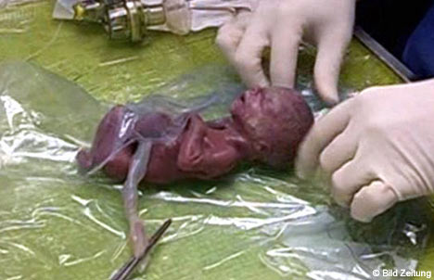

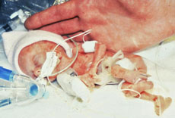
STD Related Birth Defects
Low Birth Weight
Conjunctivitis (Pinkeye)

Slide 22
Lifestyle and Habits
17. STD’s Like Herpes, AIDS, syphilis, and Chlamydia, will cause major birth defects or death to the fetus.
18. sexually active If this is you, male or female, you should act, do and think as if you are pregnant so as not to harm the developing fetus. Better to be cautious then to harm your baby.
19. radiation Including x-rays will cause gene mutilation of the nervous system and the brain to stop developing which will equal retardation.
20. pollutants This is found in the air and causes severe malformation, physical defects, and cerebral palsy so be careful what you breath.
21. caffeine This is still being studied, but in large quantities of coffee or certain sodas it can cause malformations, miscarriage,
or premature births.

Slide 23

Lifestyle and Habits
22. tobacco Using or smoking this restricts blood flow, oxygen and nutrients to developing fetus. It crosses the placenta and harms the fetus’s developing organs and causes growth retardation.
23. alcohol When the mom drinks this, it bleeds thru to the baby and the baby ends up with the same blood alcohol level as the mom. This will stay with the baby for 2 times longer than it will with the mom.

Slide 24
Lifestyle and Habits
24. Fetal Alcohol Syndrome (FAS) In large quantities, alcohol causes FAS because the fetus does not process the alcohol as well as the mom.
It is a combination of mental and physical birth defects like: facial abnormalities, retardation, learning disabilities, emotional problems, liver disease, and possible alcohol addiction. Most of these are
evident at birth. A direct result of mom drinking during pregnancy.

Slide 25
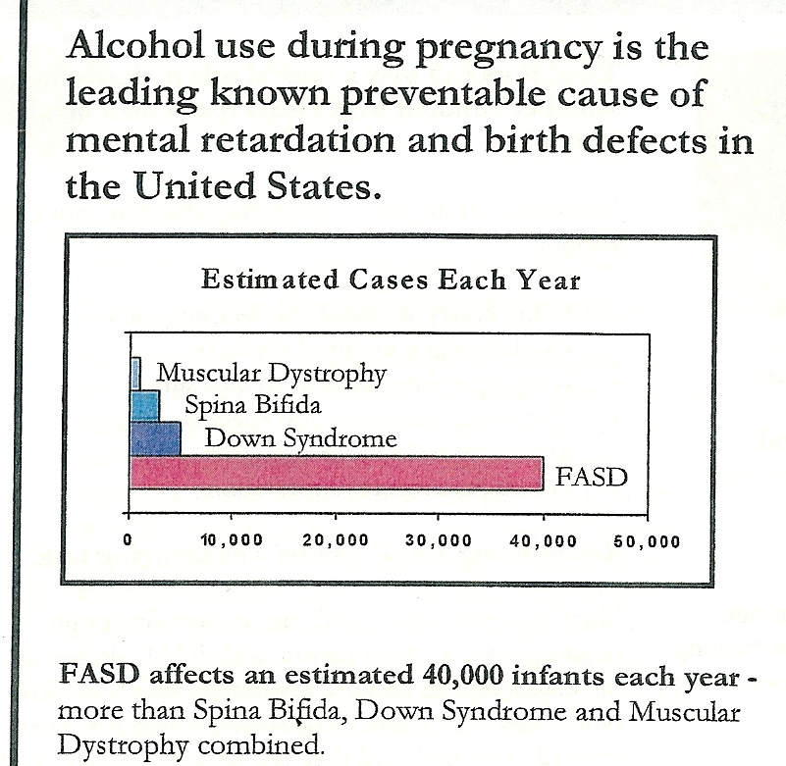
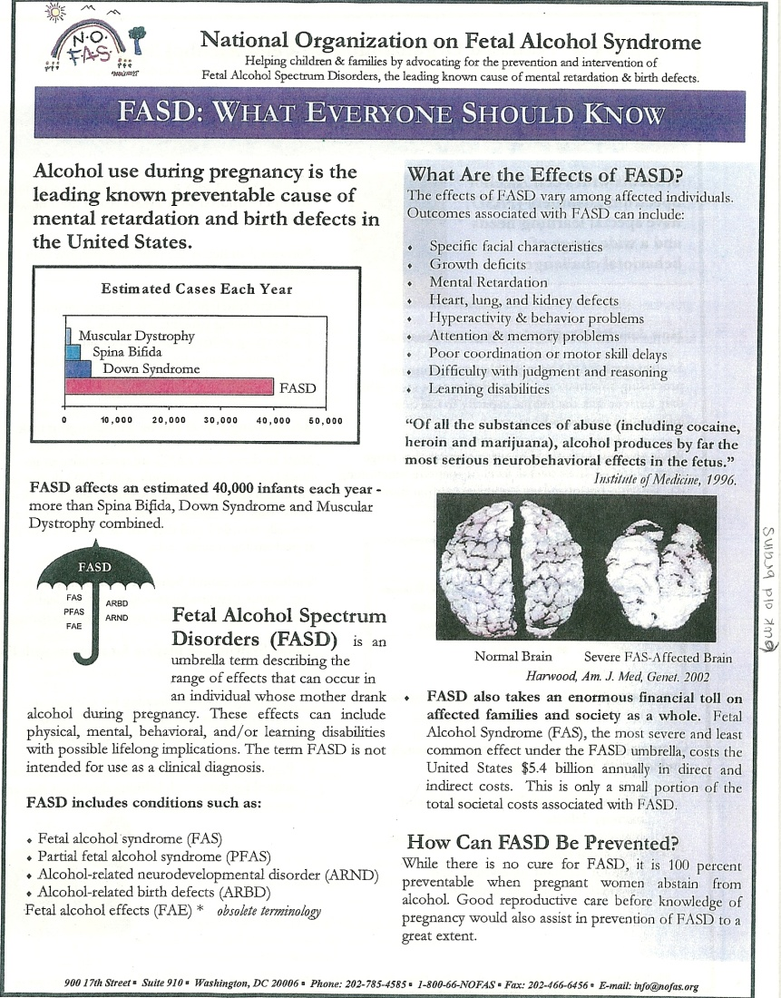

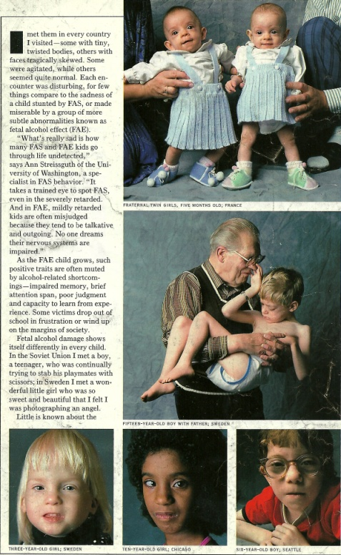

Slide 26
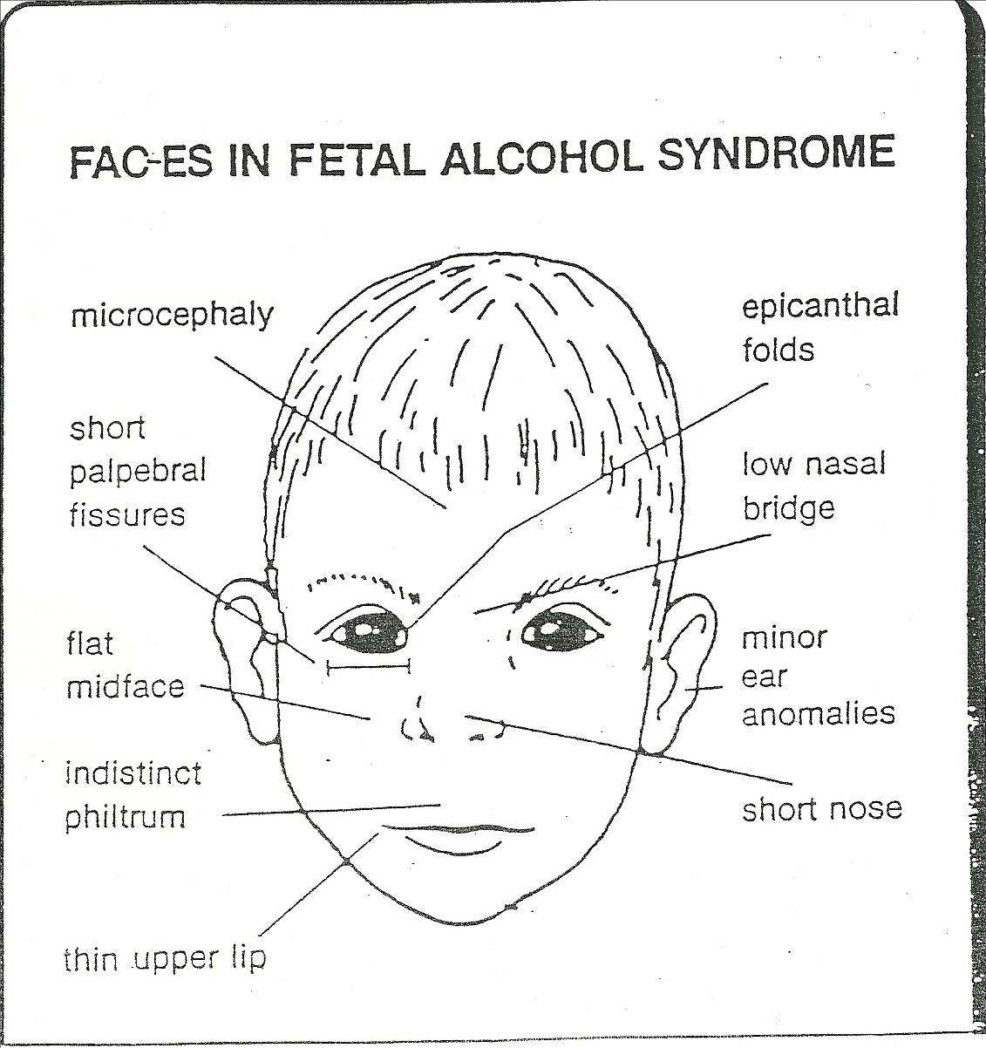

Slide 27
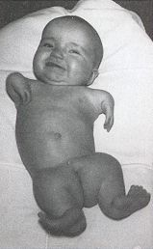
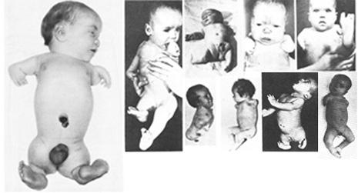
Drug Related Birth Defects
Thalidomide~ sedative to help treat morning sickness used in the 1950’s

Slide 28
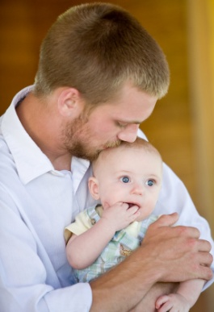
Lifestyle and Habits
25. street drugs Using these cause avoidable tragic birth defects. With each puff, pop, shoot, or snort, the mom poisons her fetus. Heart attacks, stroke. Seizures, malformations, miscarriages, stillbirth, SIDS, neurological problems, irritability, unresponsive tremors, low birth weight, and abnormal vision are just SOME of the effects on the baby.
26. withdrawal The fetus and baby must go thru this just like the “loving” user mom will, but it is much worse on them.
27. toxins Like what you might find in cat litter boxes, on stray cats, in poorly cooked meats, cleaning supplies, paint, and lead, can lead to birth defects or deaths to developing fetus.

Slide 29
PREGNANCY COMPLICATIONS AND PROBLEMS
28. premature This birth occurs at least 2-3 weeks before pre-natal development is complete.
29. low birth weight This is when the baby weights less than 5 ½ pounds at birth even if it has spent the full 40 weeks in uterus.
31. miscarriage When the baby is involuntarily expelled from the mom’s body because it’s incapable of surviving.
32. stillborn When the fetus appears to be developmentally normal, but for some reason is born dead.

Slide 30
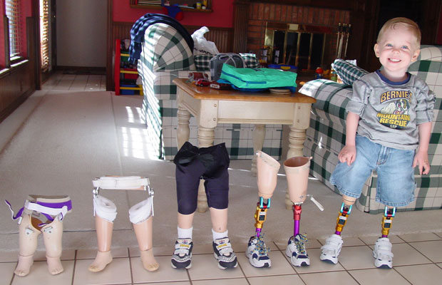

Slide 31
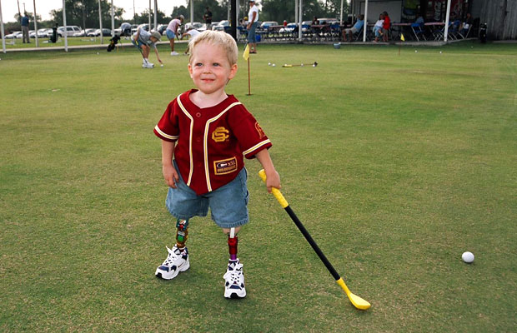

Slide 32


Slide 33
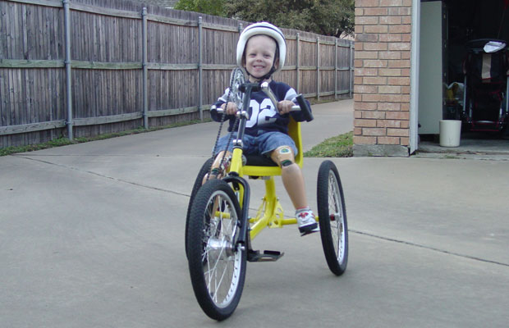

Slide 34


Slide 35
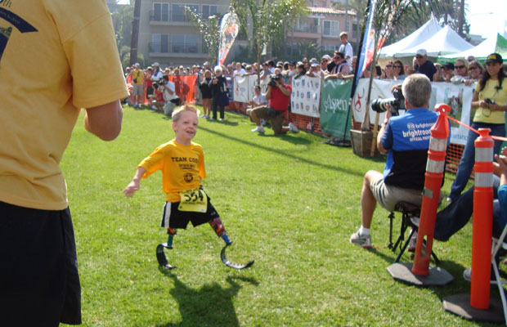

Slide 36
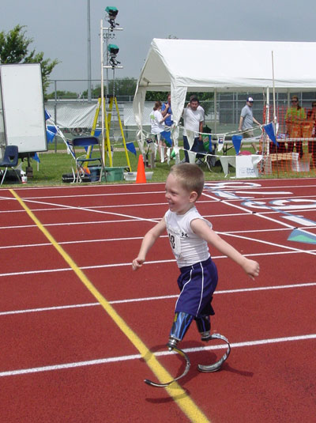

Slide 37
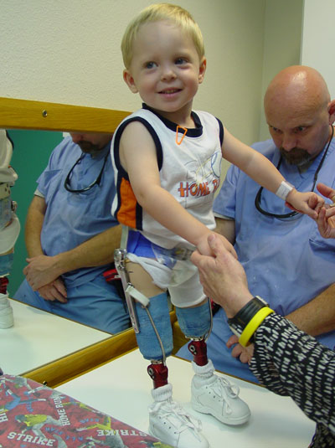

Slide 38
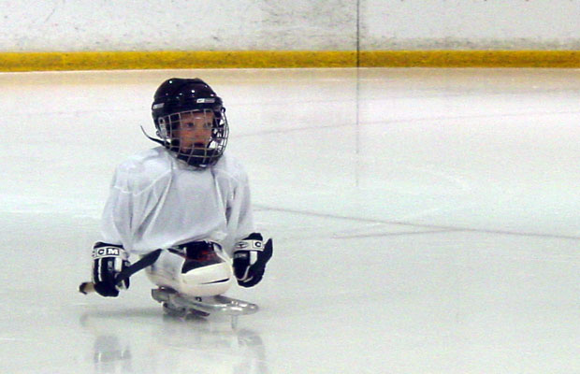

Slide 39


Slide 40
BIRTH DEFECT CHART
Use the literature in the Grey Box
Use the RED Book pgs: 135-136
Use the Blue Book pgs: 159-161
Books and Literature are to be left in the classroom.

Slide 41
VIDEO
AND DOWN WILL COME BABY

Slide 42
Schedule
Unit 5~ Reproduction
  Turn in by Monday, April 23
  Be sure to attach the white packet as well ~ has the female reproduction diagram.

