Slide 1
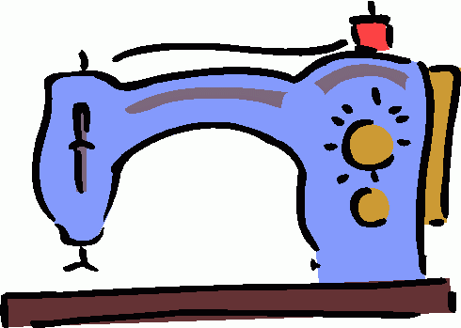
Sewing Equipment

Slide 2
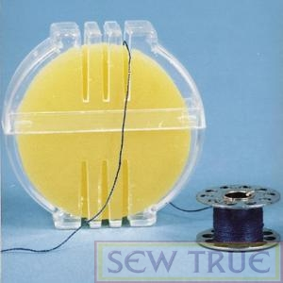
1. Beeswax
Coats and strengthens thread for hand sewing or embroidering. It also helps prevent knots.

Slide 3
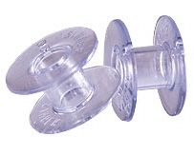
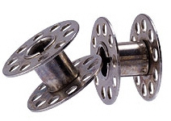
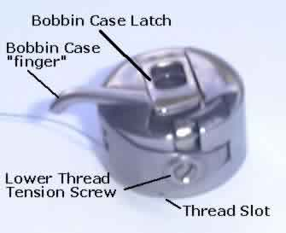
2. Bobbin
A small spool, made of plastic or metal, around which the lower thread of the sewing machine is wound.
3. Bobbin Case
The part of the sewing machine that holds the bobbin.

Slide 4
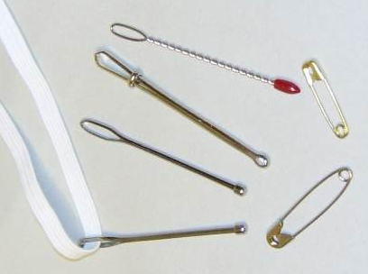
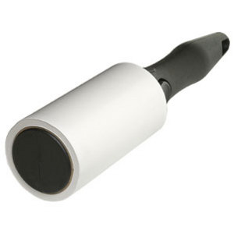
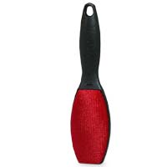
4. Bodkin
A small tool used to draw elastic or other material through a casing.
5. Lint Roller
Used to remove thread and fabric fibers from clothing.

Slide 5
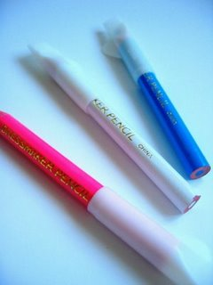

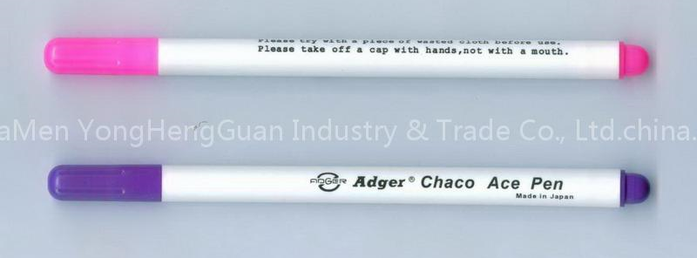
6. Marking Pens or Pencils
Fabric safe pens or pencils used for transferring pattern markings. Most are water-soluble or have disappearing ink.
7. Measuring Tape
Flexible piece of equipment used to measure body measurements, grainlines and long distances.

Slide 6
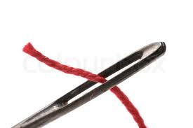
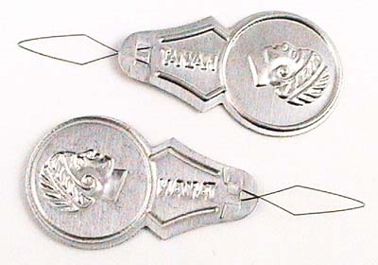
8. Needle
A small, slender piece of metal with a sharp point at one end ad a hole, or “eye” at the other. Used for hand sewing.
9. Needle Threader
A small piece of equipment used to pull thread through the eye of a hand needle.

Slide 7
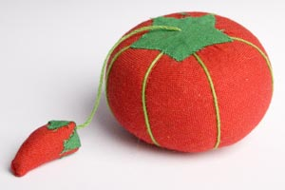
10. Pin Cushion
Small cushion used to hold and sharpen straight pins.
11. Pins
Holds layers of fabric together for cutting and sewing.

Slide 8
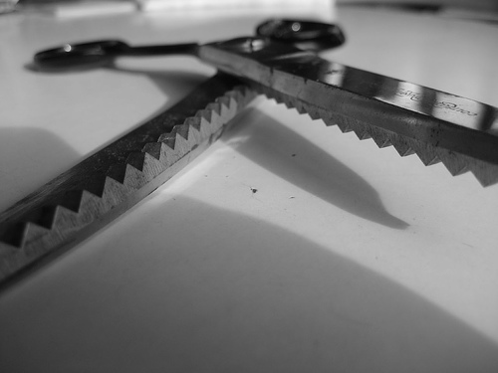
12. Pinking Shears
Shears used to cut a zig-zag, ravel-resistant edge on the fabric.

Slide 9
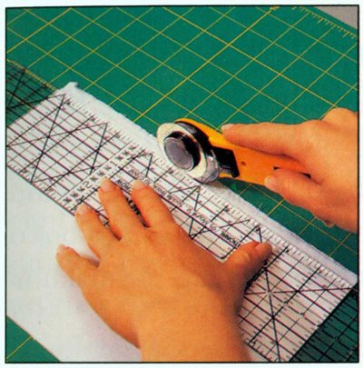
13. Rotary Cutting Equipment
Equipment used to cut very straight, clean lines in fabric. Never use the rotary blade without the ruler or the cutting mat.
Rotary Mat
Rotary Ruler
Rotary Cutter

Slide 10
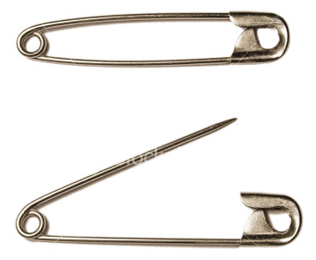
14. Safety Pins
Pins used to fasten fabric together that have a protective clasp on the end.
15. Scissors
Scissors used for cutting patterns and other non-fabric items, like paper patterns.

Slide 11
16. Seam Gauge
Metal six-inch ruler with a sliding marker.
17. Seam Ripper
Useful tool that helps unpick small stitches.

Slide 12
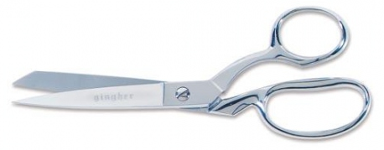
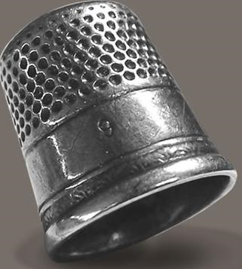
18. Shears
Sharp cutting tool to be used ONLY on fabric.
19. Thimble
A small metal cone used to protect fingers during sewing.

Slide 13
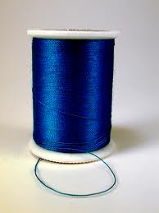
20. Thread
A very long, thin strand of cotton, nylon or other fibers used for sewing. Standard thread is “all-purpose” and high quality thread prevents stitching problems.

Slide 14
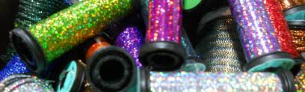
21. Specialty Thread
Includes thread such as quilting, heavy duty, embroidery and metallic. These are used for specific purposes or for decoration.

Slide 15
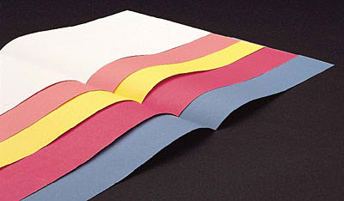
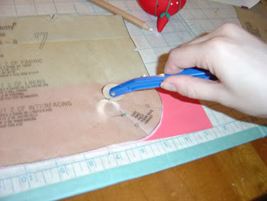
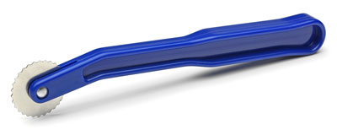
22. Tracing Paper & Wheel
Powdered paper and metal wheel used to transfer pattern markings to fabric.

