Slide 1
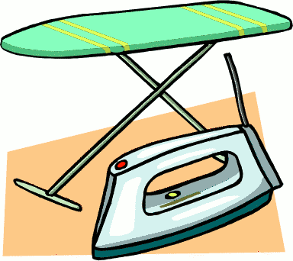
Ironing and Pressing

Slide 2
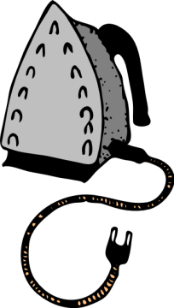
What’s the Difference?
Ironing:
The process of using an iron to remove wrinkles from damp, washable clothing. Heat and pressure are used to FLATTEN THE FABRIC.
Ironing is done with a gliding or sliding motion, BACK AND FORTH. It is done to the entire garment after laundering.

Slide 3
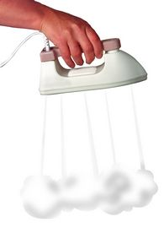
Pressing:
Involves NO sliding of the iron. The iron is placed on the fabric and then lifted, in an UP AND DOWN motion.
Moisture is added from a pressing cloth or from STEAM in the iron.
It is often done to apparel between wearing and during garment construction.

Slide 4
Number One Rule!
The number one rule when it comes to ironing or pressing is:
PRESS AS YOU SEW!
Why?
-It flattens and sets the stitches so the seam lays smooth and flat.
-It gives you a crisp, professional-looking garment.

Slide 5
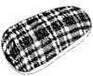
Ironing and Pressing Equipment
Tailor’s Ham & Sleeve Roll
Used to make an even curve on seams and darts while pressing.

Slide 6
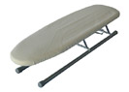
Sleeve Board
Mini ironing board that lets you press sleeves easily.

Slide 7
Point Press
Pushes out points on projects to get sharp, even points.

Slide 8
Steam Iron
A heated piece of equipment that flattens creases and shapes.

Slide 9
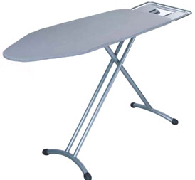
Ironing Board
A padded, flat, heat-resistant surface used for ironing and pressing.

Slide 10
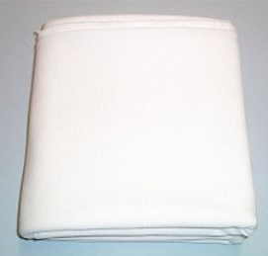
Pressing Cloth
A thin cloth placed over fabric while ironing. It creates extra steam when wet. It also prevents scorching and shine marks on fabric while ironing.

Slide 11
Temperature Settings
-It is very important to pay attention to the temperature settings when ironing different types of fabric.
-Most steam iron settings are broken into:
High - Cotton & Linen
Medium - Wool & Silk
Low - Synthetics
-Synthetic fibers are extremely HEAT SENSITIVE and can be irreversibly damaged by high heat.

Slide 12
Other Important Info
-You should use DISTILLED WATER in steam irons because then it won’t leave behind mineral build-up that can clog the steam vents.
-Always iron WITH THE GRAIN of the fabric to prevent permanent stretching.
-A straight SEAM should be PRESSED FLAT THEN OPEN. This sets the stitches so the seam will lie smooth and flat.

