Slide 1
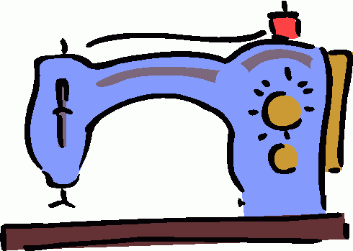
Sewing Terms

Slide 2
1. “Right” Side
The patterned side of fabric that will be showing when you are done sewing your project. Sometimes called the “Pretty” side.
“Right” Side
“Wrong” Side

Slide 3
2. “Wrong” Side
The back side of fabric that will be on the inside of the project you are sewing. Sometimes called the “Ugly” side.
“Right” Side
“Wrong” Side

Slide 4
3. Backstitch
To machine stitch two or three stitches BACKWARDS on the same line at the beginning and end of a seam to secure the stitches.
4. Basting Stitch
Long, temporary stitches used to hold pieces of fabric together.
Regular Stitch Length
Basting Stitch Length

Slide 5
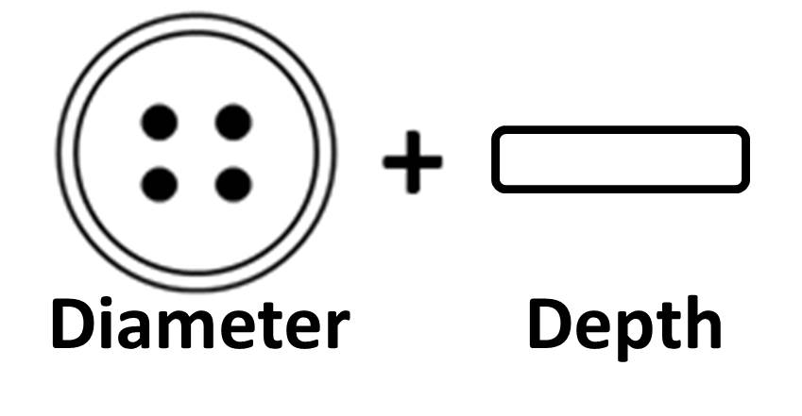
5. Buttonhole
A sewn slash in a garment used with a button as a fastener. Represented by these symbols:
6. Buttonhole Formula
Formula for measuring the correct length of a buttonhole: Button Diameter + Button Depth

Slide 6
7. Casing
A tunnel through which elastic or cording is threaded.
8. Casing Formula
formula for measuring the correct width of a casing: Elastic/Cording Width + 1/4“ + Seam Allowance

Slide 7
9. Clipping
A short cut made in the seam allowance-but not through the stitching-to allow for “bendability”.
10. Notching
Cutting V-shaped wedges out of the seam allowance to reduce bulk.

Slide 8
11. Cutting Line
The solid line on pattern pieces that you cut around.
12. Stitching Line
The dashed line on a pattern that shows where the stitching should be.

Slide 9
13. Gathering
Two to three parallel rows of basting stitches to create fullness in a garment.

Slide 10
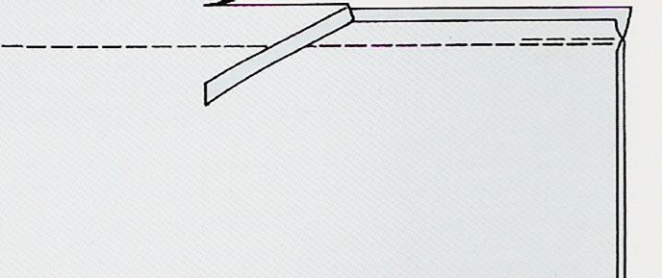
14. Grading / Layering
Trimming layers of the seam allowance to decrease bulk.

Slide 11
15. Grainline
Arrowed line indicating how to place the pattern piece on the material. This usually runs PARALLEL to the selvage.
16. Hem
The raw edge of any fabric, usually an article of clothing, turned back to the wrong side and stitched down.

Slide 12
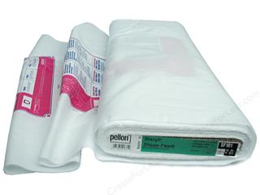
17. Interfacing
A non-woven fabric used to strengthen and stabilize other fabrics. (It usually has a fusible, heat-activated side.)

Slide 13
18. Miter
Pressing a corner, then refolding the point diagonally to form a square edge

Slide 14
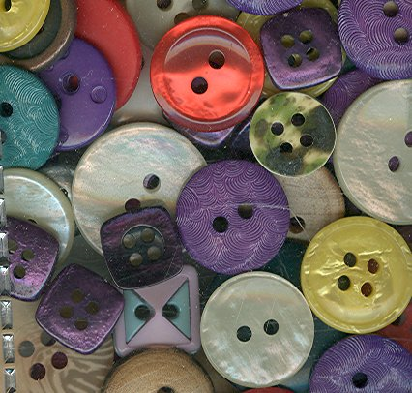
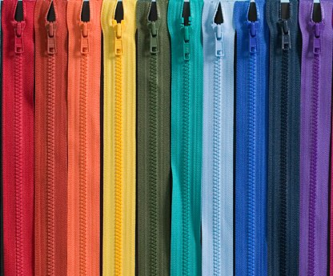
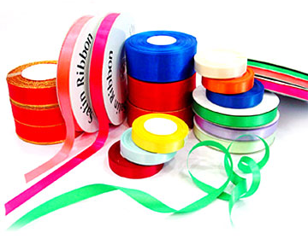
19. Notion
All items, other than fabric and patterns, needed to complete a sewing project. (Ex: buttons, zippers, trims, etc.)

Slide 15
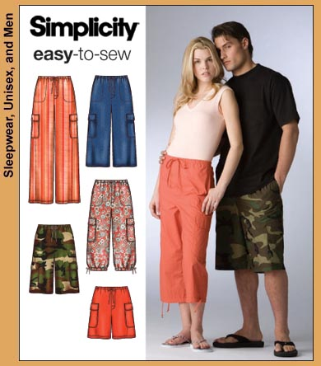
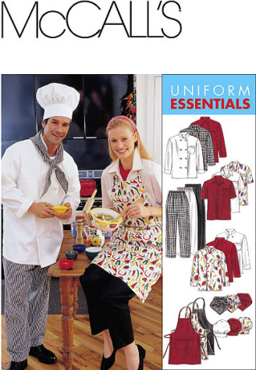
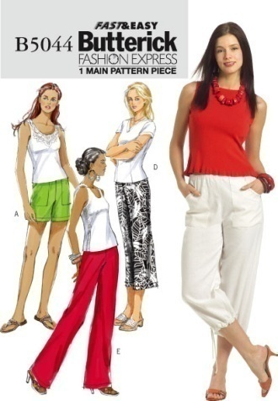
20. Pattern
Indicates what you will be making-includes size chart, garment views, notions needed, suggested fabrics and material quantities.
21. Ease
Added to commercial patterns for style, fit and wearing comfort.

Slide 16
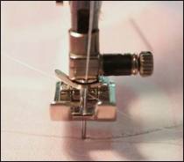
22. Pivot
At the end of a stitching line, leaving the needle down in the fabric, lifting the presser foot, turning or pivoting the fabric. After lowering the presser foot, the stitching will continue in a different direction. This technique is helpful when turning corners on a project.

Slide 17
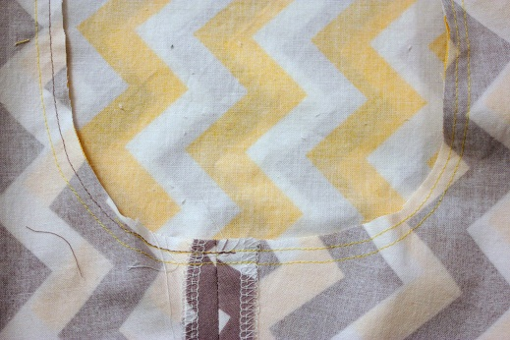
23. Reinforced Stitch
An extra row of stitching about 1/8” inside the original seam to reinforce an area of high stress, such as a crotch seam or underarm seam. Shortening the stitch length can also reinforce a seam.

Slide 18
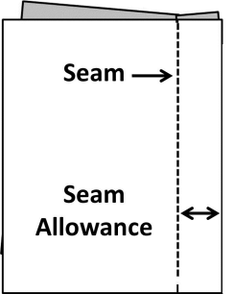
24. Seam
The stitched line that is created by sewing.
25. Seam Allowance
The distance between the edge of the fabric and the stitched line.

Slide 19
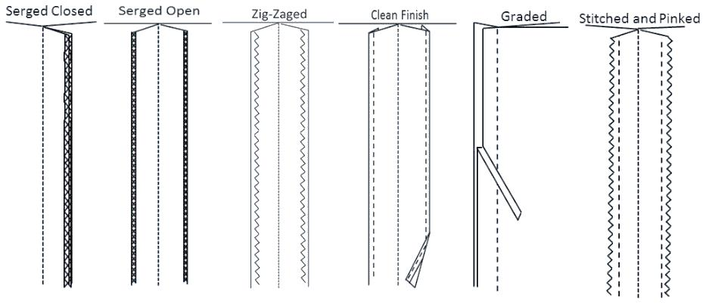
26. Seam Finish
Methods of finishing seam allowances so that they won’t fray or unravel.

Slide 20
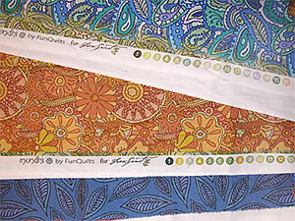
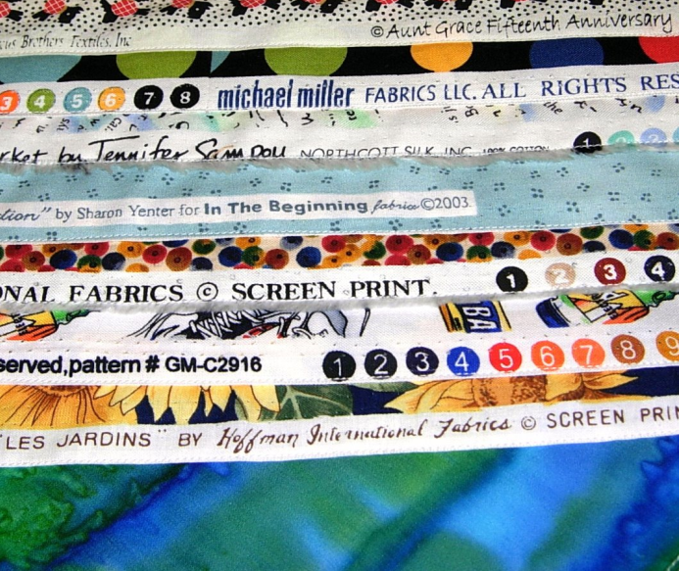
27. Selvage
The tightly woven edges on fabric that runs lengthwise down the fabric.
The grainline will run PARALLEL to the selvage.
Selvage

Slide 21
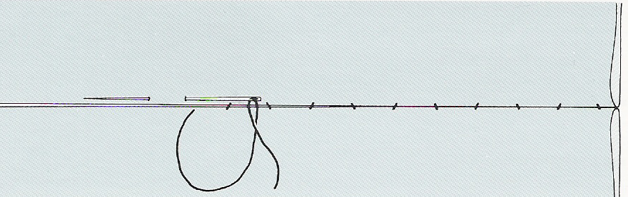
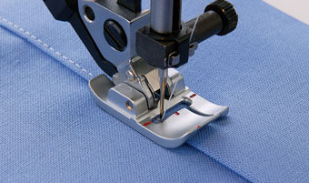
28. Slipstitch/Blind Stitch
A hand stitch that is almost invisible on both the right and the wrong side of the project.
29. Top-Stitch
A row of stitches about 1/4” away from the seam on the top or RIGHT side.

