Slide 1
MyPlate
- MyPlate was released in June 2011.
- Recommendations are for 2 years of age and older.

Slide 2

On Your Notes
For each section of MyPlate:
Write the FOOD GROUP
Write the COLOR
Write the KEY CONSUMER MESSAGE
Notes:
Any fruit or 100% fruit juice counts as part of the fruit group. Fruits may be fresh, canned, frozen or dried. They may be whole, cut up or pureed.
*The serving amounts indicated on the chart above are appropriate for individuals who get less than 30 minutes per day of moderate physical exercise beyond normal daily activities. Those who are more physically active may be able to consumer more while staying within calorie needs.

Slide 3
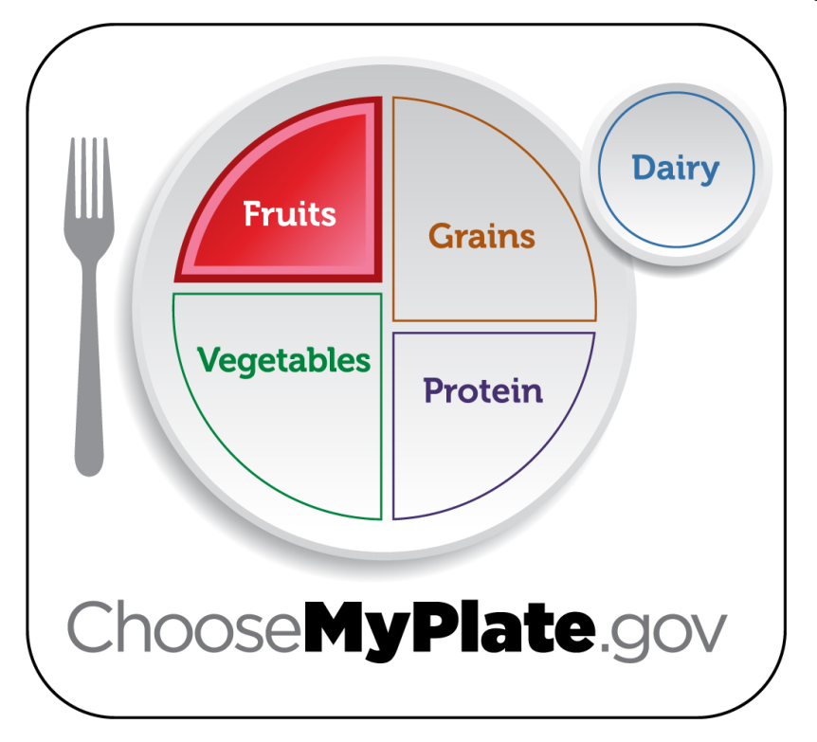
Fruits Group
Use fruits as snacks, salads or desserts.
Choose whole or cut up fruits more often than fruit juice.
Key Consumer Message:
Make half your plate fruits and vegetables.
Boys 9-13 | 1 ½ c. daily
Boys 14-18 | 2 c. daily
Girls 9-18 | 1 ½ c. daily
Notes:
Any fruit or 100% fruit juice counts as part of the fruit group. Fruits may be fresh, canned, frozen or dried. They may be whole, cut up or pureed.
*The serving amounts indicated on the chart above are appropriate for individuals who get less than 30 minutes per day of moderate physical exercise beyond normal daily activities. Those who are more physically active may be able to consumer more while staying within calorie needs.

Slide 4
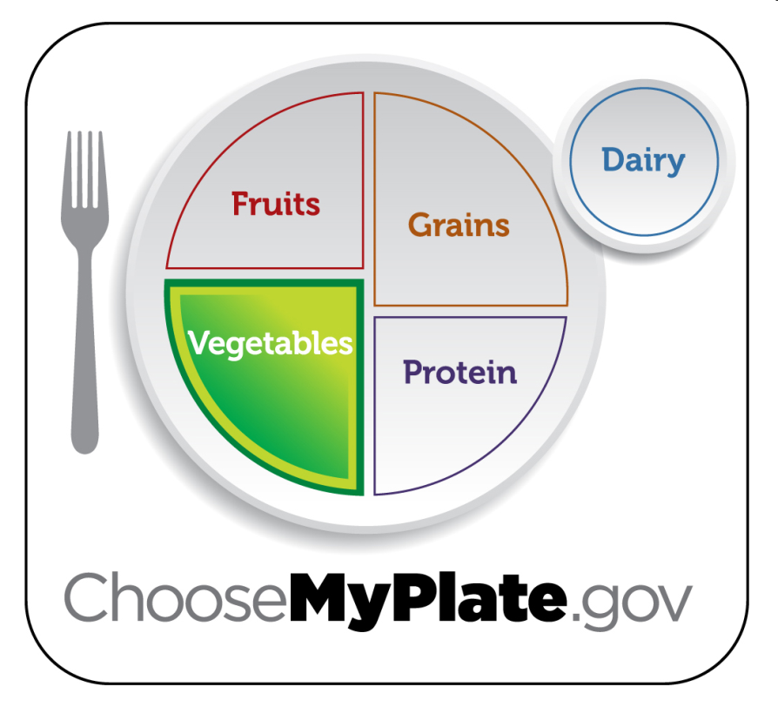
Vegetables Group
Choose fresh, frozen, canned or dried.
Key Consumer Message:
Eat red, orange and dark green vegetables.
Boys 9-13 | 2 ½ c. daily
Boys 14-18 | 3 c. daily
Girls 9-13 | 2 c. daily
Girls 14-18 | 2 ½ c. daily
Notes:
Any vegetable or 100% vegetable juice counts as a member of the vegetable group. Vegetables may be raw or cooked, fresh, frozen, canned or dried/dehydrated. They may be whole, cut up or mashed.
Vegetables are organized into five sub-groups based on their nutrient content:
Dark Green Vegetables: broccoli, dark green leafy lettuce, spinach
Red and Orange Vegetables: squash, carrots, pumpkin, tomatoes, red peppers, sweet potatoes
Beans and Peas: black beans, pinto beans, kidney beans, soy beans, lentil beans, split peas
Starchy Vegetables: corn, green peas, lima beans, potatoes
Other Vegetables: artichokes, asparagus, avocados, beets, Brussels sprouts, cabbage, cauliflower, celery, cucumbers, eggplant, green beans, peppers, iceberg lettuce, mushrooms, onions, zucchini
*The serving amounts indicated on the chart above are appropriate for individuals who get less than 30 minutes per day of moderate physical exercise beyond normal daily activities. Those who are more physically active may be able to consumer more while staying within calorie needs.

Slide 5
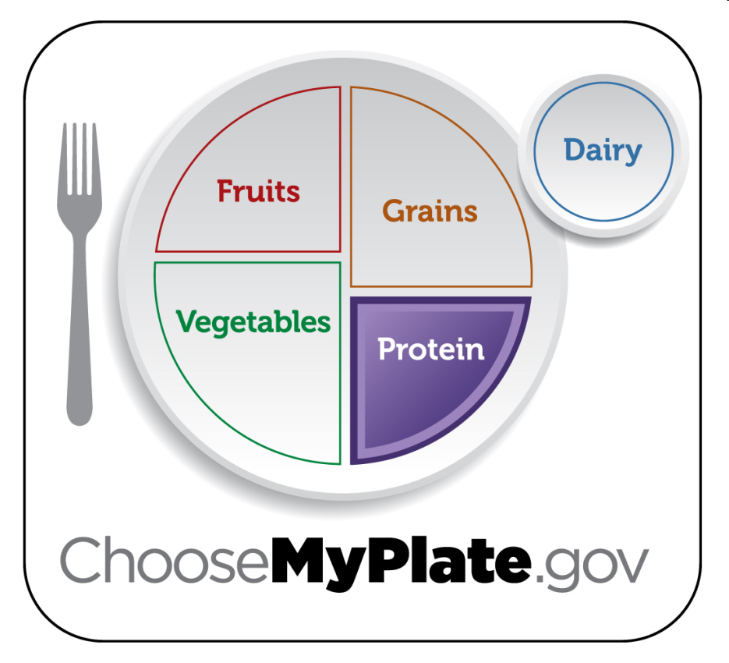
Protein Group
Choose a variety of different protein sources.
In place of some meat and poultry, choose 8 oz. seafood per week.
Try grilling, broiling, poaching or roasting.
Key Consumer Message:
Keep meat and poultry portions small and lean.
Boys 9-13 | 5 oz. daily
Boys 14-18 | 6 ½ oz. daily
Girls 9-18 | 5 oz. daily
Notes:
All foods made from meat, poultry, seafood, beans and peas, eggs, processed soy products, nuts and seeds are considered part of the protein food group. Beans and peas are also part of the vegetable group.
Select a variety of protein foods to improve nutrient intake and health benefits, including at least 8 oz. of cooked seafood per week.
Examples:
Meats: lean cuts of beef, ham, pork or veal
Eggs
Beans and Peas
Processed Soy Products: tofu, veggie burgers, TVP (Textured Vegetable Protein)
Poultry: chicken, duck, goose, turkey
Nuts and Seeds: almonds, cashews, peanuts, sesame seeds, walnuts
Seafood: catfish, cod, flounder, halibut, salmon, tuna, trout
Shellfish and Canned Fish: clams, crabs, lobsters, shrimp, calamari, anchovies, sardines
*The serving amounts indicated on the chart above are appropriate for individuals who get less than 30 minutes per day of moderate physical exercise beyond normal daily activities. Those who are more physically active may be able to consumer more while staying within calorie needs.
*The serving amounts indicated on the chart above are appropriate for individuals who get less than 30 minutes per day of moderate physical exercise beyond normal daily activities. Those who are more physically active may be able to consumer more while staying within calorie needs.

Slide 6
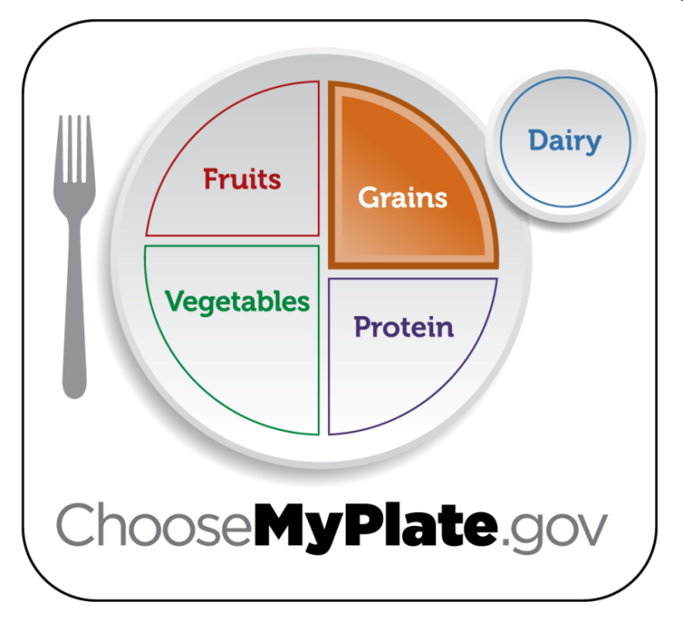
Grains Group
Choose 100% whole grain cereals, breads, crackers, rice and pasta.
Check the ingredients list on food packages to find whole grain foods.
Key Consumer Message:
Make half your grains whole grains.
 | Grains | Whole Grains
Boys 9-13 | 6 oz. daily | 3 oz. daily
Boys 14-18 | 8 oz. daily | 4 oz. daily
Girls 9-13 | 5 oz. daily | 2.5 oz. daily
Girls 14-18 | 6 oz. daily | 3 oz. daily
Notes:
Grains are divided into two subgroups:
Whole Grains: contain the entire grain kernel (bran, germ and endosperm)
Examples: whole wheat flour, cracked wheat, oatmeal, brown rice
Refined Grains: have been milled (a process that removes the bran and germ). This is done to give grains a finer texture and improve their shelf life, but it also removes dietary fiber, iron and many B-Vitamins.
Examples: white flour, white rice, spaghetti, pretzels, crackers, breakfast cereals
*Note: Most refined grains are enriched. This means certain B-Vitamins and Iron are added back in after processing.
*The serving amounts indicated on the chart above are appropriate for individuals who get less than 30 minutes per day of moderate physical exercise beyond normal daily activities. Those who are more physically active may be able to consumer more while staying within calorie needs.

Slide 7
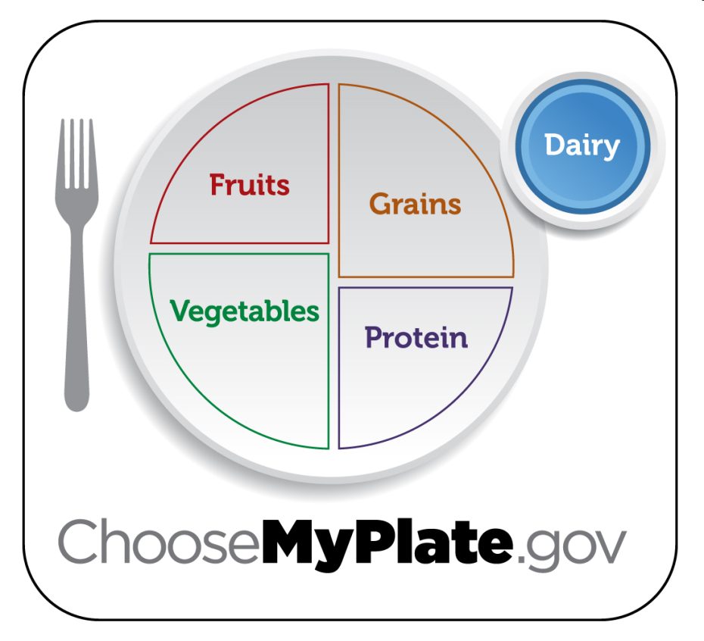
Dairy Group
Low-fat or fat-free dairy products have the same amount of calcium and other essential nutrients as whole milk, but less fat and calories.
Key Consumer Message:
Switch to low-fat or fat-free milk. Get your calcium rich foods.
Boys 9-18 | 3 c. daily
Girls 9-18 | 3 c. daily
Notes:
All fluid milk products and many foods made from milk are considered part of this group.
Foods made from milk that retain their calcium content are part of this group.
Examples: milk, flavored milks, yogurt, milk based desserts, cheese
Foods made from milk that have little or no calcium such as cream cheese, cream and butter, are not considered part of this group.
*The serving amounts indicated on the chart above are appropriate for individuals who get less than 30 minutes per day of moderate physical exercise beyond normal daily activities. Those who are more physically active may be able to consumer more while staying within calorie needs.

Slide 8

The Dietary Guidelines
Revised Every 5 Years

Slide 9

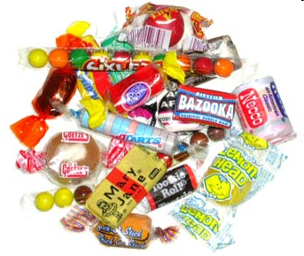
The Dietary Guidelines
Eat Nutrient Dense Foods
  What does “Nutrient Dense” mean?
    Foods that have a lot of vitamins, minerals or other important nutrients and few calories are considered nutrient dense.
    Choosing foods that are nutrient dense are better for your overall health.
Which is more Nutrient Dense?
Spinach
OR
Candy

Slide 10


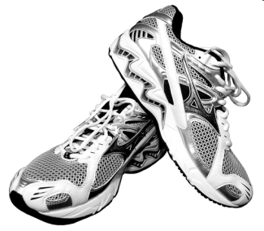
2. Balance Calories to Manage Weight
  Control total calorie intake to manage body weight.
  Increase physical activity and reduce “screen time”.
Intake
Output
Notes:
Monitor food and beverage intake, physical activity and body weight.
Reduce portion size.
When eating out, make better choices.
Limit screen time.

Slide 11
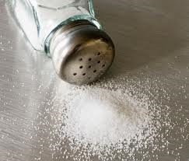




3. Reduce sodium, fats and added sugars, refined grains and alcohol.
  Reduce sodium intake to 2,300 milligrams per day
    That’s only about ½ tsp.!
  Too much sodium increase the risk of high blood pressure
  Sodium is usually added to processed foods, beverages and diet drinks
Notes:
4,000 mg = about 1 tsp.

Slide 12
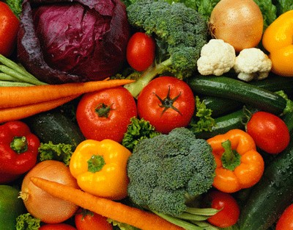
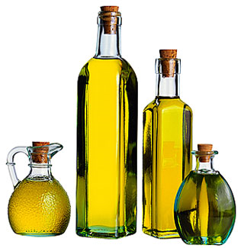

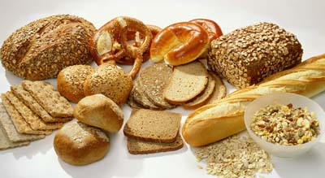


4. Increase vegetables, fruits, whole grains, milk, seafood and use oils in place of solid fats.
  Choose 8 oz. of seafood products in the place of some meat and poultry per week.
Notes:
Choose seafood products in place of some meat/poultry. (At least 8 oz. per week for teens and adults.)

Slide 13

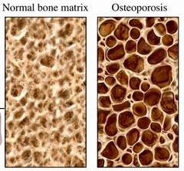

5. Build healthy eating patterns that meet nutritional needs over time at an appropriate calorie level.
  Building healthy habits NOW will affect you LATER!

Slide 14
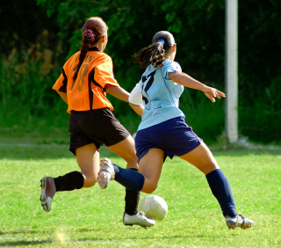

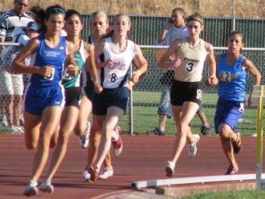
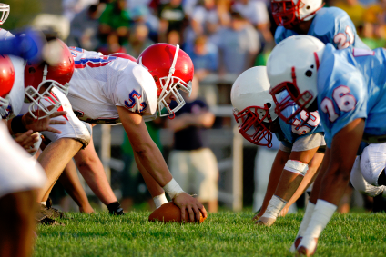

6. Include physical exercise as part of healthy eating patterns.
  6-17 year olds should be active at least 60 minutes or more each day

Slide 15
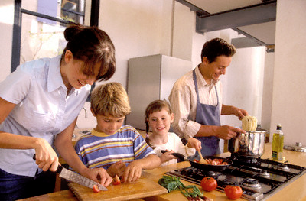
Healthy Eating Patterns
“Build a Healthy Plate”

Slide 16

Balance Calories
  Enjoy your food, but eat less.
  Avoid oversized portions.
Notes:
Find out how many calories YOU need per day to manage weight.
Take the time to fully enjoy your food and pay attention to hunger and fullness cues.
Use a smaller plate, bowl and glass.

Slide 17

2. Foods to Increase:
  Make half your plate fruits and vegetables.
  Switch to fat-free or low-fat milk.
  Make at least half your grains whole grains.
Notes:
Make the following the basis for meals and snacks:
Choose red, orange and dark green vegetables.
Add fruit as part of the meal, side dish or dessert.
Low-Fat and fat-free options provide the same amount of calcium and other nutrients, but with fewer calories and less saturated fat.
Substitute whole grains for refined products. Examples: Use wheat bread instead of white bread; brown rice instead of white rice.

Slide 18
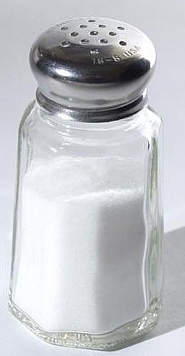
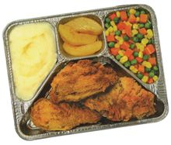


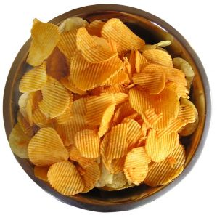
3. Foods to Reduce:
  Compare sodium in foods like soup, bread and frozen meals, and choose foods with the lower numbers.
  Drink water instead of sugary drinks.
Notes:
Cut back on foods high in solid fats, added sugar and salt. Use these foods as occasional treats, not as “everyday” foods.
Select low or reduced sodium or no-salt food items.
Soda, energy drinks and sports drinks are a major source of added sugar and calories in the American diet.

Slide 19
Oils
  Oils are not a food group, but they do provide essential nutrients.
  Choose oils that provide healthy fats.
Boys 9-13 | 5 tsp. daily
Boys 14-18 | 6 tsp. daily
Girls 9-18 | 5 tsp. daily
Notes:
Oils from plant sources don’t contain any cholesterol. They are a healthier fat source.
Examples:
Polyunsaturated Fats Food Source:
Most Vegetable Oils, Corn Oil, Soybean Oil, Safflower Oil
Monounsaturated Fats Food Sources:
Olives, Olive Oil, Avocados, Peanuts, Peanut Oil, Canola Oil
*The serving amounts indicated on the chart above are appropriate for individuals who get less than 30 minutes per day of moderate physical exercise beyond normal daily activities. Those who are more physically active may be able to consumer more while staying within calorie needs.

Slide 20
Individual Caloric Needs
  Each person’s caloric needs depends on age, gender and activity level.
Gender & Age | Daily Caloric Needs
Boys 9-13 | 1,800
Boys 14-18 | 2,200
Girls 9-13 | 1,600
Girls 14-18 | 1,800

Slide 21
Empty Calories
  Foods that have solid fats and added sugars add calories to food, but few or no nutrients.
  In some foods, like candies and sodas, ALL the calories are empty calories.
  A small amount of empty calories are okay, but most people eat far more than what is healthy.
Gender & Age | Daily Limit for Empty Calories
Boys 9-13 | 160
Boys 14-18 | 265
Girls 9-13 | 120
Girls 14-18 | 160

