Slide 1
Face Shapes

Slide 2
Knowing your face shape is the first step to creating a beautiful look

Slide 3
Not sure of your face shape? Pull your hair back / close one eye/ look in a mirror/ trace your face on the mirror

Slide 4
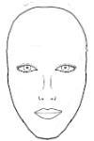
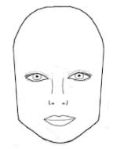
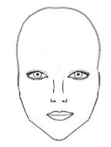
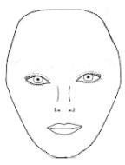
What you are looking for is one of the following: Oval Round Long Square Heart Diamond

Slide 5
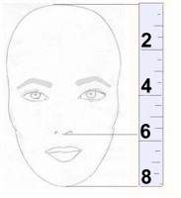
Still not sure?
Measure the length of your face
Divide the length by 3
Measure from the bottom of your nose to the bottom of your chin
Compare that number with the I/3 distance
Larger = long
Shorter = round
Equal = oval

Slide 6
Now, how to know your face shape
Let’s look at the characteristics of each face shape

Slide 7
Oval
Forehead is wider than the chin
Prominent cheekbones
Face gracefully tapers to a narrow oval chin

Slide 8
Round
Face is almost as wide as it is long
Face is widest at the cheeks

Slide 9
Long
Forehead, cheekbones and jaw line are all about the same width
Can tend to have a prominent chin
Has elongated appearance

Slide 10
Square
Forehead, cheekbones, and jaw line are all about the same
Squared jaw is the feature that is most obvious

Slide 11
Heart
Similar to the oval but the chin tapers to a point

Slide 12
Diamond
Not as common as the other face shapes
Typically the face is highly angular
The forehead is somewhat short
Widest at the temples

Slide 13
Let's do it!

Slide 14
welcome back

Slide 15
Now that you know your face shape.. So What?

Slide 16
Oval shapes try
A variety of styles. Most any hair style looks good on you
Most models fall into this category
Hair off the face looks best. Can wear hair slicked or pulled back
The perfect arch eyebrows

Slide 17
Oval shapes avoid
Don’t cover up your perfect features with heavy bangs or too forward directed styles

Slide 18
Round
To make a round face appear oval apply lines that go up the face. This draws the eye more up and down
The high arched eyebrow accomplishes this
The best eyebrow should peak toward the end of the brow. The tail should be short

Slide 19
Round shape, try
Hairstyles with fullness and height at the crown
Off center parts
Short hair styles with swept-back direction
Hair styles that are longer than the chin length
Layer the top for fullness – the rest close to the face

Slide 20
Round shape avoid
Chin length hair with a rounded line that mirrors the face’s circular shape
Center parts
Short crop bangs
Fullness at the ears

Slide 21
Long
Long and slender
About the same width at the forehead and just below the cheekbones
May have a very narrow chin or a very high forehead

Slide 22
Long shapes, try
Short to medium cut hair
Fullness at the side of your face
Soft wispy bangs
Fullness at the side of your face

Slide 23
Long shapes avoid
Too much hair length (not past the shoulder)
Center parts
Models use long hair but, have hair dressers add fullness to the hair.

Slide 24
Square
Strong angled eyebrows to balance the strong jaw line
Peak of the brow is most effective when directly above the square of the jaw

Slide 25
Square shapes try:
Short to medium length hair; especially with wave or roundness around the face
Wispy length bangs
Off center parts / use wave and curl
Height at the crown
Soften the square look of the face with layers and wispy looks around the face

Slide 26
Square shapes avoid
Long strait hair styles
Linear strait bangs or center parts
A strait bob ending at the jaw
Layer bob if it ends above or below the jaw line

Slide 27
Heart
Face is wide at the temples and hairline
Narrowing to a small delicate chin

Slide 28
Heart shapes try
Chin length or longer hair styles
Side parted hairstyles
Swept forward layers around the upper face
Gentle wispy bangs
Chin length bob is great!
Shorter styles but leave weight at the back of the neck

Slide 29
Heart shapes avoid
Short full styles that emphasize upper face
Height at the crown
Severe slicked back looks
Short full styles with tapered necklines
You have great cheekbones to emphasize! Don’t get a hairdo that is too top heavy.

Slide 30
Diamond
A cross between a heart and a dramatic oval
Widest at the cheekbones and narrow equally at the forehead and jaw line

Slide 31
Diamond shapes try
You are dramatic. Try a variety of styles
Almost everything will look good on you
Shorter styles but leave weight in the back
Better balance with styles between your cheekbones and delicate chin line

Slide 32
Diamond shapes avoid
Too much hair on your face that hide your great features
You can do about anything
Chin length hair with a rounded line that

Slide 33
Famous people
Rich people spend a lot of money on looking good
Find a famous person with your face shape and watch what looks good on them

Slide 34
Famous oval faces

Slide 35
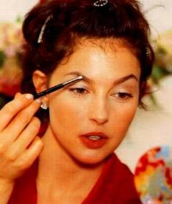
Ashley Judd

Slide 36
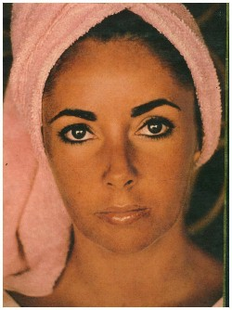
Elizabeth Taylor

Slide 37
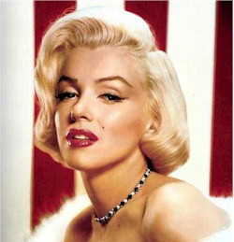
Marilyn Monroe

Slide 38
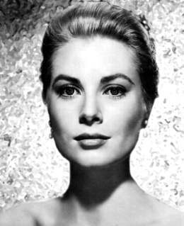
Grace Kelly

Slide 39
Famous Round Faces

Slide 40
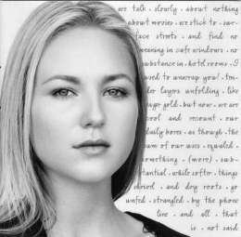
Jewel

Slide 41
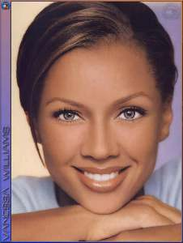
Vanessa Williams

Slide 42
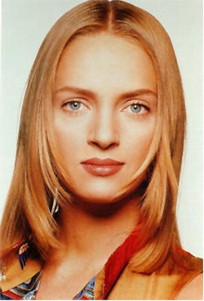
Uma Thurman

Slide 43
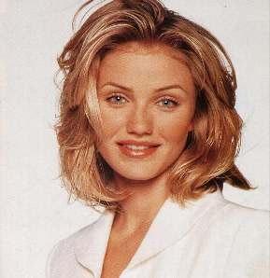
Cameron Diaz

Slide 44
Famous Long Faces

Slide 45
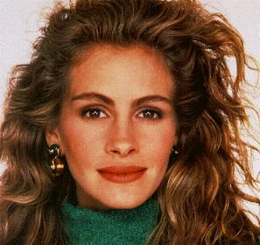
Julia Roberts

Slide 46
Jennifer Love Hewitt

Slide 47
Stephanie Seymor

Slide 48
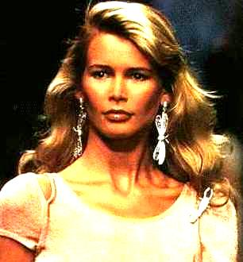
Claudia Schiffer

Slide 49
Famous Square Faces

Slide 50
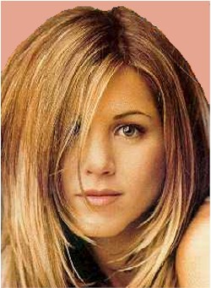
Jennifer Aniston

Slide 51
Paulina Proizkova

Slide 52
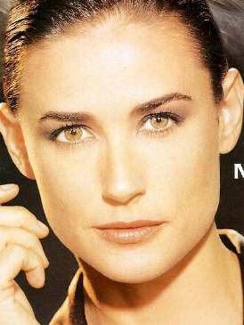
Demi Moore

Slide 53
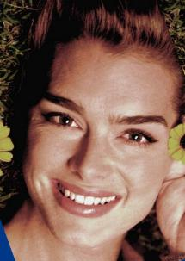
Brooke Shields

Slide 54
Famous Heart Faces

Slide 55
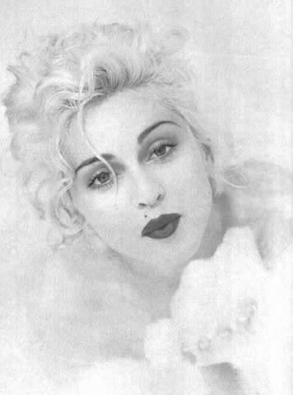
Madonna

Slide 56
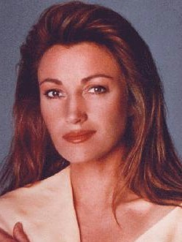
Jayne Seymour

Slide 57
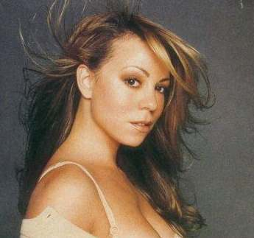
Mariah Carey

Slide 58
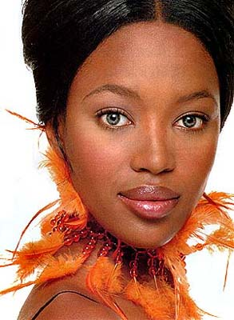
Naomi Campbell

Slide 59
Famous Diamond Faces

Slide 60
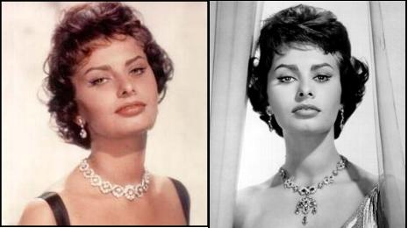
Sophia Loren

Slide 61
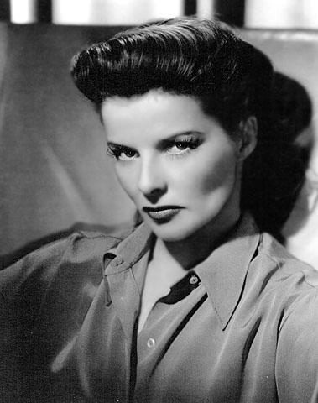
Katharine Hepburn

Slide 62
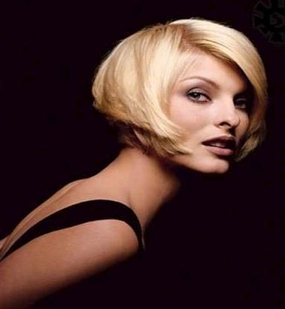
Linda Evangelista

