Slide 1
FRUITS

Slide 2
Fruits
Botanically
A fruit is an organ that develops from a flowering plant and contains one or more seeds
Culinary
A fruit is a perfect snack food, basis of a dessert, colorful sauce or soup

Slide 3
Fruits
Hybrids and Varieties
Hybrids
Result from crossbreeding fruits from different species
Varieties
Result from breeding fruit of the same species that have different qualities or characteristics

Slide 4
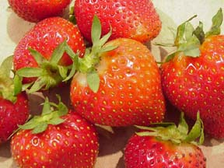
Berries
Blackberries
Blueberries
Cranberries
Currants
Raspberries
Strawberries

Slide 5
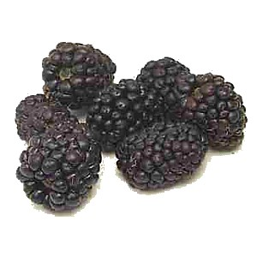
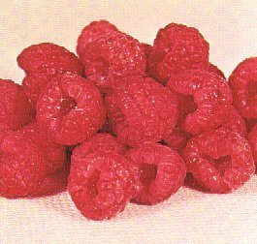
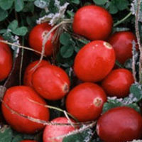
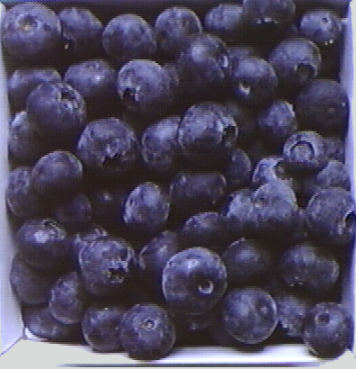
Blackberry
Raspberry
Cranberry
Blueberry

Slide 6
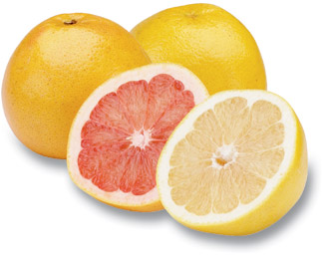
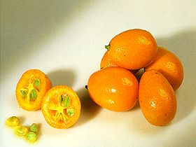
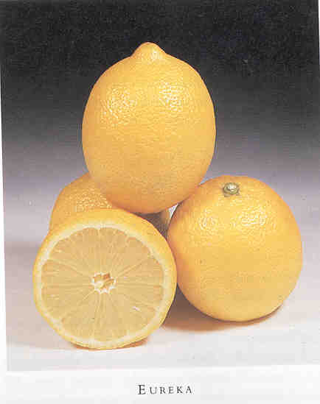
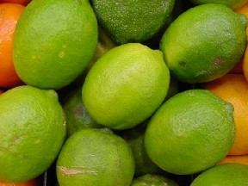
Citrus
Grapefruits
Kumquats
Lemons
Limes
Oranges
Tangerines

Slide 7
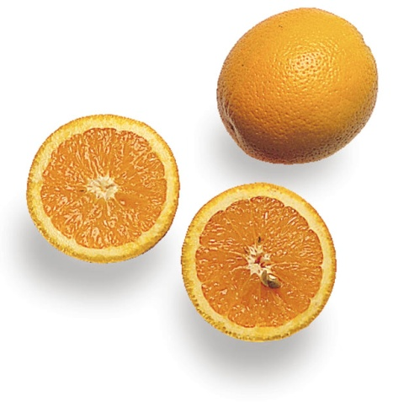
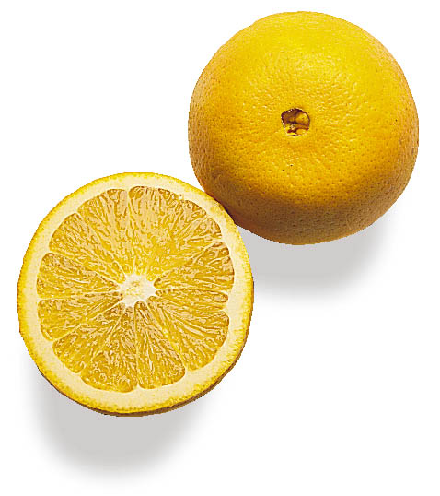
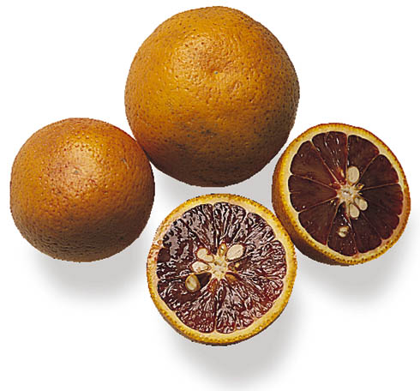
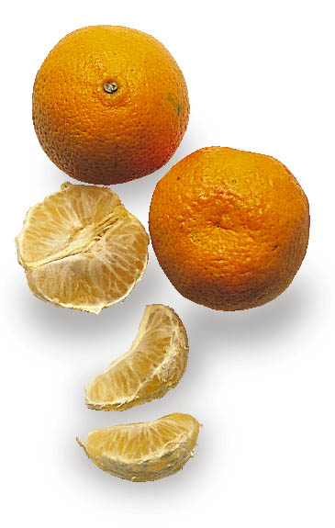
Citrus
Valencia Oranges
Naval Oranges
Blood Oranges
Tangerines

Slide 8
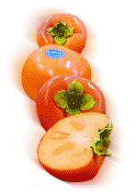
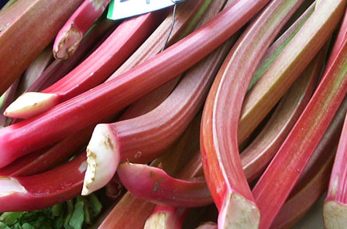
Exotics
Figs
Guava
Lychees
Cape gooseberries
Mangosteens
Persimmons
Pomegranates
Prickly pears
Rambutans
Rhubarb
Star fruits

Slide 9
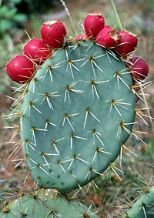
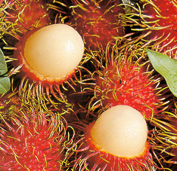
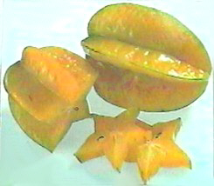
Pomegranate
Prickly Pear
Rambutan
Star Fruit

Slide 10
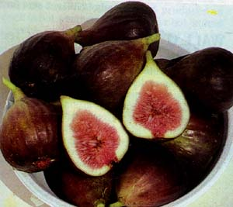
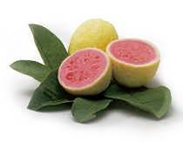
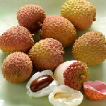
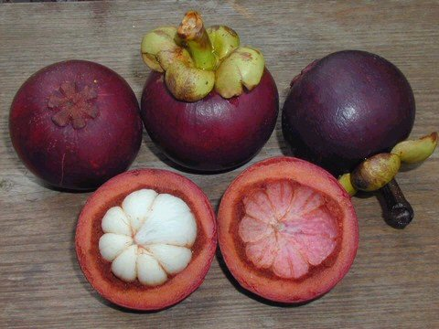
Figs
Guava
Lychee
Mangosteen

Slide 11
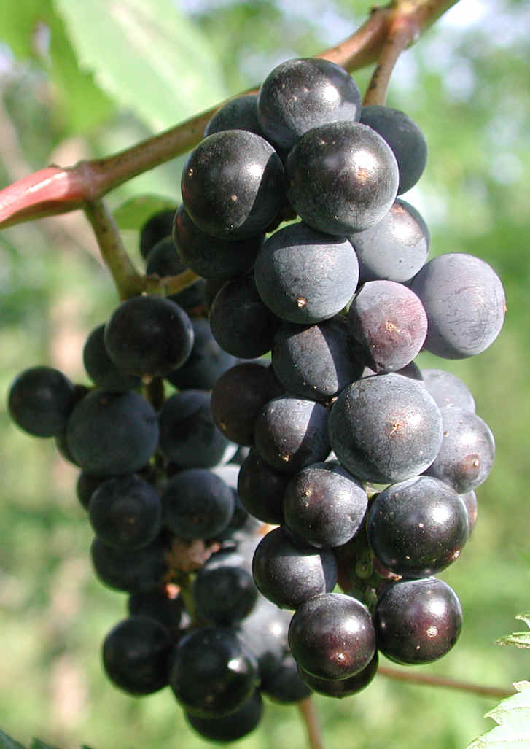
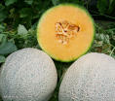
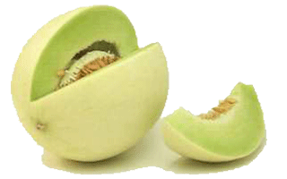
Grapes and Melons
Table grapes
Melons
Cantaloupe
Casaba
Crenshaw
Honeydew
Watermelon

Slide 12
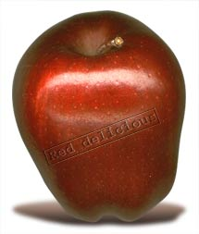
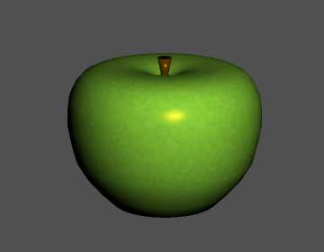
Apples
Fiji
Gala
Golden Delicious
Granny Smith
Jonathan
McIntosh
Pippin (Newton)
Red Delicious
Rome
Winesap

Slide 13
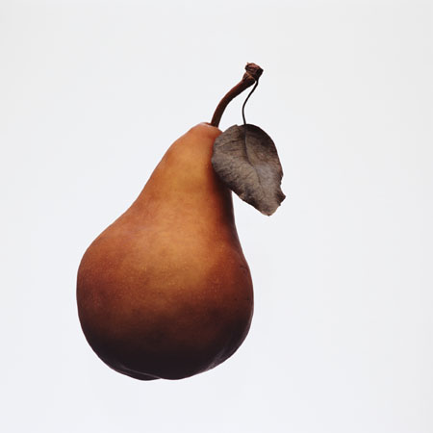
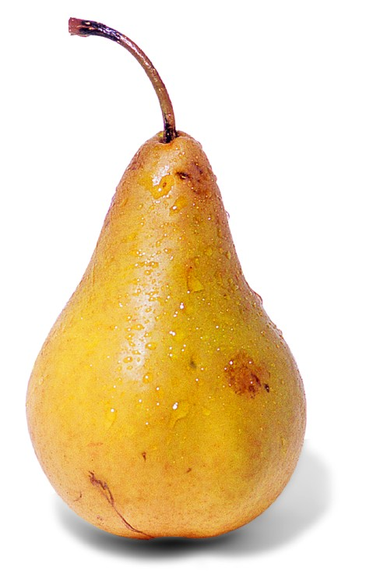
Pears
Anjou
Bartlett
Bosc
Comice
Seckel
Asian

Slide 14
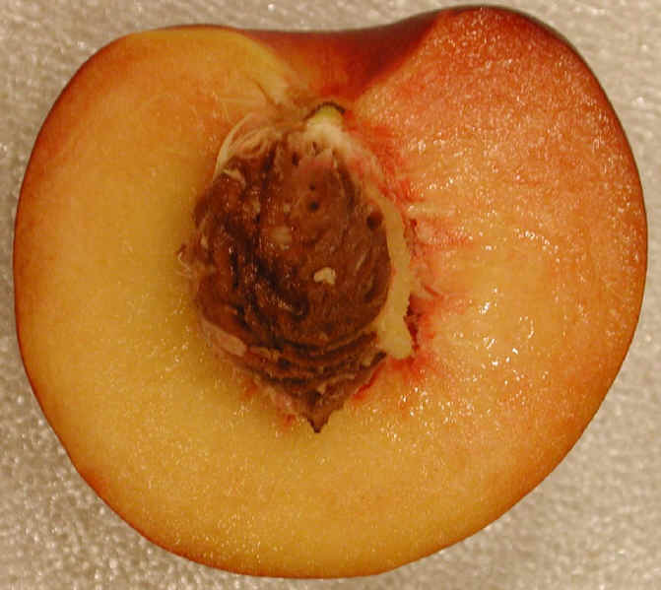
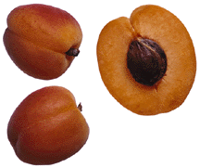
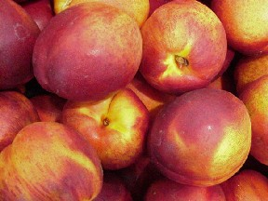
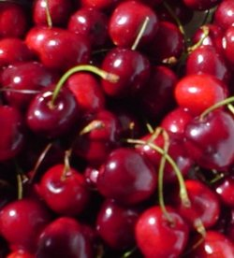
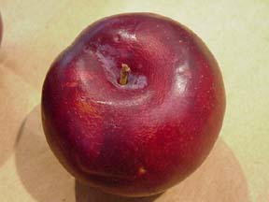
Stone Fruits
Apricots
Cherries
Peaches
Nectarines
Plums

Slide 15
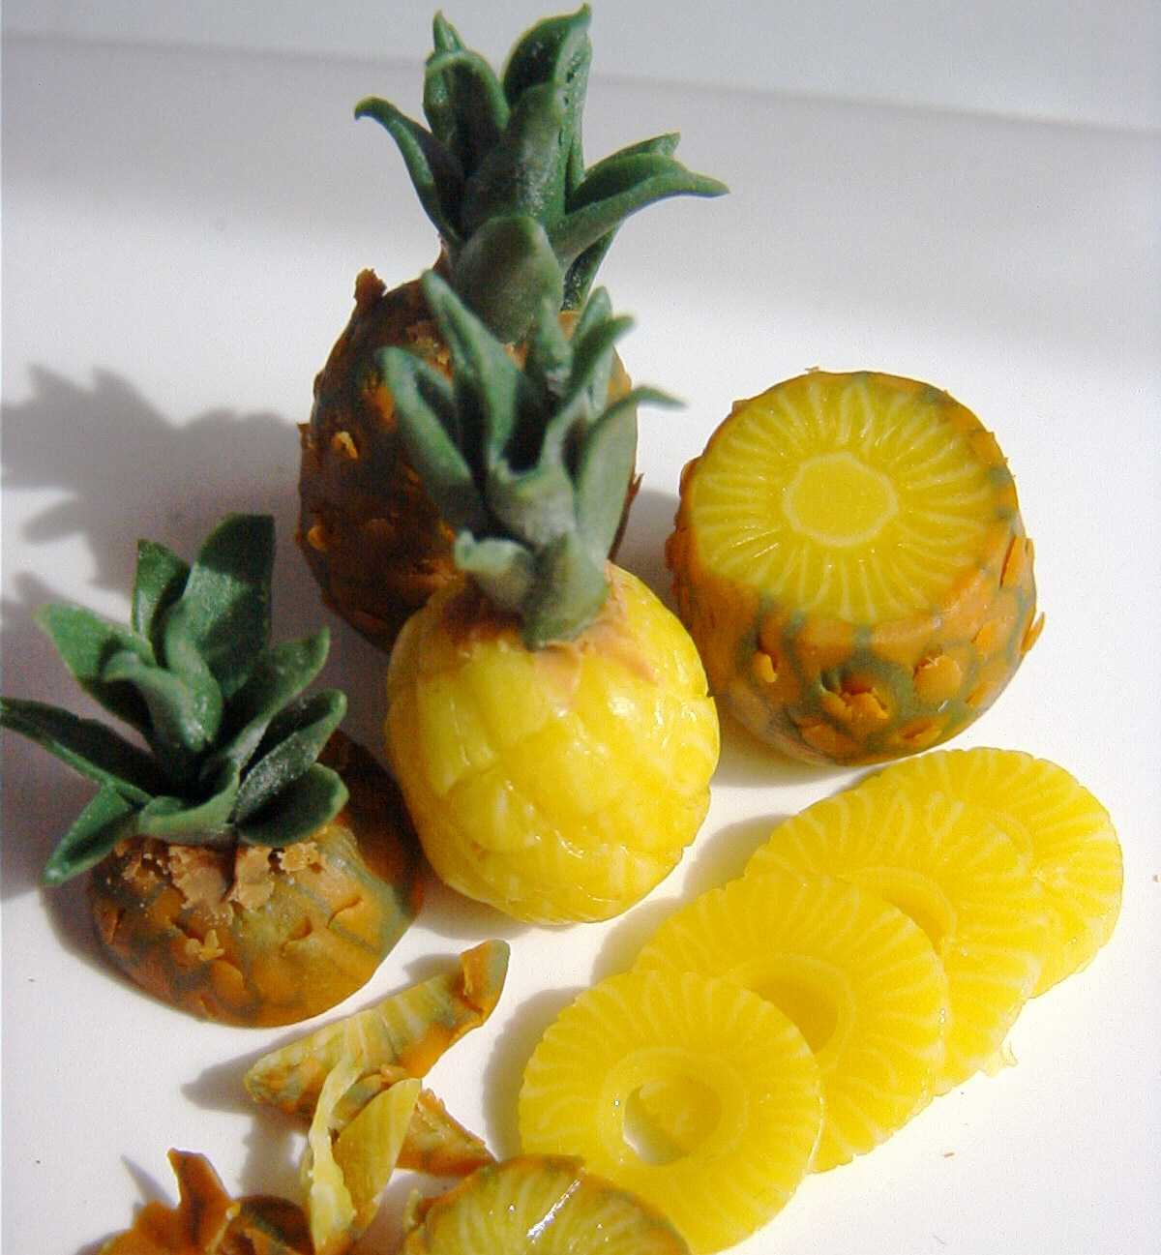
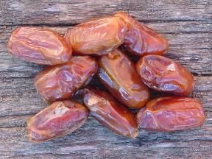
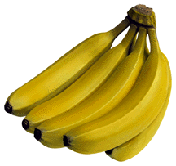
Tropical
Bananas
Dates
Kiwis
Mangos
Papayas
Passion fruits
Pineapples

Slide 16
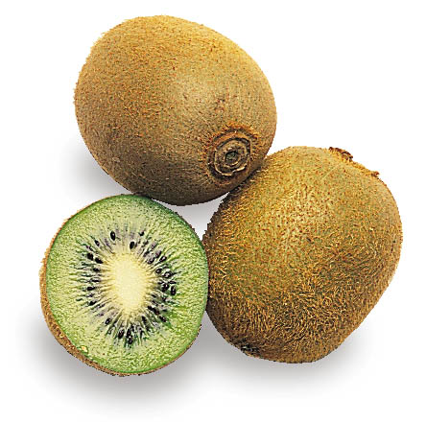
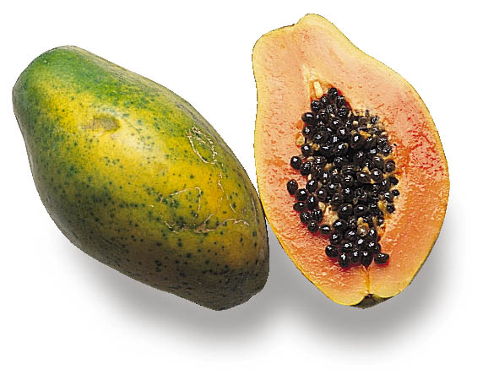
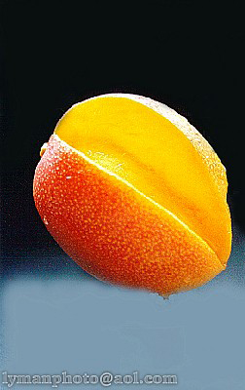
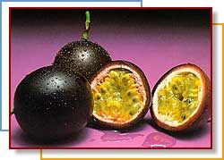
Kiwi
Red Papaya
Mango
Passion Fruit

Slide 17
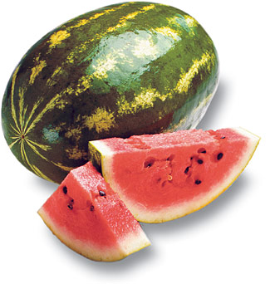
Nutrition
Fruits are 75 – 95% water
Low in fat, sodium and protein
Excellent source of fiber (especially the skins!)
Vitamins/Minerals Fruits Provide:
Vitamin C (Citrus, melons, strawberries)
Vitamin A (Deep yellow and green fruits)
Potassium (Bananas, raisins, figs)

Slide 18
Nutrition, Continued
Choose whole or cut up fruits more often than fruit juice.
Air, Heat and Water Can Destroy Nutrients in both Fruits and Vegetables.
Always wash fruits and vegetables to remove pesticides that might remain on the skin.

Slide 19
Guidelines for Selecting Fruits
Firm
Free From Decay
Crisp
Smooth
Dense
Free From Bruises
Good Color
Good Smell
In Season (Will Be Cheaper)

Slide 20
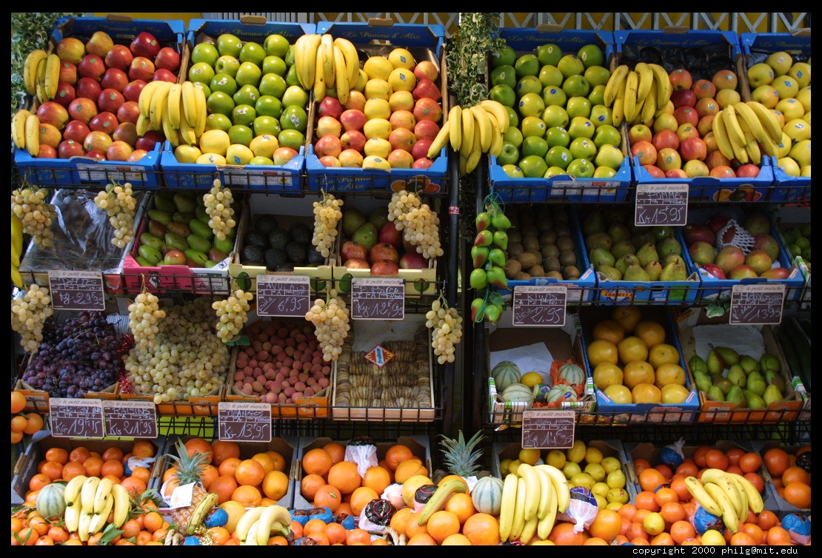
Purchasing and Storing Fruits
Purchasing
Most fruits are sold by weight or by count
Fruits are packed in crates, bushels, cases, lugs, or flats
Storing Fruits In:
Cold (Refrigerator)
Dry
Give Them Space

Slide 21
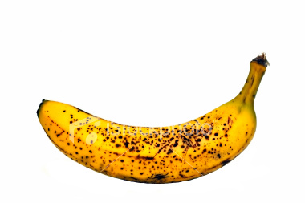
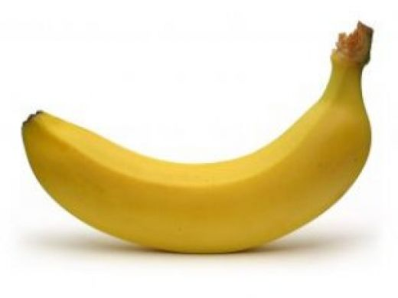
Ripening
Ripening happens when starches found in the fruit break down into sugar (Bananas in the fridge)
This leads to deterioration or spoilage:
Color Lightens
Texture Softens
Decreases in Acidity
Increases in Sweetness

Slide 22
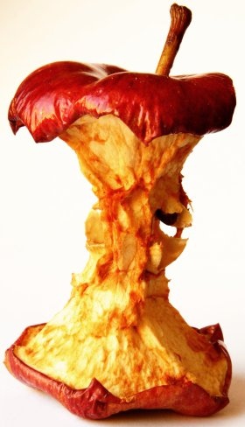
Browning
Browning occurs when the cut surfaces of food reacts with oxygen.
This is called OXIDATION.
To prevent this, cover cut fruits with a liquid containing Ascorbic Acid (Vitamin C).

