Slide 1
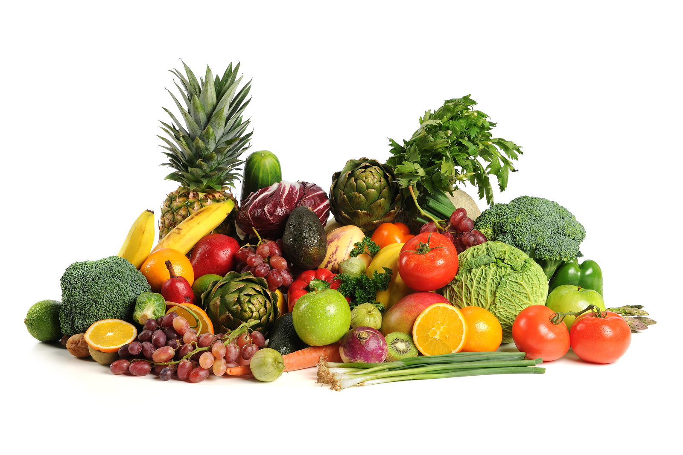
Fruits and Vegetables
Vitamins and Minerals

Slide 2
Botanical Classification
Roots
Stems and shoots
Tubers
Leaves
Bulbs
Seeds
Fruits
Flowers

Slide 3
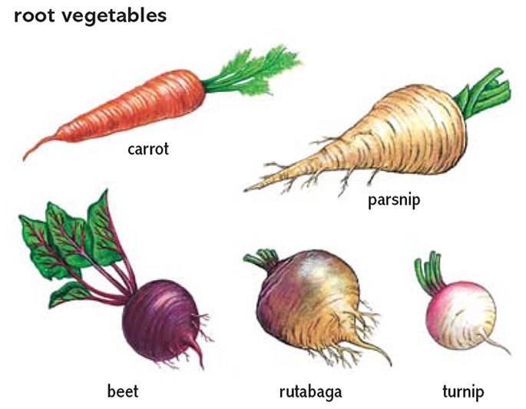
Classifying vegetables
Roots
Carrots
Radishes
Beets

Slide 4
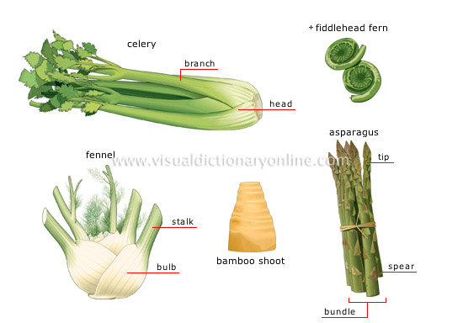
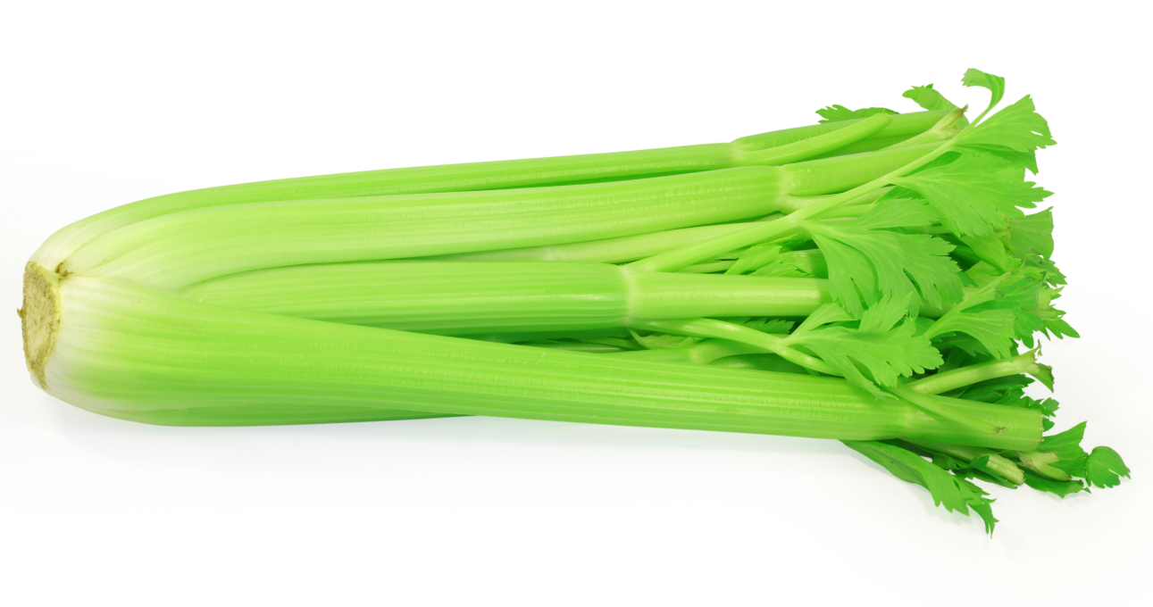
Classifying vegetables
Stems
Celery
Mushrooms
Asparagus

Slide 5
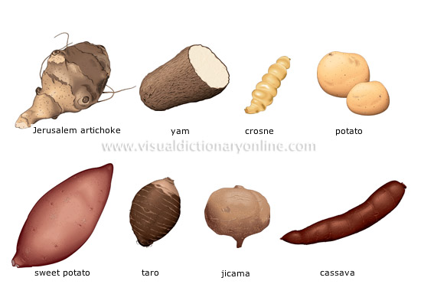
Classifying vegetables
Tubers
Potatoes
Sweet potatoes

Slide 6
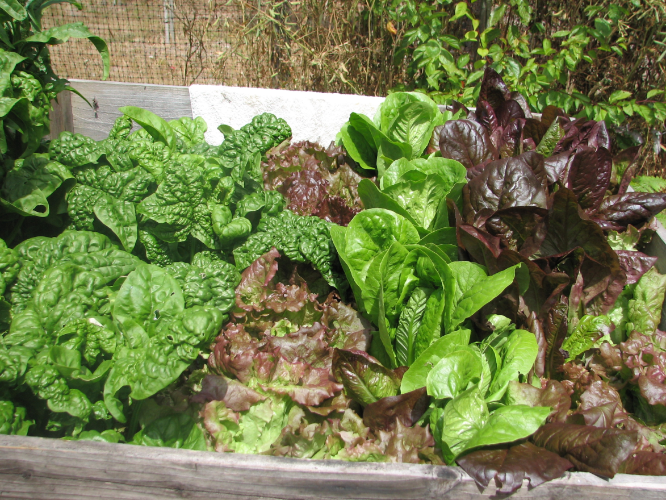
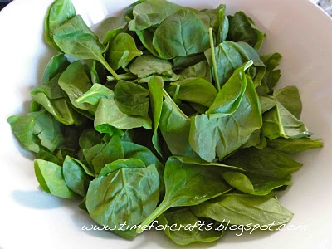
Classifying vegetables
Leaves
Romaine
Spinach

Slide 7
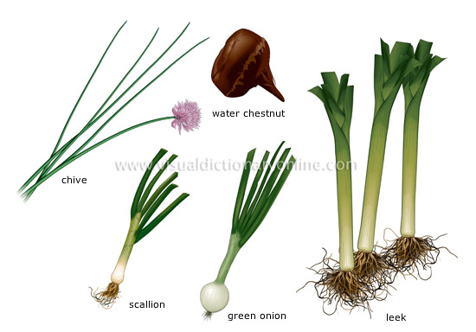
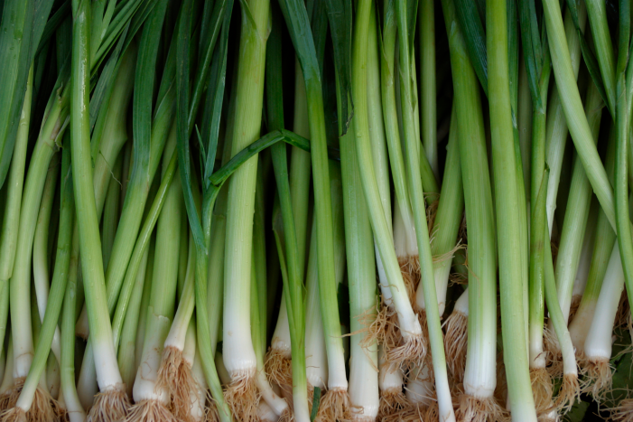
Classifying Vegetables
Bulbs

Slide 8
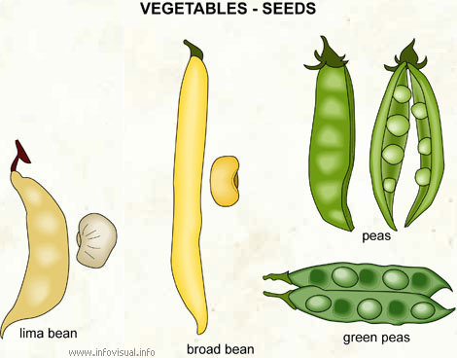
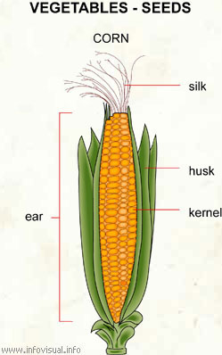
Classifying Vegetables
Seeds

Slide 9
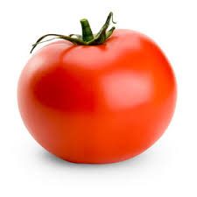
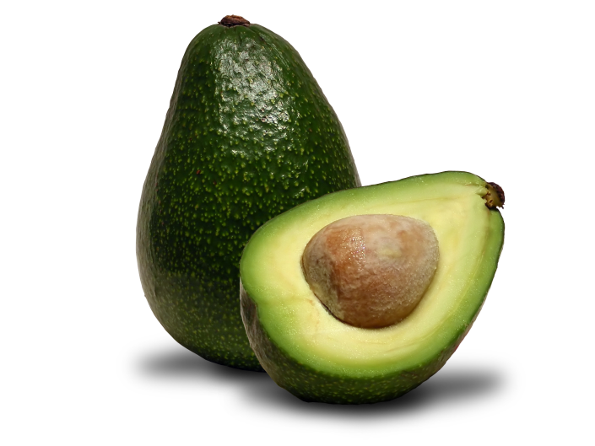
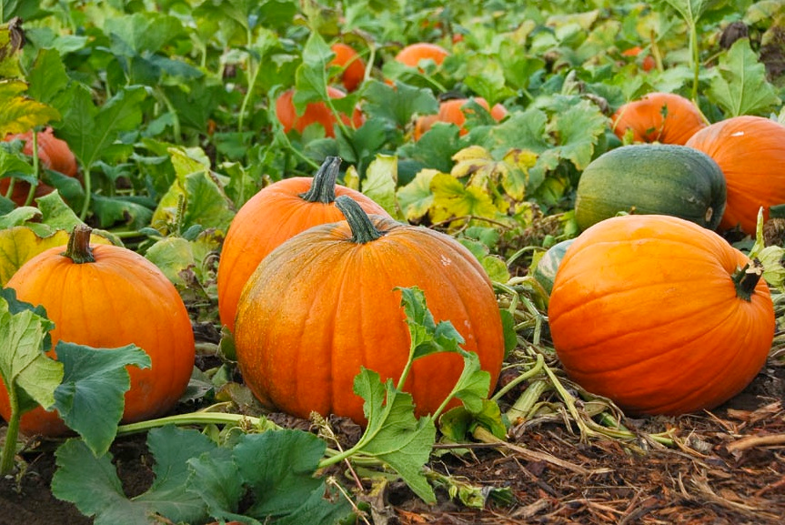
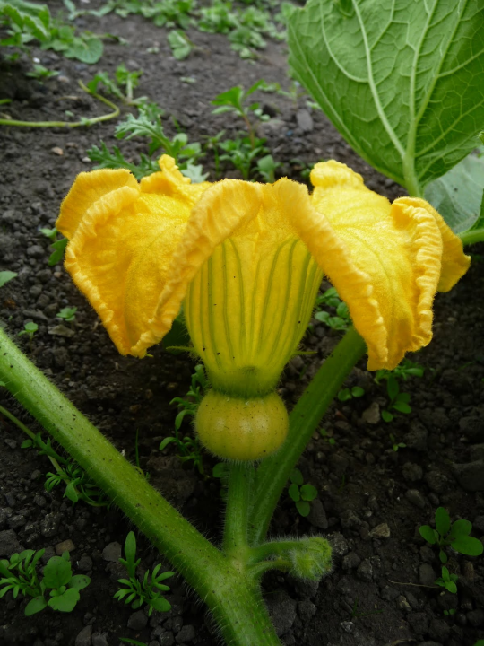
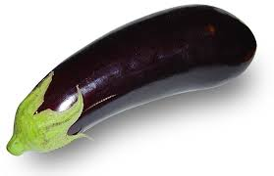
Classifying Vegetables
Fruits
Seeds on the inside

Slide 10
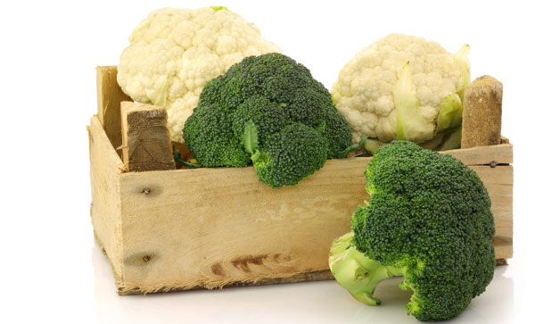
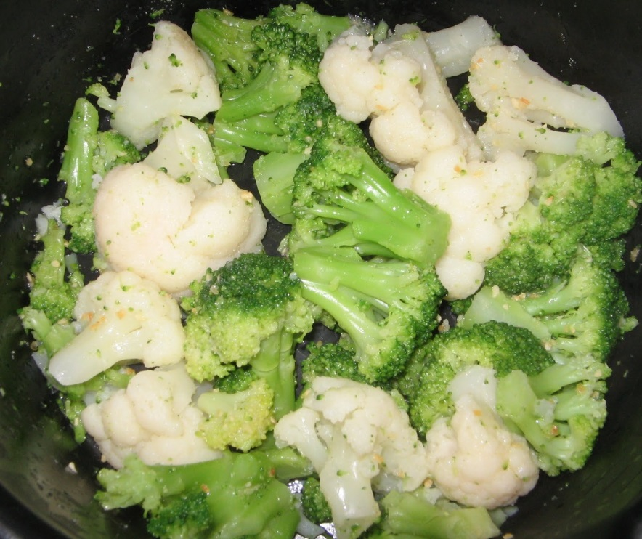
Classifying Vegetables
Flowers
Broccoli
Cauliflower

Slide 11
Fruits and Vegetables
Vegetables contain more starch and less sugar than fruits
When selecting fruits and vegetables
Firm
Free From Decay
Crisp
Smooth
Dense
Free From Bruises
Good Color
Good Smell
In Season (Will Be Cheaper)

Slide 12
Fruits
Botanically
A fruit is an organ that develops from a flowering plant and contains one or more seeds
Culinary
A fruit is a perfect snack food, basis of a dessert, colorful sauce or soup

Slide 13
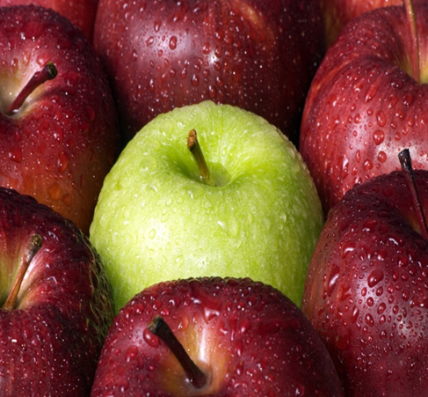
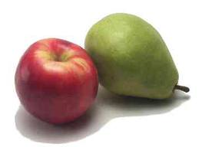
Classifying fruit
Pomes
Has a core and seeds

Slide 14
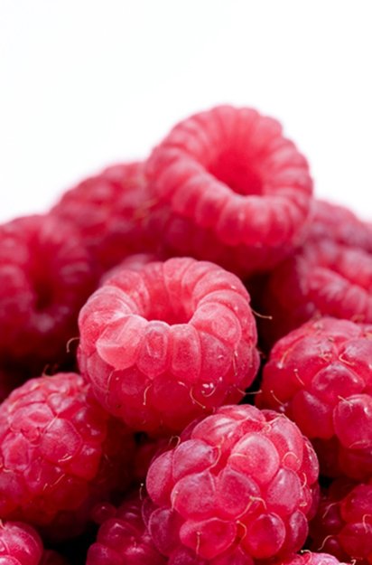
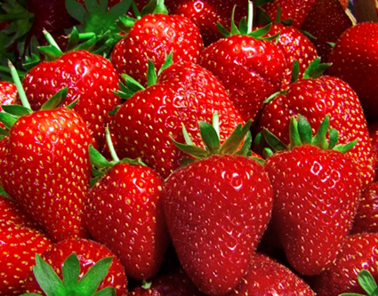
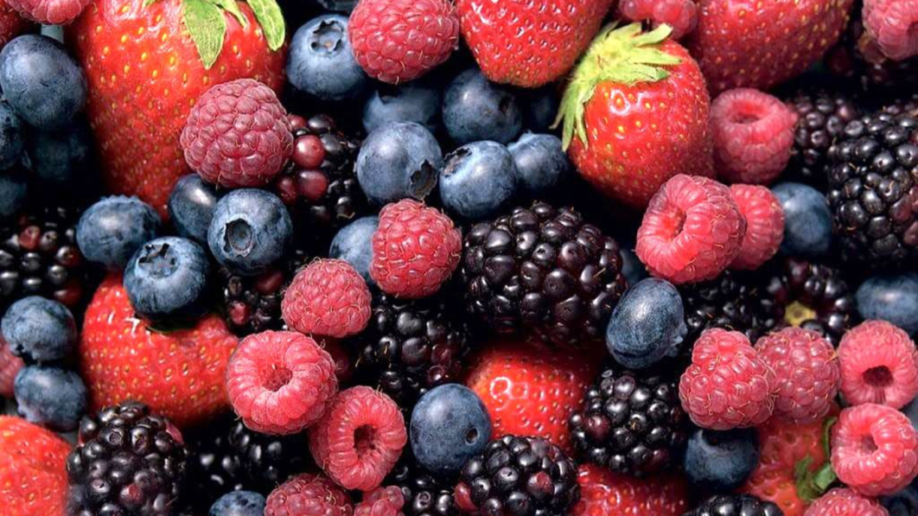
Classifying fruit
Berries
Made up of mostly water and very fragile

Slide 15
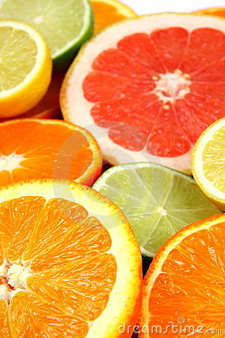
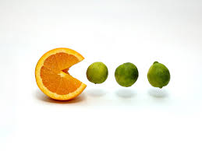
Classifying fruit
Citrus fruit
High in Vitamin C
Sour
Has a peel, eat the flesh inside

Slide 16
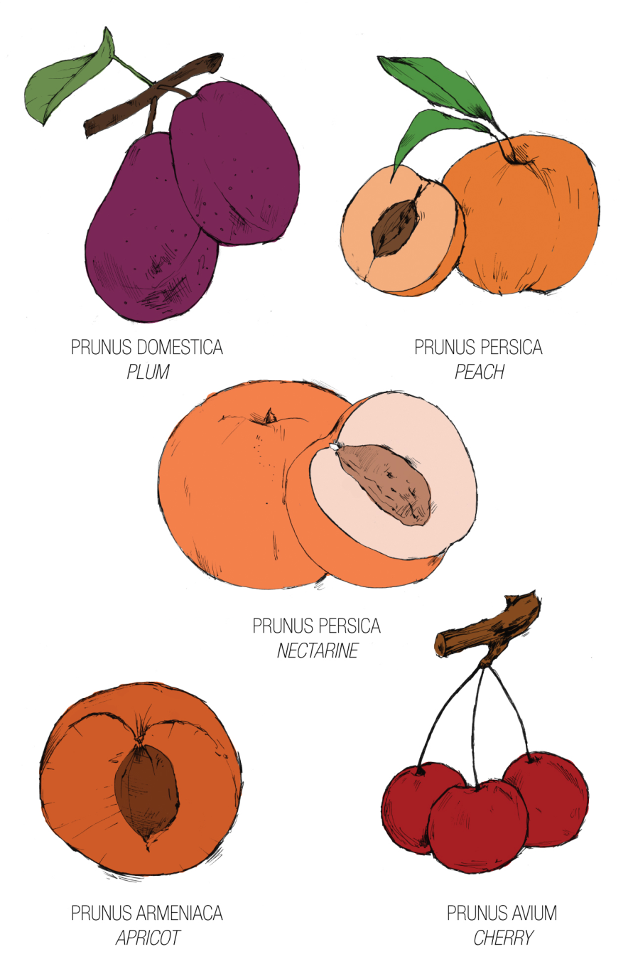
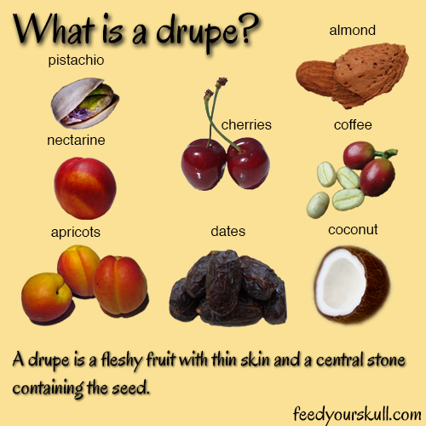
Classifying fruit
Drupes
Has one pit

Slide 17
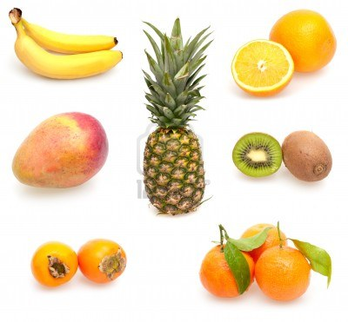
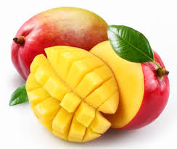
Classifying fruit
Tropical Fruit
Grown in a tropical place

Slide 18
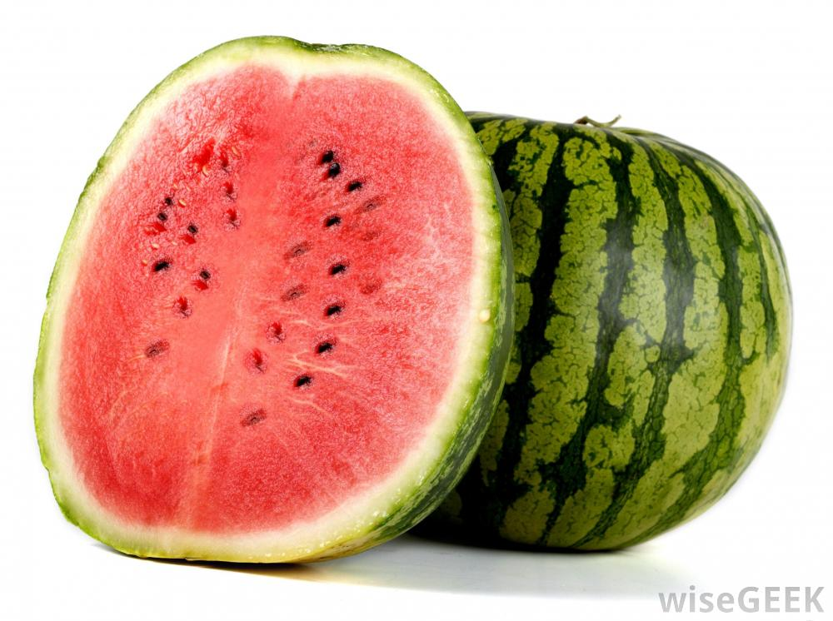
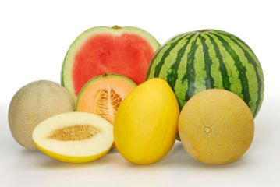
Classifying fruit
Melon
Cannot be preserved (canned or frozen)

Slide 19
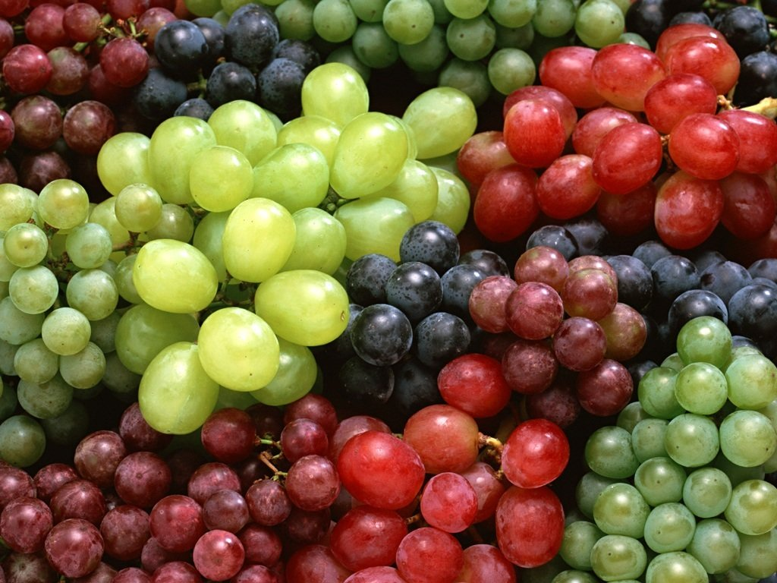
Classifying fruit
Grapes

Slide 20
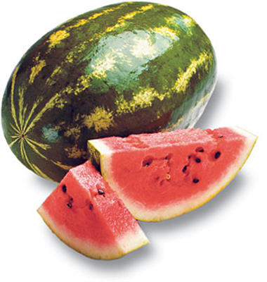
Nutrition
Fruits are 75 – 95% water
Low in fat, sodium and protein
Excellent source of fiber (especially the skins!)
Vitamins/Minerals Fruits Provide:
Vitamin C (Citrus, melons, strawberries)
Vitamin A (Deep yellow and green fruits)
Potassium (Bananas, raisins, figs)

Slide 21
Nutrition
Choose whole or cut up fruits more often than fruit juice.
Air, Heat and Water Can Destroy Nutrients in both Fruits and Vegetables.
Always wash fruits and vegetables to remove pesticides that might remain on the skin.

Slide 22
Ripening
Ripening happens when starches found in the fruit break down into sugar (Bananas in the fridge)
This leads to deterioration or spoilage:
Color Lightens
Texture Softens
Decreases in Acidity
Increases in Sweetness

Slide 23
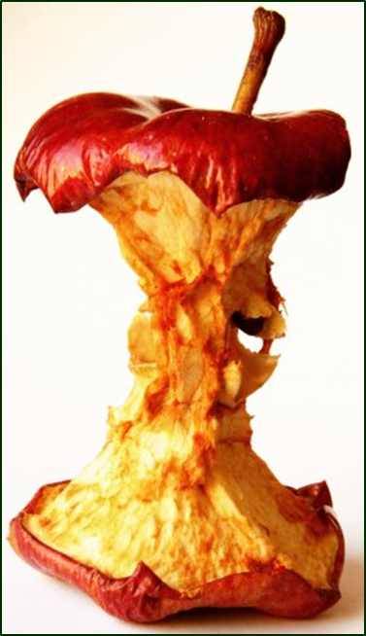
Browning
Browning occurs when the cut surfaces of food reacts with oxygen.
This is called OXIDATION.
To prevent this, cover cut fruits with a liquid containing Ascorbic Acid (Vitamin C).

