Slide 2
Got Milk?

Slide 3
Milk
It is recommended that we switch to low-fat or fat-free milk and get least 3 cups daily from the Dairy food group
Milk and milk products, (yogurt, cheese, etc.) are excellent sources of complete proteins because they come from animal sources.

Slide 4
Milk is one of the most nutritious drink
Protein
Calcium/Phosphorous
Vitamin D
Lactose (sugar) Carbohydrate
Fat (2% or whole)
Water

Slide 5
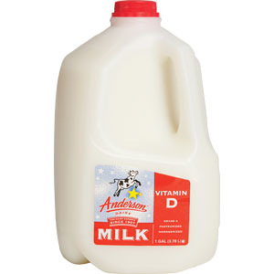
Milk
By law, milk must be fortified with Vitamins A and D.
Fortified means that “extra” has been added to the product.

Slide 6
Whole Milk (red)
IT IS ABOUT 3.3% FAT BY WEIGHT
8 FAT GRAMS PER CUP
2.99 A GALLON

Slide 7
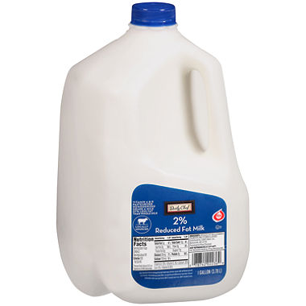
2%-reduced (blue)
IT IS ABOUT 1.3% FAT BY WEIGHT
5 FAT GRAMS PER CUP
2.69 A GALLON

Slide 8
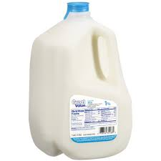
Low-fat or 1% (light blue)
HAS SOME OF THE FAT REMOVED
0 FAT GRAMS PER CUP
2.59 A GALLON

Slide 9
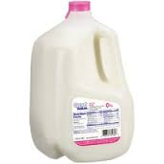
Fat-Free or Skim (pink)

Slide 10
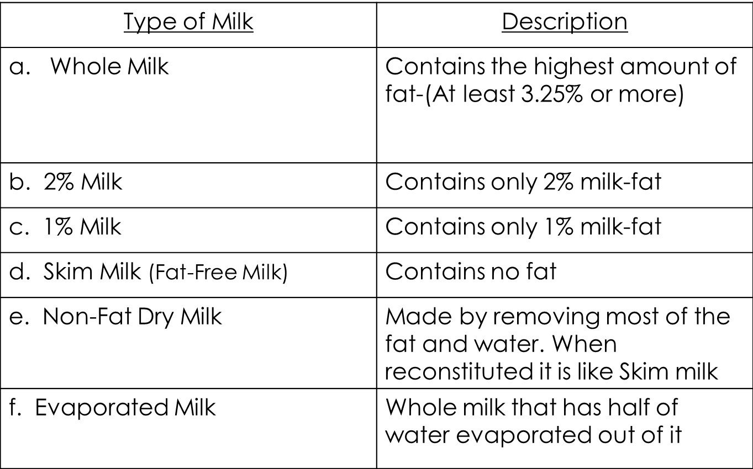
Types of Milk

Slide 11
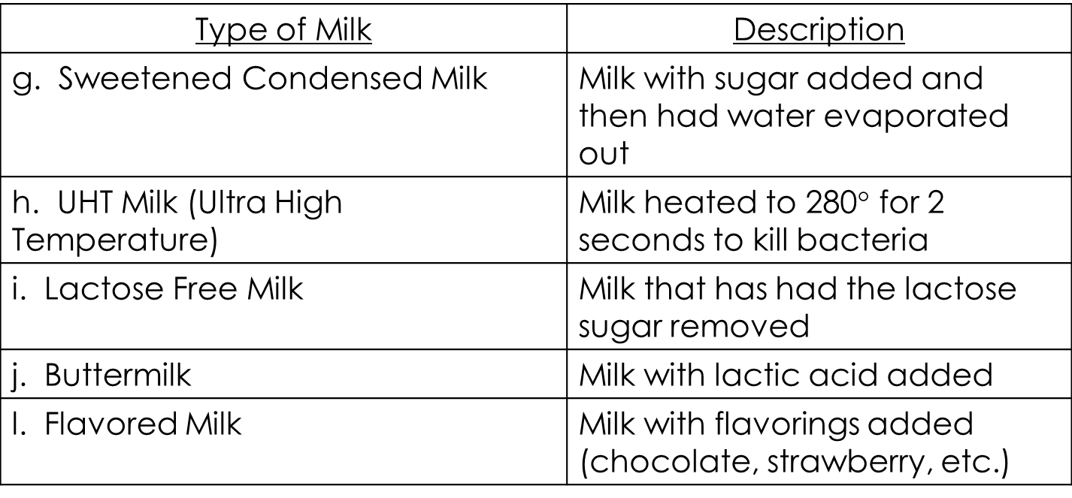
Types of Milk

Slide 12
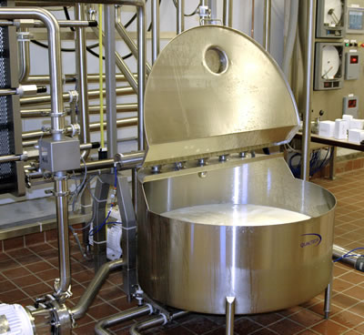
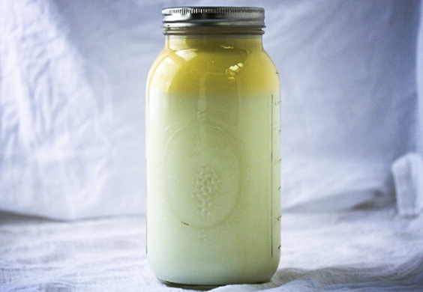
Processing Milk
Pasteurization: milk that has been heat treated to remove or kill harmful organisms
Homogenization: the fat particles in milk have been broken down and evenly distributed so they cannot join together again.

Slide 13
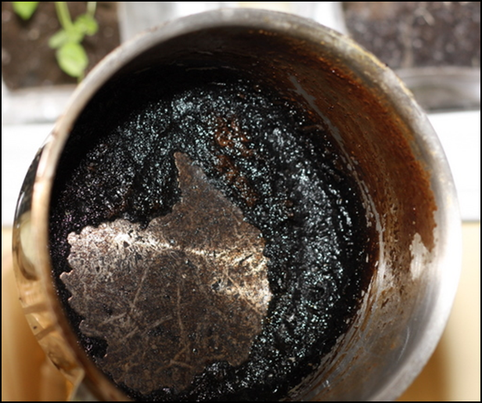
Cooking with Milk
Scorching occurs when the proteins in milk are overcooked. They fall and cling to the bottom of the pan. They create a thick, black layer that is difficult to remove.

Slide 14
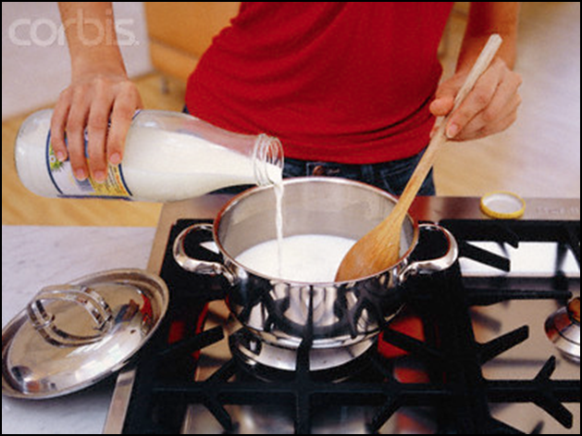
Cooking with Milk
To prevent scorching, cook milk on low heat and stir it constantly to prevent the proteins from collecting on the bottom of the pan.
Heating milk in the microwave will also prevent scorching.

Slide 15
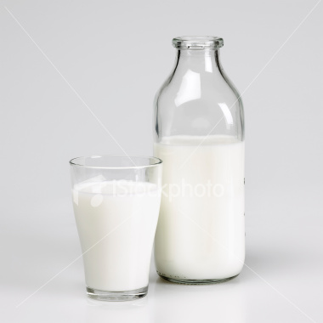
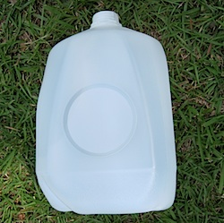
Milk in an opaque container
Milk spoils easier in a glass or see through container
Sun destroys vitamin A and riboflavin (B₂)

