Slide 1
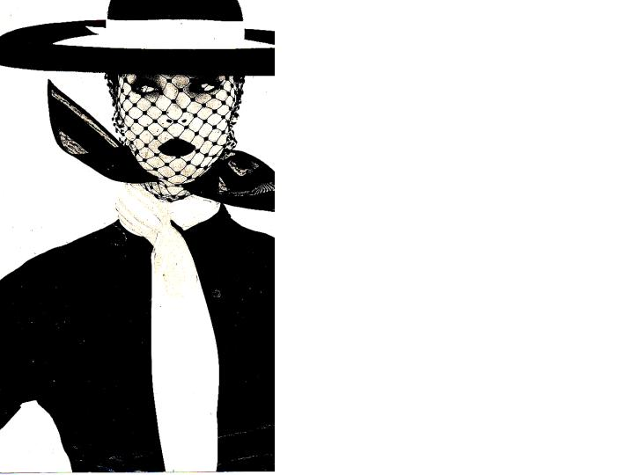
Color in Fashion

Slide 2
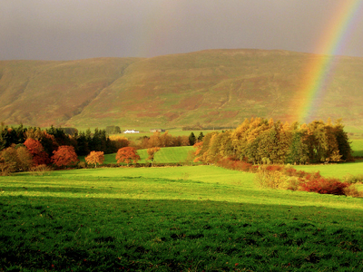
Components of Color
Color is a property of light
Light is made up of energy rays of different wavelengths
Each wavelength is a separate color
When sunlight passes through a prism, the rays are bent
Each wavelength bends a different amount and the light is separated into colors—red, orange, yellow, green, blue, indigo, and violet

Slide 3
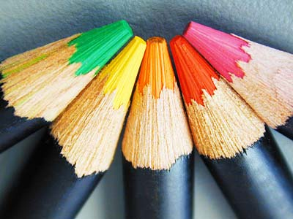
Color
Color affects:
How we feel—our mood
Our body temperatures
Our energy level
Our stress level
It can even affect your eye sight

Slide 4
Say the color of the word and not the name of the word
YELLOW BLUE ORANGE
BLACK RED GREEN
PURPLE YELLOW RED
ORANGE GREEN BLACK
BLUE RED PURPLE GREEN
BLUE ORANGE

Slide 5
RED
Most emotional color
Can make people feel bold, excited, or even nervous
Raises blood pressure and heart rate
People will pay more for an item if it has a red tag on it.
The most powerful, dramatic, warm color.

Slide 6
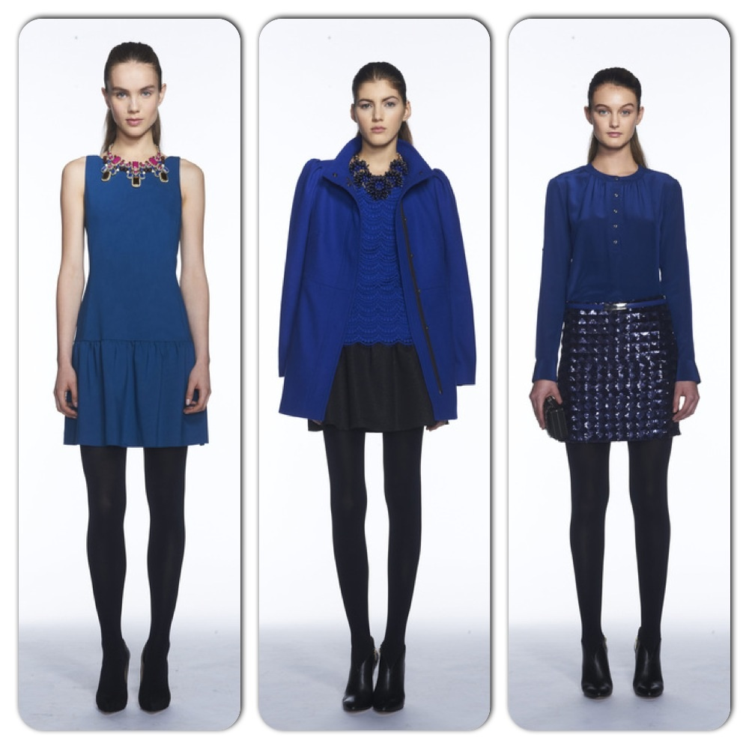
BLUE
Blue is generally subdued and is often used to create a calm feeling
Best color to wear for job interviews
Suggests respect, responsibility, authority
Blue is the favorite m&m
Slows down time

Slide 7
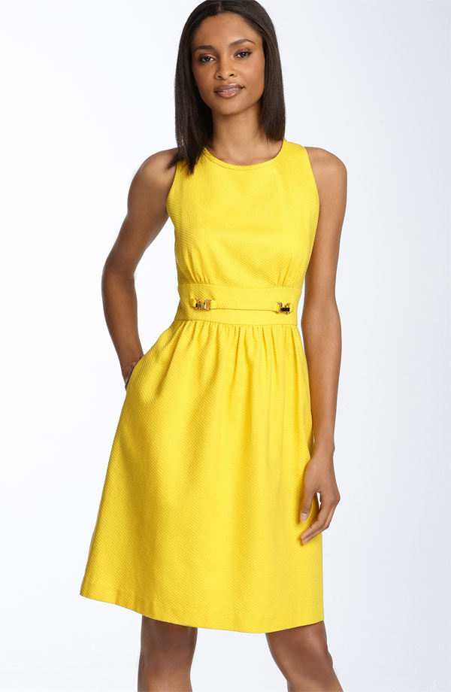
YELLOW
Makes you cheerful and hopeful
Yellow helps jog your memory (Use yellow paper to take notes, legal pads)
Draws attention

Slide 8
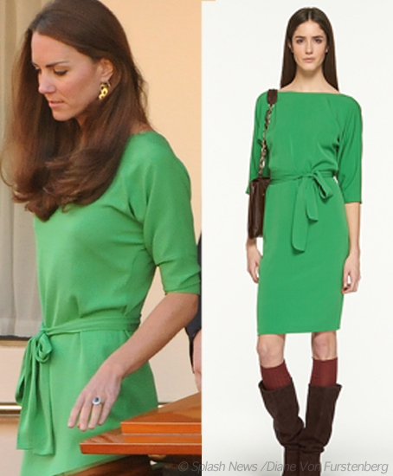
GREEN
Green has a calming effect, like nature.
Color of success (dollar bills)
Soothes pain
Everyone mellows out around the color green

Slide 9
BROWN
Friendly color
Warm, snug, secure
Home-like
If you wear brown people tend to think you are a better listener
Brown is associated with good food
Protective color
Stable, self-disciplines, dependable

Slide 10
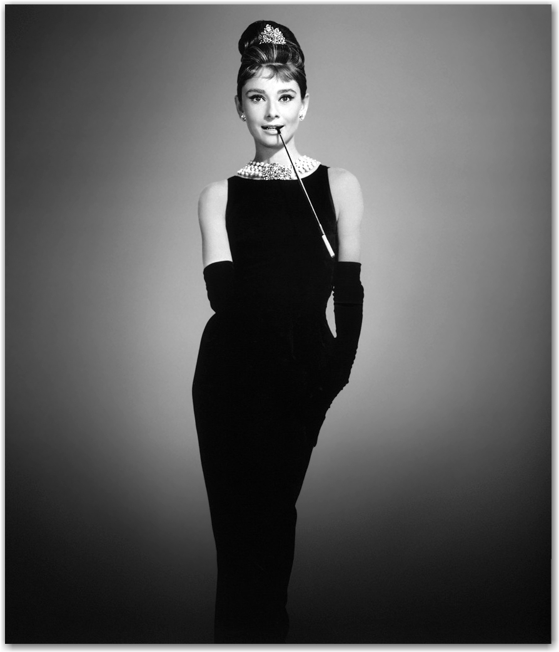
BLACK
Sophisticated, mysterious, dramatic
Mourning, sorrow, depression
Power and strong authority
Good accent color
Most slimming color
Men who wear black are considered arrogant
People who wear black tend to have more complex personalities

Slide 11
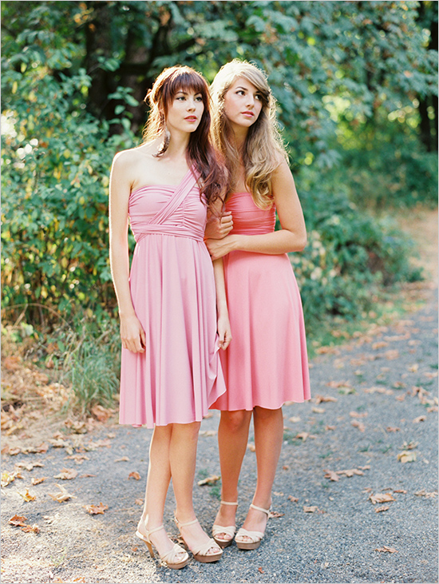
PINK
Sweeter than any other color
Can be calming (it has been suggested that all prisoners wear pink jumpsuits and paint walls pink)
Feminine
Laidback, carefree, innocent, romantic
Good accent for clothing not recommended as overall in clothing
Not a good color if you want to be taken serious

Slide 12
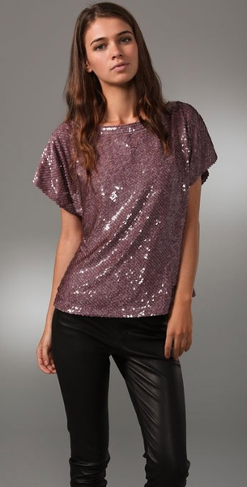
VIOLET
Most complex color
Combines red and blue, creating mixed effects. Royalty, dignity
Women all over the world accept purple as a color to wear
We get sick of violet quicker than any other color
More inventors favorite color was purple than any other color
Seen as an artistic and expressive color

Slide 13
ORANGE
Warms a room in a very welcoming way.
Informal
Stimulation
Considered a cheap, inexpensive color
Good around fast food—makes you hungry quickly
A majority of people only like orange in the fall
Least favorite m & m color

Slide 14
COLOR
To maintain or decrease attention and apparent size, to appear taller and slimmer
Cooler hues
Darker values
Duller intensities
Close contrasts
Examples: navy, khaki, grape, charcoal, mauve

Slide 15
color
To increase attention and apparent size, to appear shorter and heavier
Warmer hues
Lighter values
Brighter intensities
Strong contrasts
Examples: shocking pink, pumpkin, tangerine, raspberry

Slide 16
Color personalities!!
To appear refined, romantic
Warm to cool hues
Lighter values
Dull, muted to medium intensities including pastels
Close contrasts, subtle
Examples: shell pink, lavender, misty rose, orchid, blue, peach, all pastels

Slide 17
Color Personalities!!!
To feel and appear happy, youthful, sportive
Warmer hues
Light to dark values
Medium to bright intensities
Strong contrasts, bold
Examples: coral, red, khaki, ivory, brown, camel, cinnamon, brick

Slide 18
Color personalities!!!
To appear mature, serious, somber, classic
Cool hues
Dark values
Dull intensities
Examples: navy blue, taupe, charcoal, maroon, gray, black

Slide 19
Color personalities!!
To feel and appear dramatic/exotic
Warm to cool hues
Dark values, deep
Bright intensities, rich
Strong contrasts, bold
Magenta, fuchsia, emerald green, royal blue, regal purple, sapphire, amethyst

Slide 20
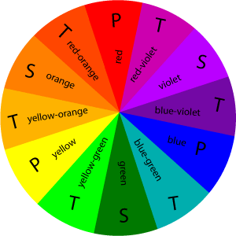
COLOR WHEEL
The color wheel is circular arrangement of primary, secondary, and tertiary colors.
The sequence of colors on the wheel is fixed.
The first color wheel was developed by Sir Isaac Newton in 1666

Slide 21
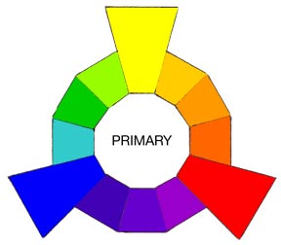
PRIMARY COLORS
Yellow, red, and blue
These colors are basic—they cannot be created by mixing other colors.
Yellow

Slide 22
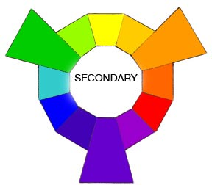
SECONDARY COLORS
Orange, violet, and green
These colors are made by mixing equal parts of two primary colors
Secondary colors appear on the color wheel halfway between the primary colors that make them

Slide 23
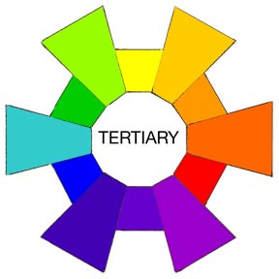
TERTIARY COLORS
Yellow-orange, red-orange, red-violet, blue-violet, blue-green, and yellow-green
Also known as intermediate colors
Created by combining a primary color with a neighboring secondary color

Slide 24
Components of Color
Color is a property of light
Light is made up of energy rays of different wavelengths
Each wavelength is a separate color
When sunlight passes through a prism, the rays are bent
Each wavelength bends a different amount and the light is separated into colors—red, orange, yellow, green, blue, indigo, and violet
Notes:
Repeat; Review

Slide 25
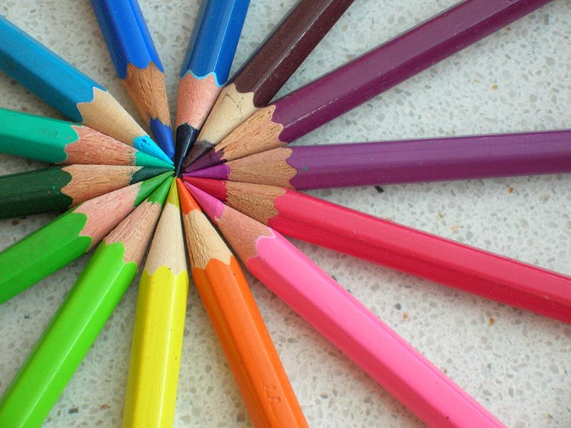
Hue—another name for color
The specific name of a color is its hue
Hue is the feature of color that makes one color different from others
Each color on the color wheel is a hue
Black, white, and gray don’t appear on the color wheel because they have no hue—technically they are not colors at all

Slide 26
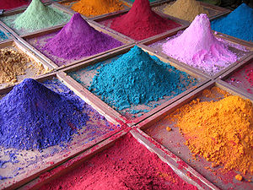
Pigments
All objects contain pigments—substances that absorb some light rays and reflect others.
The colors that you see are the reflected light rays
For example, when light strikes a red chair, all the rays in the light are absorbed except the red rays)

Slide 27
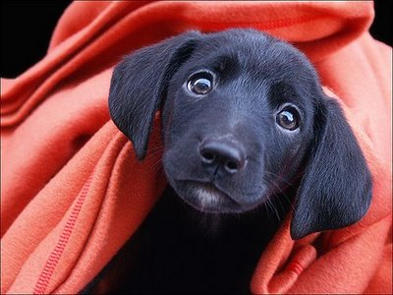
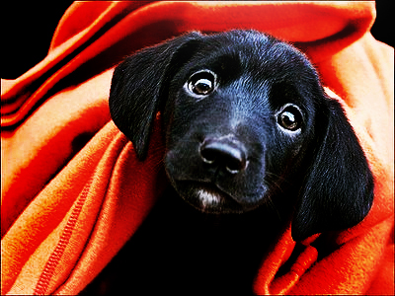
Intensity
The brightness or dullness of a color
High intensity—objects seem larger and closer
Low intensity—muted and generally create a calmer effect than intense or pure colors

Slide 28
VALUE
Lightness and darkness of a color
The basic hues in the color wheel are considered middle or normal values

Slide 29
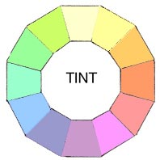
Tint
A hue that is lighter than its normal value
Has white added to it
Examples: pink is a tint of red, peach is a tint of orange, lavender is a tint of violet

Slide 30
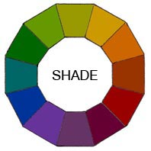
Shade
A color that is darker than its normal value
Has black added to a hue
Examples: navy is a shade of blue, rust is a shade of orange, maroon is a shade of red

Slide 31
Tone
Color that has gray added to it
Duller than its normal value, but not as dark as a shade

Slide 32
Remember: all are values!
Tints - adding white to a pure hue:
Shades - adding black to a pure hue:
Tones - adding gray to a pure hue:
Tint
Shade
Tone

Slide 33
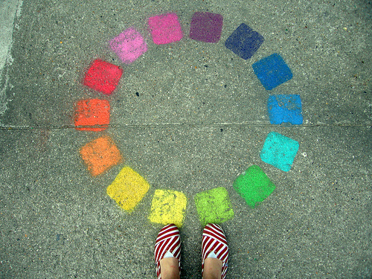
Color Schemes
A color scheme is the choice of colors used in design in order to create a mood or set a tone
Color schemes are used to create style and appeal.

Slide 34
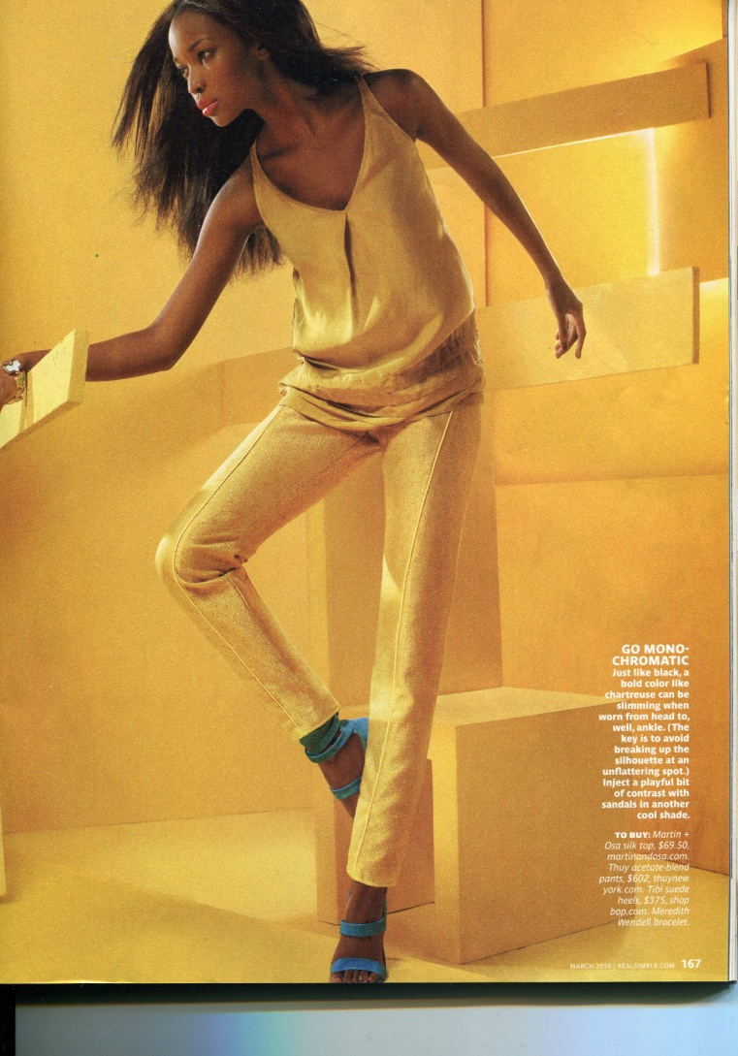
Color Schemes in Clothing

Slide 35
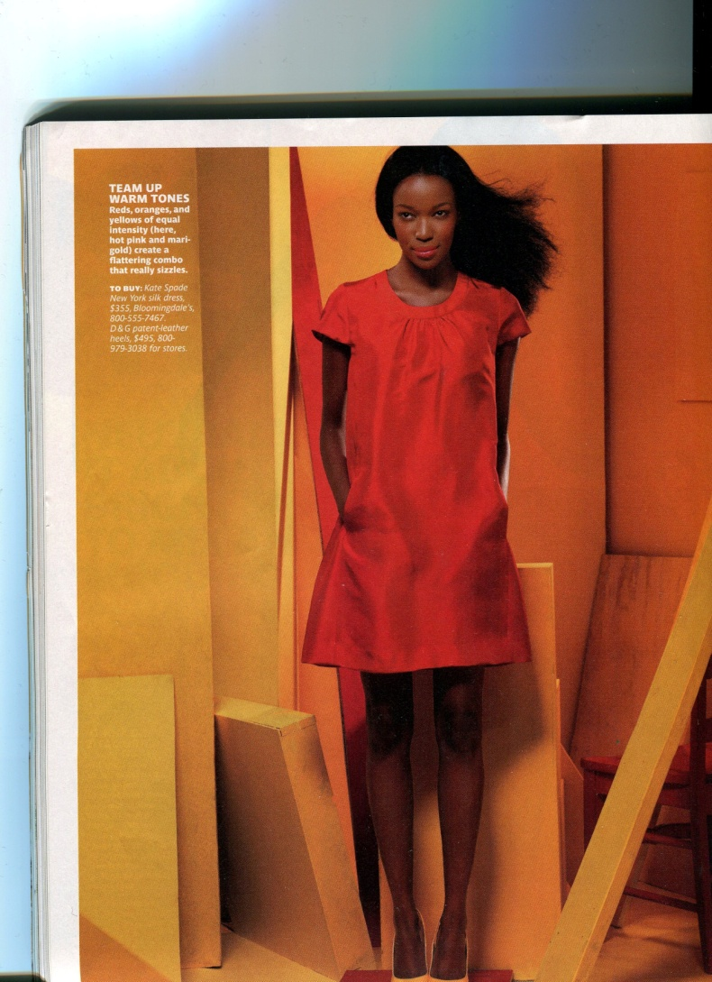

Slide 36
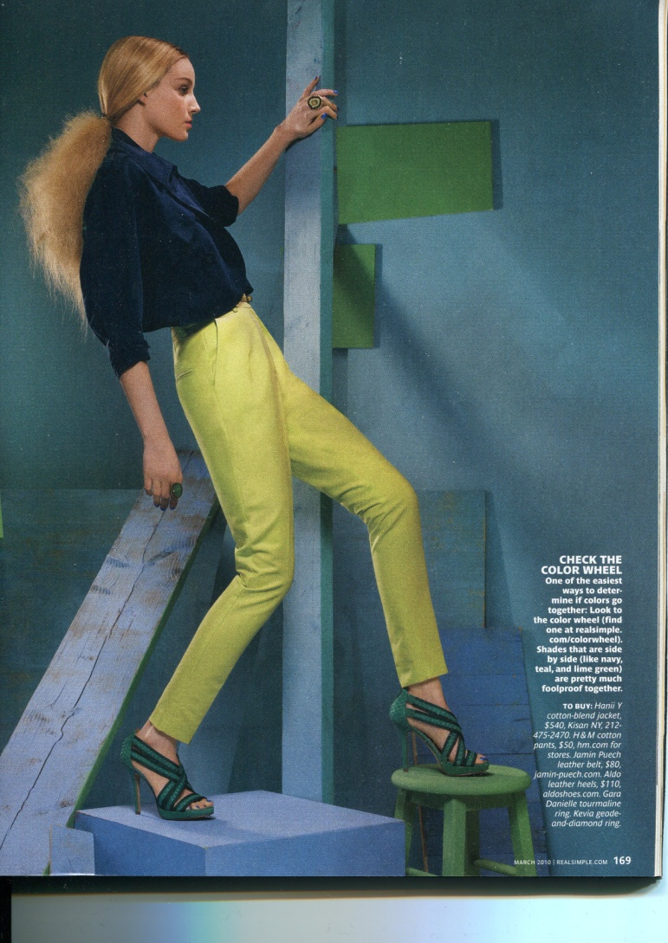

Slide 38
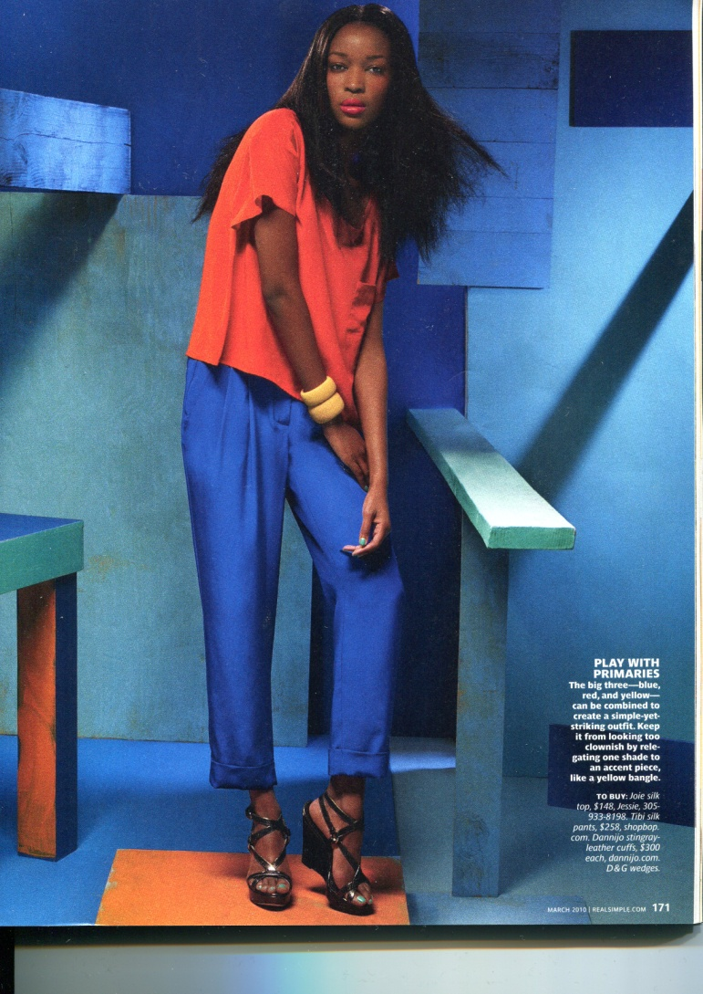

Slide 39
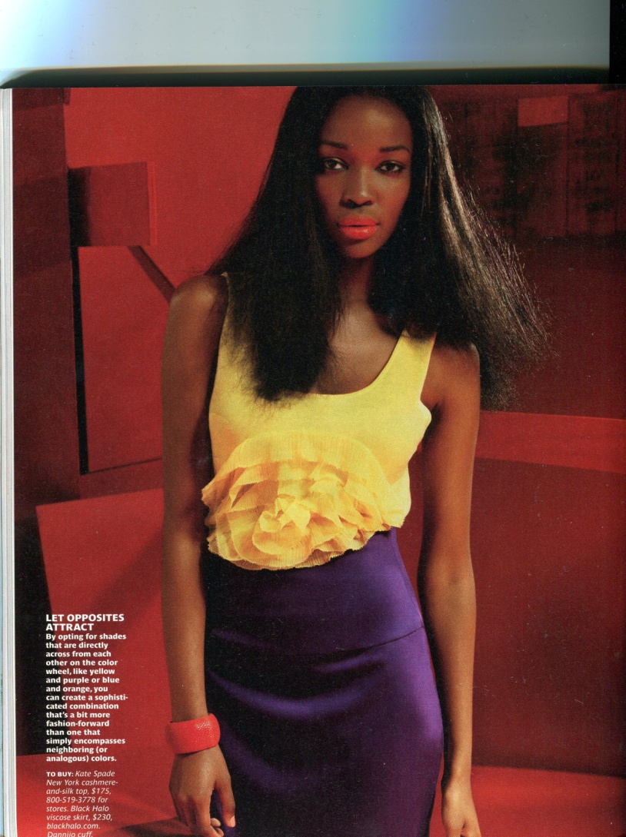

Slide 40
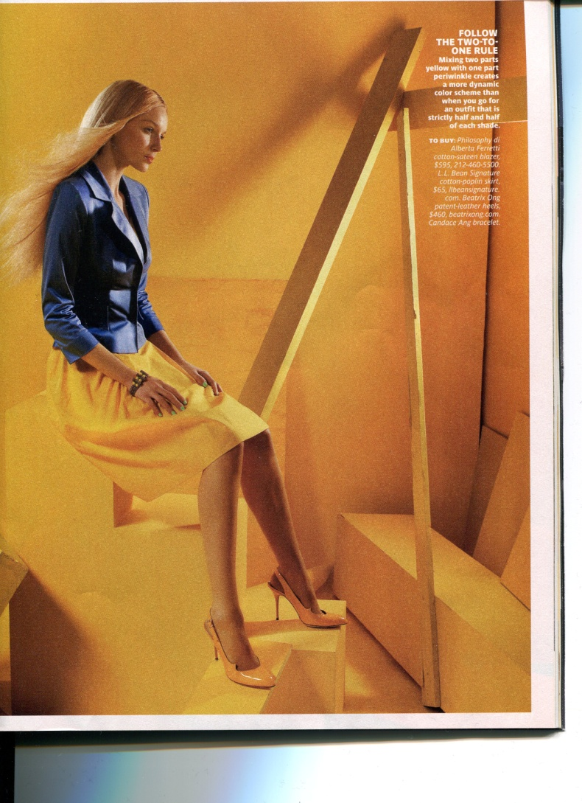

Slide 41
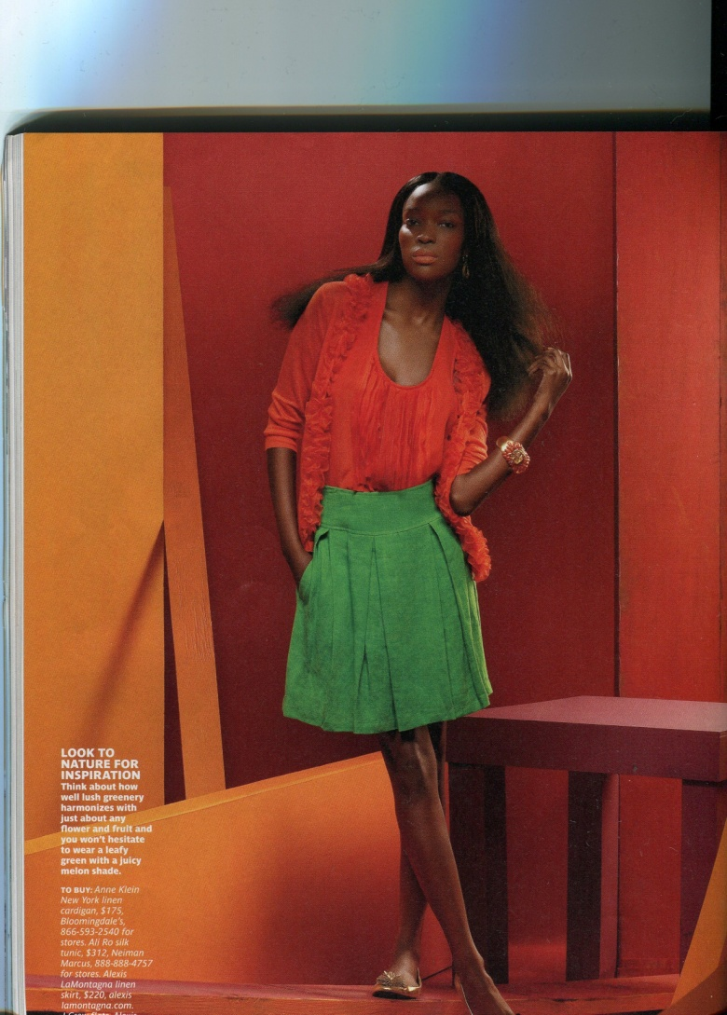

Slide 42
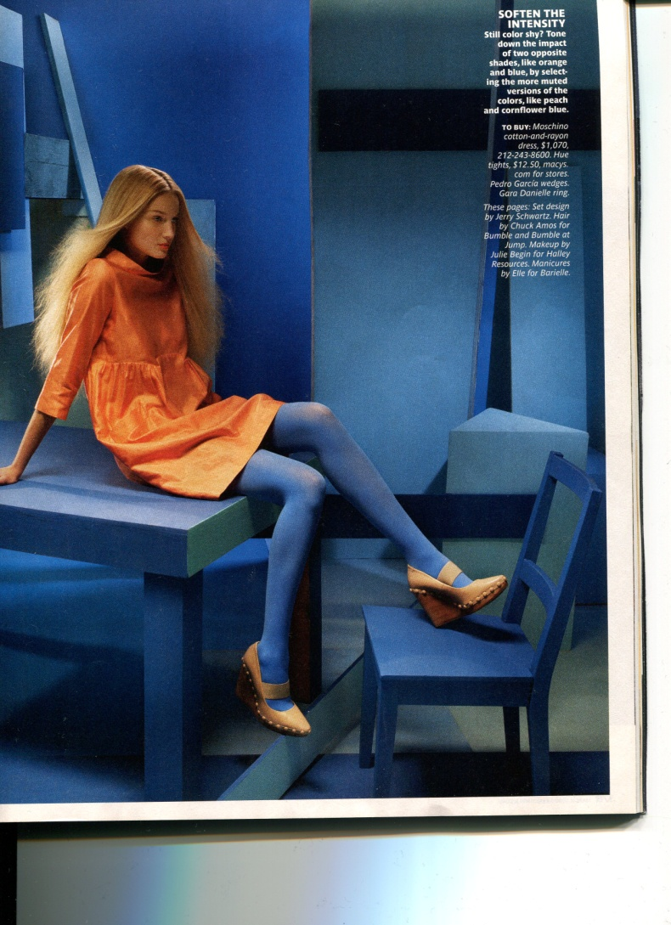

Slide 43
Monochromatic
Mono means “one”, refers to the tints tones and shades of one color
Possible color combinations are limitless!
Mint green and forest green
Generally calming, however it depends on the hue

Slide 44
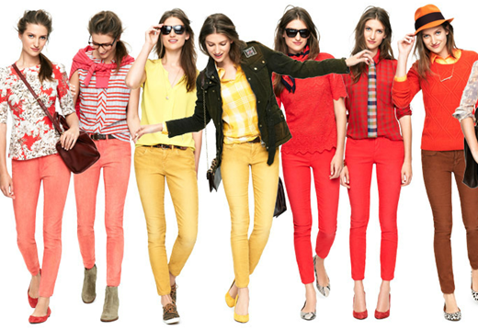
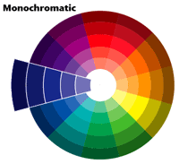
Monochromatic
A monochromatic color scheme uses tints and shades of one color on the color wheel

Slide 45
Analogous
Often referred to as adjacent. Two, three, or four hues that lie next to one another on the color wheel. All hues have one hue in common.
Possible colors (Can include tints, tones & shades)
Yellow-green, yellow, yellow-orange, orange
Feeling created: can be calming or exciting depending on whether they come from the cool or warm side of the color wheel.
This color scheme is most effective if one of the hues repeats some aspect of your personal coloring… eyes, hair…

Slide 46
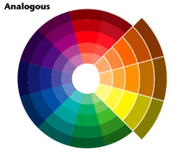
Analogous
Two or more colors that are next to each other on the color wheel

Slide 47
Complementary
Combine two colors from the opposite side of the color wheel.
Possible colors: red & green, blue & orange
Feeling associated: stimulating due to opposite visual characteristics. By dulling the intensity or value, calming effect may be achieved.
Can be very flattering to personal coloring, and versatile

Slide 48
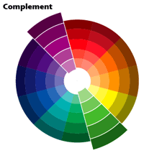
Complementary
Two colors that are directly across from each other on the color wheel.

Slide 49
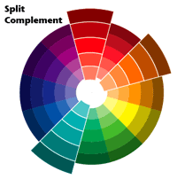
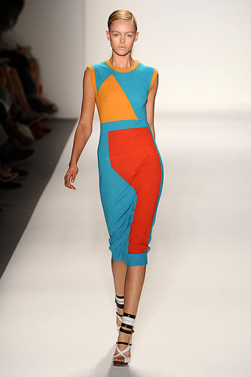
Split Complementary
A color scheme that uses three colors. It combines one color with the two colors on each side of its compliment

Slide 50
Triad
Three colors equally spaced on the color wheel
Possible colors: tints, tones and shades of primary or secondary colors
Very exciting and stimulating if used in full strength.

Slide 51
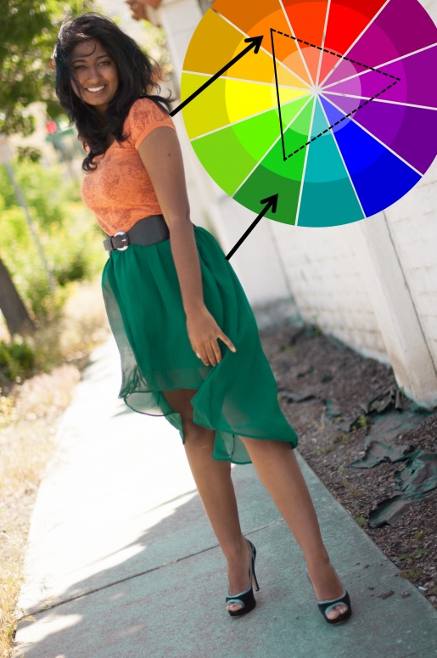
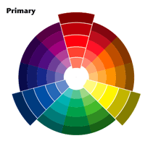
Triad
Three colors that are equally spaced on the color wheel.

Slide 52
Neutral
One, two, or three achromatic neutrals, may or may not vary in the degree of warmness or coolness, lightness or darkness, brightness or dullness
Possible colors: black and white, combination of browns
Effect: vary in mood depending on the degree of light and dark value contrast
Are most effective if the degree of lightness or darkness in your hair and/or skin coloring is repeated in the lightness or darkness of the clothing

Slide 53
Accented neutral
One color added to other neutrals to form a scheme.
Possible colors: black, white & red, browns with light blue
Effect: draws attention to the one added hue

Slide 54
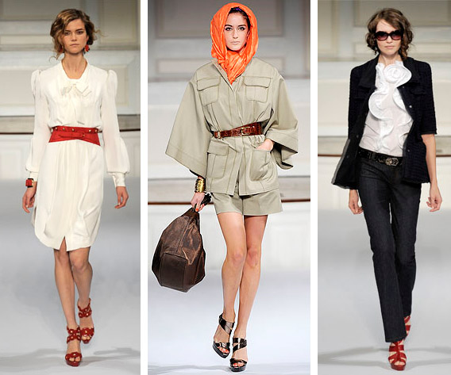
Accented Neutral
Neutral color scheme with a “splash” of color

Slide 55
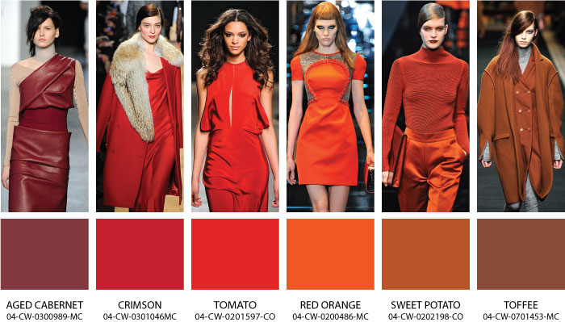
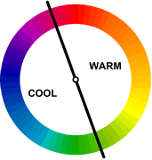
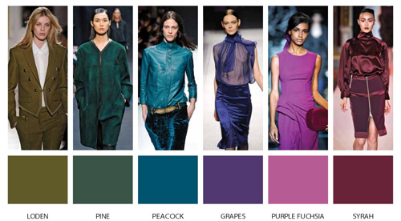
Warm and Cool Colors
You can also divide the color wheel in half

Slide 56
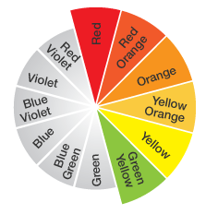
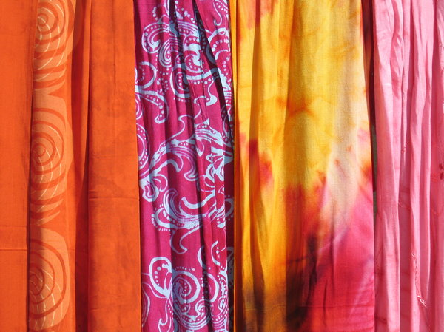
Warm Colors
Warm colors make things appear closer
Red-orange conveys the most warmth of any color
In general, colors associated with the sun—red, orange, and yellow—are considered warm colors

Slide 57
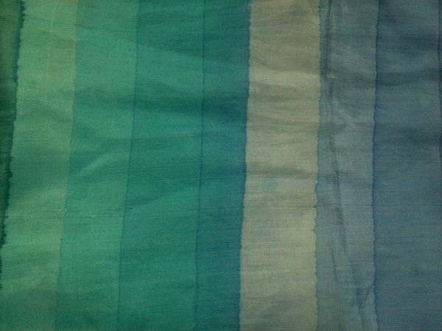
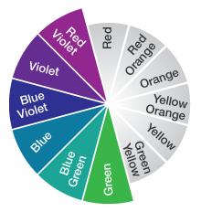
Cool colors
Blues and greens—colors that capture the essence of the ocean—are considered cool colors
Cool colors things appear further away
Cool colors have a relaxing effect

