Slide 2
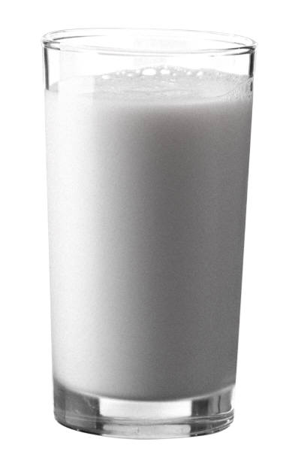
Milk

Slide 3
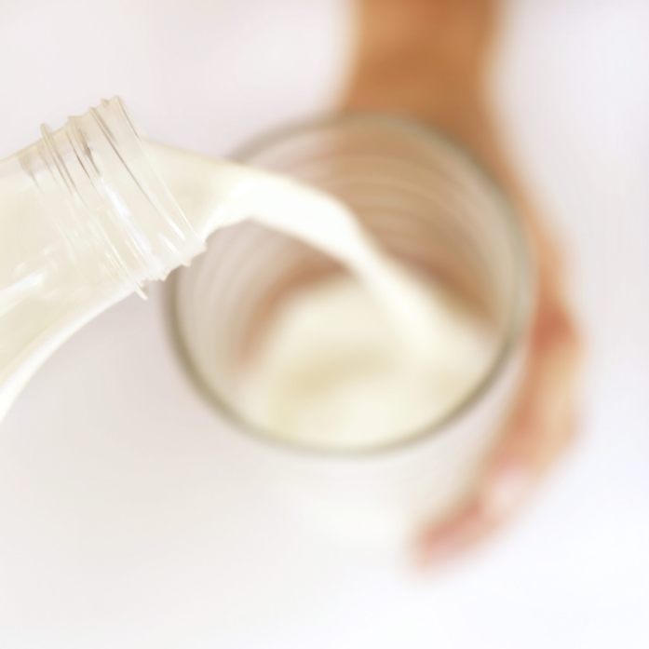
Milk
It is recommended that we switch to low-fat or fat-free milk and get least 3 cups daily from the Dairy food group.
Milk and milk products, (yogurt, cheese, etc.) are excellent sources of complete proteins because they come from animal sources.

Slide 4
Nutrients In Milk
By law, milk must be fortified with Vitamins A and D.
Fortified means that “extra” has been added to the product.
You can also get Vitamin D from sunlight. That is why it is sometimes called the “Sunshine Vitamin.”
Milk products also provide important minerals like Calcium, Iron and Phosphorus to help build healthy bones and teeth.

Slide 5
Processing Milk
7. Milk goes through several treatments before it is safe to drink. Two of these processes are:
Pasteurization: milk that has been heat treated to remove or kill harmful organisms.
Homogenization: the fat particles in milk have been broken down and evenly distributed so they cannot join together again.

Slide 6
Types of Milk
8. There are several types of Milk:
Type of Milk | Description
a. Whole Milk | Contains the highest amount of fat-(At least 3.25% or more)
b. 2% Milk | Contains only 2% milk-fat
c. 1% Milk | Contains only 1% milk-fat
d. Skim Milk (Fat-Free Milk) | Contains no fat
e. Non-Fat Dry Milk | Made by removing most of the fat and water. When reconstituted it is like Skim milk
f. Evaporated Milk | Whole milk that has half of water evaporated out of it

Slide 7
Types of Milk, cont.
8. There are several types of Milk:
Type of Milk | Description
g. Sweetened Condensed Milk | Milk with sugar added and then had water evaporated out
h. UHT Milk (Ultra High Temperature) | Milk heated to 280° for 2 seconds to kill bacteria
i. Lactose Free Milk | Milk that has had the lactose sugar removed
j. Buttermilk | Milk with lactic acid added
l. Flavored Milk | Milk with flavorings added (chocolate, strawberry, etc.)

Slide 8
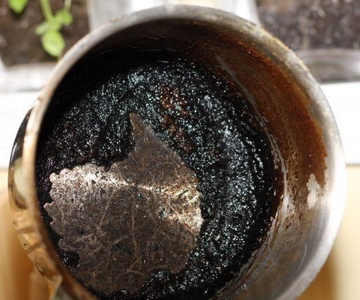
Cooking With Milk
Milk products scorch easily.
Scorching occurs when the proteins in milk are overcooked. They fall and cling to the bottom of the pan. They create a thick, black layer that is difficult to remove.

Slide 9
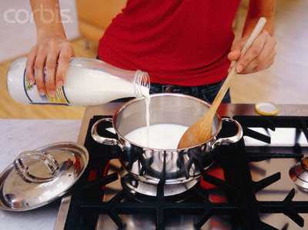
Cooking Milk, cont.
To prevent scorching, cook milk on low heat and stir it constantly to prevent the proteins from collecting on the bottom of the pan.
Heating milk in the microwave will also prevent scorching.

