Slide 1
Principles of Design
Principles are considered the “rules” of design

Slide 2
Vocabulary Builder
Scale
Proportion
Balance
Rhythm
Emphasis
Harmony
What do these words mean outside the world of design?

Slide 3
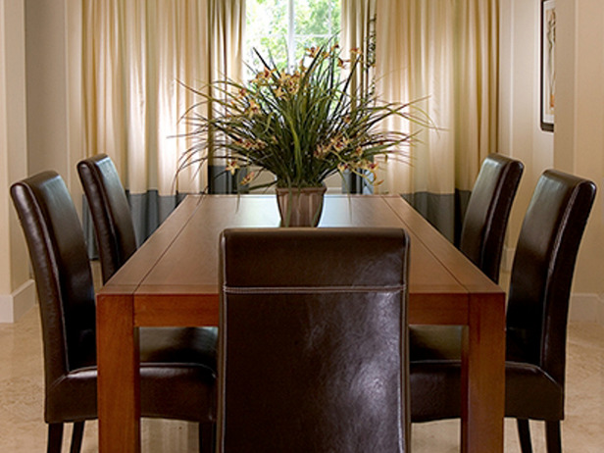
Balance
Balance provides a feeling of equality
Occurs when the amount, size, or weight of objects on both sides of a center point is equal, or when they appear to be equal

Slide 4
Balance
The feeling of rest
Equal weight on all parts of the room
Formal
Both sides are the same
Informal
Sides are different
Formal Balance
Informal Balance

Slide 5
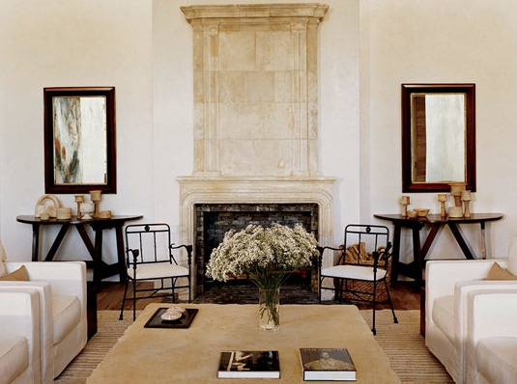
Symmetrical Balance
Formal balance
The arrangement of forms on one side of an imaginary line is the mirror image of the forms on the opposite side.
Convey dignity and quiet
Suggest a feeling of rest and calm

Slide 6
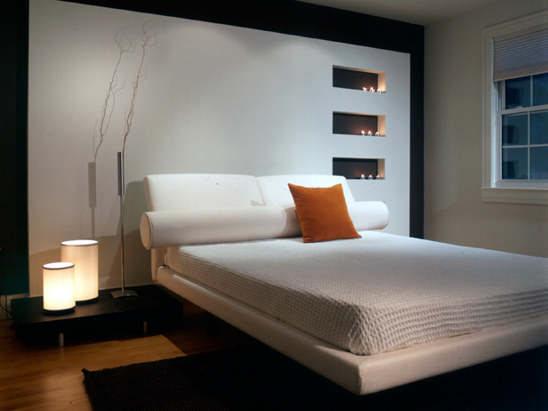
Asymmetrical Balance
Informal balance
Either side of an imaginary ventral line are unmatched, but appear to be in balance.
Consider objects’ apparent weight rather than their actual weight

Slide 7
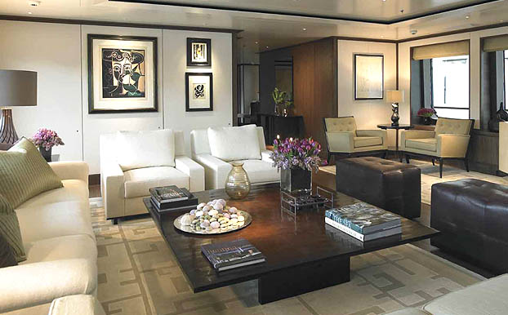
Is this formal or informal balance?

Slide 8
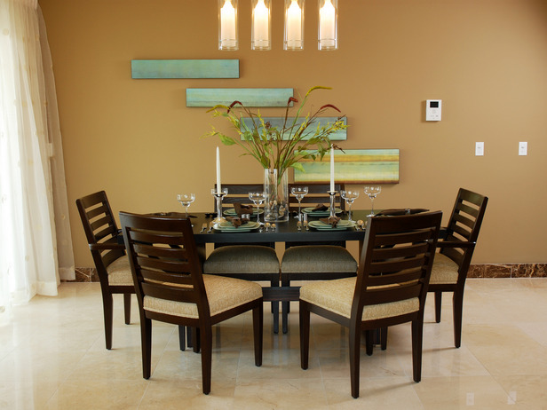
Rhythm There are 5 types of Rhythm
The principle that suggests connected movement between different parts of a design
Can be created with colors, lines, forms, or textures
Can be achieved in various ways

Slide 9
Types of rhythm:
Repetition
Transition
Radiation
Gradation
Contrast and opposition

Slide 10
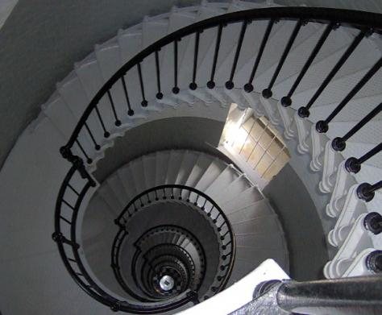
Repetition Rhythm
A design tool is repeated
Leads the eye from one point to another

Slide 11
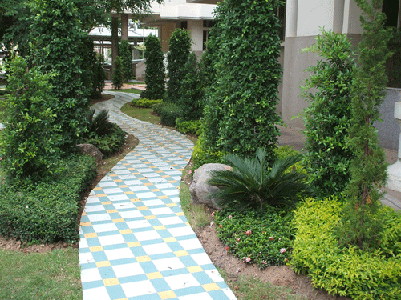
Transition Rhythm
When lines change direction by flowing in a curve, or when curved lines lead the eye from one object to another.
Examples: Arched doorways, draperies with swags, and a sofa with a back that curves into the arms.

Slide 12
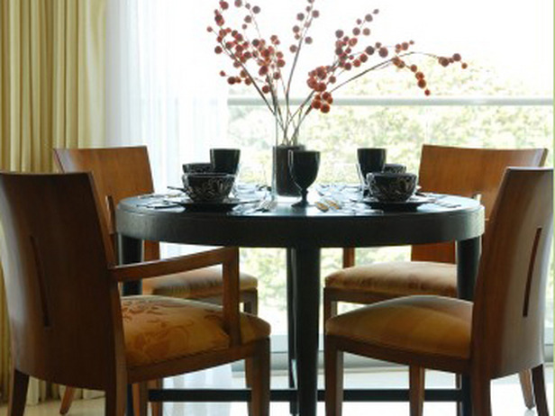
Radiation Rhythm
Radiation occurs when lines radiate, or move outward, from a central point.
Chairs arranged around a round table
Grouping small pictures around a large one

Slide 13
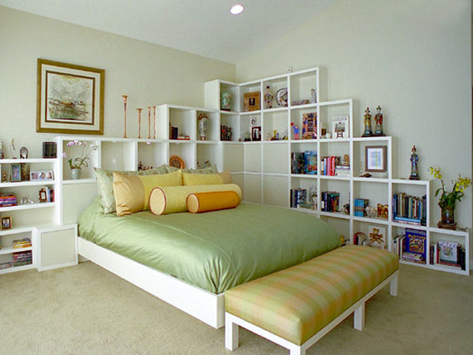
Gradation Rhythm
Moves your eye from light to dark or from small to large
A gradual change is usually more pleasing than an abrupt one.

Slide 14
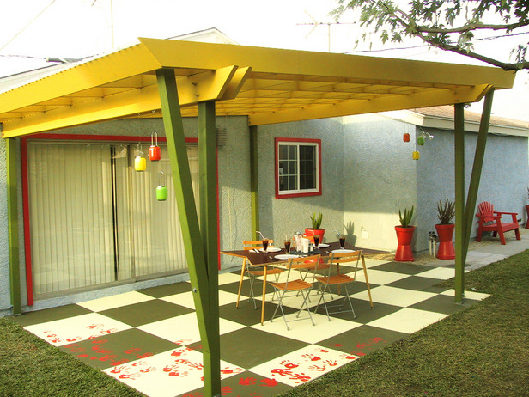
Opposition Rhythm
When lines come together to form right angles
Examples: square corners of a doorway, a sofa with arms at right angles to the back.

Slide 15
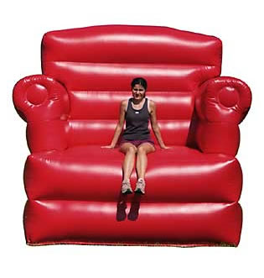
Scale
Relates to the size of a design in relation to the surrounding area in which it is placed
Example: too small of furniture
Click Here!→

Slide 16
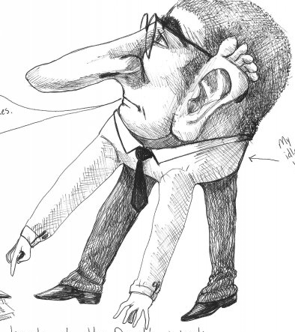
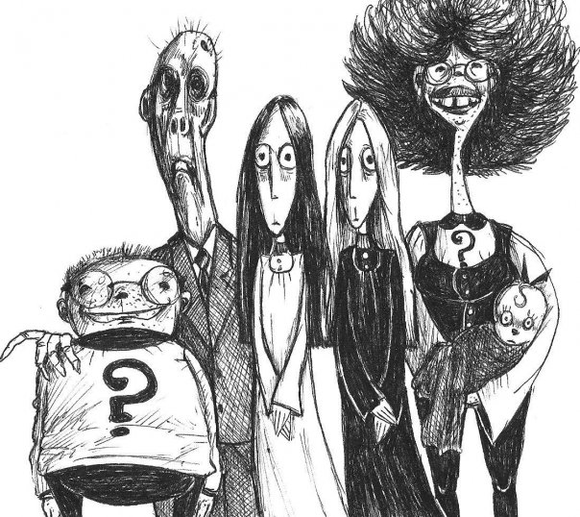
Proportion
Refers to the size relationships that can be found within an object or design.
Ignoring proportion may be the most common reason that a room setting just doesn’t look right.

Slide 17
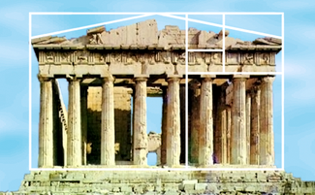
Proportion “The Golden Mean”
Is the ratio of all the parts to the whole design
A ratio of 2:3 is the best
A ratio of 5:8 also works well
A ratio of 4:4 is not a pleasing design

Slide 18
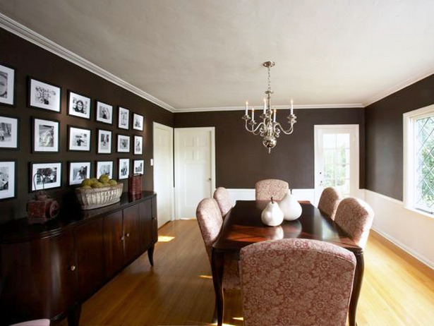
“The Golden Mean”
The ratio of 2:3 is used to decide where to put the wainscoting

Slide 19
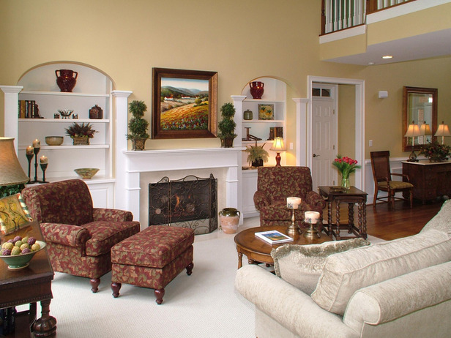
“The Golden Mean"
The golden mean can also be used to measure room elements against one another
2.6 mm
4 mm

Slide 20
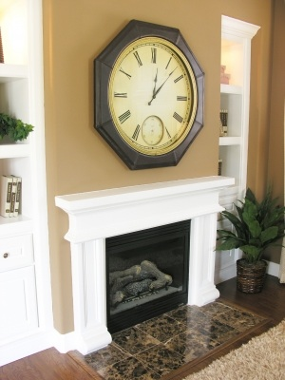
Emphasis
The center of interest in a room.
Draws your attention.
Can be one large object, or a collection of smaller ones.
Should be dominant, but not overpower the rest of the room.

Slide 21
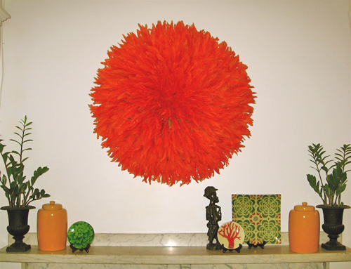
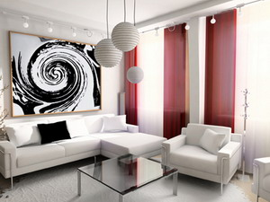
Emphasis

Slide 22
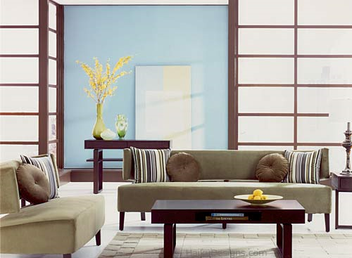
Harmony
When all parts of a design are related by one idea
Variety within unity is important because variety adds interest to a design

