Slide 1
Self Concept Cycle

Slide 2
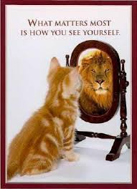
What is the difference?
-Self-Concept
  How you think about yourself
  -Self- Esteem
  How you feel about
  what you think of
  yourself

Slide 3
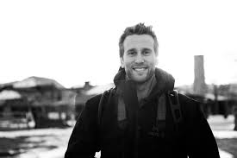
Self- Concept
The person I think I am

Slide 4
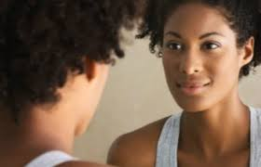
Self-Concept
The person others think I am

Slide 5
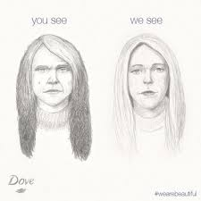
Self-Concept
The person others think I think I am
Dove clip http://www.youtube.com/watch?v=litXW91UauE

Slide 6
Self Concept Cycle
My Actions
As others see me
Others reaction to me
As I see myself

Slide 7
Characteristics
Positive Characteristics
-I am an okay person
-I can do anything I want to do
-I have strengths & abilities
-I see myself as being as good as or better than my friends
-There are many ways to do something
Negative Characteristics
-I am a jerk.
-Why try? I could never do it anyway.
-I cannot do anything right.
-I am not nearly as good as my friends.
-I knew my plans would not work out.

Slide 8
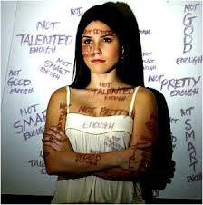
Self Concept
How can we build our self-esteem?

Slide 9
Survival
Values, Goals, & Refusal Skills

Slide 10

What are Values?
Qualities, characteristics, or ideas which we feel very strong about.
Affects our:
-Decisions
-Goals
-Behavior

Slide 11

Where do you get your values?
Home
School
Friends
TV
Church
Year Raised In
Music
Society
Work
Books

Slide 12
Characteristics of Values
Personal
Our actions point out our real values
Give direction/consistency
Experiences-Changes
Gives us an identity
Freely Chosen
Respecting someone else’s values

Slide 13
Value vs Fact
Value
Fact
A Statement of one’s personal beliefs
Established by observation and measurement

Slide 14
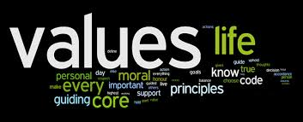
Types of Values
1. Moral
2. Aesthetic
3. Material
4. Intrinsic
5. Extrinsic
6. Universal
7. Group Specific

Slide 15
Values
Family
Religion
Money
Marriage
Travel
Education
Recreation
Sports
Honesty
Winning
Independence
Close Friends
Popularity
Health
Career
Peace
Adventure
Prestige
Children
Power
Trust
Loyalty
Security
Influence
Charity
Comfort
Patriotism

Slide 16

Goals
What comprises a goal?
Aspects:
  S-specific
  M-measurable
  A-attainable
  R-realistic
  T-tangible

Slide 17

Refusal Skills
Reasons we give in to Peer Pressure:
  To save face
  It’s Easier
  To Fit In

Slide 18
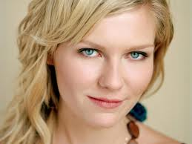
Save Face
Broken record technique
Give reasons or excuses
Find a friend who feels the same way you do or recruit an ally
Avoid the situation
Change the subject
Take a stand
Take the pledge
It’s the Law

Slide 19
Decision Making
A Problem Solving Technique

Slide 20
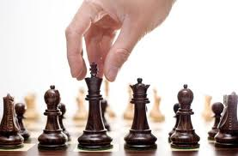
Decision Making
Why is it important to make decisions?

Slide 21
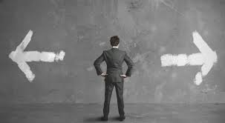
Decision Making
What kind of decisions do you make everyday?

Slide 22
Decision Making
5 Easy Steps to Promote Your Success!
Step 1
Step 2
Step 3
Step 5
Step 4

Slide 23
Decision Making
Step 1:
Identify the problem
Step 1
Step 2
Step 3
Step 5
Step 4

Slide 24
Decision Making
Step 2:
Brainstorm possible solutions
Step 1
Step 2
Step 3
Step 5
Step 4

Slide 25
Decision Making
Step 3:
Explore & Evaluate Possible Solutions
Step 1
Step 2
Step 3
Step 5
Step 4

Slide 26
Decision Making
Step 4:
Make a decision, plan, & act on the decision
Step 1
Step 2
Step 3
Step 5
Step 4

Slide 27
Decision Making
Step 5:
Evaluate results of the decision & accept responsibility for results of decision
Step 1
Step 2
Step 3
Step 5
Step 4

