Slide 1
Bell Quiz #4~ Cognitive Dev.
1. A babies brain triples in the first 2 years based on:
A. Toys they are given
B. Books and songs surrounded by
C. Its environment
D. TV shows they watch
2. Crawling develops motor skills, but also brain pathways necessary for:
A. Reading
B. Playing
C. Showing emotions
D. Overcoming egocentrism
3. Knowing an object still exists, even though it is out of sight, is an example of:
A. Assimilation
B. Separation anxiety
C. On-looker play
D. Object permanence

Slide 2
Bell Quiz #4 ~ Cognitive Dev.
4. You can encourage an infant’s language development by:
A. Speaking more than one language
B. Using baby talk
C. Doing exercises that strengthen the muscles in the mouth
D. Giving positive feedback for the sounds they make
5. Jean Piaget said that from birth to 2 years old children are in the sensorimotor stage which means they learn through:
A. Sensory Play
B. Active Play
C. Repetition
D. Imitation
6. Which is an example of a cognitive skill
A. Walking
B. Recognizing their name
C. Separation Anxiety
D. Learning how to laugh

Slide 3
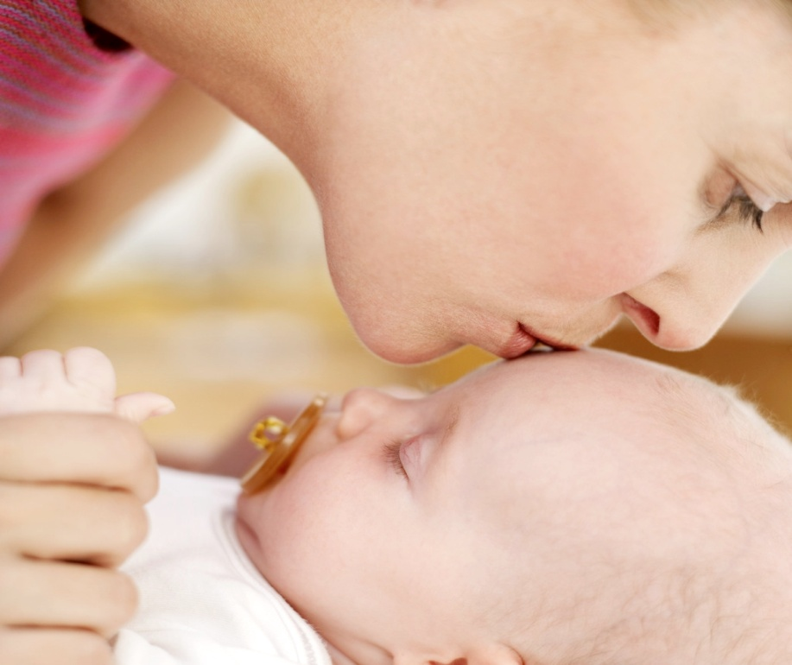
1st YEAR EMOTIONAL and SOCIAL DEVELOPMENT

Slide 4
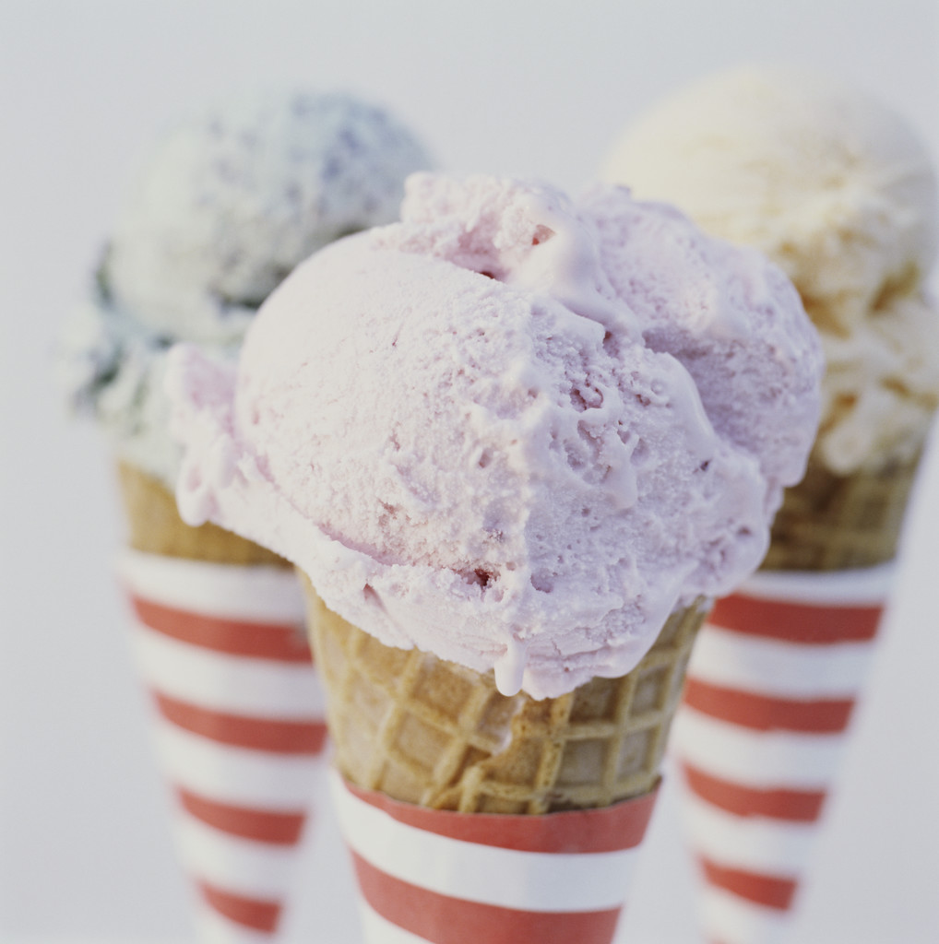
ICE CREAM MATCH
According to Dreyer’s Ice Cream and researchers at the Smell and Taste Treatment and Research Foundation, certain types of ice cream determine your personality type. All you have to do is invite a prospective mate over for ice cream and offer your guest a choice of six different flavors of ice cream to find your perfect match.

Slide 5
Double Chocolate Chunk
You are lively, creative, dramatic, charming, and enthusiastic and the life of the party. Chocolate fans enjoy being at the center of attention and can become bored with the usual routine.
Chocolate Chip
You are generous, competitive, and accomplished; charming in social situations, ambitious and competent.
Butter Pecan
You are orderly, perfectionist, careful, detail-oriented, conscientious, ethical and fiscally conservative. You are also competitive and aggressive in sports. The “Take Charge” type of personality.
Vanilla
You are colorful, impulsive, a risk taker who sets high goals and has high expectations of yourself, and enjoys close family relationships.
Banana Cream Pie
You are very easy going, well adjusted, generous, honest and empathetic.
Compatibility Chart:
Vanilla goes best with Vanilla.
Double Chocolate Chunk goes best with Butter Pecan or Chocolate Chip.
Butter Pecan needs Butter Pecan.
Strawberries and Cream go best with Chocolate Chip.
Chocolate Chip is best paired with Butter Pecan or a Double Chocolate Chunk.
Banana Cream Pie is compatible with all flavors!
Strawberries and Cream
You are shy yet emotionally robust, skeptical, detail-oriented, opinionated, introverted, and self-critical.

Slide 6

Emotional Development
  Begins at birth.
  The process of learning to recognize and express one’s feelings and to establish one’s identity as a unique person.
  It deals with a child’s changing feelings about themselves, others, and the world around them.
  How a baby learns the meaning of love.
    Tone of voice, mood, care, facial expression, affection, closeness…

Slide 7
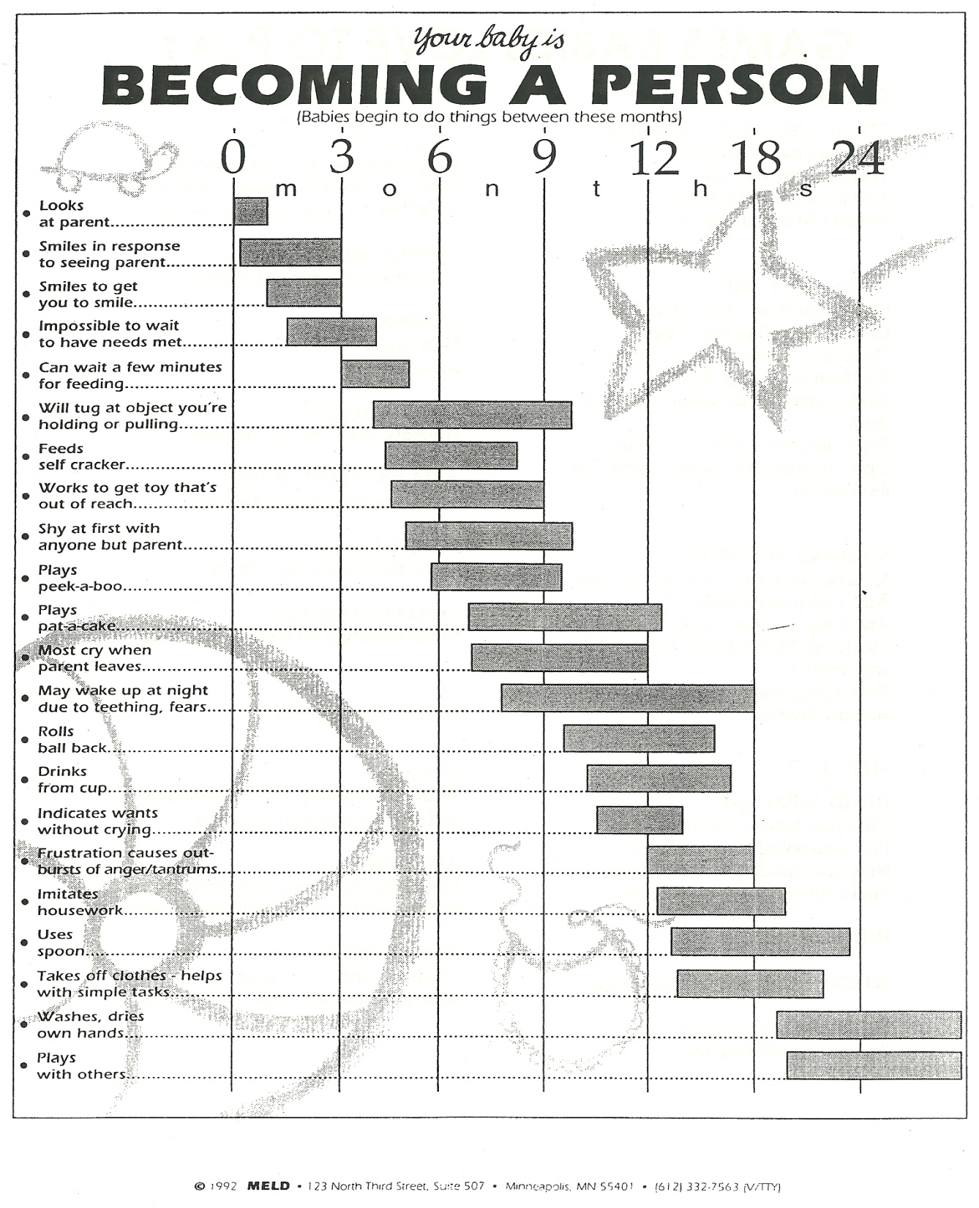

Slide 8
2. Nurturing and bonding, as it relates to infants, is showing love and concern, respect, support, understanding, responding, consistency, etc…..
This bond is called attachment
  a special closeness in a relationship

Slide 9

4. Failure to Thrive is what happens to babies when they have no one to love and nobody to love them.
  It causes slower development in all of the 5 areas of development.

Slide 10
Attachment Video Clip
Bonding and Attachment Video~ The First Years Last Forever
http://www.youtube.com/watch?v=QYi-ta_xXSQ&feature=related

Slide 11

Erick Erickson
Trust vs. Mistrust stage.
To develop Trust in an infant:
  Show love and concern, giving respect, supporting, understanding, responding quickly, be consistent, be sensitive to their needs, provide a routine and schedule, holding, cuddling, playing, talking to them, loving them
Through this, infants feel:
  safe, secure, confident, happy, loved, stronger, independent, smarter, higher self-concept, etc…

Slide 12
Your shower routine?
Consistency and routines are necessary for a child to identify the expected behavior and to trust their parents, caregivers, and the world they live in.
Mistrust
    Receive inconsistent care
    Receive little love and attention
  Fear and suspicion toward the world and everyone in it.

Slide 13
Trust Cycle
Happy Infant
Relaxed and happy parents
Parents meet the infant’s needs
Unhappy, frustrated, and disappointed parents
Unhappy, fussy, and demanding infant
Happy Infant
Parents do not meet the infant’s needs
TRUST
MISTRUST

Slide 14
Infant Personalities
3 common infant personalities:
      a. Sensitive child
      b. Placid child
      c. Aggressive child
Identify the characteristics of each temperament and how a caregiver can handle this.

Slide 15
SENSITIVE CHILD
♥ Slow to warm up to people
♥ Was usually fussy and irritable as a baby
♥ Reluctant to try new things or experiences
♥ New experiences may end in failure, pain or embarrassment. The child may then lose self-confidence, resulting in uncertainty and insecurity
♥ More sensitive to sounds and changes in the environment, colors, and changes in moods of people
♥ Can grow up to be sensitive to other people and work as counselors or therapists. May also use their sensitivity in the fields of music, art, or drama
Caregivers Can:
♥ Help this child establish self- confidence by being patient, encouraging, and by providing lots of reassurance.
TEMPERMENT TYPES INFANT PERSONALITIES

Slide 16
PLACID CHILD
☺ Easy going
☺ Less upset by change in routine
☺ Adjusts easily to new people and situations
☺ Happy, cheerful, patient, quiet
☺ Goes through life with a minimum of fuss and upset
☺ Can grow up to be peacemakers, any job that requires an even temper; will get along with co-workers
Caregivers Can:
  Needs love and encouragement to push themselves toward achieving their goals
  May need to be challenged, if not, they could end up being a couch potato
TEMPERMENT TYPES INFANT PERSONALITIES

Slide 17
TEMPERMENT TYPES INFANT PERSONALITIES
AGGRESSIVE CHILD
Constantly active and on the go, loves activity
Awake more than other babies
Responses are extreme (kicks more strenuously ) and temper tantrums are normal
Strong-willed, eats more vigorously, cries more loudly
Often larger than other babies
Not concerned with failure, will try again and again
Needs lots of constant parenting
Can use aggressiveness in play, sports, or leadership (positive and negative)
Caregivers Can:
With a nurturing parent, the child can grow up to be a responsible leader of people.
Parents must impose reasonable limits
Child needs lots of love and praise
Child needs to be made aware of the feelings and interests of others
If the aggressive nature is not limited or channeled in a positive direction, this child could get into a lot of trouble

Slide 18
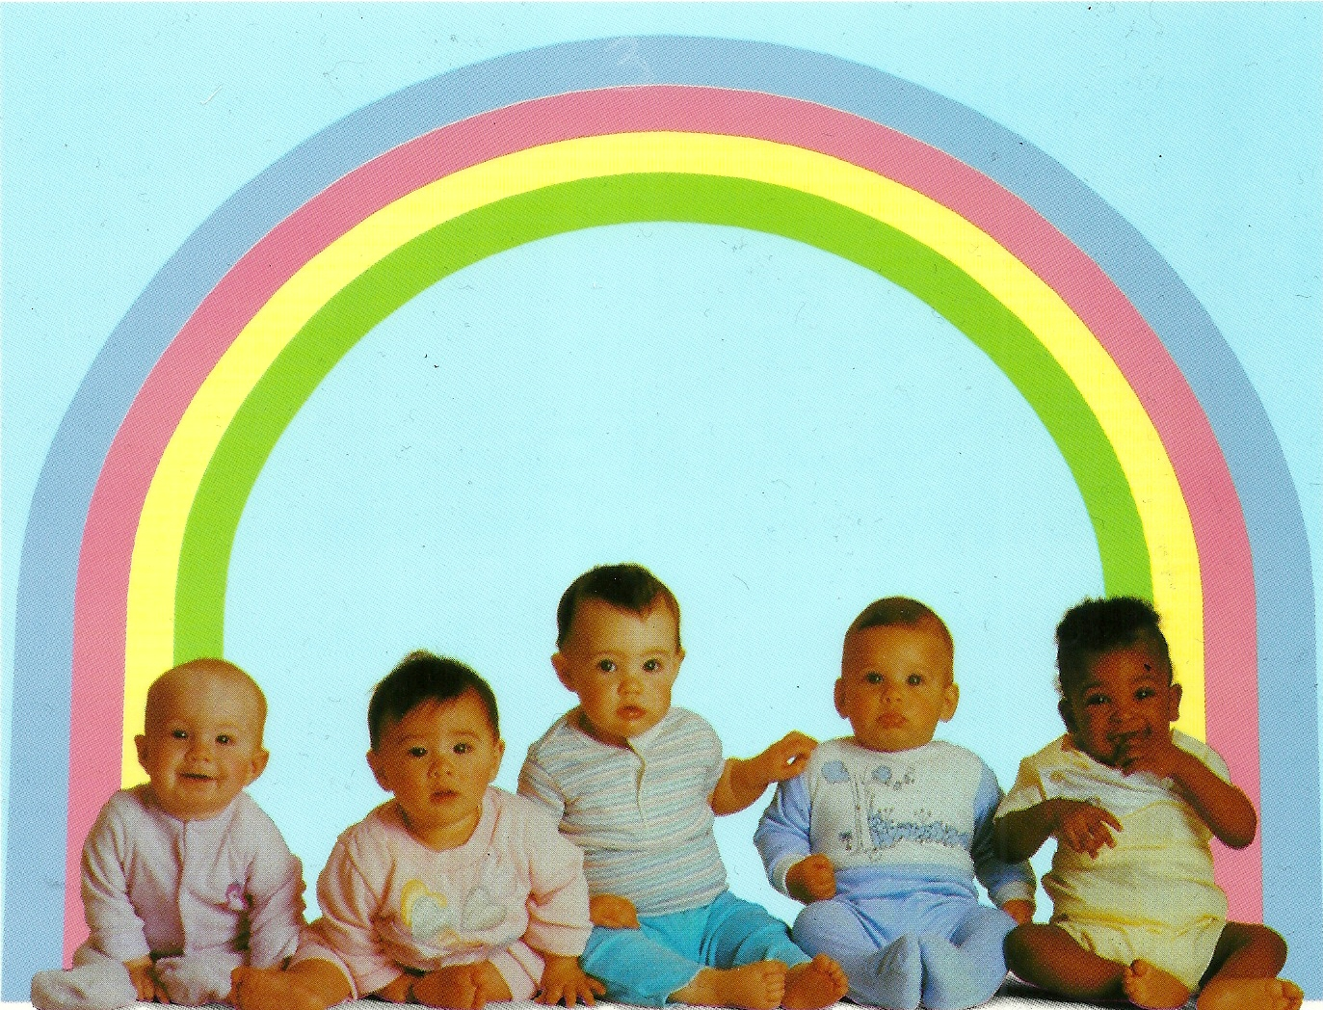


Slide 19
Bell Work
We worry about what a child will become tomorrow, yet we forget that he is someone today.
              ~Stacia Tauscher
What does this quote mean to you?

Slide 20
Unit 1, Quiz #1
1. Communicable diseases:
A. Are not passed from one person to another
B. Are usually fatal
C. Are passed from one person to another
D. Cannot be prevented or treated
2. Which type of environment is developmentally beneficial for a 12 month old?
A. A playpen full of stimulating toys
B. A bedroom full of book, crafts, and educational toys
C. Free access to a child proof house
D. A bathtub with boats and paints
3. In what position should a newborn be placed to sleep?
A. With a pillow
B. On its stomach
C. On its back
D. On a fluffy, warm blanket with stuffed animals

Slide 21
Unit 1, Quiz #1
4. All of the following are advantages of breast-feeding except:
A. Newborns can get all of the nutrients needed from breast milk
B. There is less chance of developing allergies
C. The baby has a stronger immune system
D. Both mom and dad can take part in feeding the baby
5. A good rule of thumb when bathing a baby is:
A. Start with the dirtiest areas and end with the cleanest
B. Begin giving baths as soon as the baby is born
C. Have all the needed supplies in the room, but not close
enough to reach them without leaving the baby’s side.
D. Start with the cleanest areas on the body and end with the
dirtiest areas
6. The safest place, in an automobile, to put a car seat is in the:
A. Front seat next to the driver
B. Back seat next to the window
C. Front seat next to the window
D. Center of the backseat

Slide 22

Infant Social Development
1. Social development is
  learning the rules of play
  Learning how to interact with others
  Learning to express oneself to others

Slide 23

Infant Social Development
2. Newborns prefer to look at the human face – their main form of socializing

Slide 24
Infant Social Development
3. Through play:
  a child learns about and develops all areas of development.
  they learn about themselves, other people, and the world around them.

Slide 25
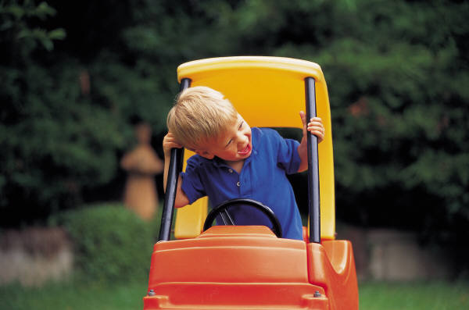
TYPES OF PLAY
SOLITARY PLAY
  Solitary Play is independent play or playing alone, having no interest in anyone else or what other’s are doing.
  Examples: cars, blocks
On –Looker PLAY
  On-looker Play is watching others play. May talk to others, but not involved with them.
  Wants to be close enough to interact, but still keeps to them self.
  Examples: duck duck goose game

Slide 26

4. Stranger Anxiety is fear of a strange or unfamiliar face.
  Happens about 18 months.
  Expressed through crying and withdrawal
  It occurs because of the infants progressing cognitive development and understanding of the world.
5. Separation Anxiety is when a child is uncomfortable being away from parents or primary caregiver.
  Appears about 6 months and then again (even stronger) at 18 months.

Slide 27
Reflection #4
What is your first memory of your childhood? Explain

Slide 28
Infant Simulation Day
6 Groups
  You will rotate through each station
  Be sure to fill out the Infant Simulation Worksheet at each station

Slide 29
INFANT LABS AND 1ST YEAR DEVELOPMENT
Complete 1 lab and write an analysis on it.
  Place analysis in this quarter’s notebook.
  The “MUST DO” clothing evaluation has its own analysis form. Place it in your notebook.
Use the posters and textbook to complete the month by month milestones occurring throughout the first year,

