Slide 1
Design
The selecting and organizing of materials to fulfill a function.

Slide 2
There are two types of design
An integral part of the structure itself. When structure and design cannot be separated.
Structural Design

Slide 3
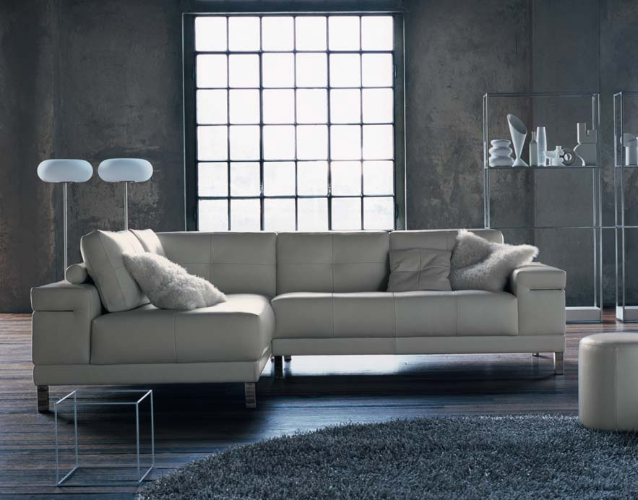
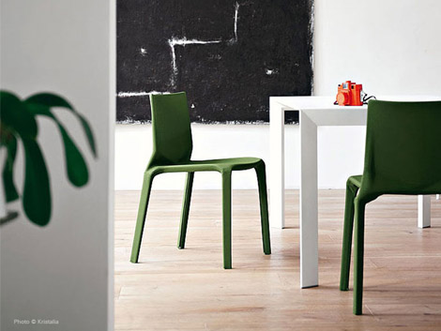
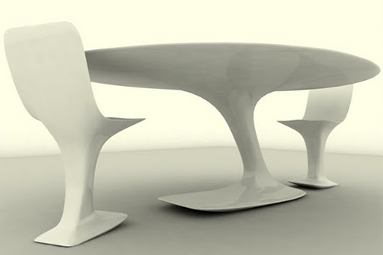

Slide 4
Decorative Design
Involves the application of color, line, texture, fringe, beads or decoration to an object.

Slide 5
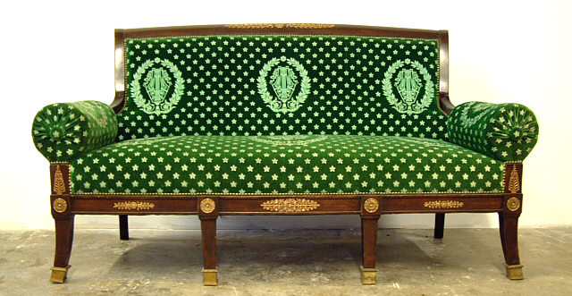
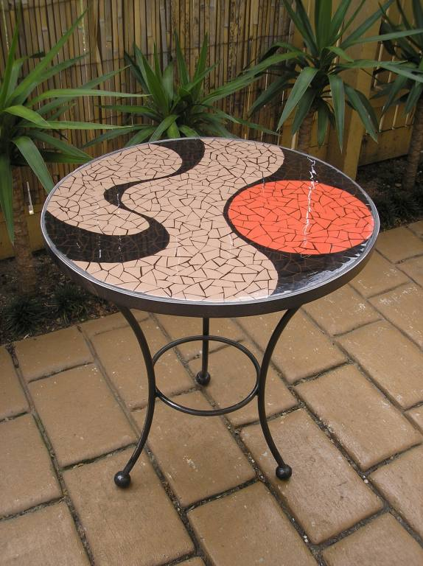
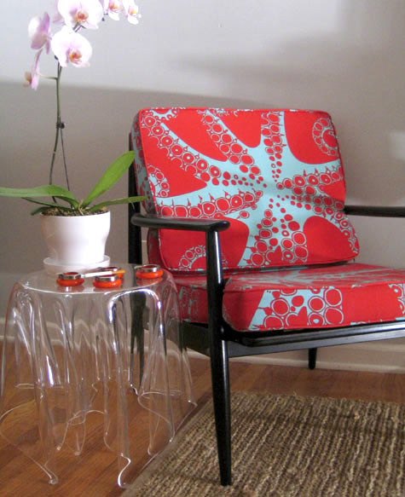
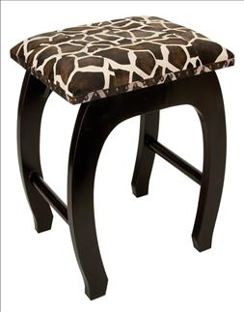

Slide 6
Design Patterns
Naturalistic
Stylized
Abstract
Geometric

Slide 7
Naturalistic
Reproductions of natural subjects

Slide 8
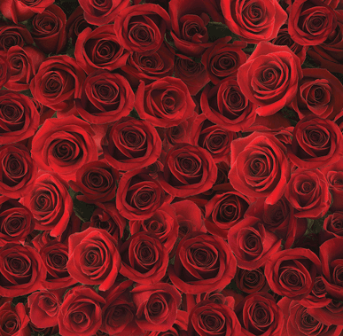
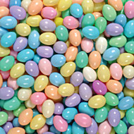
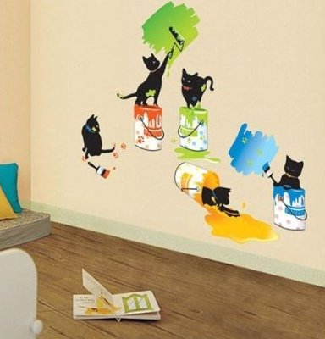

Slide 9
Stylized
A representation that simplifies the subject to emphasize the basic qualities

Slide 10
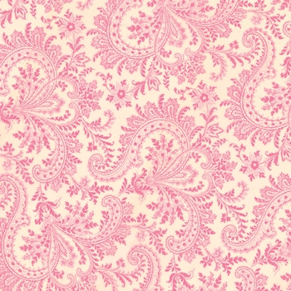
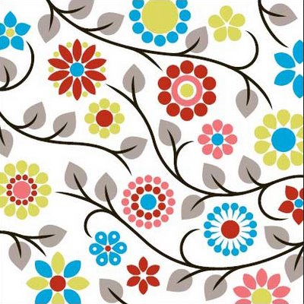
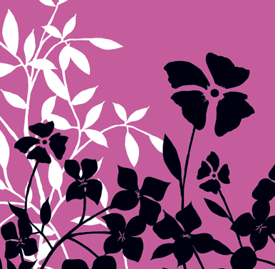
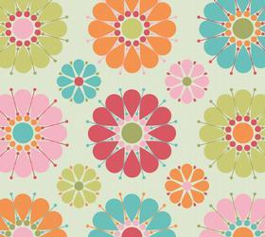

Slide 11
Abstract
Unrecognizable as a specific object or thing

Slide 12
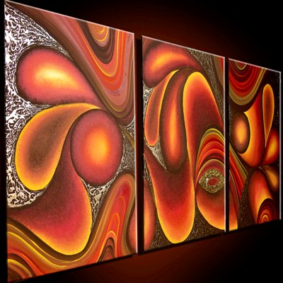
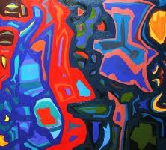

Slide 13
Geometric
Made with the use of stripes, plaids and geometric shapes

Slide 14
