Slide 1
Teaching Children About Sexuality
Why? When? What? How?

Slide 2
A five year old girl asked the question that every parent dreads, “Mommy, how are babies made?” The mom did her best to explain, but the daughter still looked confused.
“But what about kittens?” she asked.
“Well, it is exactly the same way.” I said.
“Wow!” she said excitedly, “My Daddy can do anything!”

Slide 3
Leonard, 8
Josh , 6

Slide 4
Simone, 6
Jonathan, 3

Slide 7
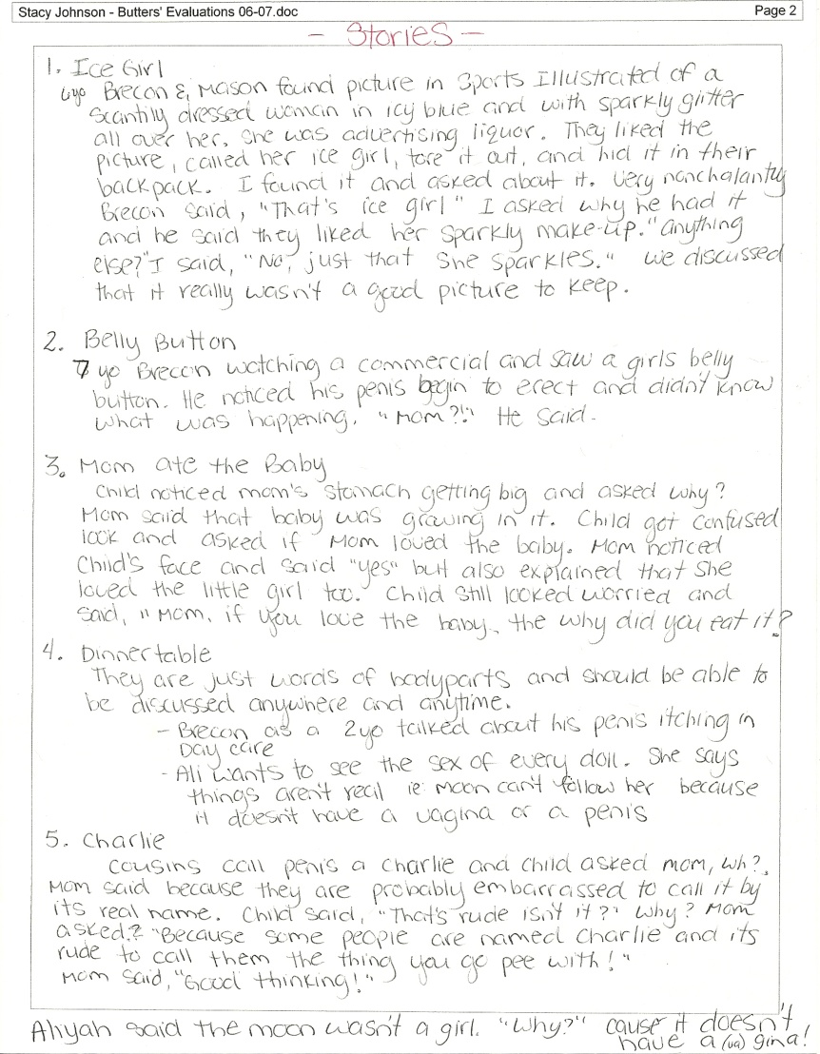

Slide 9
Reasons For Teaching Children About Sexuality
To obtain correct facts of anatomy and physiology
2. To improve self-concept

Slide 10
3. To clarify values and morals

Slide 11
To improve communication between the parent and the child
To recognize destructive elements in relationships including using sex as a bargaining tool.
To understand marriage fertility and related bodily functions to conception and pregnancy

Slide 13
Reasons For Teaching Children About Sexuality
7. To avoid STI’s (STD) which are spreading rapidly
8. To avoid sexual abuse, rape, and the definition of both. To understand how they occur and what to do if they happen.
9. To understand and accept sexuality and bodily functions that will occur later in life

Slide 14
Due to a power outage, only one paramedic responded to the call. The house was very dark so the paramedic asked Kathleen, a 3-yr old girl to hold a flashlight high over her mommy so he could See while he helped deliver the baby... Very diligently, Kathleen did as she was asked. Heidi pushed And pushed and after a little while, Connor was born. The paramedic lifted him by his little feet and spanked him on his bottom. Connor began to cry. The paramedic then thanked Kathleen for her help and asked the wide-eyed 3-yr old what she thought about what she had just witnessed.. Kathleen quickly responded, 'He shouldn't have crawled in there in the first place.....smack his butt again!'

Slide 15
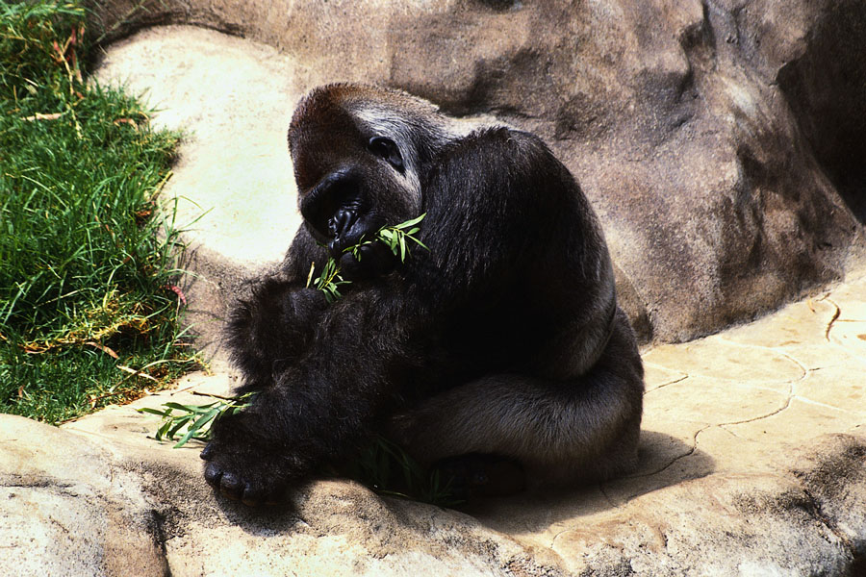

Slide 16
Guidelines For Teaching Children About Sexuality
1. Begin teaching when children start asking questions.
If the child has not asked a few questions by the time they are 5 years old, look for opportunities to talk to them about sexuality

Slide 18
Guidelines For Teaching Children About Sexuality
2. Always tell the truth!!!!
A mom tried to explain the facts of
life to her young children in a way that
they could understand. When she was
expecting her third child, she told her
toddler and 5 year old that Daddy had
planted a seed inside her and a baby
grew from that see. Quite puzzled, the 5 year old asked,
“Was my face on that packet of seeds?”

Slide 19
Use correct terminology
Answer only the questions the child asks and in terms they can understand.
Charlie, ate baby
My 2 daughters were having a discussion about
family resemblance. “I look like Mom, “ said my nine year old,
“but I have Dad’s eyes and Dad’s lips.”
The six year old said, “I look just like Dad, but I have light hair.”
Then she turned to her Mom and asked, ‘What does Dad
have to do with us being born anyway?”
Her older sister jumped right in and said, “Don’t be stupid,
Christina. Dad is the one who drove Mom to the hospital.”

Slide 20
Guidelines For Teaching Children About Sexuality
5. Always leave the door open for more discussion later
“Do you have any more questions? If you ever do, just ask.”
6. Explain your moral standpoint as part of every discussion.
Let children share their ideas, opinions, and give input
Throw up

Slide 21
Guidelines For Teaching Children About Sexuality
7. Remember that children are naturally curious about physical differences
a. Answer questions in a calm, matter of fact way
b. Explain about modesty and manners
c. Do not jump to conclusions

Slide 22
Life’s Greatest Miracle
Fill out the guide while we view “Life’s Greatest Miracle”

Slide 23
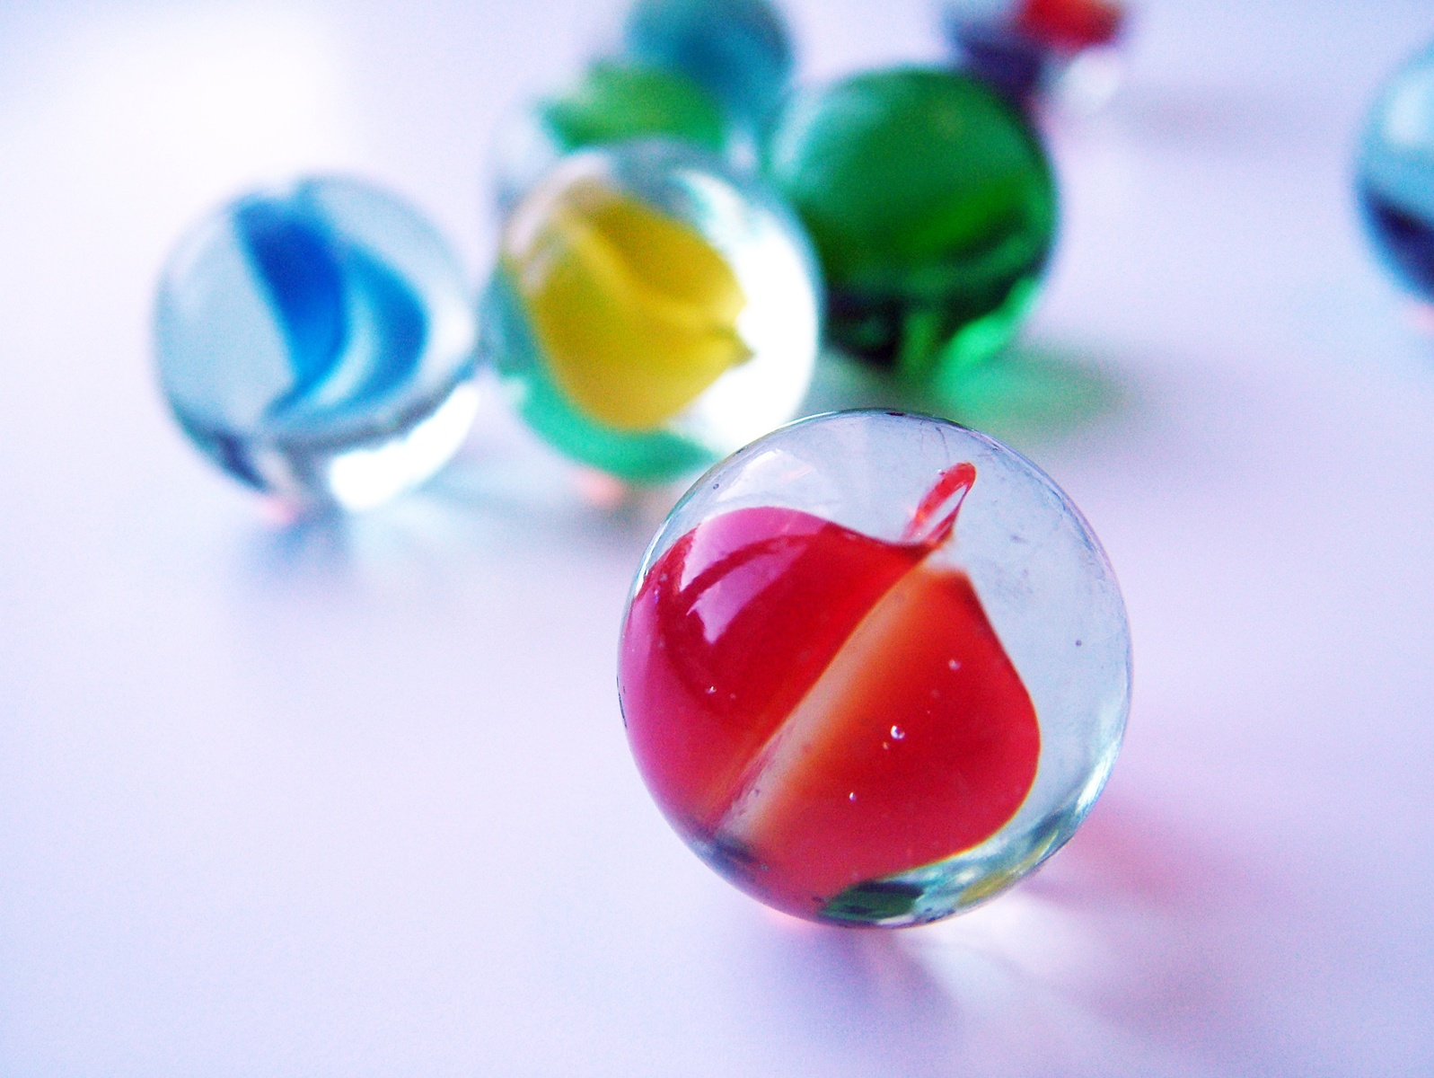

Slide 25
Art School

Slide 26
Unit 5,Reflection #1
The first time I learned about the Facts of Life… (you finish the prompt with 5 sentences)

