Slide 1
September 19, 2011
Bell Work
Supplies
What are some identifying features of a toddler?
Unit 2 Study Guide
Pencil

Slide 2
Cognitive Development
Supplies for today~
  Blank sheet of paper for quiz
  Note guide

Slide 3
Unit 2 Quiz #1
A good way to show toddlers that they are loved is by:
  A. Giving hugs and telling them are loved
  B. Buying them toys
  C. Having surprises for them on birthdays and other special occasions

Slide 4
2. What type of play do toddlers MOST often participate?
A. Onlooker play
B. Parallel play
C. Cooperative play
D. Dramatic play

Slide 5
3. Which term is used to describe the toddler’s idea that the whole world revolves around them?
A. Negativism
B. Autonomy
C. Egocentrism
D. Stubborn

Slide 6
4. Which of these is a characteristic of a typical two year old?
A. Plays cooperatively with others
B. Accepting and agreeable
C. Patient
D. Short attention span

Slide 7
5. Toddlers want to be
A. Independent
B. Treated like a baby
C. Just like their friends
D. Helped when they do thing.

Slide 8
Correct quiz
Pass it to someone else
DO NOT change your answers

Slide 9
Reality Baby
Gunner
Pablo
Carie
Dalton
Myrranda
Sierra
Kenzee
Tiffany G.
Jenessa
Abbie
Wednesday:
Tori
Tia
Shania
Morgan
Madison
Yardlee
Chase
Lindsey
Brooke
Tasmin

Slide 10
Children’s Book
Madi S.
Yardlee
Shania
Wednesday
Carie
Chase
Friday
Gunner
Abbie

Slide 11

TODDLER COGNITIVE DEVELOPMENT
A Toddler is a little scientist!
What will a scientist do to learn about….

Slide 12
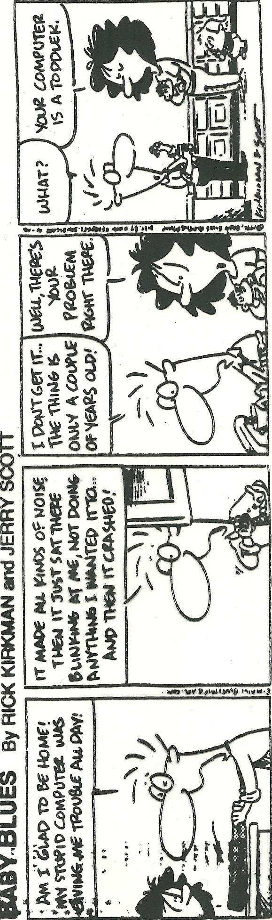

Slide 13
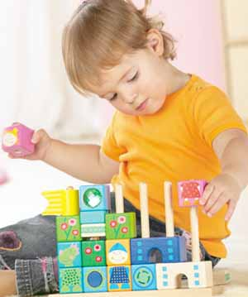
1. Cognitive Development is:
Shaped by both heredity and environment.
An environment that promotes learning contains:
  Positive environment with positive attitudes:
    Encouragement and support
    Freedom to be curious and explore
    The attitude a toddler forms towards learning lasts a lifetime
  Interaction with people
    The most important part of a good learning environment are the people in it.
  Availability of playthings and manipulatives
  Constant stimulation is critical in furthering brain development.

Slide 14
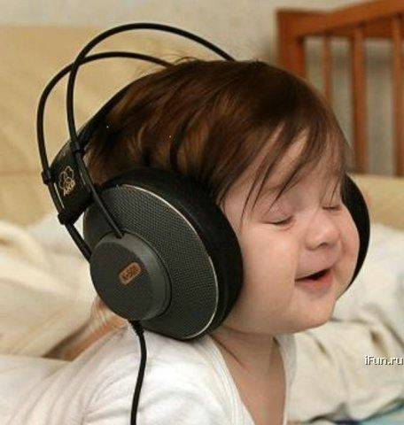
Constant stimulation critical in FURTHERING brain development.
Sight
  Look at things
  Dark and light
  Photo albums
Touch
  Feeling tour of yard
  Feeling board
  Recognizing things by touch only
Taste
  Sweet and sour
  Salty and sweet
Hear
  Name that sound
  Animal sounds
  Sound makers
Smell
  Distinguish odors
  What’s cooking
  Scratch and Sniff

Slide 15
2. Identify average cognitive MILESTONES in the toddler stage of development.
ONE YEAR OLD
  Sounds
  Words
  Finds hidden objects
TWO YEAR OLD
  Says about 272 words, phrases, and simple sentences
  Understands simple directions
  Identifies simple pictures
  Likes to look at books
  Attempts basic reasoning skills
  Understands time concept of “before” and “after”
  Enjoys coloring and painting

Slide 16
Identify average cognitive MILESTONES in the toddler stage of development
Gross Motor skills
  Pick up ball
  Climb and sit
  Push and pull
  Riding toys
Fine Motor skills
  Pounding pegs
  Pop beads
  Blocks
  Make faces
Problem Solving
  Opening lids
  Drop-in toys
  Puzzles
  Stacking and nesting toys
  Hide and Seek

Slide 17
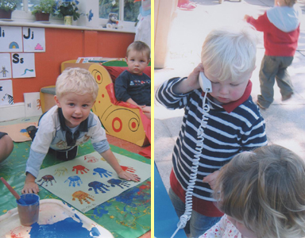
3. Four methods of LEARNING :
Incidental Learning
  Unplanned learning.
Trial and Error
  A child tries several solutions
  before finding one that works.
Imitation
  Learning by watching and copying.
Directed Learning
  Learning by actually being taught.
Which method are these?

Slide 18
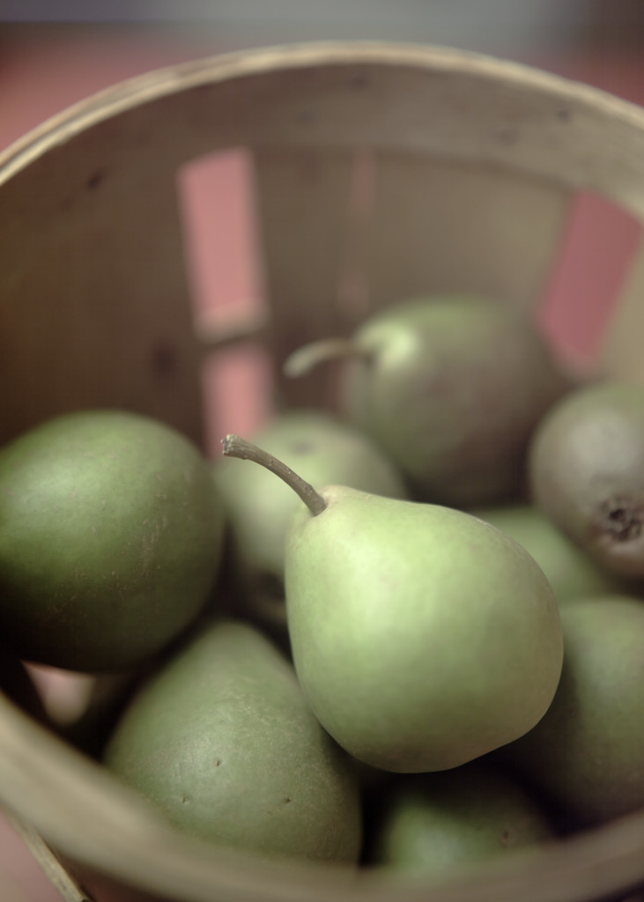
4. Children learn through everyday experiences and through play.

Slide 19

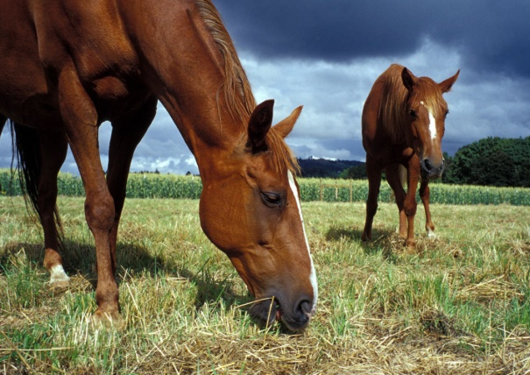
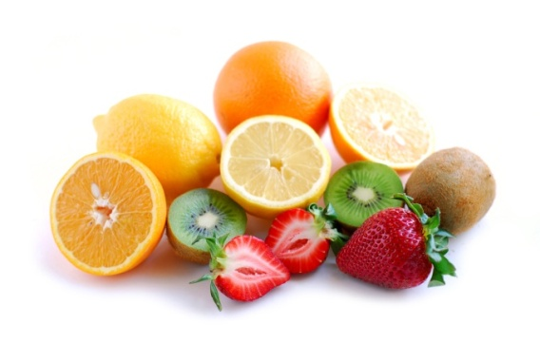
5. Concept Development
As a child learns to think, they begin to organize information received from their SENSES, into CONCEPTS .
  General categories of objects and information.
    fruits, color, shape, animals
      Anything that moves is alive
      dog = all 4 legged animals
      ball = all round objects are a ball

Slide 20
6. Seven areas Needed to learn!
Intellectual ACTIVITY develops at a remarkable pace during the toddler years.
Attention
  * ignoring the surrounding distractions and focus on a particular topic.
Memory
  * without this there would be no learning.
Perception
  * learning about the world using the senses and making connections.
Do the child activities meet these 7 areas?

Slide 21
Seven areas Needed to learn!
Intellectual ACTIVITY develops at a remarkable pace during the toddler years
4. Reasoning
  * enables problem solving, decision making, recognizing relationships, and forming concepts.
5. Imagination
  * allows the child to try new things and to experience being different people.
6. Creativity
  * using the imagination to produce something.
7. Curiosity
  * encourages children to ask questions and to try new things and activities.

Slide 22
PLAY DOUGH PICTIONARY!
Each group will receive 1 container of playdough.
Decide who will go first and so on.
All people going first come up to me.
  I will show all of these people the first word.
On my “Go!” run back and sculpt the word to your group. When your group guesses it, send person number 2 up for the next word.
  Tell me your last word so I know which word to give you.
  Continue on until each person has gone.
REMEMBER PICTIONARY RULES:
  NO TALKING by the person sculpting.
  NO ACTIONS, SOUND EFFECTS, or CLUES by the person sculpting.

Slide 23
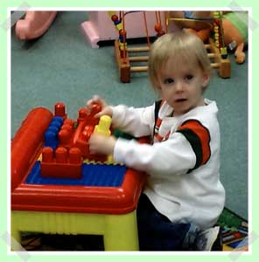
7. Jean PIAGET: Toddler Cognitive
Sensorimotor Stage – (12-24 months)
  learning through senses and actions
  finds hidden objects (object permanence),
  explores and experiments
  solves problems
  think using symbols
  uses imaginations

Slide 24




Preoperational Stage – (2-7 years old)
Not aware of real vs. make-believe concepts (Santa Clause, Ghosts,..)
  This causes fear in a child so provide concrete (touch and see) experiences to help the child begin to make connections.
Egocentric thinking
  thoughts, ideas, actions, and feelings are all pertaining to the way they think.
Limited focus on more than one thing or feature at a time.
Rely on concrete (see and touch) experiences – objects, activities, visual.
Problem solve by using feelings, pretending, or imitating rather than by thinking it through.
Make-believe play to create and express ideas.
Understanding abstract terms (love, beauty).
Learning that symbols = words
Are you pre-operational savvy?

Slide 25




















a. ____________
b. ____________
d. ____________
c. ____________
f. ____________
h. ____________
i. ____________
e. ____________
g. ____________
l. ____________
j. ____________
k. ____________
m. ____________
n. ____________
n. ____________
o. ____________
q. ____________
p. ____________
r. ____________
s. ____________

Slide 26
a. ___Sprite___
b. ___Ore Ida____
c. ___Kellogg's___
d. KFC
f. ___Adidas___
h. Western Family
i. General Mills
e. ___Lay’s____
g. ___Honda___
j. Betty Crocker
k. _Chevrolet_
l. _Ocean Spray_
m. _Smucker’s_
n. ____Sony____
n. ___Google___
o. __Staples___
q. ___Kleenex___
r. American Express
p. _Coca Cola_
s. ___NBA___

Slide 27



Finger lickin’ good
It’s the real thing
Breakfast of champions
The Un-cola
Don’t leave home without it
Let your fingers do the walking
Notes:
Name the products and describe the logo before the logo is shown.

Slide 28
8. A caregiver can guide and promote cognitive development by:
Giving time and attention
  The most important part of a good learning environment is the people in it.
Take advantage of simple learning opportunities
Allow time for thinking (problem solving and decision making)
Give only as much help as the child needs to succeed
Encourage children to draw their own conclusions
  “Let’s find out” (see and do) vs. giving them an explanation.
  Sensory stimulation and concrete learning
Model problem solving so they can hear how to think their way to a solution.
Maintain positive attitudes in the child and in the caregiver
Keep explanations simple and on the child’s level
Allow kids to explore and discover their world
Give them opportunities to understand the world and how it works
  Everyday learning experiences
Develop Self-help Skills

Slide 29

9. Playing and PLaythings also stimulate learning
Experience imaginary situations.
Act out different roles.
Problem solving, decision making, and drawing conclusions.
Develop large and small motor skills.
Teach sharing and cooperation.
Always remember that time spent playing with your child is the best toy of all!

Slide 30
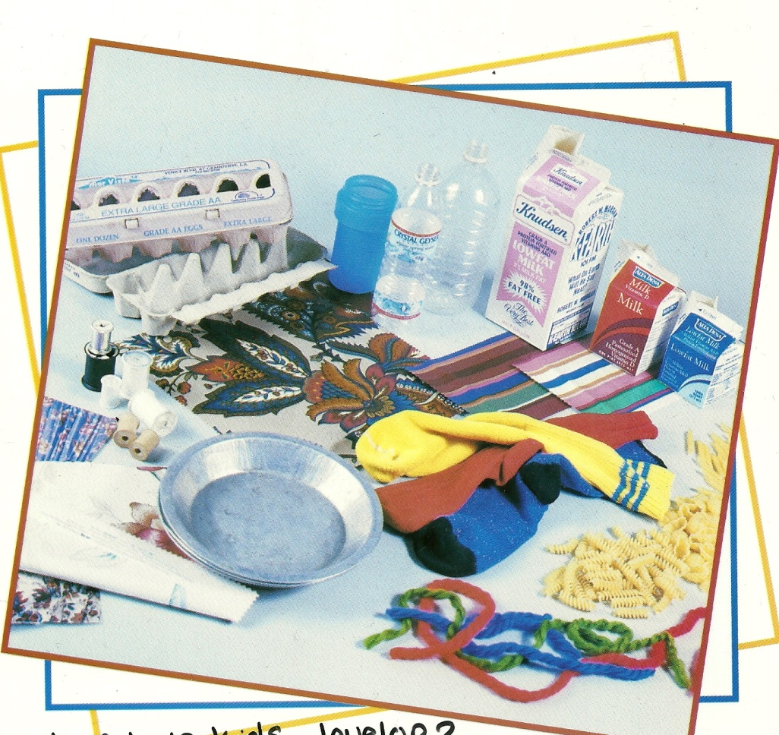
Everyday Household Objects make phenomenal toys
http://www.youtube.com/watch?v=GjO0CskrCUs&safety_mode=true&persist_safety_mode=1
Toy Box
Why buy expensive toys?- clip

Slide 31


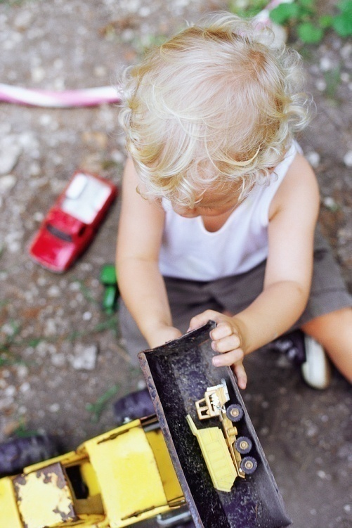
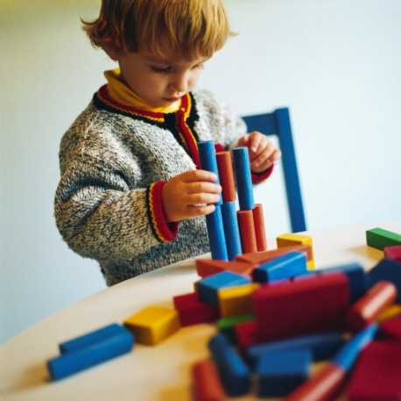
10. guidelines for choosing safe toys:
No small parts to swallow
No sharp edges
Not flammable
Well made and durable
Easy to care for
Encourage imagination
Variety of uses / play
Colorful
Size of child to toy
Age appropriate
No long strings
Noise level
Easy for child to handle

Slide 32
TOYS FOR BABIES: 6 months to 1 year
STATE ASSIGNMENT = Evaluate age appropriate learning activities and materials
Babies respond to their environment by using all five senses - smell, taste, sound, touch and sight - and properly selected toys provide them with opportunities to learn about size, sound, texture and how things work.
Suggested toys for babies 6 months to 1 year:
mobiles,
rattles,
squeaky toys,
unbreakable mirrors,
gyms,
washable soft dolls or stuffed animals (make sure noses and eyes are safe),
pop-up toys,
blocks,
material or hard cardboard books showing familiar pictures and objects,
stacking cups,
balls,
push pull toys
bath toys

Slide 33
TOYS FOR TODDLERS: 1-2 years
Little toddlers are active and need toys suitable for physical play – walking, climbing, pushing and riding. They like things to ride on and climb in.

Slide 34
Suggested toys for toddlers 1 to 3 years
ride ons,
trikes,
wagons,
large balls,
wading pool,
a sandpit and toys to use in it,
digging tools,
child sized furniture,
play dough,
musical instruments (drums, horns, toy piano, music tapes and CDs),
cassette tape player,
blocks,
simple puzzles
picture books

Slide 35

TOYS FOR CHILDREN: 3-5 years
This age group thrives on ‘make-believe’. They enjoy being around other children and participating in imaginative play. Dress-ups and play toys that help them in these imaginary roles are important.

Slide 36
Suggested toys for children
3 to 5 years
play food,
play money,
dress-ups and accessories,
cash registers,
telephones,
medical kits,
bead threading,
story books,
tape recorders,
make-believe props,
petrol stations,

Slide 37
farms,
houses,
restaurants,
shops,
puppet shows,
dolls,
doll strollers and cots.
They are also fascinated with cars, trucks, airplanes, boats, diggers, tractors.
Outdoor play: sandpits, bikes, helmets, balls, bats, chalk, bubble blowers, climbing frames, and slides. Board games, electronic toys and word matching games are great for visualization and memory skills.
Arts and Crafts: paint, brushes, play dough, scissors, glue, colored paper, felt pens.
Construction toys with interlocking pieces.
Other favorites are books, CDs, tapes, videos, arts and craft activities, stuffed toys and animals..

Slide 38
11. READING together is an important learning activity for a child of any age.
Children who are read to from an early age learn to read faster and easier.
Vocabulary and language skills are developed.
Reading together builds a close relationship.
It helps children learn to separate fact from fantasy.
It is one of the best ways to help build independence and self-esteem.
Books are a great way to discuss real life experiences.

Slide 39
Reality Baby Return
Tori
Tia
Shania
Morgan
Madison
Yardlee
Chase
Lindsey
Brooke
Baylee
Tasmin
Wednesday:
Alix
Brinley
Tiffany C.

Slide 40
Children’s book
  Today:
  Gunner
  Abbie
  Wednesday:
  Morgan
  Tia

Slide 41
12. techniques for reading out loud
Choose age appropriate books
Reading a story is like putting on a play
Snuggle up close so all can see
Keep your focus on the child not the story
Encourage participation, ie: turn pages
Explain unknown words
Point to the words of familiar objects
Read and re-read as often as the child likes
Let the child guide the pace of the story
Read at least 20 minutes every day to your child
Test Day reading

Slide 42
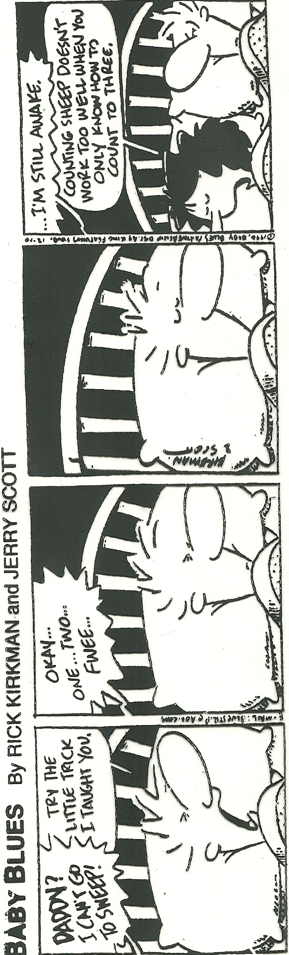

Slide 43
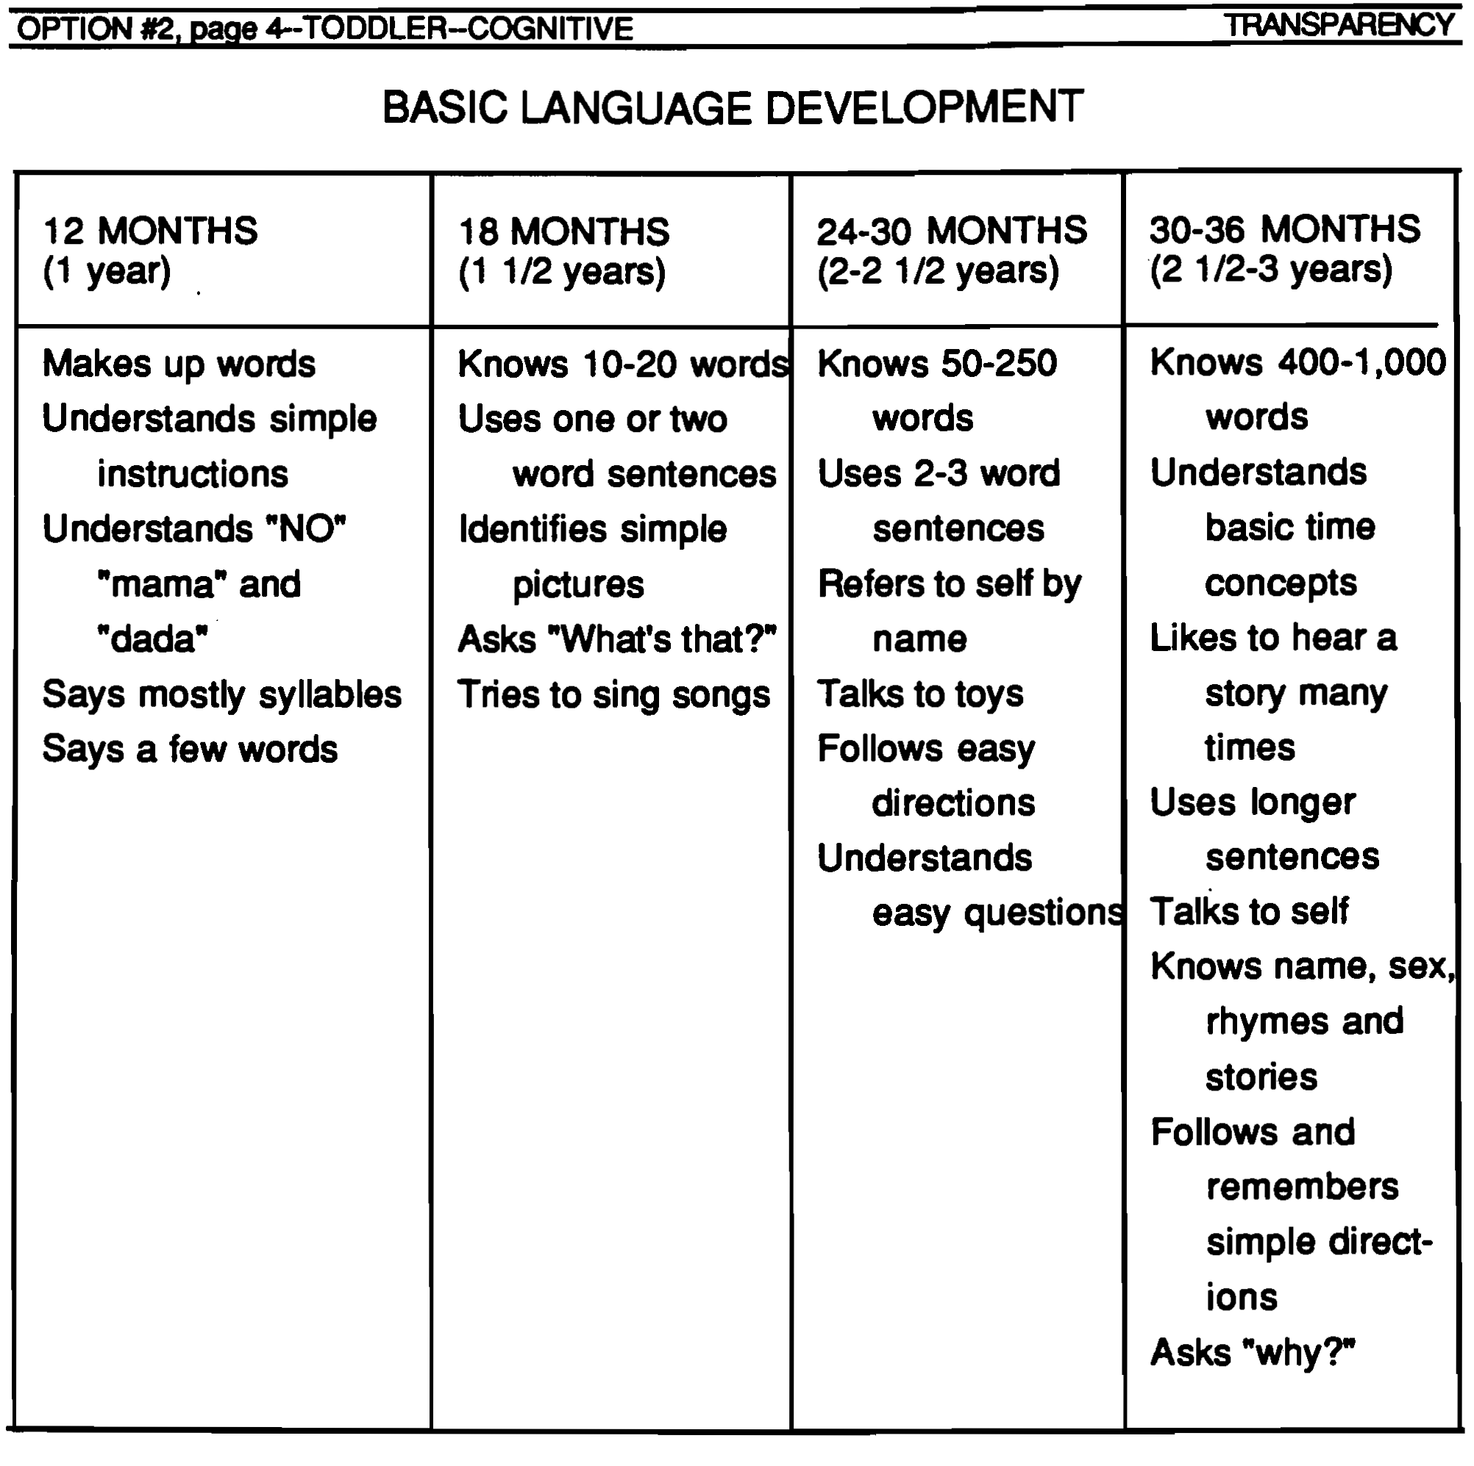
13.

Slide 44

14. When using one or two words in early language development, which part of SPEECH is used first?
  Nouns, Verbs, or Adjectives
Nouns

Slide 45

http://www.youtube.com/watch?v=M_V-GI2BQss&feature=related&safety_mode=true&persist_safety_mode=1
Birds on a Wire clip
Notes:
POLAR BEAR – COKE = What does a child think when they see this? Advertising plays on the child’s cognitive thoughts. Even without hearing words, you still know what is going on. Teaching language is not just about the words, but the non-verbal cues.

Slide 46
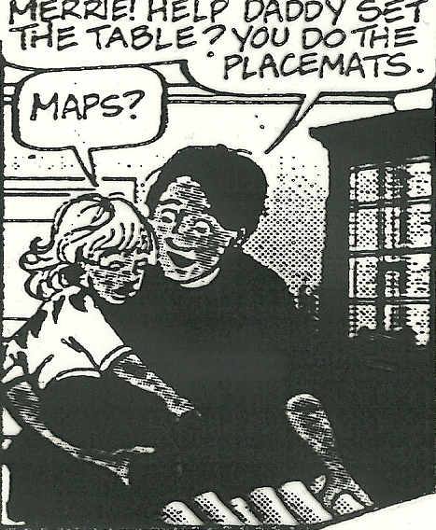
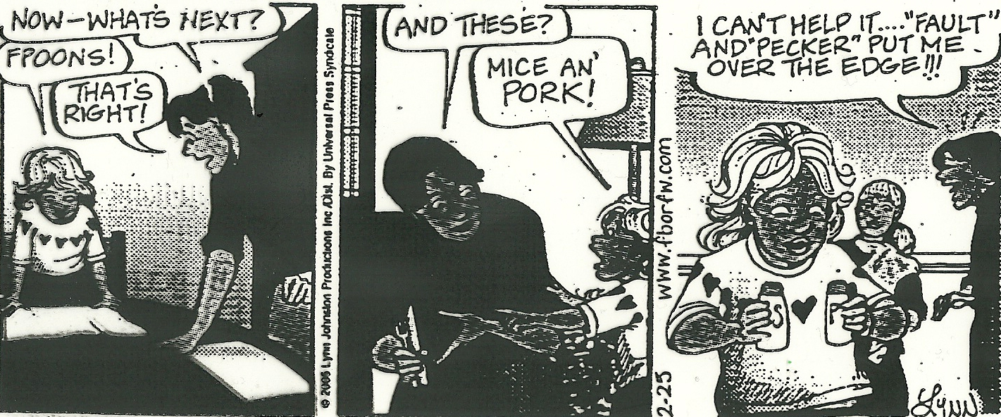

Slide 47

15. Language Development
A child’s Language Development is strongly influenced by how caregivers and older children speak to them.
  Being a GOOD language model is one of the best ways to encourage proper language development.
  Avoid baby talk or parentese
Pronounce words correctly
  (“My wed sert” – “Yes, you have a nice red shirt”)
    Connect objects with correct names
      (“wa, wa” – “You want a glass of water?”)
Modeling Language Scenarios

Slide 48
16. A caregiver can encourage language development by….
Talk to them
  Give a “Travel log” of daily activities, actions, and routines both of you are doing- step by step, why, and how.
  Answer their questions.
  Pause and wait for the child to respond back or answer your questions.
  Use clear and simple speech.
Listen to Them
  Really listening by look at them, eye contact.
  Allow children to talk about daily activities and routines.
Respond back to them
  Respond to them in more than one word or grunts.
Avoid overcorrecting them or scolding
  (“I singed a song!” – “Yes, you sang a song”)
Other language promoting techniques
  Reading together.
  Sing songs, nursery rhymes, and finger plays.
  Play word games (telephone, show me, charades, follow directions).
  Define new terms that you or the child uses.
  Allow them to explore and play with few restrictions.
Sock poem

Slide 49
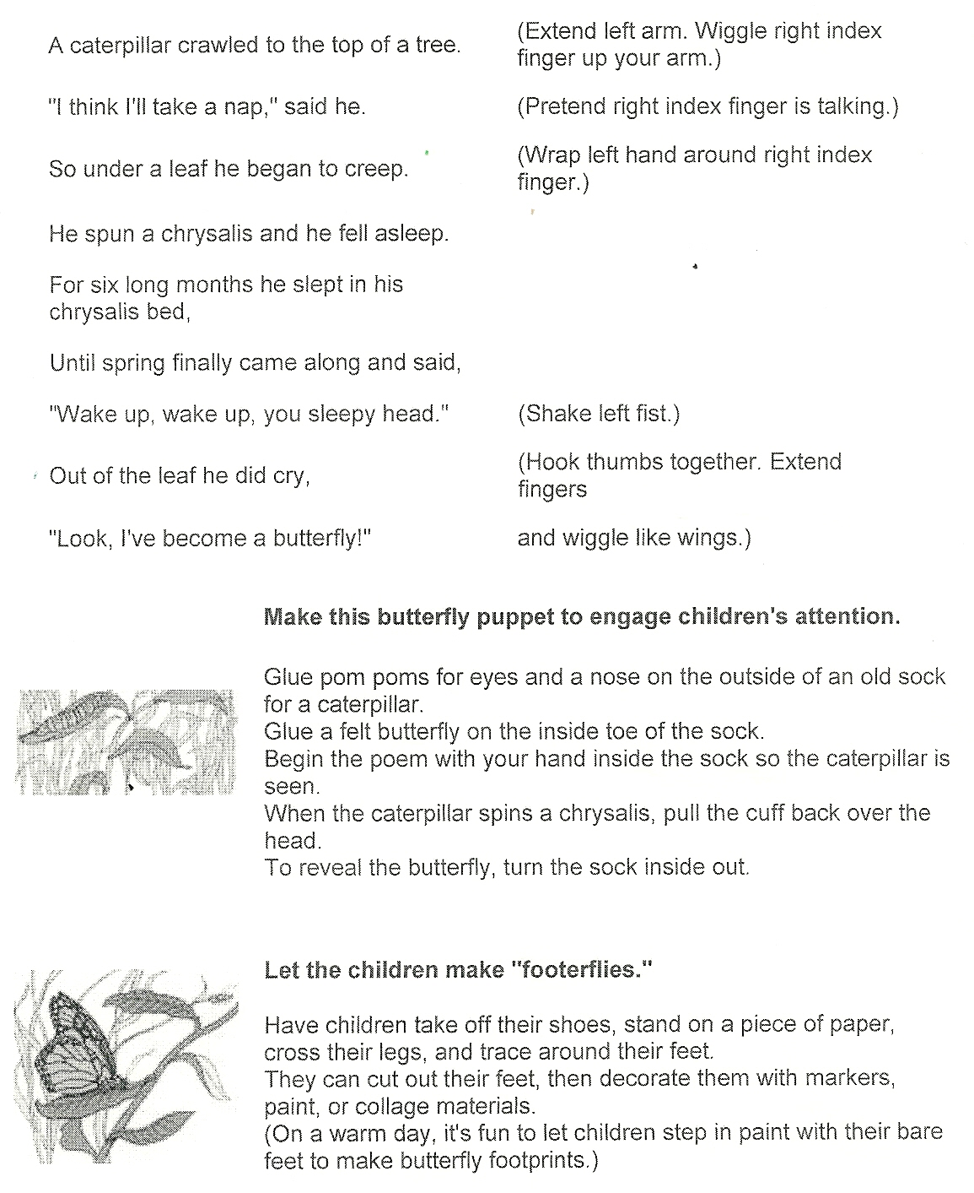

Slide 50
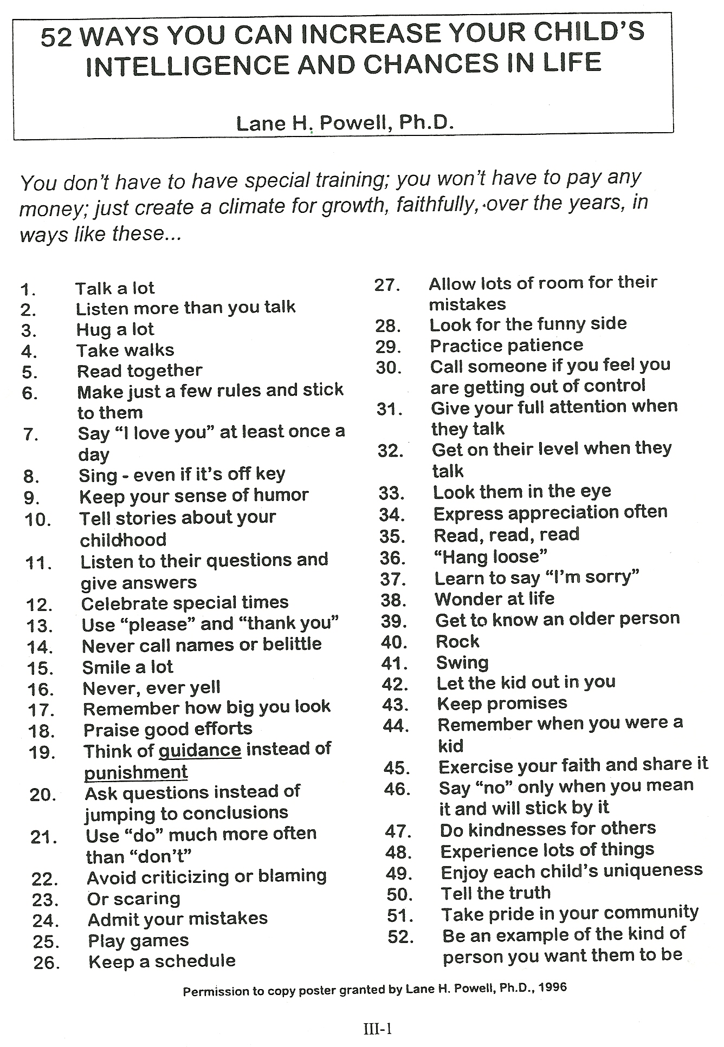

Slide 51
Toddler empathy day
Rotate through each station to gain empathy for toddlers.
Be sure to fill out the guide as you visit each station. You will summarize the day on the last sheet of the Empathy portion
Groups of 2

Slide 52
Reflection #4
What will you tell your kids about Santa Claus, The Tooth Fairy, Easter Bunny, etc.?

Slide 53
Reflection #5
Tell about your first day of Kindergarten / school.

