Slide 1
Reality Baby
Alix
Brinley
Tiffany C.
Morgan
Tia
Friday:
Tiffany G.
Jenessa

Slide 2
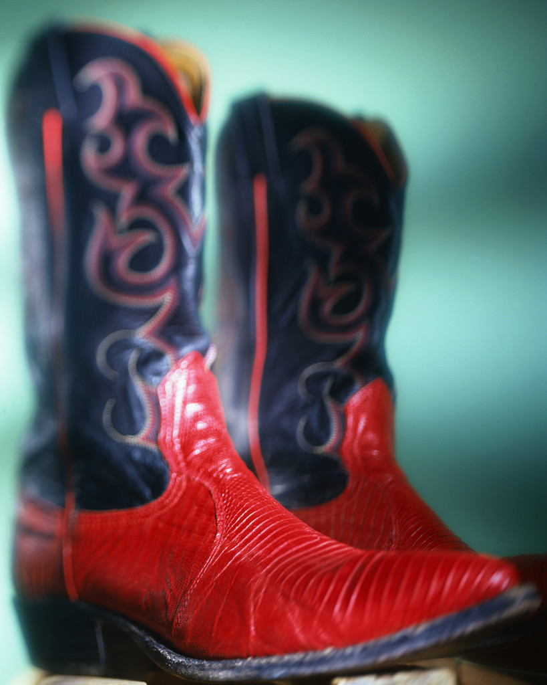
Preschool Social and emotional
Welcome back to the pre-school conference!
Appropriate noun or verb
Dressing a Preschooler

Slide 3
Schedule
Today~ Social/Emotional/Cognitive Development
Friday~ Toddler Empathy Day
Tuesday~ Unit 2 Study Guide due and Unit 2 Test

Slide 4
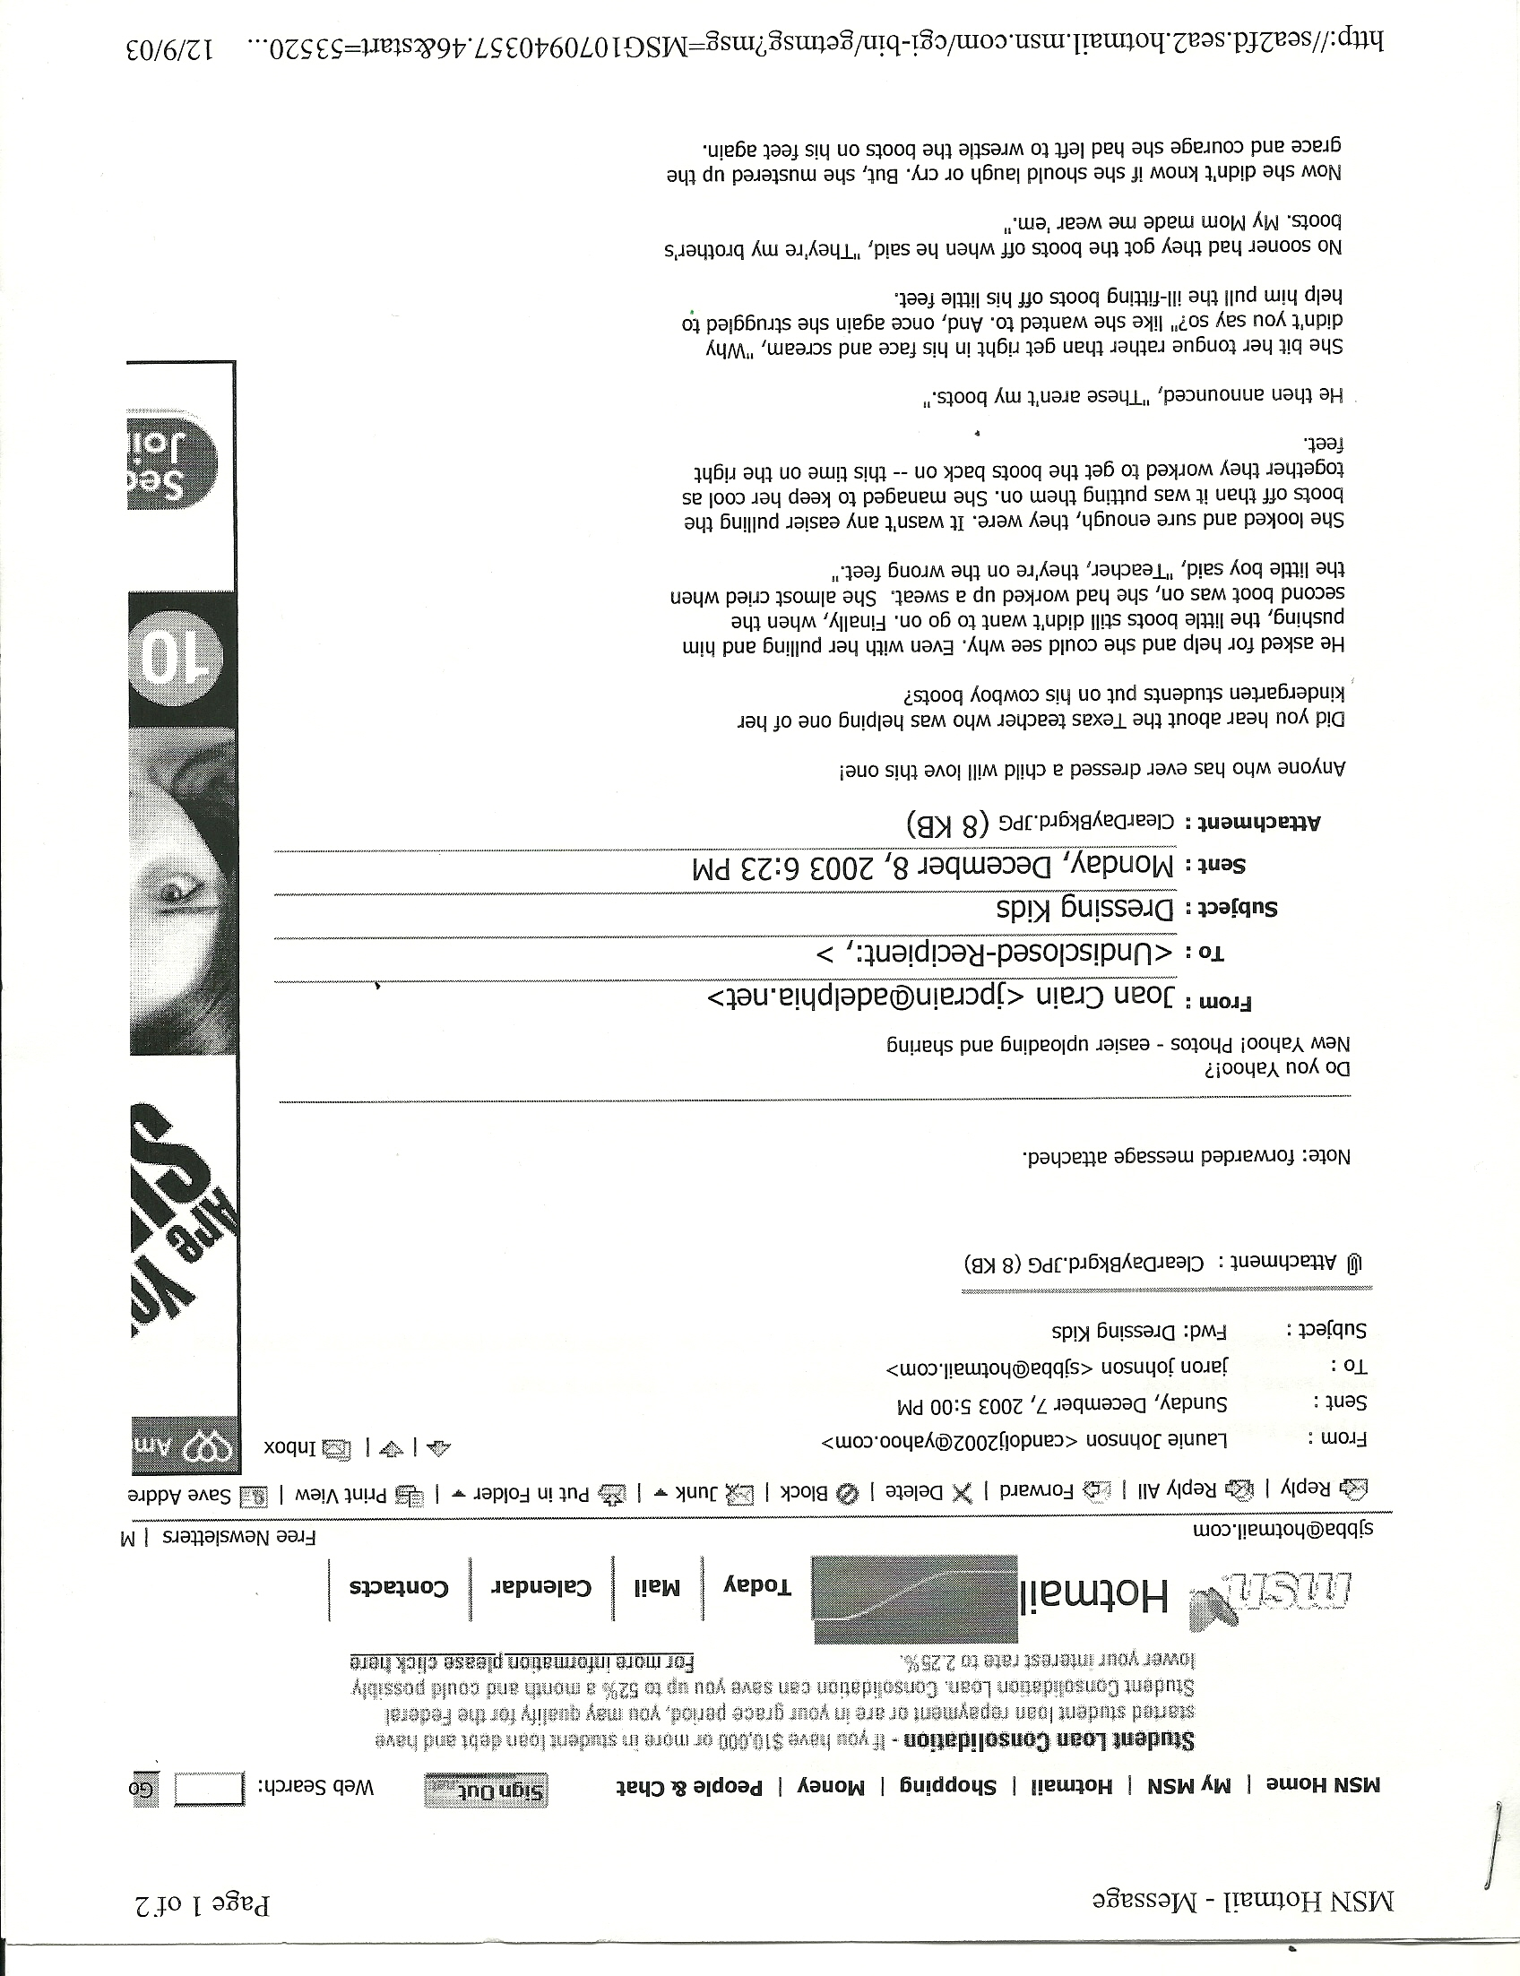
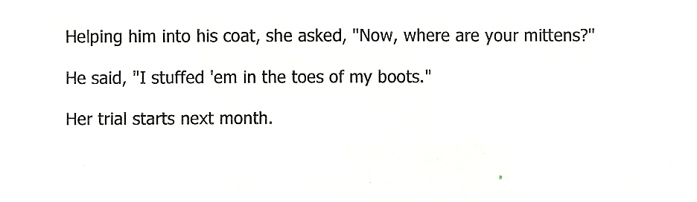

Slide 5

A caregiver can help the child learn to handle their anger by….
Being a good example.
  The way a parent expresses their own anger will teach a child how to handle their anger
Encourage the child to talk about the anger instead of holding it in or acting it out.
Encourage the child to use their words – not their bodies – to express anger
Teach the child self-control early in life before inappropriate expressions of anger occur and become a habit
Teach other methods to release anger: hit a pillow, scream into a pillow, exercise
Caregivers realize that:
The frequency of anger decreases from age 4-6, but the effects of anger last longer.
Sources of earlier frustration are eliminated as a child’s skills improve
Children will often take their anger out on a scapegoat – sibling, pet, toy, furniture..
Disagreements are the most common cause of anger
A child’s anger is loud, verbal, they make exaggerated threats, they seek revenge
Parents can be the cause of the anger and the child will want to “punish” the parent
A child’s personality does play a factor on how anger is demonstrated
Paper Tear Art
If you chance to meet a frown…..

Slide 6
Preschool Social/Emotional Dev.
Emotional and Social Milestones of Preschoolers
  Three Year old
    Likes to conform,
    Easy going attitude
    Not so resistive to change
    More secure
    Greater sense of personal identity
    Beginning to be adventuresome
    Enjoys music.
    Parallel play
    Enjoys being by others
    Takes turns
    Knows if he is a boy or girl
    Enjoys brief group activities requiring no skill
    Likes to "help" in small ways--responds to verbal guidance

Slide 7
Emotional and Social Milestones
Four year old
  Seems sure of himself
  Often negative
  May be defiant
  Seems to be testing himself out
  Needs controlled freedom.
  Cooperative play
  Enjoys other children's company
  Highly social
  May play loosely organized group games - tag, duck-duck-goose, talkative, versatile.

Slide 8

Anger
18.
Q8
Three and Four Year Old | Five Year Old
-Show anger by physically fighting -Anger lasts longer than before -Often threaten and attempt to “get even” | -More likely to try to hurt other children’s feelings rather than hurting them physically. -Learning that words can sting -Begin to tease, insult, nag, and make fun of others (gets worse at age 6)
Sticks and stones…….

Slide 9
Preoperational Cognitive Development Terms
SORTING~ Household objects such as buttons, silverware, game pieces, peg board pieces. color chips, blocks with different shapes, blocks made out of different materials.
CLASSIFYING: Natural objects such as boys/girls, car/trucks, dolls or people by hair color, big/little. tall/short, zoo animals/farm animals.
SERATION: Line up the class members according to height. Have a pile of rocks and have the children line them up according to the weight of each rock. Stories such as "Goldilocks and the Three Bears" and "Three Billy Goats Gruff" include differences in characters such as young/old, big/little.

Slide 10
Q9
As children find success at accomplishing new skills and dealing with unfamiliar situations, their self-confidence is built.
Erik Erikson’s preschool stage of Initiative vs. Guilt says that a child’s motivation to accomplish tasks is based on feelings of independence and self-worth.
T
19.
T
20.

Slide 11
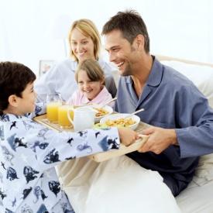
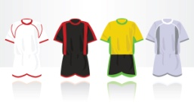
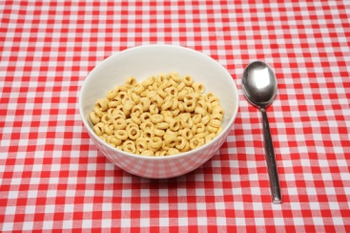
.
Initiative
Guilt
Encourage child to create and to try new things
Teach them that mistakes do not make them bad, but this is how we learn.
  (miss take = try task again)
Allow and encourage a child’s ambitions, new abilities, ideas, and opinions.
Let them do things on their own.
Scold instead of encourage
Get angry over mistakes
Discourage them from risking
Stop their actions because…
Focus on failures
Set rigid rules and restrictions
Belittle and ridicule
Fail to praise and encourage their ideas and ambitions.

Slide 12

Magic Chair
The Imagination of a Preschooler – How can a caregiver use it to their advantage?

Slide 13
T
21.
In addition to imaginary dangers (such as ghosts, monsters, and robbers), a preschooler also has real fears of the dark, being left alone or abandoned, school, and loss of social acceptance.
►A caregiver can help a preschooler deal with these fears by….
-Accept the child’s fears by listening and understanding, do not dismiss it
-Let the child express the fear without being ridiculed or made fun of
-Help the child feel able to face the fear: talking about it, acting it out, problem solve ways to handle the fear
-Taking appropriate actions, if the fear is justified, to remove the source
A 3-4 year old separate fact from fantasy. A developing 5 year old, who has a bigger imagination and engages in make-believe play, that there is a difference between fact and fantasy.
Q10
F
22.
cannot
can
begins to understands
does not understand

Slide 14



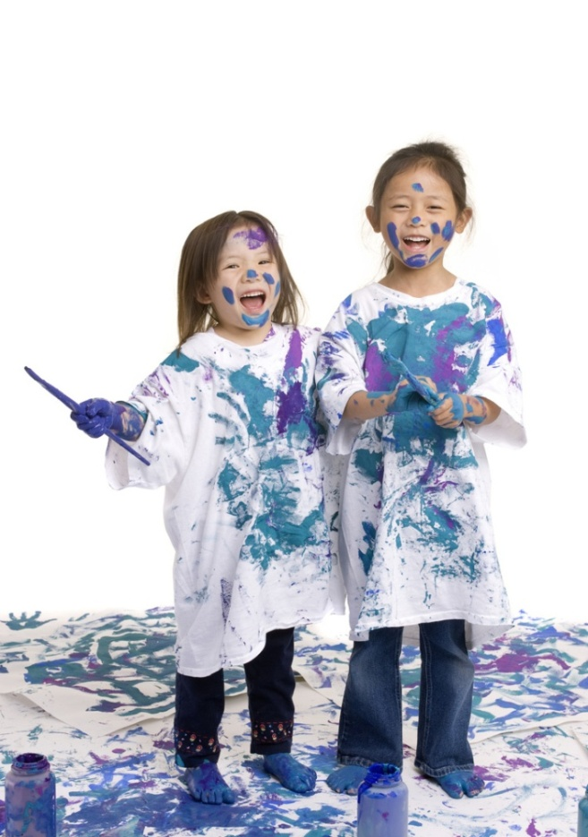
Q11
Cookie sneak
F
not
Imaginary friends are common in preschoolers. They show a very healthy and normal emotional and social development.
Compared to a toddler, a preschooler’s anger, jealousy, and frustrations will based on their ability to be more patient and to gain an inner self- control.
23.
do not
F
24.
Q12
increase
decrease

Slide 15
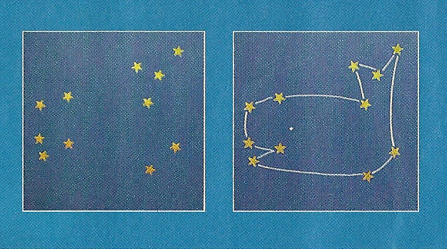
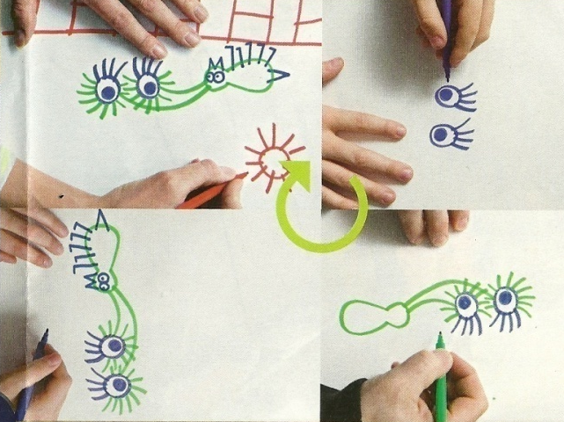
How patient are you? How much self-control do you have? A person’s ability to learn and problem solve is related to the development of these emotional skills.
DOT to DOT
TAG TEAM DOODLE
Randomly place at least 20 dots on the whiteboard.
  Can randomly number/letter the innovative dot picture.
Hand it to your table partner to complete your dot-to-dot puzzle.
  Study the finished picture to see what it could be.
Partner 1 draw a random picture of shapes/lines.
Turn the board ¼ turn and have your table partner add on to this.
Turn the board another ¼ turn and partner 1 add on again.
Continue turning the board and adding on to the picture until both feel that it is complete.

Slide 16
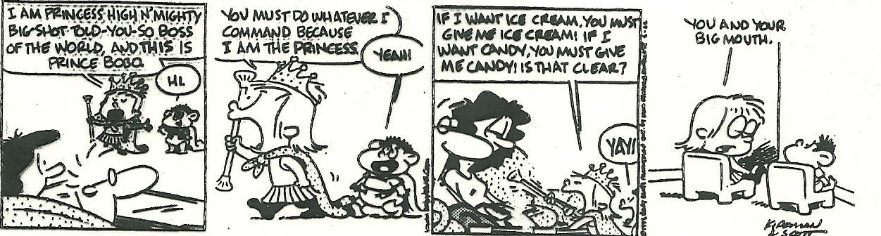
Preschool Social Skills

Slide 17
T
Preschoolers are peer oriented. They are enjoying new social skills and spending more time outside of the home playing with others their age.
As part of their new social skills, a preschooler is more able and willing to share.
Although preschoolers can engage in solitary, onlooker, and parallel play, their new social skills allow them to also participate in cooperative play.
25.
Q13
T
26.
F
27.
still do not

Slide 18
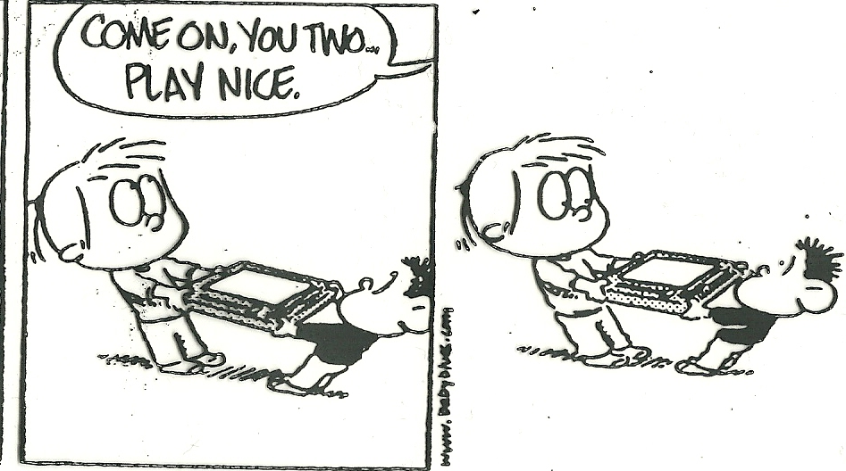
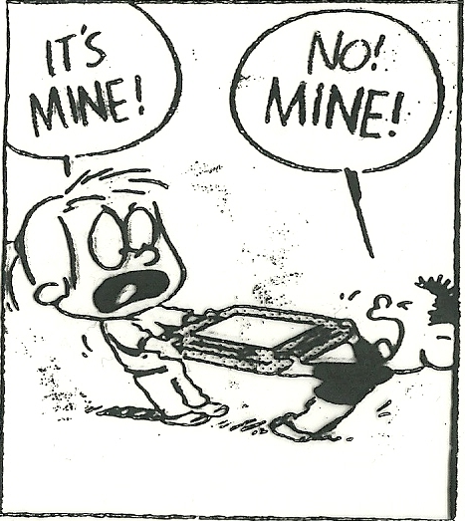
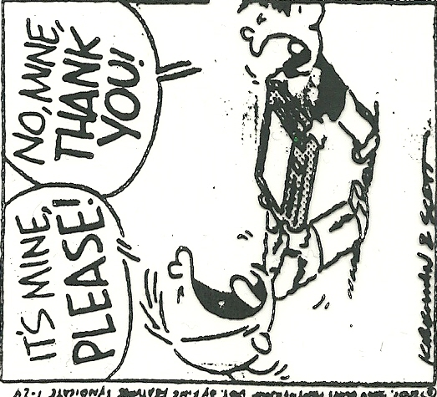

Slide 19

Storyteller (smatt 208)
Q14
F
Preschoolers have a strong sense to their family and home. They want to feel important in the family and they enjoy helping. 3-4 year olds may quarrel and bicker with siblings, while 5 year olds tend to play better with and care for siblings.
28.
get away from
be with

Slide 20
A preschooler is beginning to understand that it is important to base their behavior on their feelings and beliefs of right and wrong. This is the concept of Kohlberg’s theory of Moral Development.
MORAL DEVELOPMENT
  Identifying personal values and learning right from wrong
  Respecting human rights and behaving accordingly, developing
  Principles to guide behavior and then following these
  Listening to their conscience
T
29.
Q15

Slide 21
► LAWRENCE KOHLBERG Theories of Moral Development
1. Preconventional
Children begin life with no sense of right or wrong.
Learn quickly the certain behaviors are punished and others rewarded
Learn to avoid punishment and strive for behavior or acts rewarded
2. Conventional (about age 9)
Learn to behave according to a sense of what others need or want.
They follow established rules and respect authority
Begin to act in accordance with what is right and wrong.
3. Post Conventional (about age 16)
Mature morally.
Respect human rights and develop individual principles to guide their behavior and choices.
Motivation to act a certain way comes from within, not just to follow the rules.

Slide 22
T
30.
Part of moral development is learning the difference between truth and lies. (conscience) They learn that telling the truth brings trust from others. Punishment for a lie should not be so severe that a child would rather lie than to accept responsibility for their actions.
►➔A conscience develops from:
-Rules of behavior learned in early childhood.
-Identifying that some actions make them feel good and other actions make them feel bad.
-Learning that the caregiver smiles, laughs, and praises for some actions and frowns, lectures, and punishes for others.
►➔The most effective way caregivers can teach moral behavior to children is to:
-Set a good example
-Consider the child’s age and abilities
-Show love and acceptance no matter what
-Discuss (not lecture) the mistakes in private
- Remember that learning self-discipline is a life-long process
READ THE SCENARIO in your Study Guide and ANSWER THE QUESTIONS
Notes:
Brecon experimented on my brush that had a handle filled with gel. He wanted to see what the gel looked like so he used some scissors to cut a small area apart and squeeze out the contents. When I went to do my hair, I wrestled with brush and the gel contents that were oozing out and tangling my hair. Needless to say, I was not too happy by the time I had finished my hair. I decided to take action on Brecon and wrote him a note that said: The test results are in and the doctors figured out that you have contracted a rare disease called greedyosis. The only way to rid yourself of it is to- well, I just can’t tell you in this note so I will tell you after school. Unbeknownst to me, he read this and spent the morning and school day panicking and freaking out over this disease (I had forgotten that we had recently been to the doctor for a wart on his toe.) and wondering what he was doomed for. After school he stormed into the house with a look of fear across his face asking what was wrong with him. I told him that it was a joke, but that the remedy for the made up disease was very real. I decided that the cure was to work off the cost of the brush and then go and buy me a knew one. Once everything was explained and he had told me how scared he was, we had a good laugh.

Slide 23
PRESCHOOL LABS
Finish The Thumbie Picture and story = Must Do
  Turn picture and story in with you Empathy Packet. (next Friday)
Do the vocabulary section of your packet. You may work as group or as a table.

Slide 24
Reflection #5
Tell about your first day of Kindergarten / school

