Slide 1
VEGETABLES

Slide 2
Vegetables
The term vegetable refers to any herbaceous plant that can be partially or wholly eaten
The plant has no woody tissue
Vegetables contain more starch and less sugar than fruits

Slide 3
Botanical Classification
Roots
Stems and shoots
Tubers
Bulbs
Leaves
Fruits
Seeds
Flowers

Slide 4
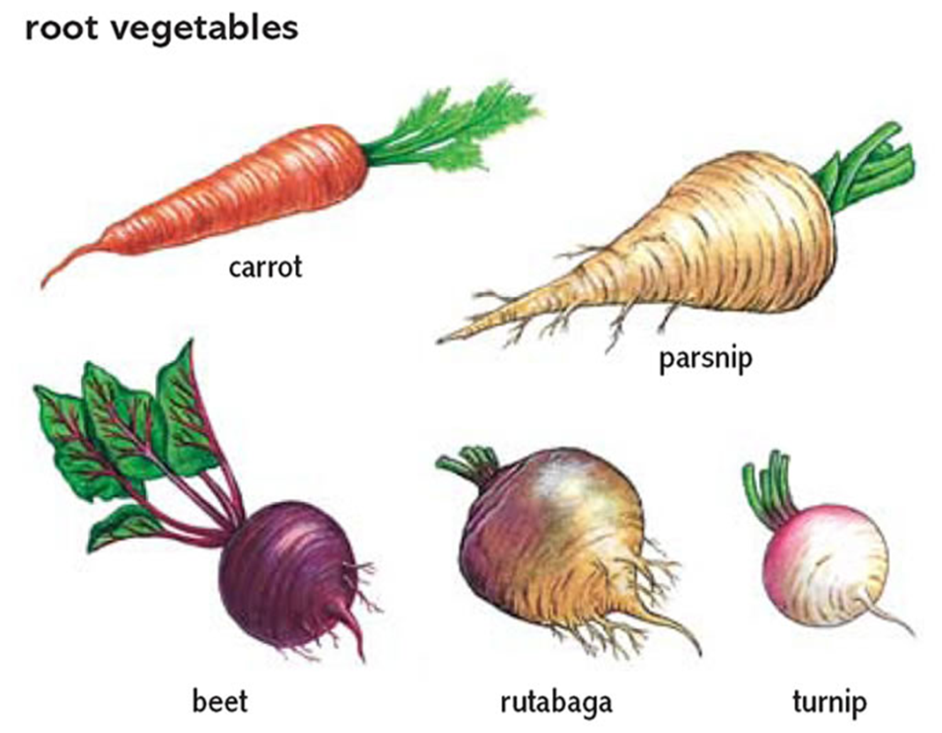
Classifying vegetables
Roots
Carrots
Radishes
Beets

Slide 5
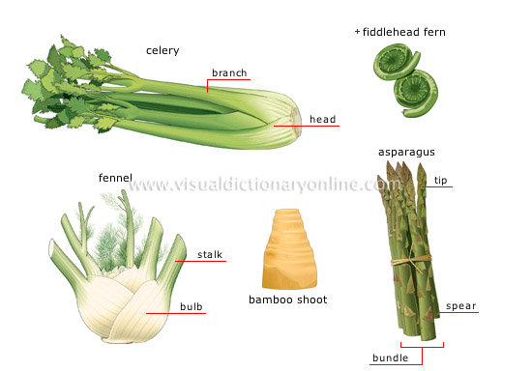
Classifying vegetables
Stems
Celery
Mushrooms
Asparagus

Slide 6
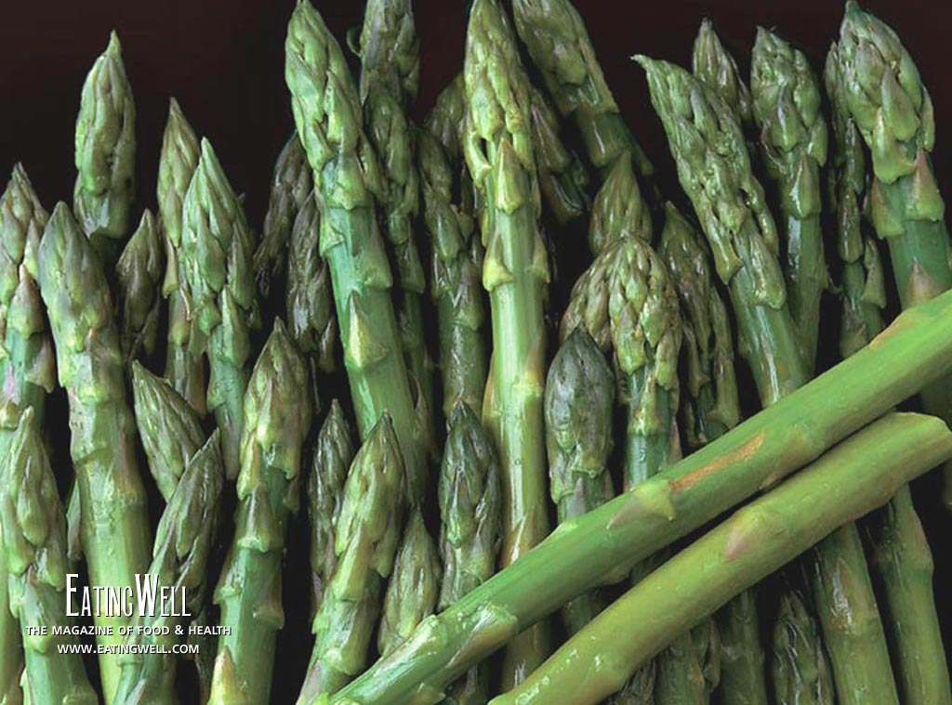
Stalks
Artichokes
Asparagus
Celery
Fennel
Hearts of palm
Bamboo shoots

Slide 7
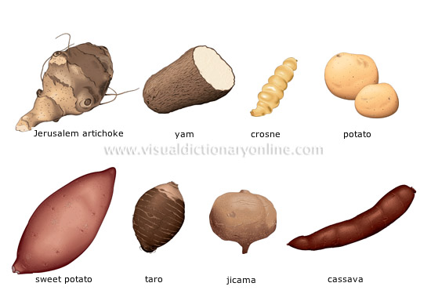
Classifying vegetables
Tubers
Potatoes
Sweet potatoes

Slide 8
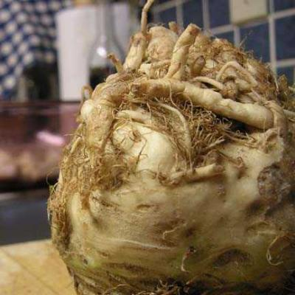
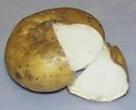
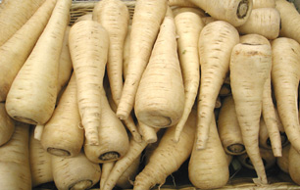
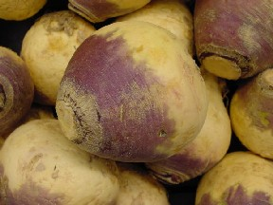
Celery roots
Jicama
Parsnips
Rutabagas

Slide 9
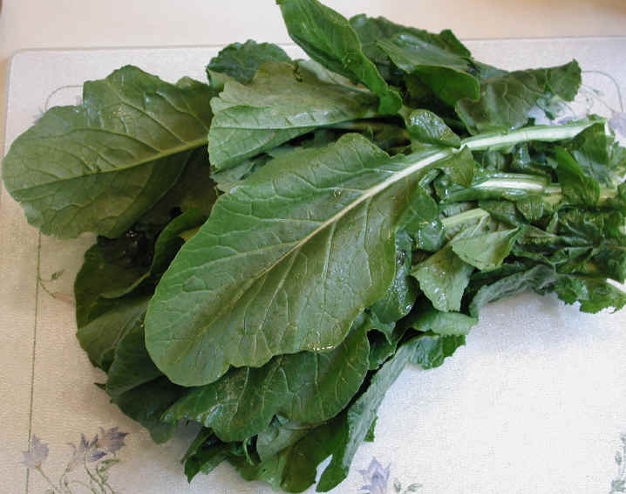
Classifying vegetables
Leaves
Romaine
Spinach

Slide 10
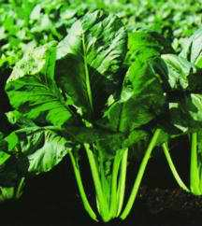
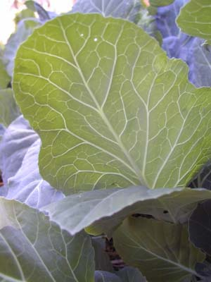
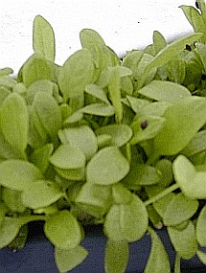
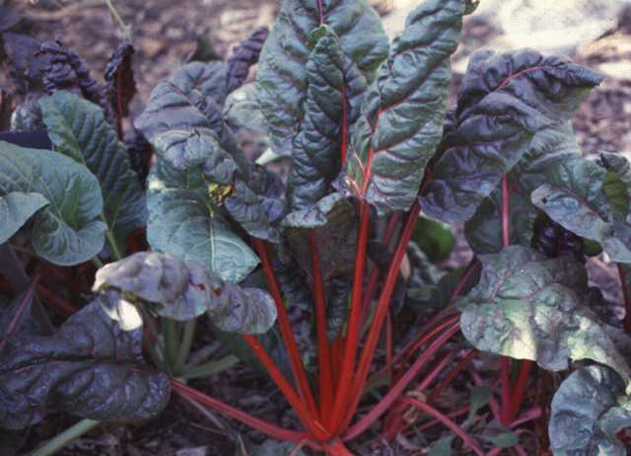
Mustard
Collards
Sorrel
Swiss chard

Slide 11
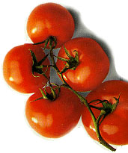
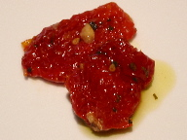
Fruit-Vegetables
Avocados
Eggplants
Asian and Western
Peppers
Sweet peppers
Hot peppers
Tomatillos
Tomatoes
Sun-dried tomatoes

Slide 12
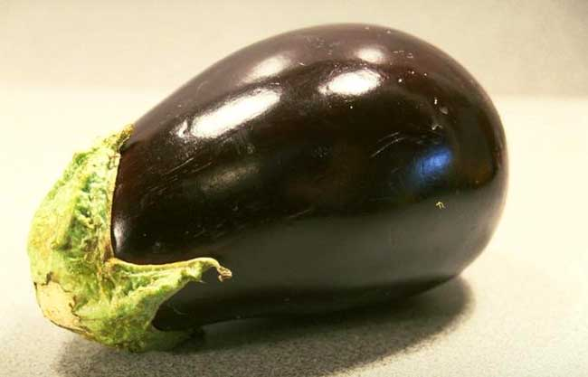
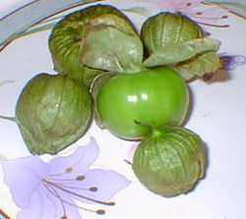
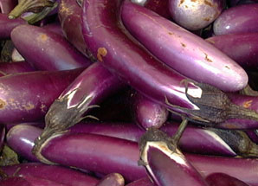
Tomatillos
Eggplant
Japanese eggplant

Slide 13
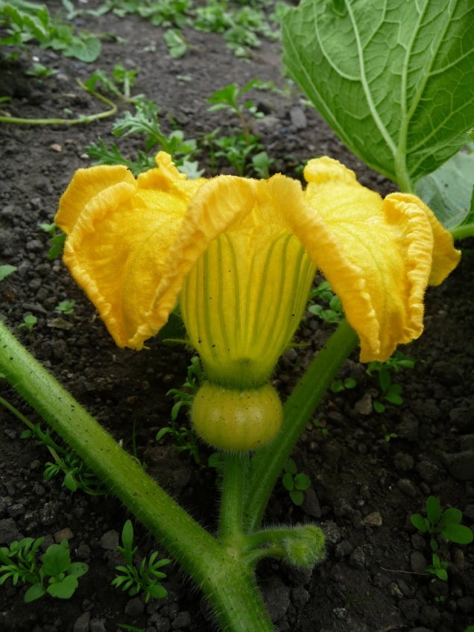
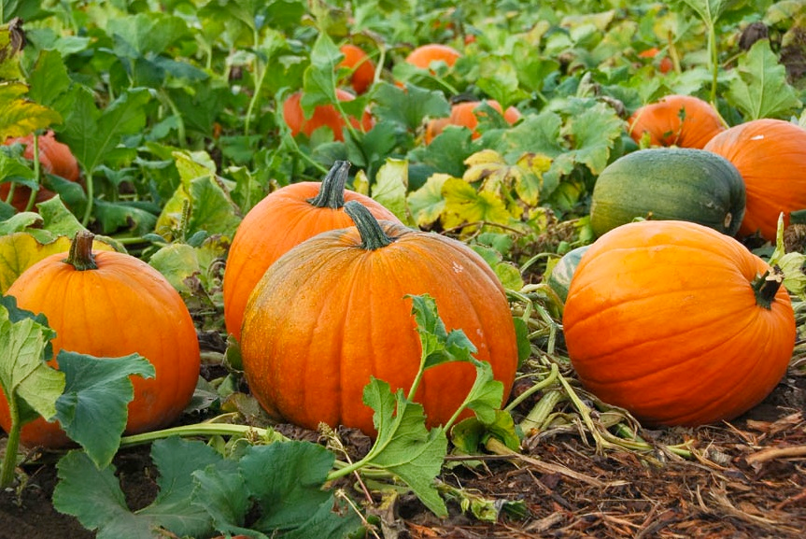
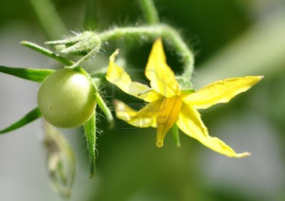

Slide 14
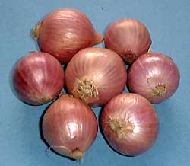
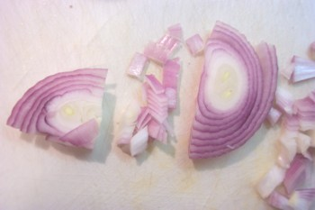
Bulbs
Bulb onions
Garlic
Leeks
Scallions
Shallots

Slide 15
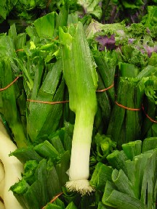
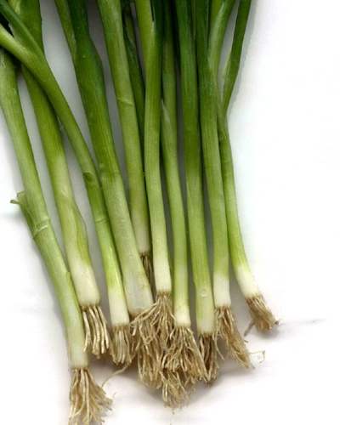
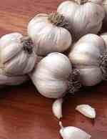
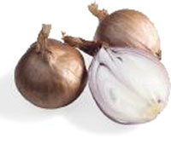
Leeks
Scallions
Shallots
Garlic

Slide 16
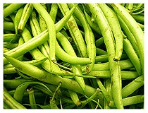
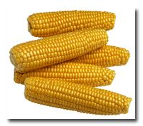
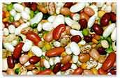
Pods and Seeds
Corn
Legumes
Dried beans
Fresh beans
Shelling peas
Edible pea pods
Okra

Slide 17
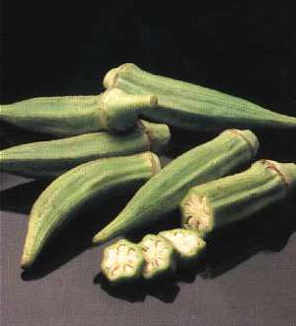
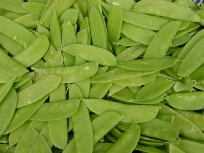
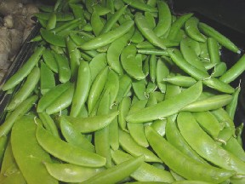
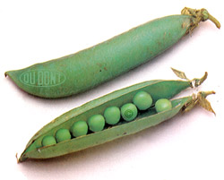
Okra
Snow Peas
Sugar Snap Peas
Shelled peas

Slide 18
Nutrition
Vegetables provide the following Vitamins and Minerals:
Vitamin A
Vitamin C
Vitamin D
Potassium
Folic Acid
Calcium
Magnesium

Slide 19
Nutrition, continued…
Vegetables contain NO cholesterol
They are low in calories, fat and sodium (They are “Nutrient Dense”)
Eat more red, orange and dark green vegetables from the Vegetable Group.

Slide 20
Best Cooking Methods for Preserving Nutrients
The two BEST methods are:
Microwaving
Steaming
You can also:
Bake
Stir-Fry
Simmer
Sauté

Slide 21
Five Ways to Preserve Nutrients When Cooking Fruits and Vegetables
Cook in larger pieces
Use small amounts of water
Cook only until “fork” tender
Cook quickly
Save the water used to cook in for soups and gravies (most nutrients dissolve into the water)

