Slide 1
What is Interior Design?
Designing interiors of homes, offices, schools, hotels, etc. using the basic principles and elements of design.

Slide 2
Who are we designing for?
The Client.

Slide 3
Professionalism and Presentations
You never get a second chance to make a first impression.
Dress
Speech
Organized
Posture
Eye contact
No fidgeting
Confident, not arrogant

Slide 4
When creating visuals…
Title it-no fancy fonts
Straight edges
No glue or other attachment material showing
Words and main points are straight
Mount on neutrals
When mounting, keep background edges to ¼”
Always use the materials that are intended for the project
Keep it simple
NO Scrapbooking in professional presentations!

Slide 5
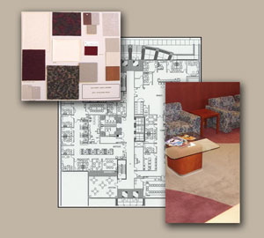
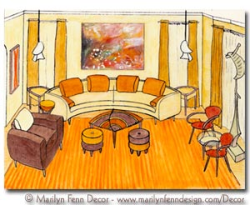
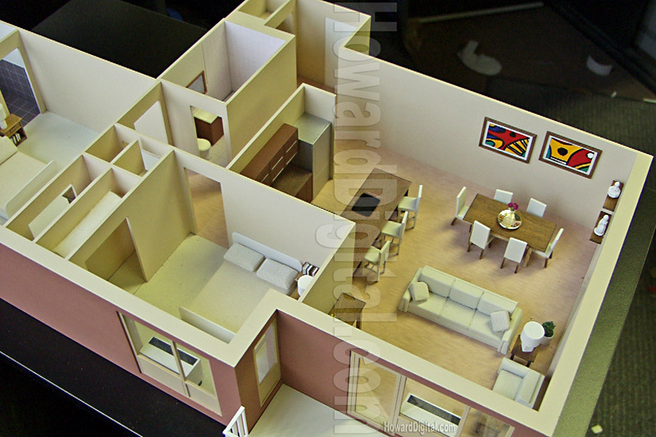
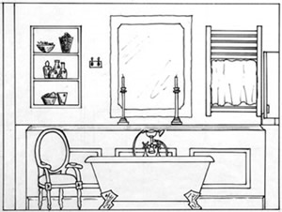
Presentation methods…
Presentation drawings
Interior perspectives
Presentation floor plans
Presentation elevations
Renderings
Presentation boards
Models
Power point
Other technology

Slide 6
Lettering for Presentations
Although most work in the design world does use technology, many designers still do some presentations by hand. It becomes very important that designers and contractors can read each others writing.
Basic block lettering is used in these situations. It is important for you to understand the basics of block lettering so that letter formation is consistent with the industry.

Slide 7
Creating a Logo
With any business, it is important that people recognize your work. A logo can help with the recognition and serve as an icon to advertise and bring in more clients.
Now create your own!!!
https://www.youtube.com/watch?v=XkBNbcMR_Uo

